Slide 1
Translating Footnotes
Btt writer for the desktop

Slide 2

What Is This Presentation About?
In this presentation you learn to:
Explain how footnotes are used
Translate a footnote

Slide 3
What Is a Footnote?
A footnote is additional information about a certain part of the text. The footnote usually appears at the bottom of a book’s page.
In BTT Writer, a footnote is shown as a black page icon that you click to display the footnote.
Footnotes can provide further explanation when:
There are names or other words that differ between various Bible versions.
Some versions of the Bible have words or verses that are not in the ULB.

Slide 4
Adding a Footnote
To add a footnote to the translation:
Copy the footnote.
Paste the footnote into the translated text.
Add footnote coding.
Translate the footnote text.
These steps are shown in the next slides.

Slide 5
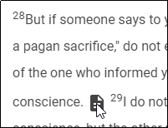
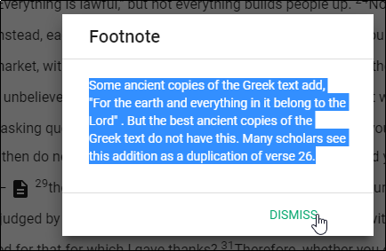
Step 1: Copying the Footnote
To copy a footnote from the ULB:
Click the footnote icon to open it. (Example is 1 Cor. 10:28)
Highlight the text of the footnote.
Copy the footnote text (Ctrl + C on Windows).
Dismiss the footnote.

Slide 6


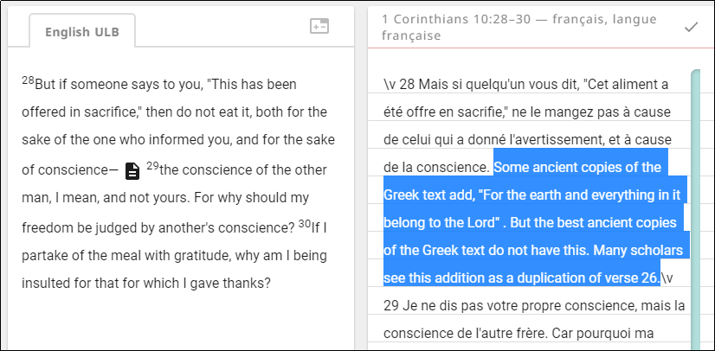
Step 2: Pasting the Footnote into the Translation
To paste the footnote into the translation:
If the chunk has been marked “done”, click the toggle at bottom right of the translated chunk.
Click the Edit icon (pencil).
Click the appropriate spot in the translated text.
Paste the footnote text (Ctrl + V on Windows).

Slide 7
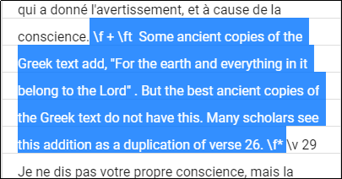
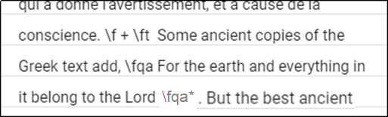
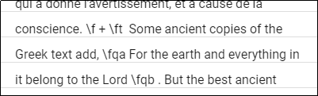
Step 3: Adding Footnote Coding
Footnote coding identifies the text as a footnote and separates it from the surrounding text. To add footnote coding:
Type the following text at the beginning of the footnote, separated from the surrounding text by spaces: \f + \ft
Type the following text at the end of the footnote, separated from the surrounding text by spaces: \f*
If there is a quote within the footnote, replace the beginning quotation mark with \fqa and a space
Replace the ending quotation mark with a space and \fqa*

Slide 8
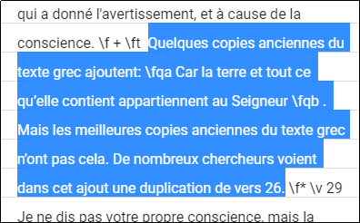
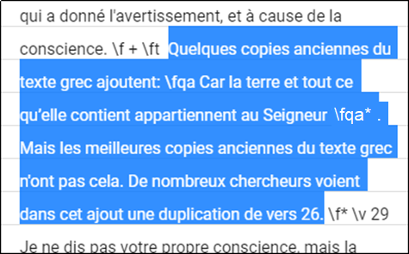


Step 4: Translating the Footnote Text
Translate the footnote.
Click the check mark to save the edits on the chunk.
Mark the chunk as done.

Slide 9
What Did You Learn?
In this presentation you learned to:
Explain how footnotes are used
Translate a footnote

