Slide 1
Starting a New Project
BTT Writer for the Desktop

Slide 2
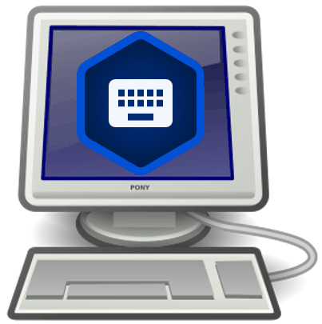
What Is This Presentation About?
In this presentation you learn to:
Explain what a BTT Writer project is
List the two types of BTT Writer screens
Describe the different types of projects
Create a new mother tongue translation project
Create new resource projects

Slide 3
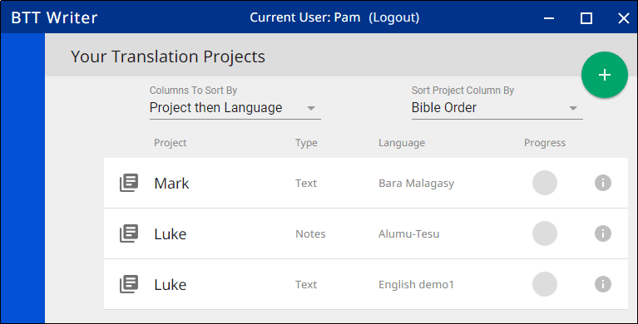
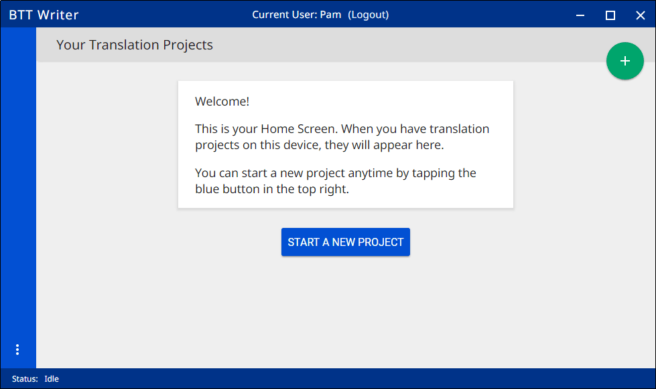
There Are Two Types of Screens
BTT Writer opens to display the first type, the Home screen.
Logout button
Logout button
User name
User name
Your projects (if any) are listed here.
Notes:
This is the Home screen. We’ll look at the second type of screen, the Project screen, after we create a project.

Slide 4
What Is a Project?
A project is a workspace to translate a specific portion of Scripture or Bible story into a target language, OR to translate Bible resources from English to a gateway language.
2 elements:
Target language: What language am I translating INTO?
Project category: What will I be translating?
Old or New Testament? Which book?
Open Bible Stories?
Notes, Questions, or Words?
After creating a project, you must specify source text: What will I use to translate FROM?
Can be English or a gateway language, ULB or UDB
Can use multiple source texts (up to 3)

Slide 5
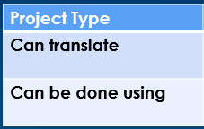
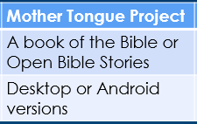
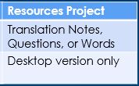
Two Types of Projects
Mother Tongue project: Translating from English or a gateway language into a mother tongue
Can translate either a book of the Bible or Open Bible Stories
Can be done either on the desktop or Android versions of BTT Writer
Resources Project: Translating Bible resources from English to a gateway language
Includes Translation Notes, Translation Questions, or Translation Words
This can be done only on the desktop version of BTT Writer

Slide 6
Steps to Create a New Mother Tongue Project (Translating from English or a gateway language into a mother tongue)
Ensure that the Gateway Language Mode setting is off.
Click the icon to start a new project
Choose the target language (language you’re translating into) Suggestions for practicing: English Demo 1 or English Demo 2
Choose the project category (what you will translate) Suggestion: Bible:NT → James
Specify a source text (language and text for the source translation) Suggestion: English (en) – Unlocked Literal Bible
These steps are shown in the next few slides.

Slide 7
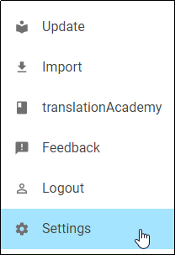

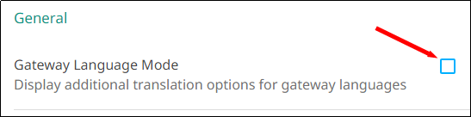
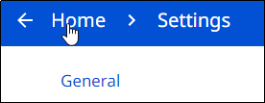
Starting a Mother Tongue Project: Step 1
Ensure that the Gateway Language Mode setting is off:
Tap the three dot icon to invoke the Options menu.
Select Settings.
Ensure that Gateway Language Mode is NOT selected.
Click the back arrow or the Home link to return to the home screen.

Slide 8


Starting a Mother Tongue Project: Step 2
Click the icon to start a new project: Click the plus icon OR the “Start a New Project” button
OR

Slide 9
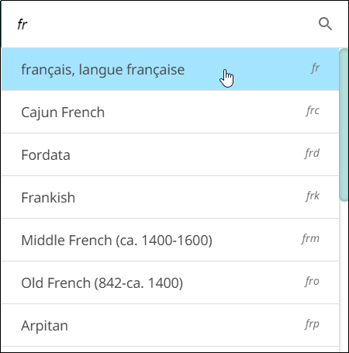
Starting a Mother Tongue Project: Step 3
Language you’re translating into
Choose target language:
Click magnifying glass
Search for language, such as “fr”
Click desired target language to select it

Slide 10
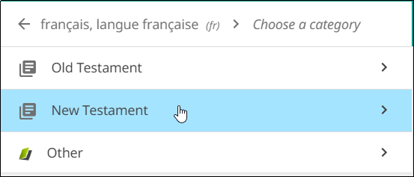
Starting a Mother Tongue Project: Step 4
What you will translate
Choose project category:
Click Old Testament OR New Testament
If you’re translating Open Bible Stories, click Other, and then select Open Bible Stories.

Slide 11
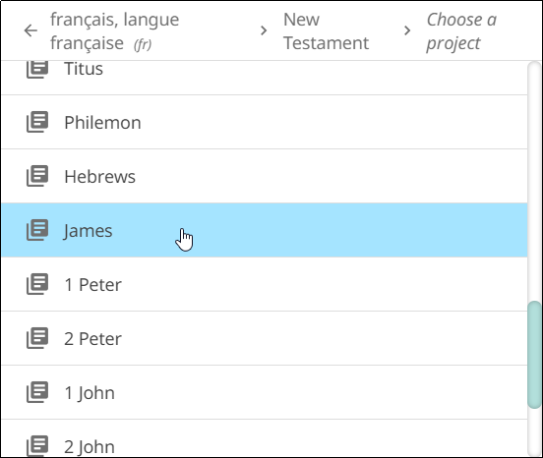
Starting a Mother Tongue Project: Step 4
Choose project category
Click Old Testament OR New Testament
If you’re translating Open Bible Stories, click Other, and then select Open Bible Stories.
Scroll down if necessary
Click the book you want to translate

Slide 12
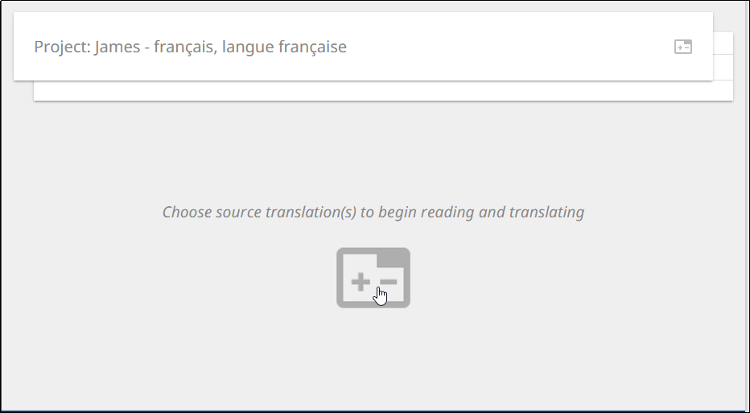
Starting a Mother Tongue Project: Step 5
Choose one or more source texts:
Project is created:
Can’t work until a source text is specified – click the +- icon.

Slide 13
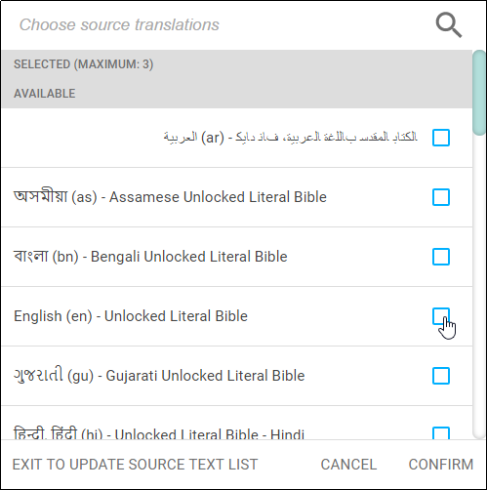
Starting a Mother Tongue Project: Step 5
Choose one or more source texts:
Project is created.
Can’t work until a source text is specified – click the +- icon.
Select the check box next to one or more source texts.
Click Confirm.

Slide 14
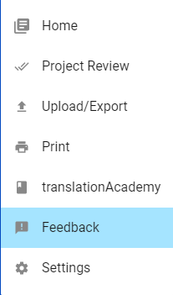
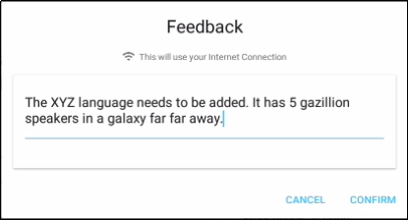
What if my target language isn’t listed?
Use English demo1 or English demo2 as the target language.
Send a request to add your target language:

Slide 15
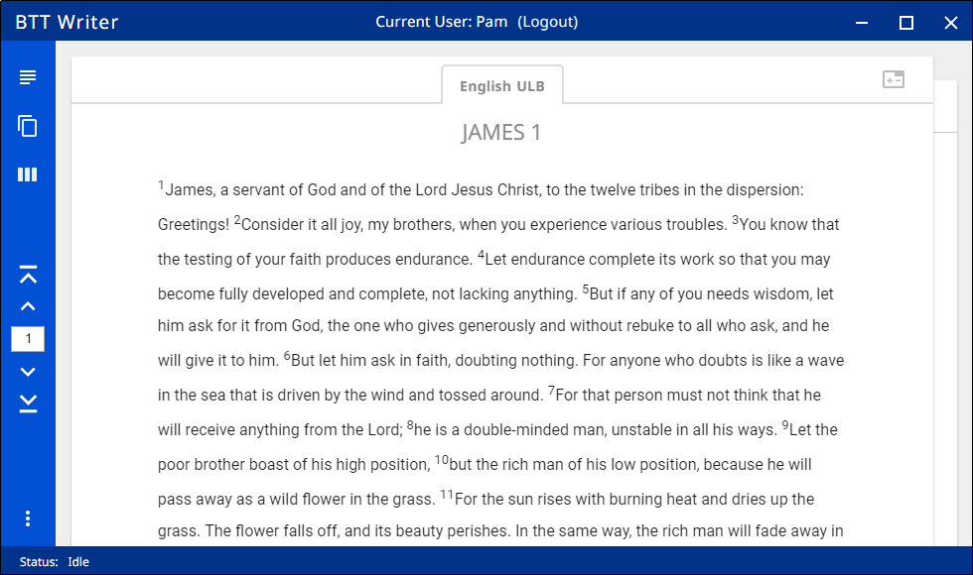
Second Type of Screen
The Project screen opens: Your working area for a single project. You are now ready to begin translating.

Slide 16
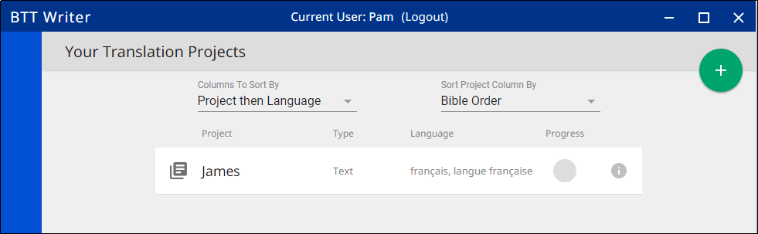
Back to the Home Screen
Click the 3-dot menu.
Select Home.
You can see your project listed as a Text project if you chose to translate a book of the Bible.

Slide 17
Steps to Create a New Resource Project (Translating Bible resources from English into a gateway language)
Perform setup.
Click the icon to start a new project
Choose the target language (language you’re translating into). Suggestions for practicing: English Demo 1 or Demo 2
Choose the project category (what you will translate).
Specify English ULB as the source text.
These steps are shown in the next few slides.

Slide 18

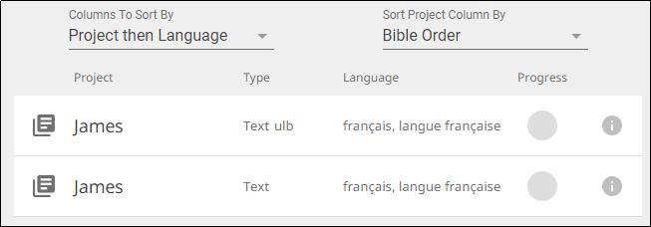
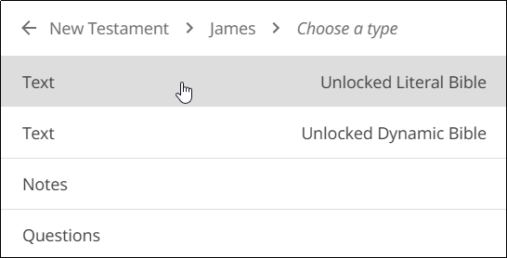
Starting a Resources Project: Step 1
Perform setup:
Ensure that the Gateway Language Mode setting is ON.
For Translation Questions or Translation Notes, set up a new Text ULB project for the Bible book you will work on (use steps for creating a mother tongue project.)
Always choose English (en) – Unlocked Literal Bible as the source text– this is the version with the resources attached.
The new project is shown as a Text ULB project.
You will not do any work in this project, but it is necessary before you can create Questions or Notes projects.

Slide 19
Starting a Resources Project: Step 2
Click the icon to start a new project – click the plus icon.

Slide 20
Starting a Resources Project: Step 3
Choose the target language.
For Notes or Questions projects, must be same target language as the Text ULB project you created during setup.
You can use the search function.

Slide 21
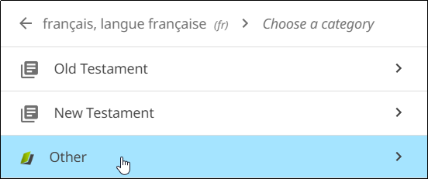
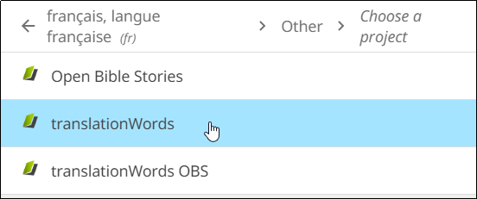
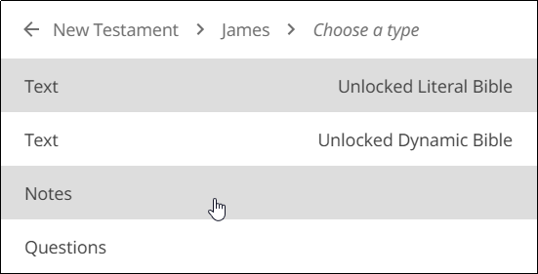
Starting a Resources Project: Step 4
Choose project category.
For Words project, click Other > Translation Words
For Notes or Questions projects, must be same target Bible book as the Text ULB project you created during setup, and then select Notes or Questions.

Slide 22
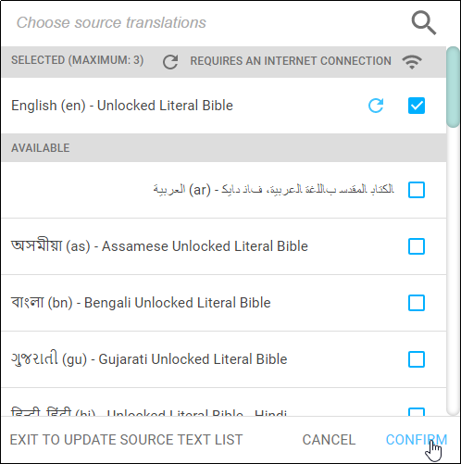
Starting a Resources Project: Step 5
Specify English ULB as the source text – this is the source text with the resources that you will be translating.

Slide 23
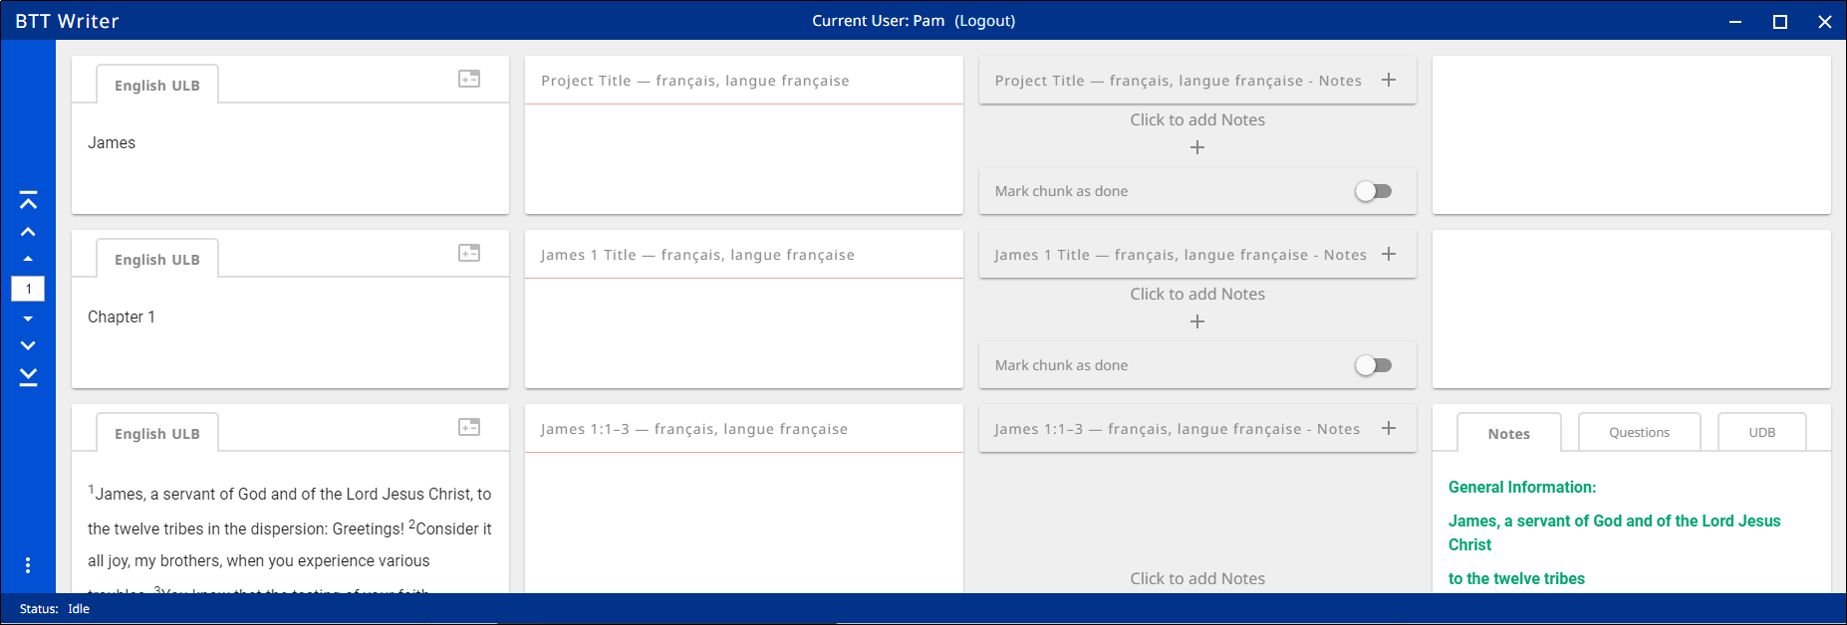
The Project Screen for a Notes Project
The Project screen opens and you are ready to translate.

Slide 24

The Project Screen for a Questions Project
The Project screen opens and you are ready to translate.

Slide 25
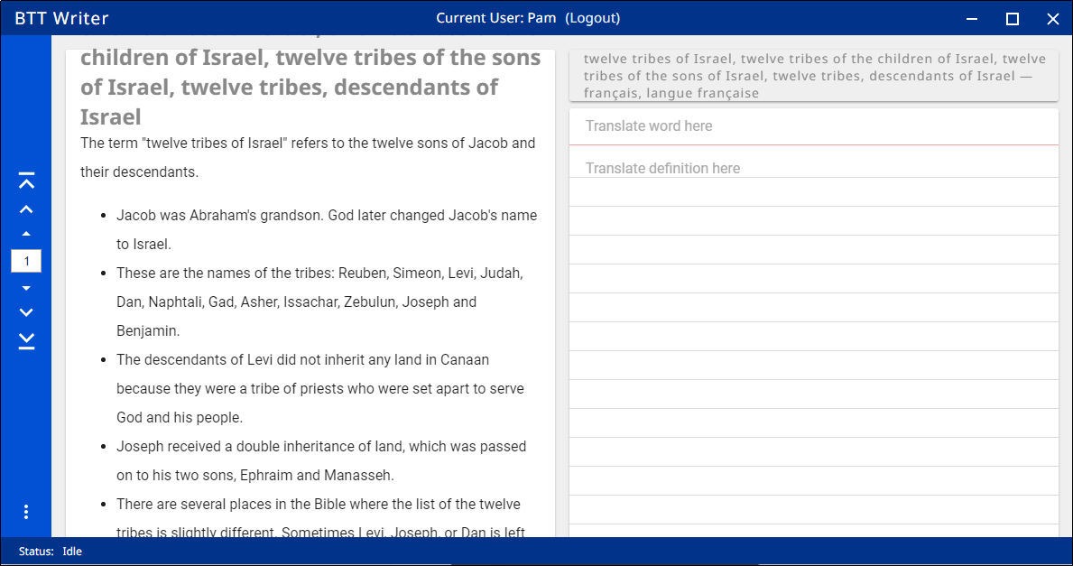
The Project Screen for a Words Project
The Project screen opens and you are ready to translate.

Slide 26
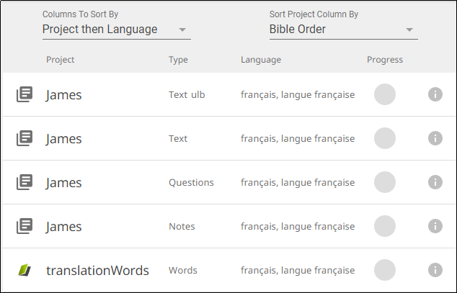
Back to the Home Screen
Click the 3-dot menu.
Select Home.
You can see your projects listed:
Text ULB project (you don’t work in this project, but it’s needed for Notes or Questions projects.)
Text project (this is the mother tongue project.)
Questions project
Notes project
Words project

Slide 27
What Did You Learn?
In this presentation you learned to:
Explain what a BTT Writer project is
List the two types of BTT Writer screens
Describe the different types of projects
Create a new mother tongue translation project
Create new resource projects

