Slide 1
Making a Project Accessible
BTT Writer for android

Slide 2
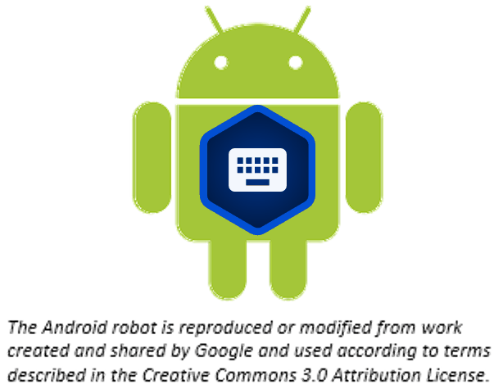
What Is This Presentation About?
In this presentation you learn to:
Define accessibility as it pertains to Bible translation
Make your translation accessible to others

Slide 3
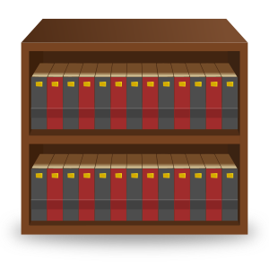

What Is Accessibility?
It’s useless to have Bible translations that just sit on a shelf (or on someone‘s computer)!

Slide 4
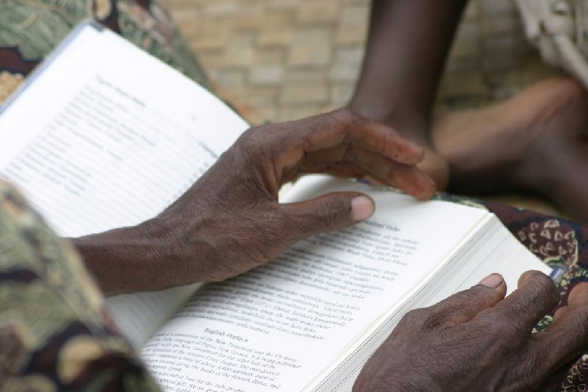
What Is Accessibility?
X
It’s useless to have Bible translations that just sit on a shelf (or on someone‘s computer)!
We want the Bible to get into the hands of the people who so desperately need it.

Slide 5
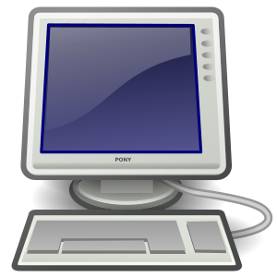
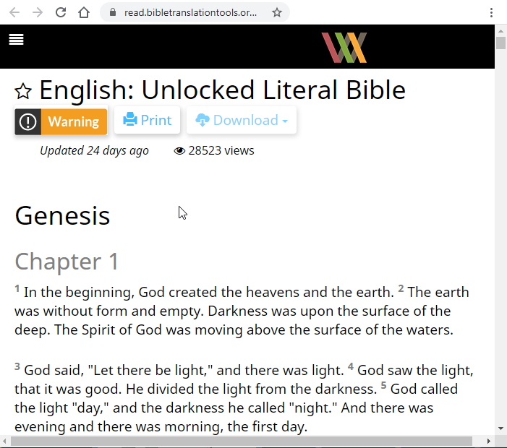
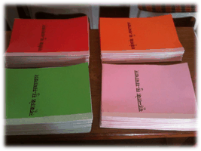
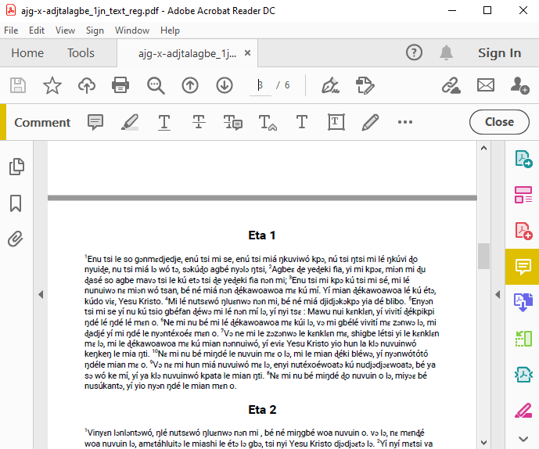

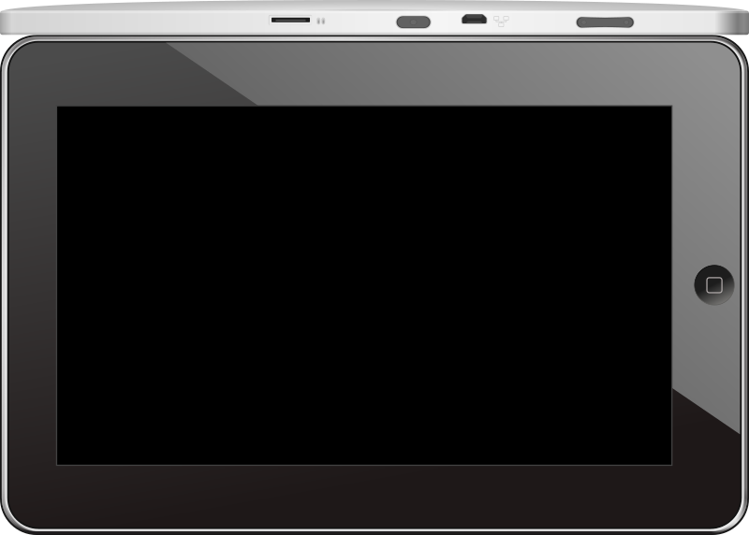
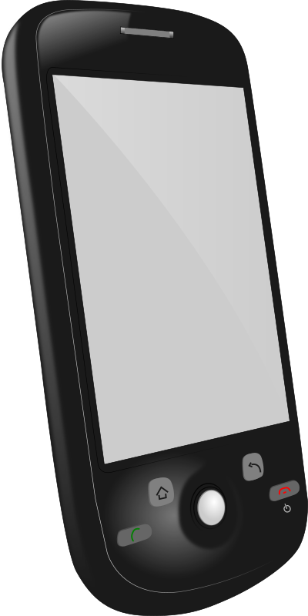
What Is Accessibility?
Accessibility is making your work available to others in a format they can use.
In what format?
READ
ONLINE
Whatever the church wants!
PRINTED COPIES
FANCY
BIBLES
TABLET/PHONE
PDF
FILES

Slide 6
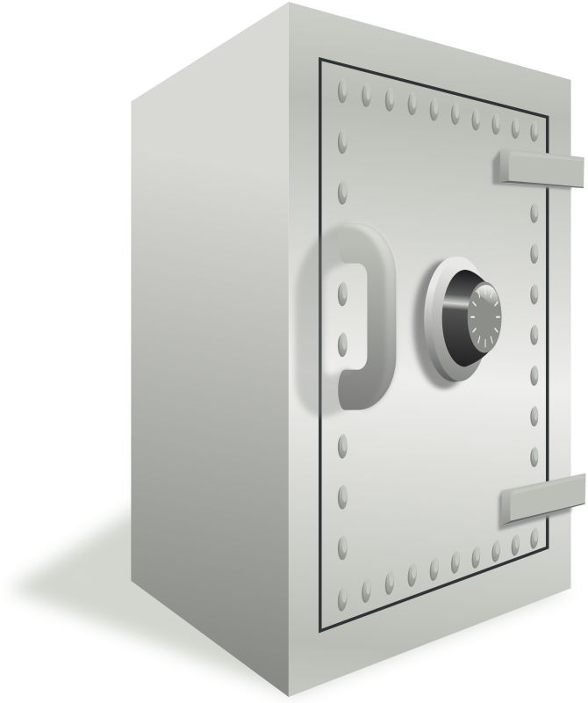
How Do I Make My Work Accessible?
Uploaded project is available online to anyone at the URL:
https://content.bibletranslationtools.org/username/project_code.
For user-friendly content, click See in Reader
Or use the URL https://read.bibletranslationtools.org/username/project_code).
Upload your project to the WA content server (WACS) as often as you want to create a backup of your work (see Uploading or Exporting Your Work).

Slide 7
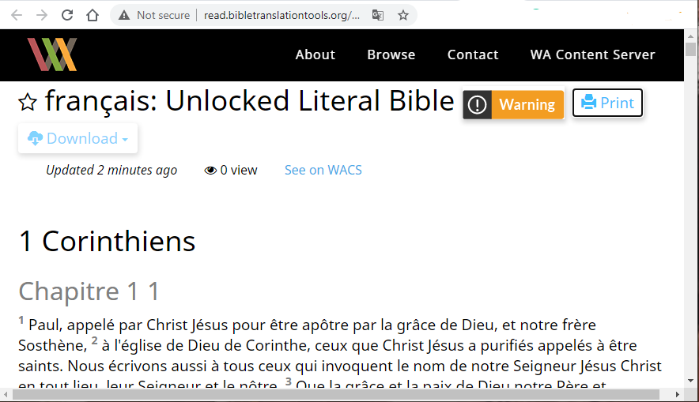
Viewing Accessible Projects
From the content server, anyone can:
See the web version of your project
Download a USFM file of your project
Print your translation

Slide 8
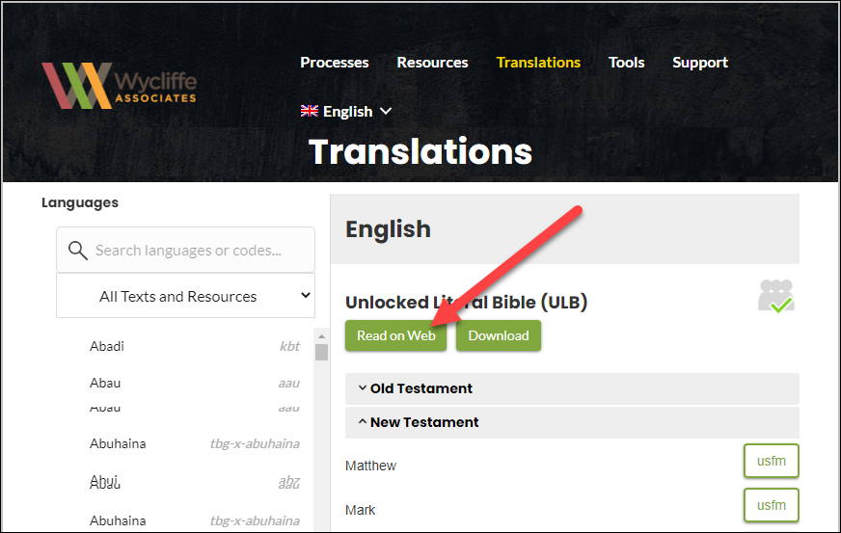
Viewing Translations on bibleineverylanguage.org
Many translations are available on the Bible in Every Language website.
Talk to your Wycliffe Associates contact to make your translation visible there.

Slide 9
What Did You Learn?
In this presentation you learned to:
Define accessibility as it pertains to Bible translation
Make your translation accessible to others

