Slide 1
translationRecorder
How to guide

Slide 2
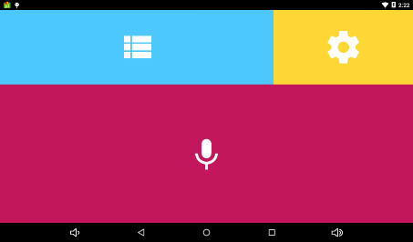
Settings:
From the home screen, select the yellow area to access Settings.

Slide 3
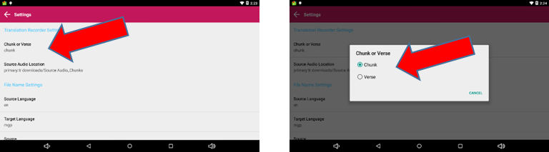
From settings select Chunk or Verse.

Slide 4
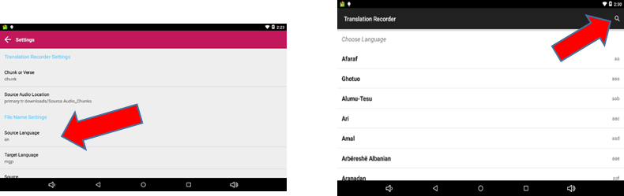
Next select Source Language. You can search for your desired language by clicking the magnifying glass and typing in the language or language code. (Source Language is the language from which you will translate.

Slide 5
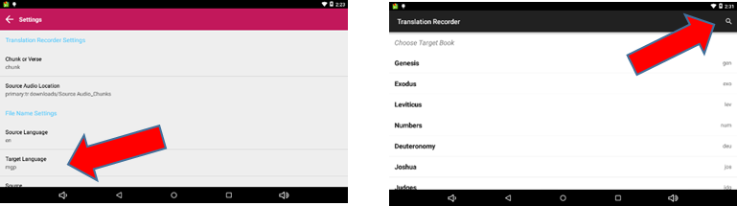
Next, select Target Language. You can search for your desired language by clicking the magnifying glass and typing in the language or language code. (Target Language is the language into which a translation is being made.)

Slide 6
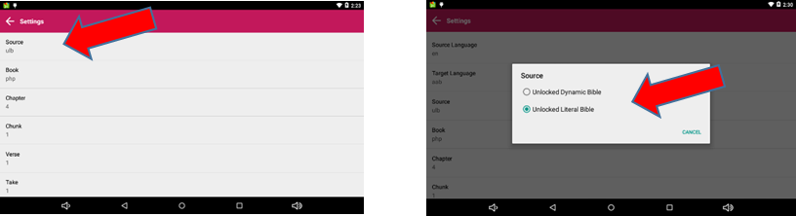
Next, select your Source.

Slide 7
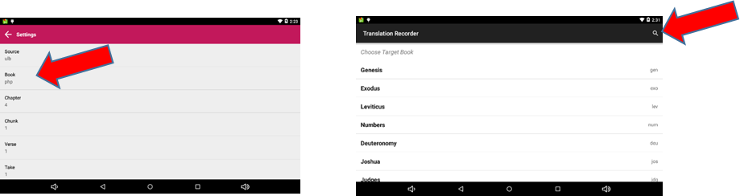
Next, select your Book. You can search for your desired book by clicking the magnifying glass and typing in the book name or simply scroll through the list.

Slide 8
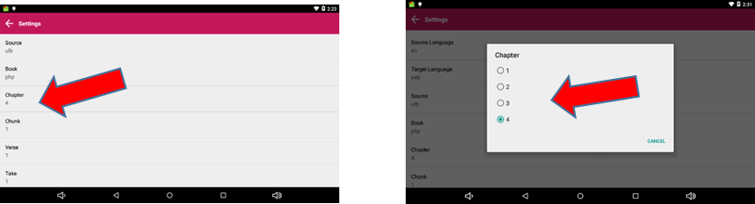
Next, select the Chapter you wish to work in.

Slide 9
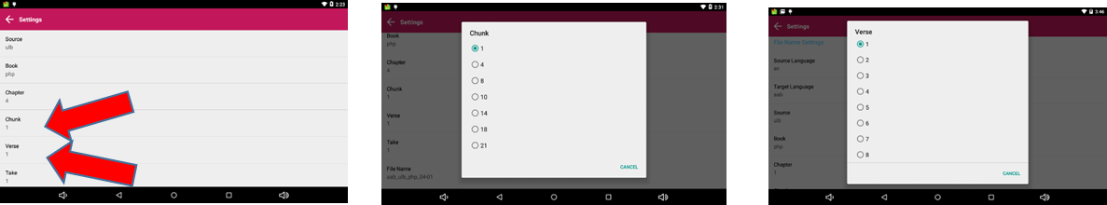
Next, you will select the Chunk or Verse you wish to work in. This is based on your answer for step two. If you selected Chunk in step two you would select Chunk then which Chunk you want. If you selected Verse in step two you would select Verse then the Verse you wish to work in.

Slide 10
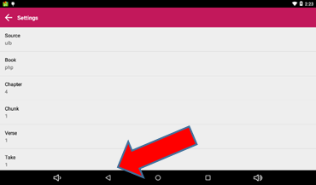
You have now set all your settings and are ready to work within translationRecorder. Now tap the back arrow at the bottom of the screen. That will take you out to the main menu.

Slide 11
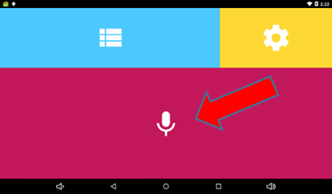
Recorder:
Click anywhere in the pink section to take you into the Recorder.

Slide 12
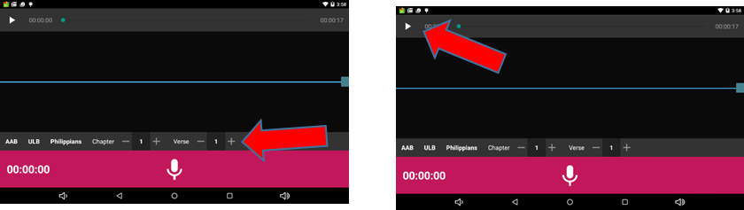
You are now in the Recorder. You can see the Target Language, the Source, the Book, the Chapter and the Verse right above the pink bar at the bottom. You can tap on the play button in the gray bar at the top of the screen to listen to the English version of that particular verse/chunk.

Slide 13

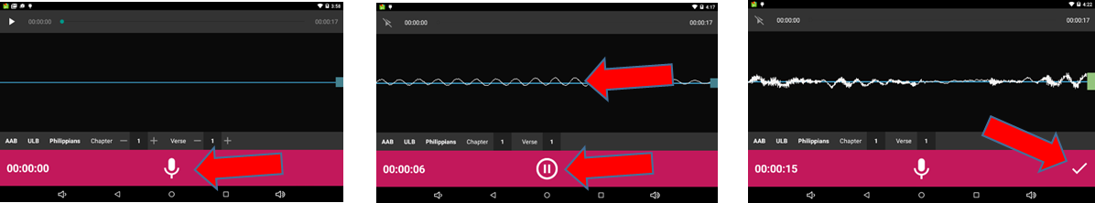
When you are ready to start Recording simply tap the in the pink bar. Speak clear and loudly into the microphone. As you begin to speak you will see waves appear on the screen which is a result of the sound of your voice. When done with that portion tap the pause button. You can then start recording again or tap the checkmark to move to the checking screen.

Slide 14



After you have recorded the material and you have you have tapped the checkmark to move to the checking screen, you are now able to edit your recording. To replay your recording simply press the play button . To rewind the recording press and to fast forward press .

Slide 15
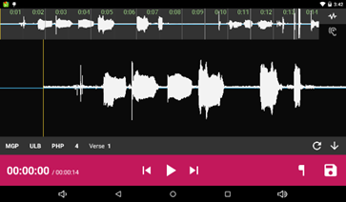
After you have recorded the material and you have you have tapped the checkmark to move to the checking screen, you are now able to edit your recording. To replay your recording simply press the play button . To rewind the recording press and to fast forward press .

Slide 16




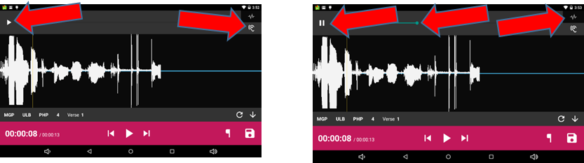
To compare your recording to the original version press the and press play . To pause the recording press the pause button . To rewind or fast forward press and hold the dot and slide to the left for rewind or to the left to fast forward. To return to your recording press the button.

Slide 17



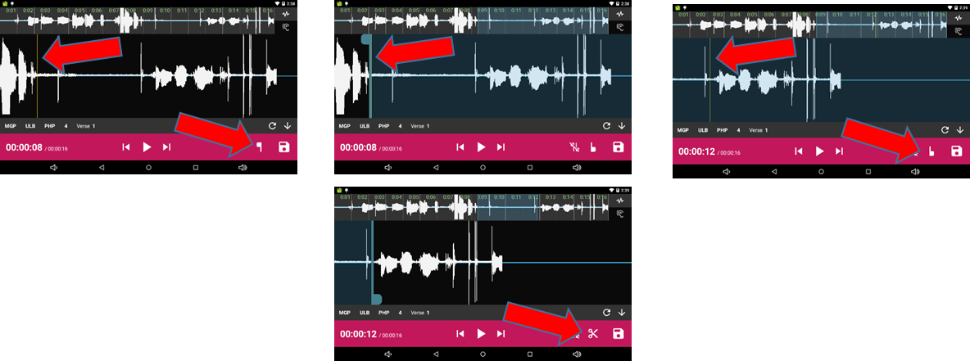
To remove a section of recording simply line up the thin yellow line where you want it to start to cut and press the button. This will insert a marker where the cut will start. Then drag the recording by holding your finger on the screen and sliding to the left until you reach the end of the cut and press the button. This will mark the section for deletion. To delete press the .

Slide 18




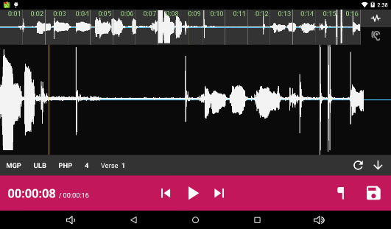
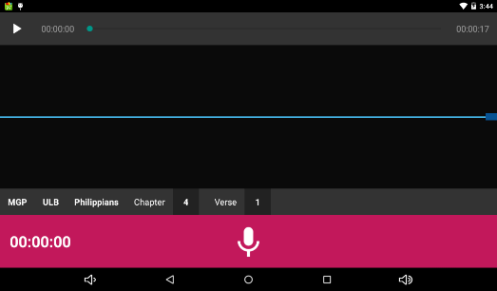
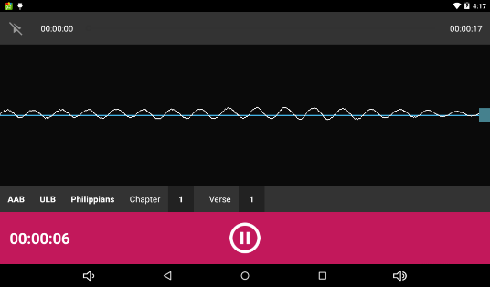
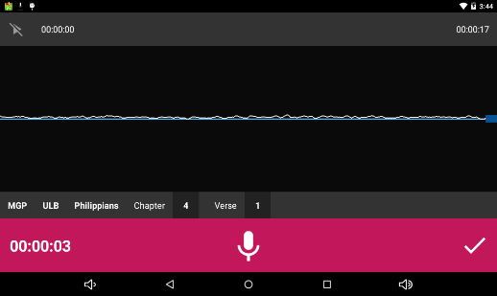
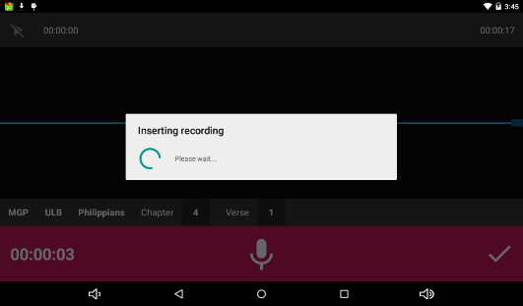
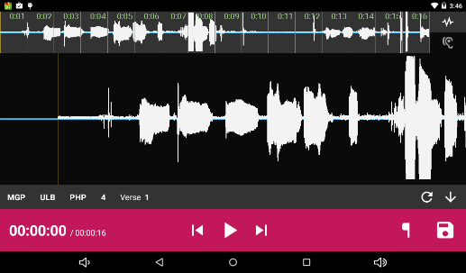
To insert a new section to the recording simply line up the thin yellow line where you want the recording to be insert and press the . This will open a new recording session. Press the to start recording. When finished press the . To insert the new recording press the . A pop up will appear stating it is inserting recording…please wait. It will then take you back to the original recording for you to either replay or save .

Slide 19
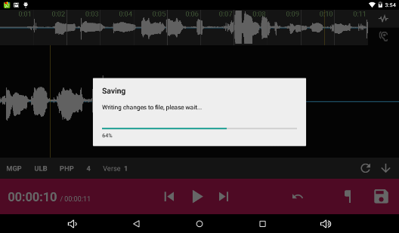
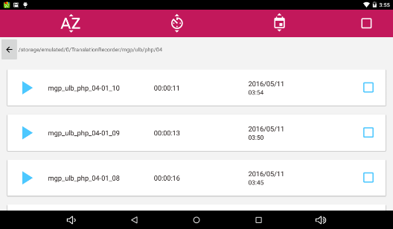
To save the file tap . You will get a pop up saying it is saving. Once it is done saving it will open the file manager with your most recent file on top.

Slide 20
File Manager:
Click anywhere in the blue section to take you into the File Manager.

Slide 21
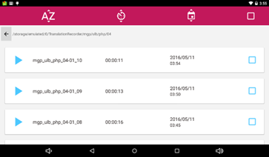
Once in the File Manager you will see all your saved files listed.

Slide 22



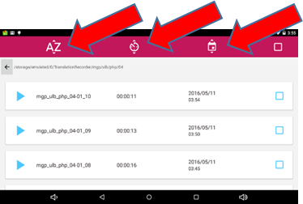
You can sort your files three different ways. By tapping it will sort your files in alphabetical order, by tapping it will sort your files by duration of recording and finally by tapping it will sort your files by date and time saved.

Slide 23


To open a file simply tap in front of the file name you wish to open.

Slide 24


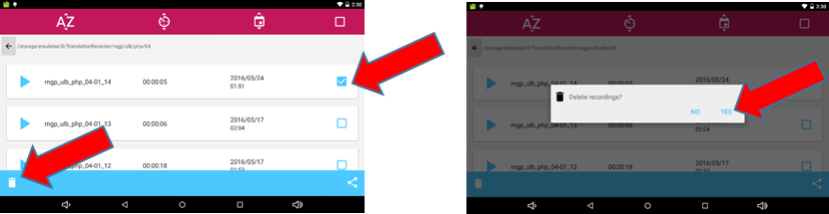
To delete a file simply tap at the end of the file name you wish to delete. Then tap the . A pop up appears “Delete Recording?” tap Yes.

Slide 25



To share or move a file simply tap at the end of the file name you wish to share/move. Then tap . A pop up appears with several options for sharing. Select the option you desire by tapping it. It then opens a window to name the file. You can keep the default name and tap SAVE or type in a new file name and tap SAVE. To see where the file is being saved tap and then tap which will open the Save To location which appears highlighted. To change the location simply tap the location you wish to save it to and tap SAVE.

Slide 26
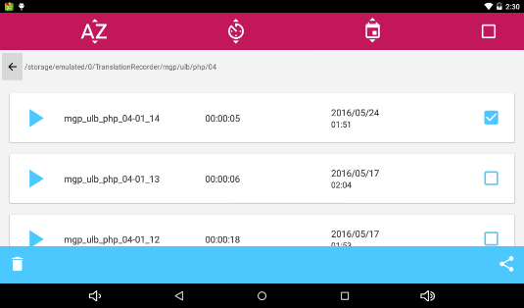
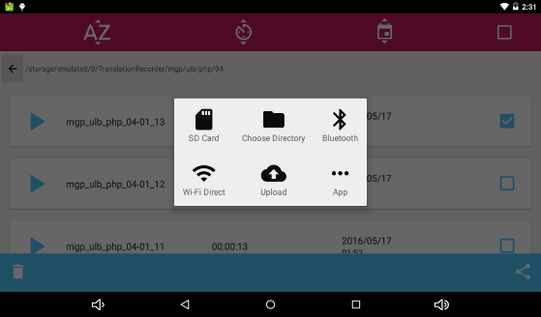
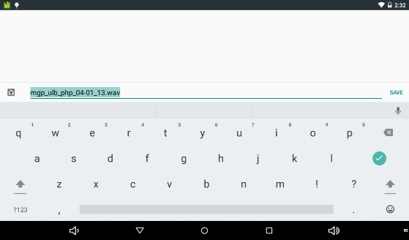
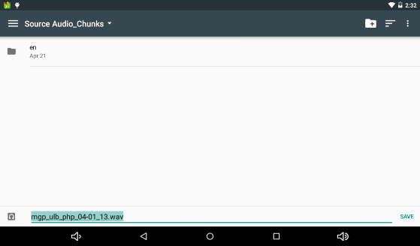
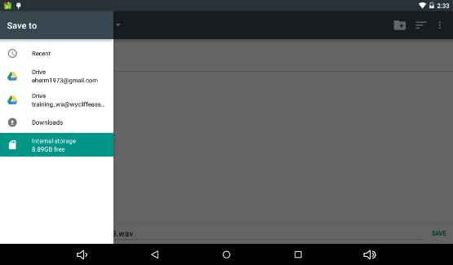
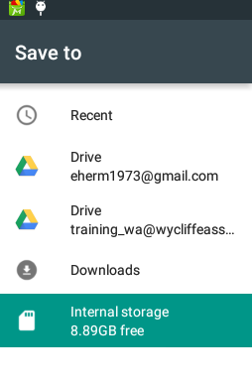
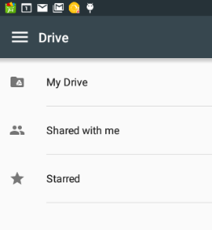
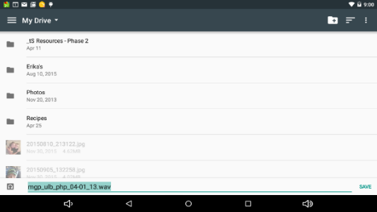

Slide 27

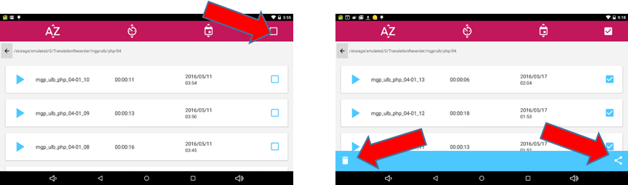
To select “All” files tap from the file manager home screen. This will put a check mark in all the boxes for every file listed. From there you can either Delete or Share all the files at once. Follow the instructions listed above for Deleting or Sharing your files.

