Slide 1
translationRecorder v1.2.4
Installing

Slide 2
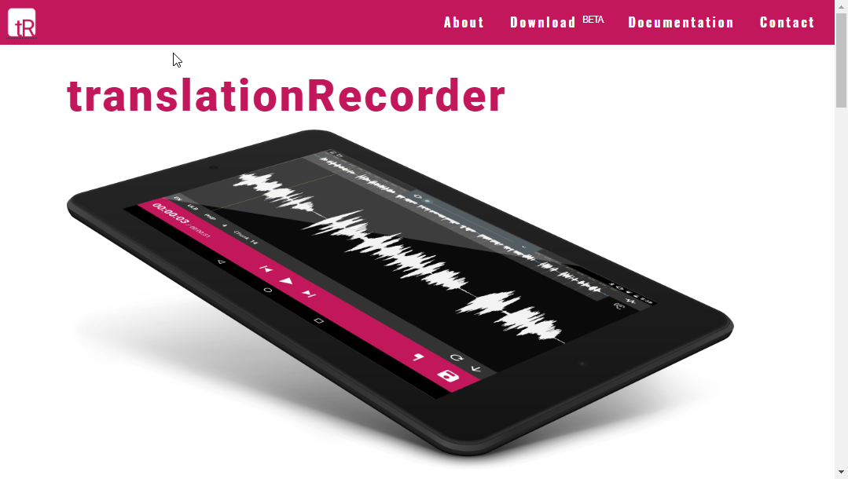
Getting the Installation Software:
Go to translationrecorder.org.
Tap on the ‘Download’ link in the top menu bar.

Slide 3
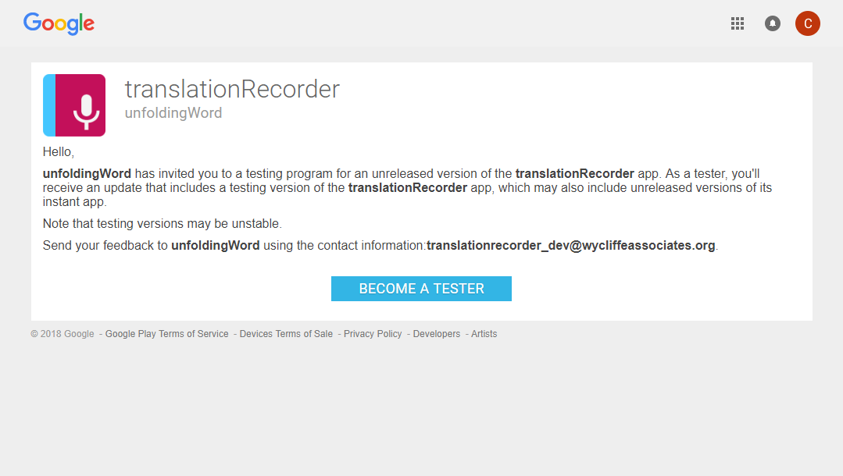
Getting the Installation Software:
The browser opens to a Google page.
Tap the ‘Become a Tester’ blue button to become a tester.

Slide 4
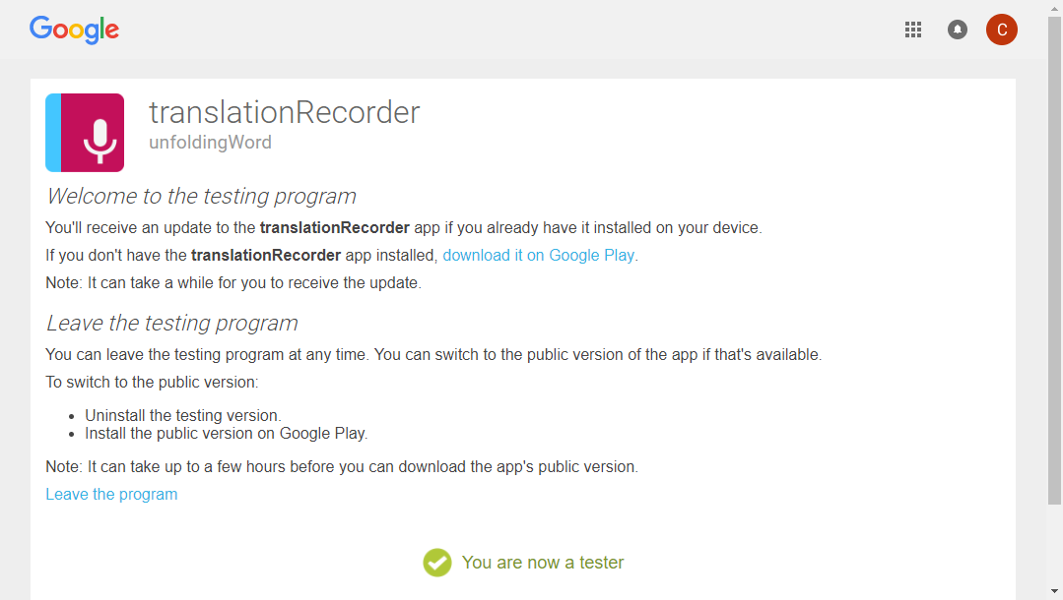

Getting the Installation Software:
The notice that ‘You are now a tester’ appears.
Tap the link to ‘download it on Google Play.’

Slide 5
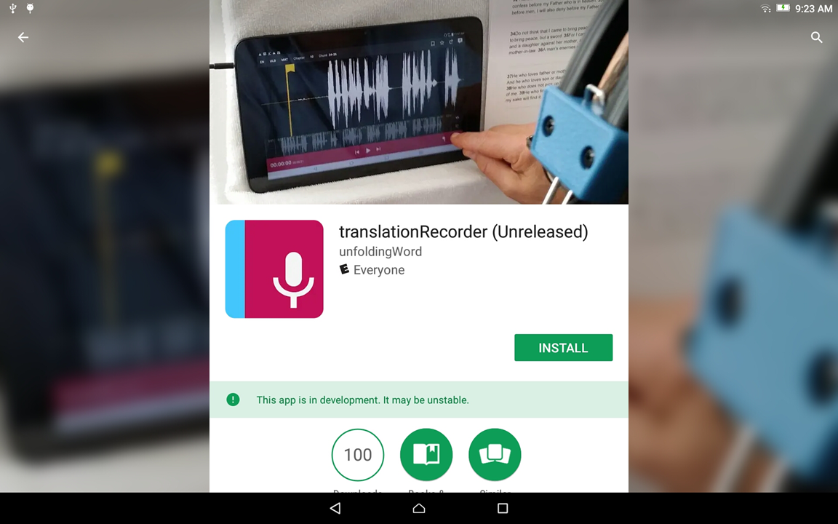
Installing the software:
Tap the ‘Install’ green button to start installing the software.

Slide 6
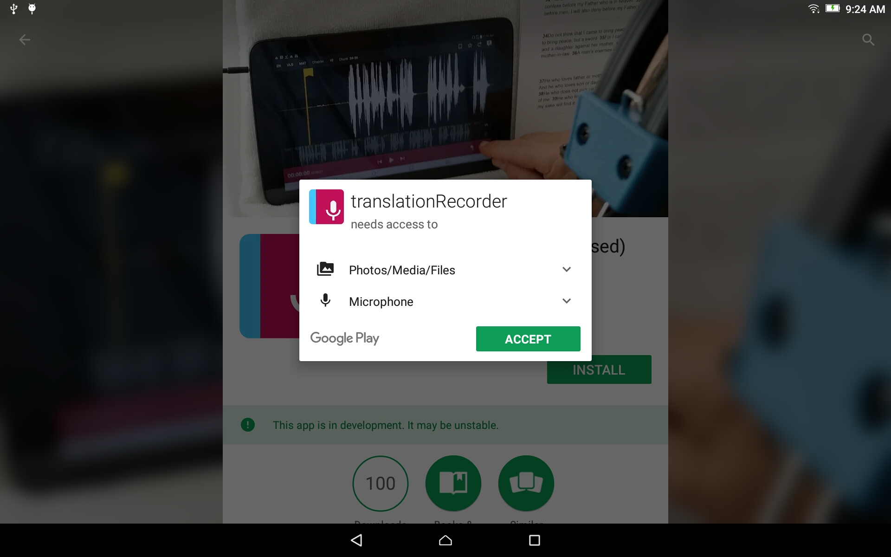
Installing the software:
Accept the software’s permission to access the microphone by tapping on the green ‘Accept’ button.

Slide 7
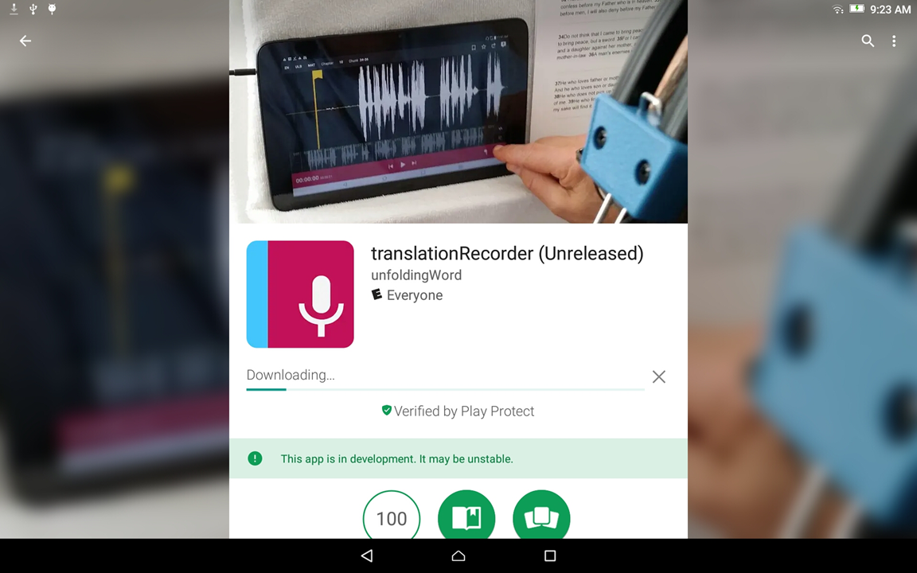
Installing the software:
Wait while the software downloads and installs.

Slide 8
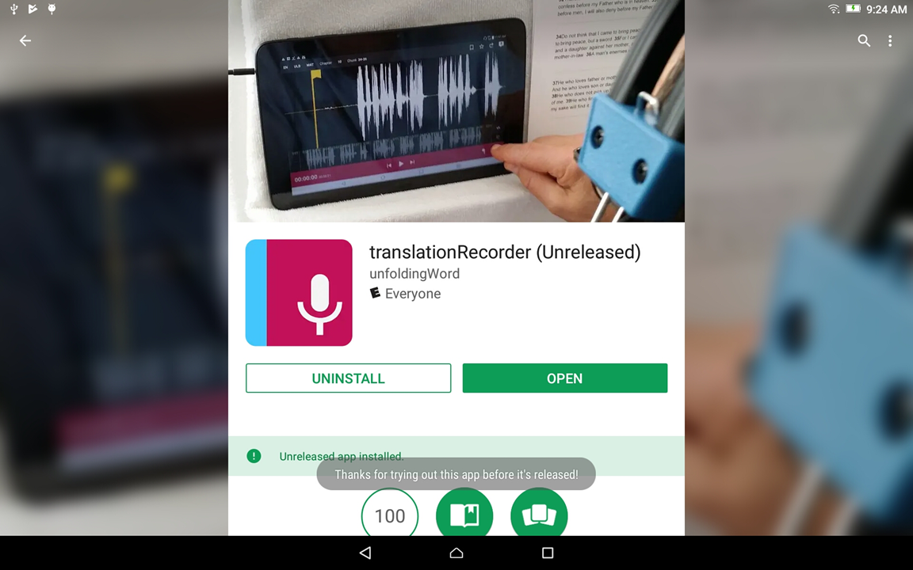
Installing the software:
Tap the ‘Open’ green button to open the program.

Slide 9
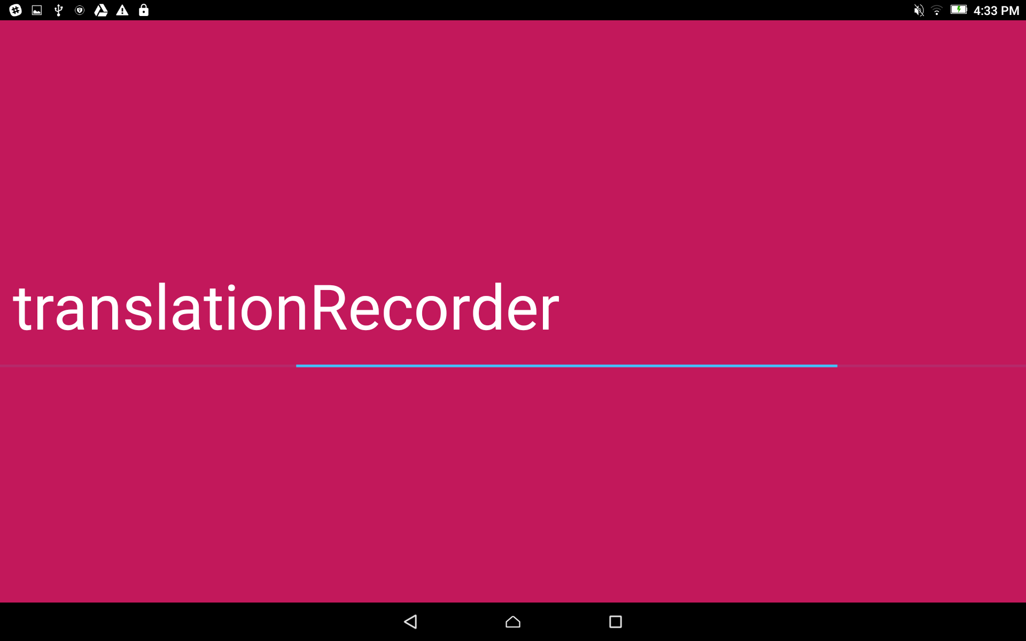
Software installed:
translationRecorder is opening.

