Slide 1
translationRecorder
How to guide v1.2

Slide 2
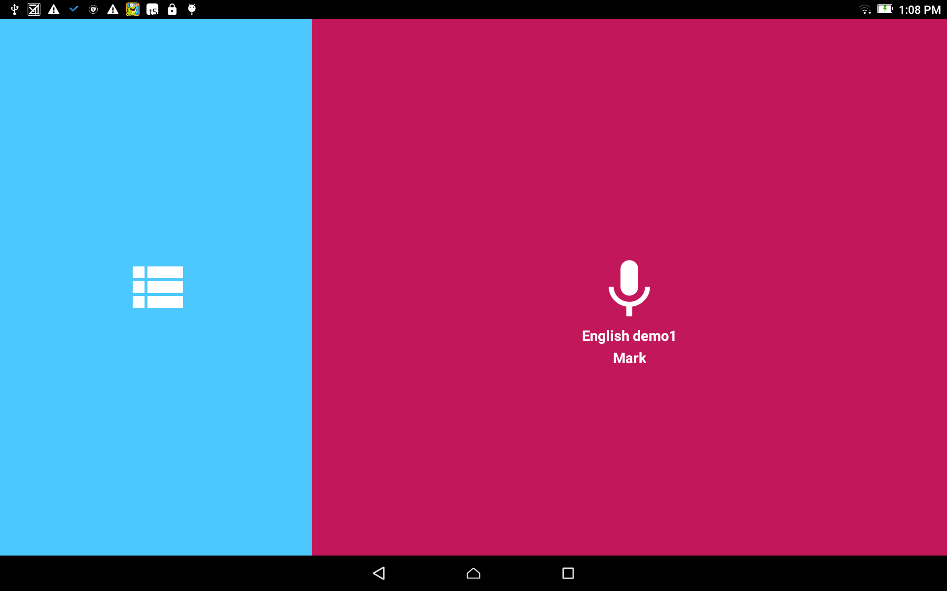
Start a Project:
From the home screen, tap in the blue area to open the Project Manager.

Slide 3
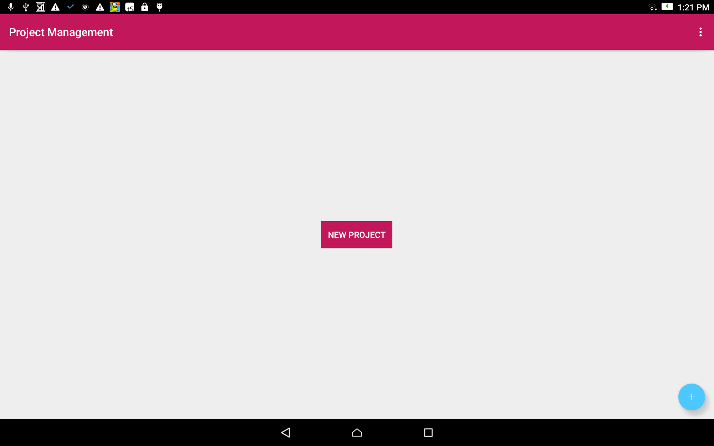
Create a new project:
Tap on the blue circle with a white plus sign.

Slide 4
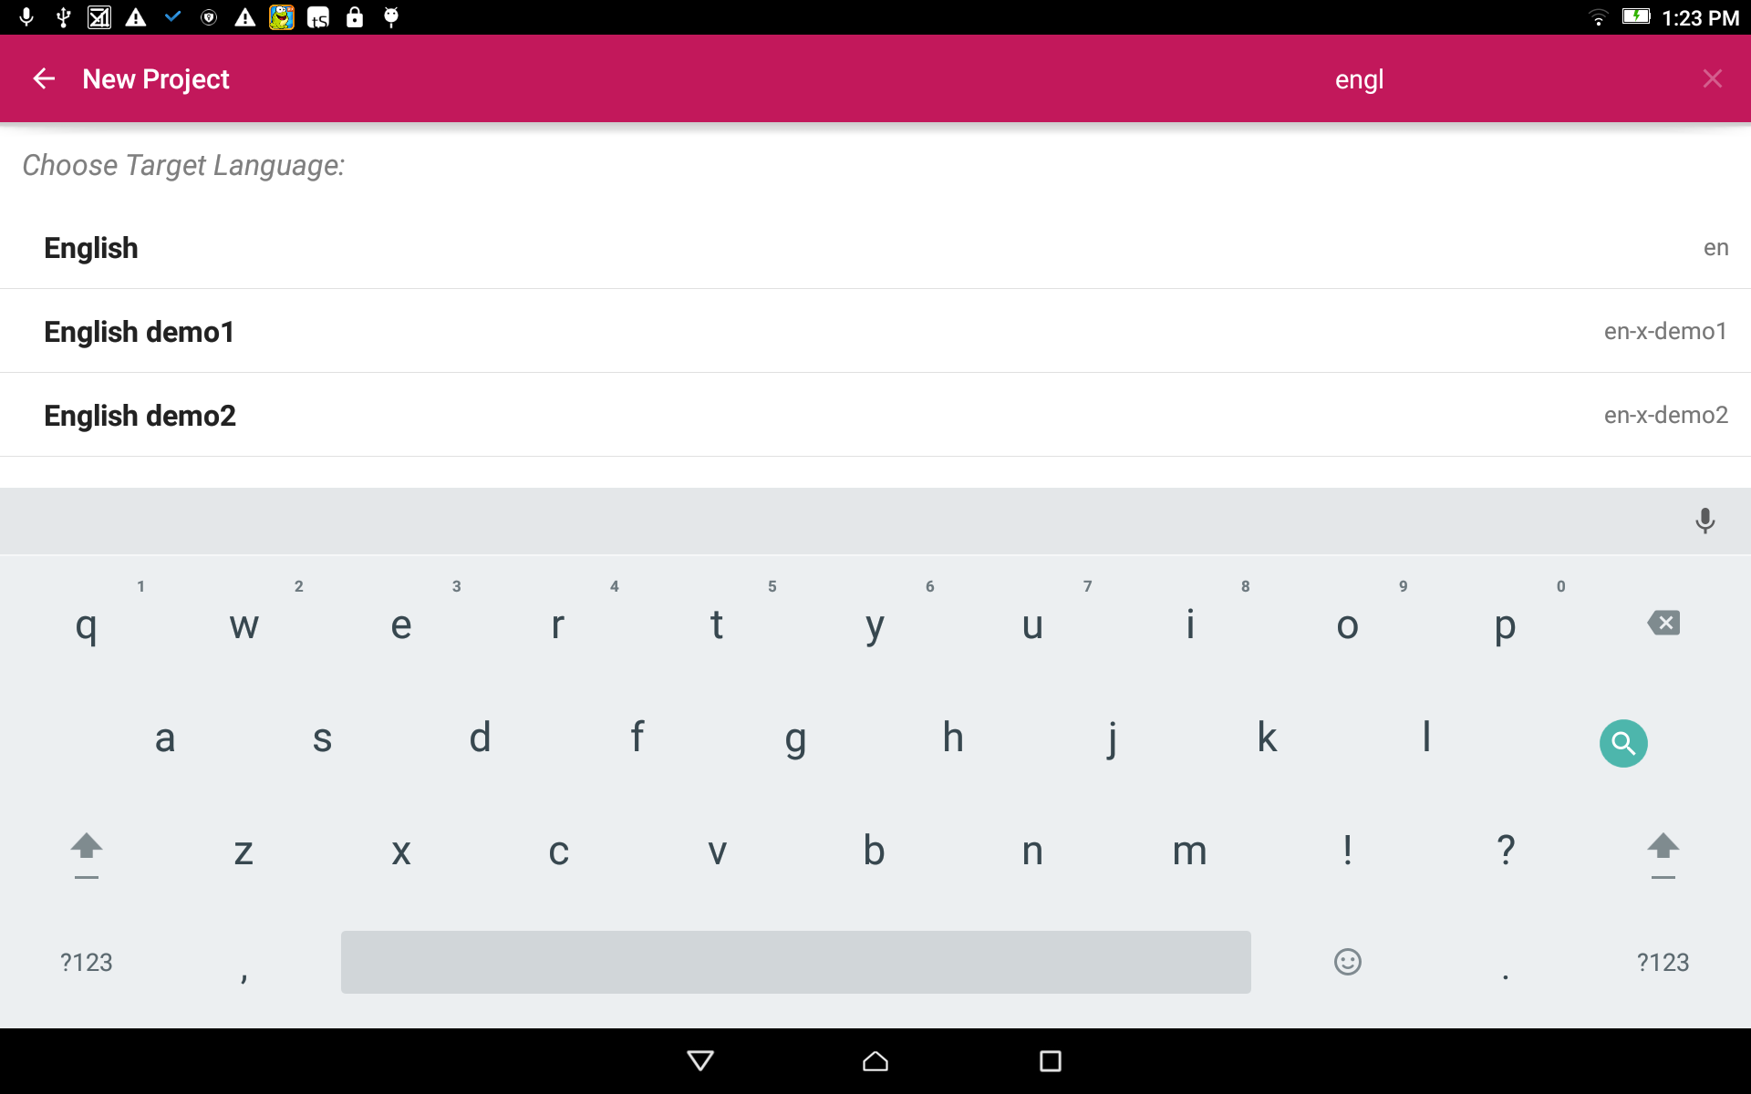
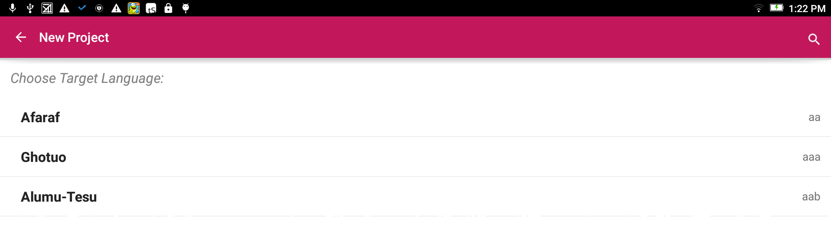


Select the Target Language:
The Target Language is the language into which you will translate.
Search for the desired language by either:
Scrolling to the language name.
Clicking the magnifying glass and typing in the language name or language code.

Slide 5
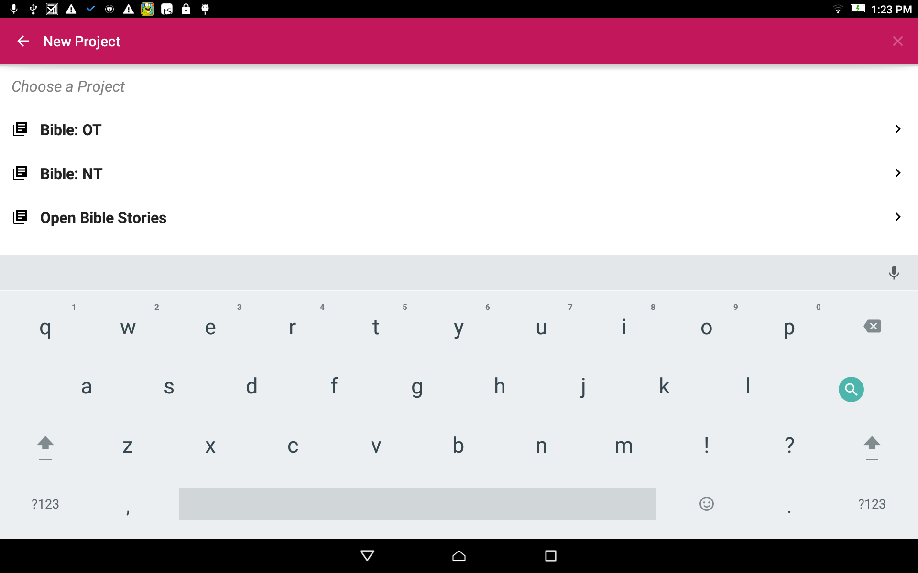
Choose a Project:
Tap on the words to choose to start a OT, NT or Open Bible Stories project.

Slide 6
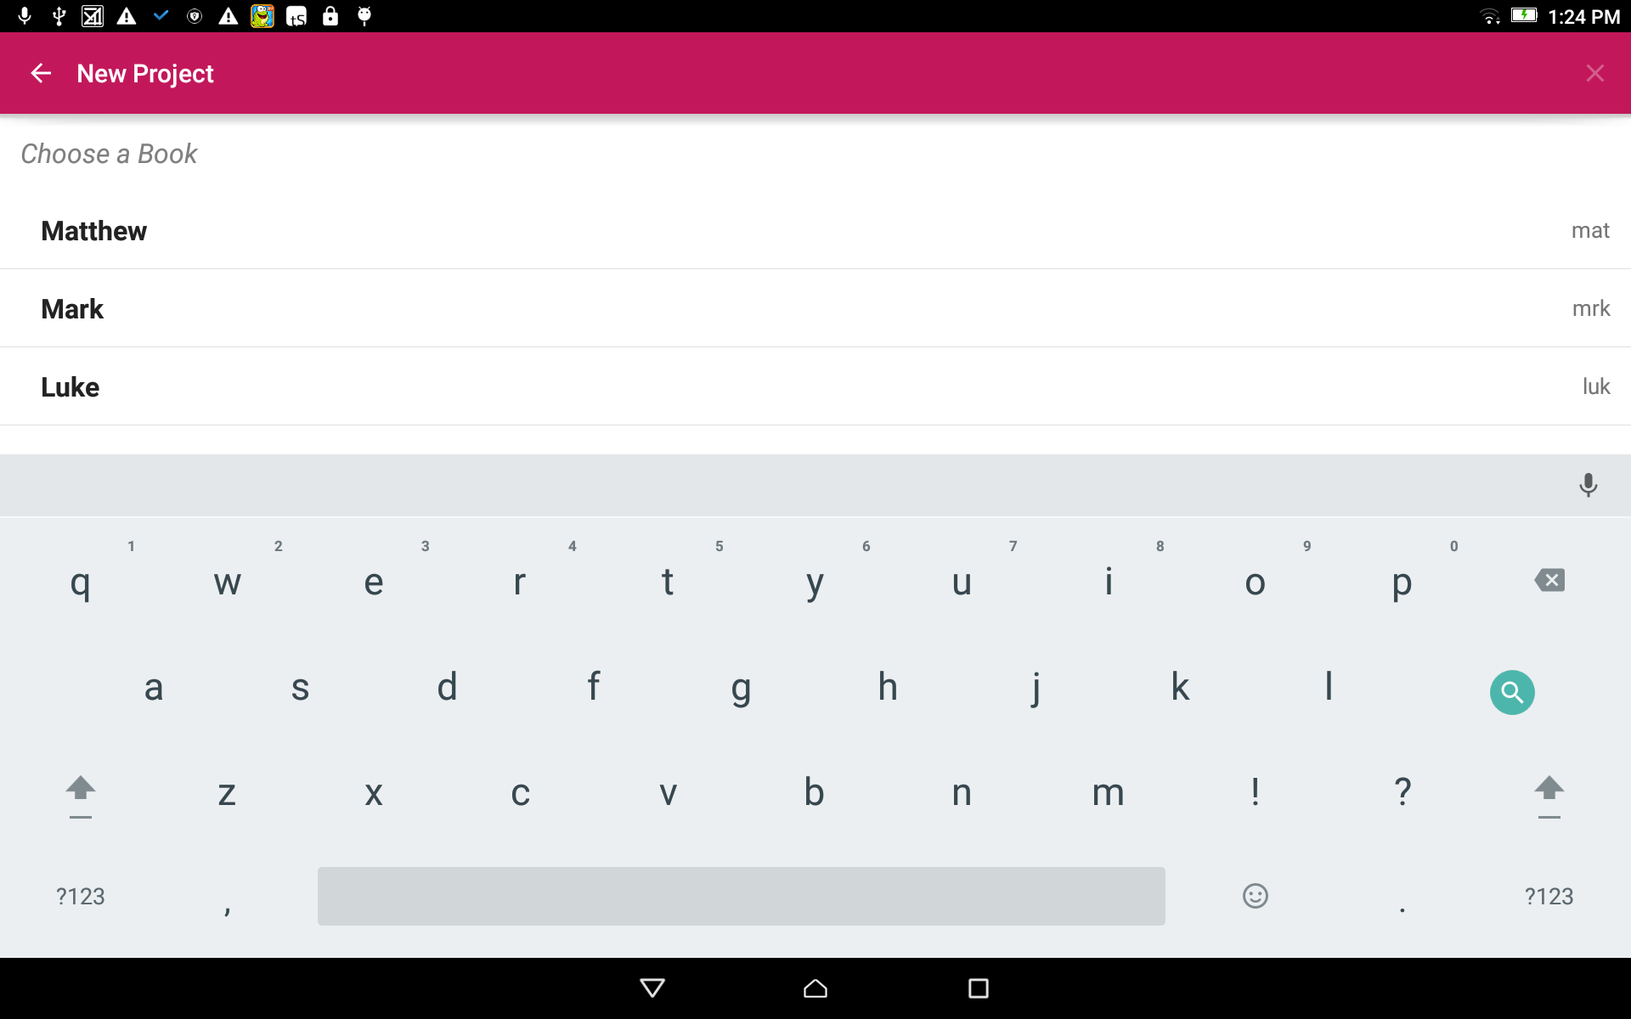
Choose a Book:
Tap on the book title to choose a book for the project.

Slide 7
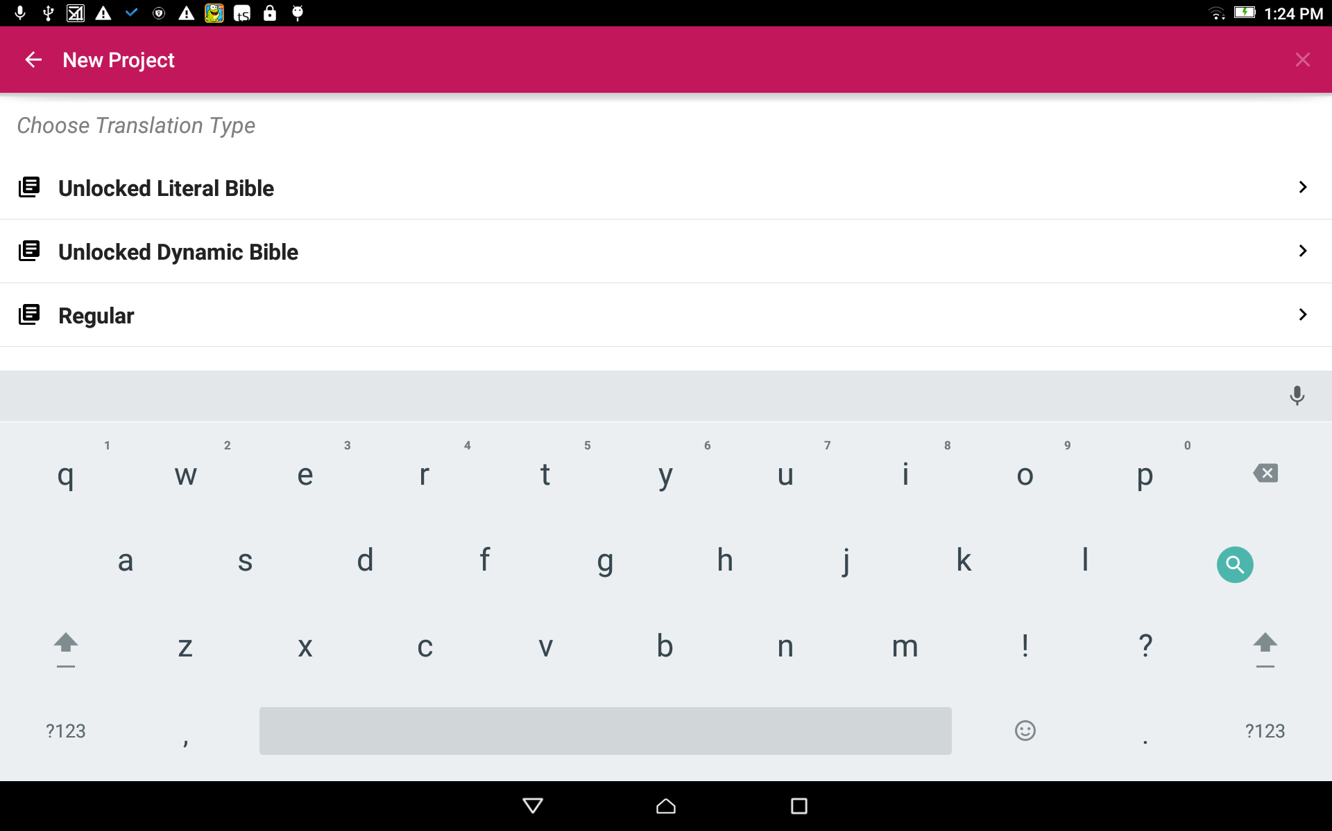
Choose a Translation Type:
The translation type is the type of translation of the final project work.
Tap on the words to choose a translation type.

Slide 8
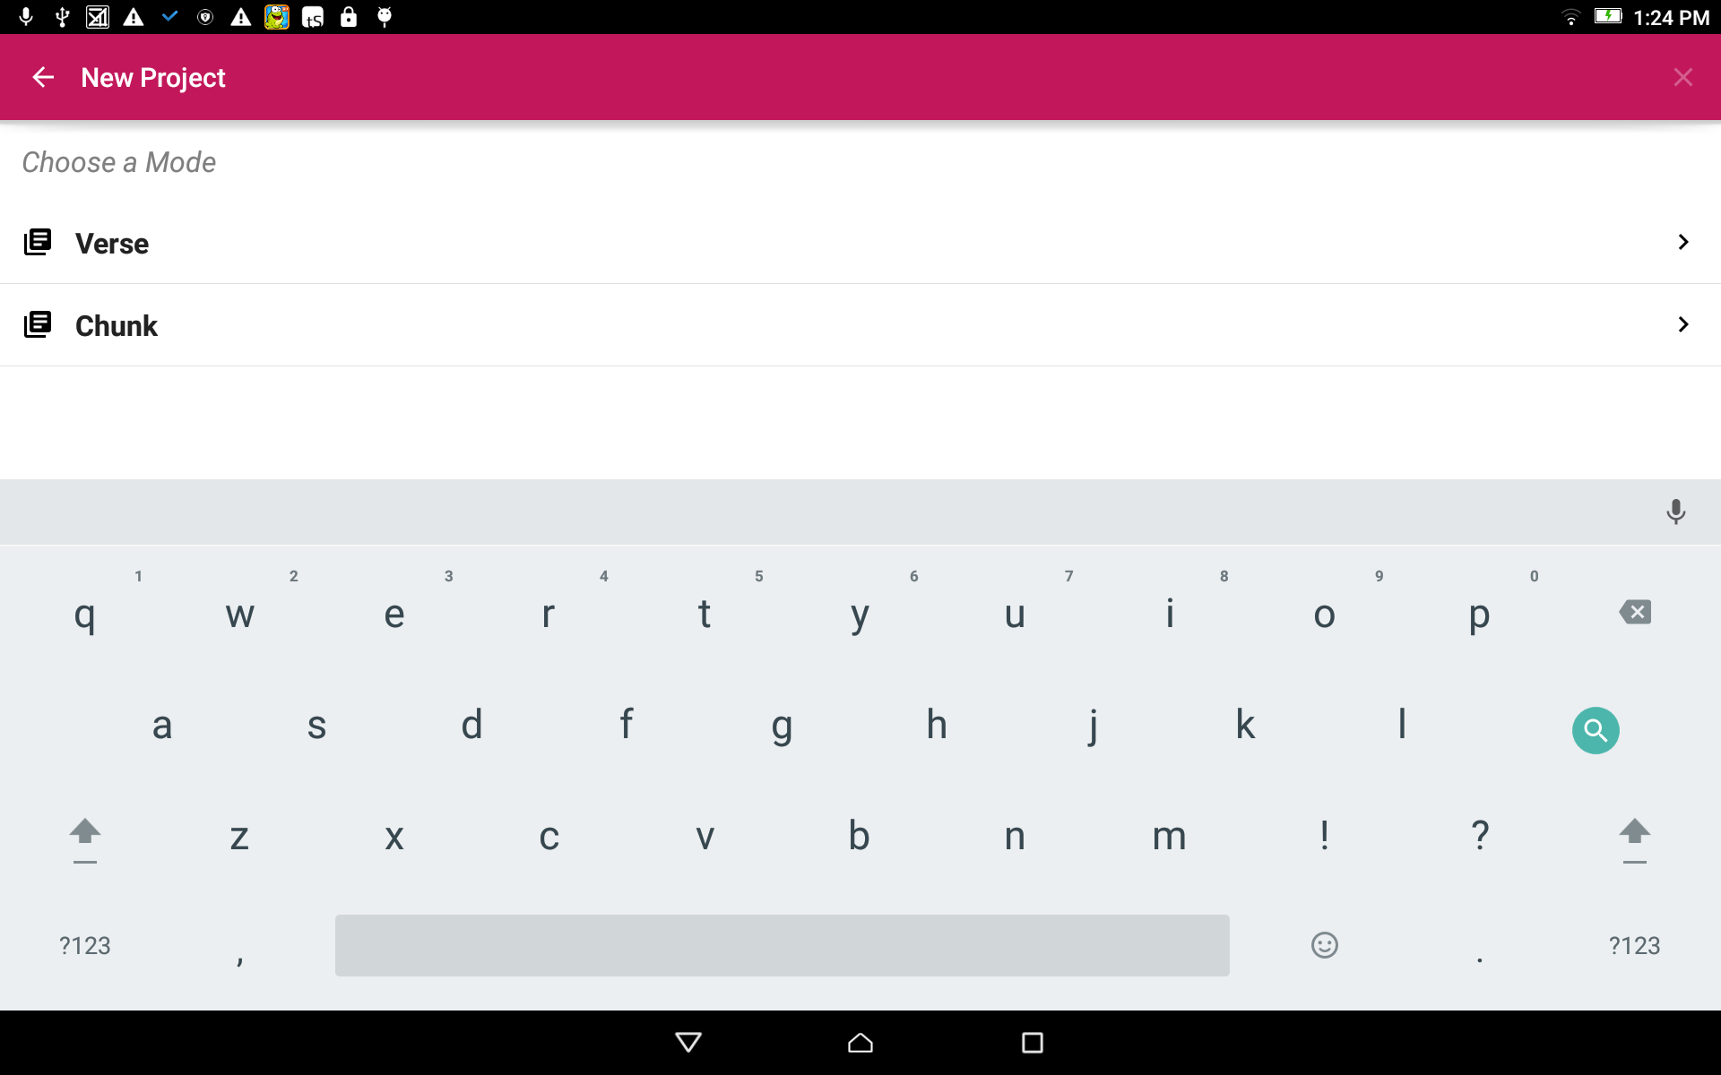
Choose a Mode:
Tap to choose either Verse or Chunk mode. This is how the information will be divided.

Slide 9
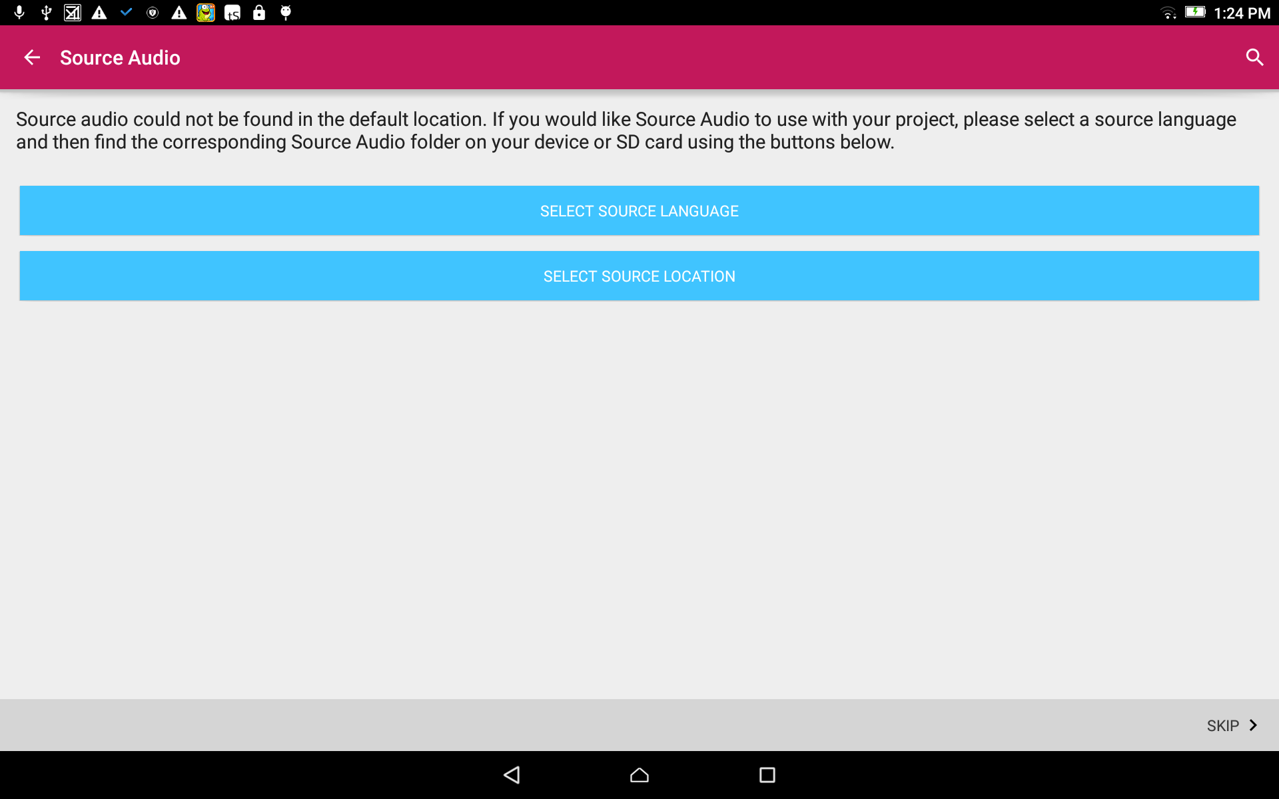
Choose the Source:
The Source Language is the language from which you will translate.
Tap on the top blue bar (Select Source Language).

Slide 10
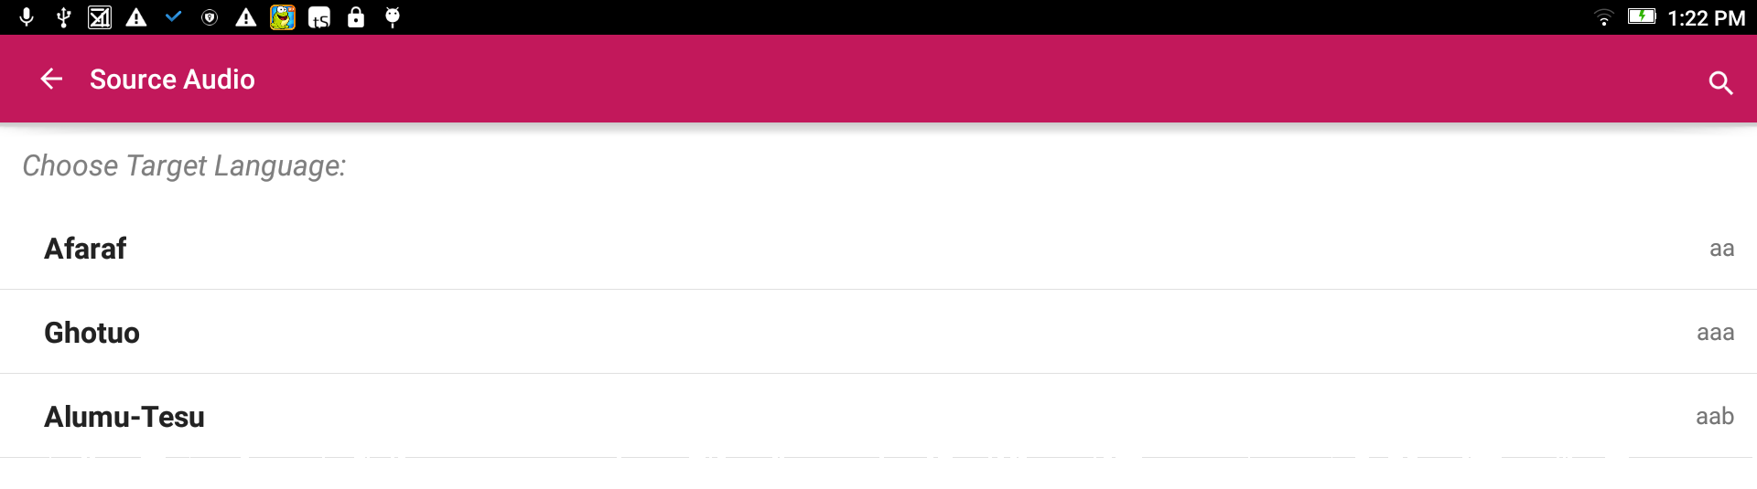
Select the Source Language:
Search for the desired language by either:
Scrolling to the language name.
Clicking the magnifying glass and typing in the language name or language code.

Slide 11
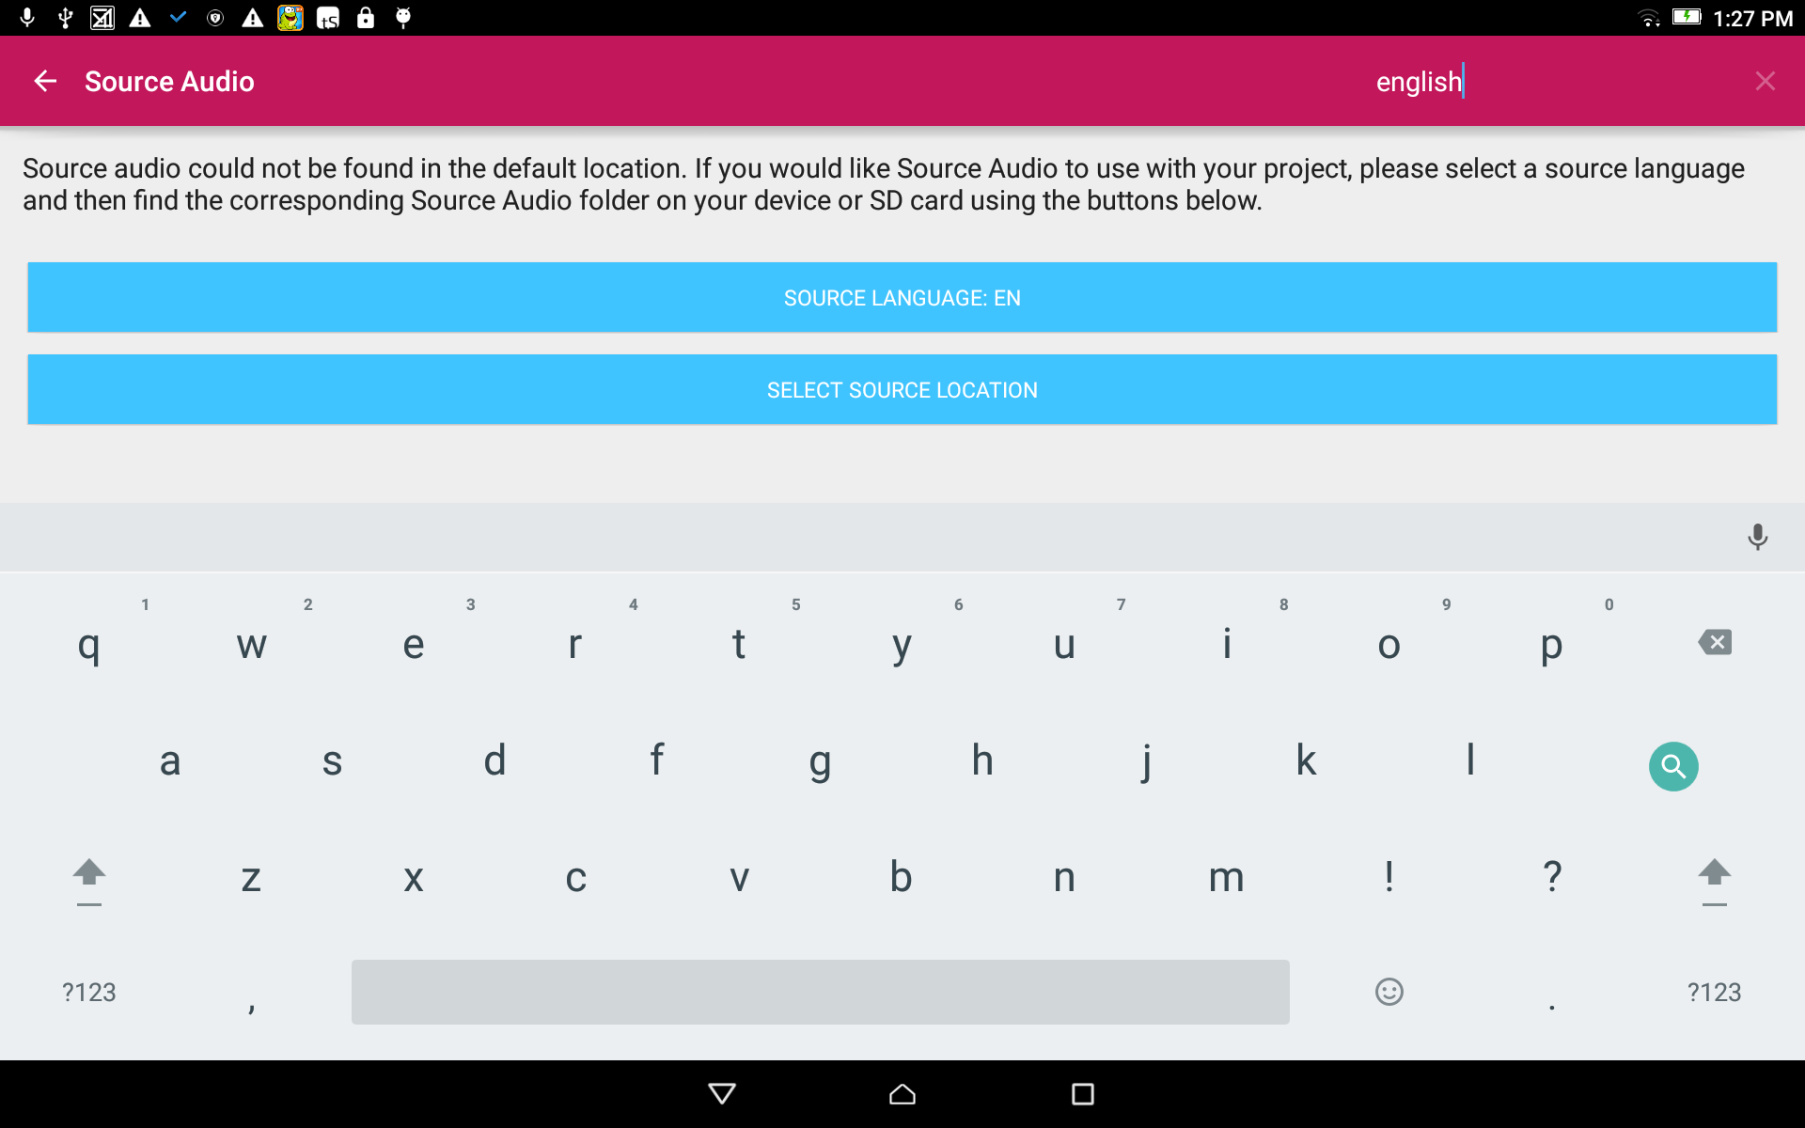
Choose the Source:
The language code now shows on the Source Language blue bar.
Tap on the bottom blue bar (Select Source Location).

Slide 12
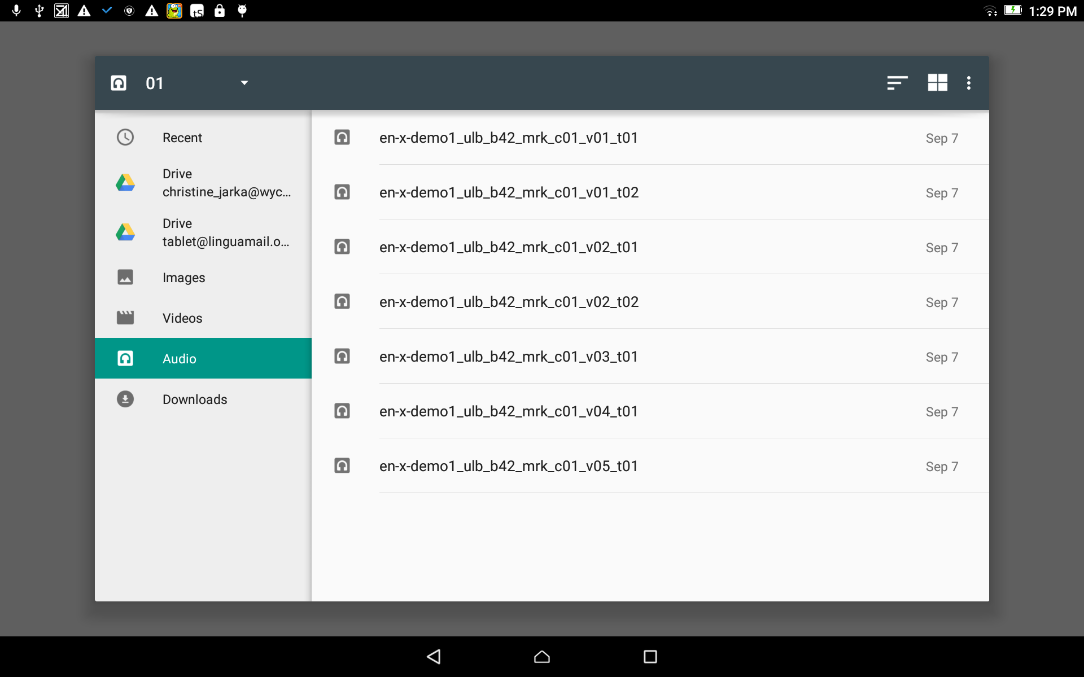
Choose the Source:
Use the File Manager to find and select the appropriate source file. (The facilitator will help with this.)

Slide 13
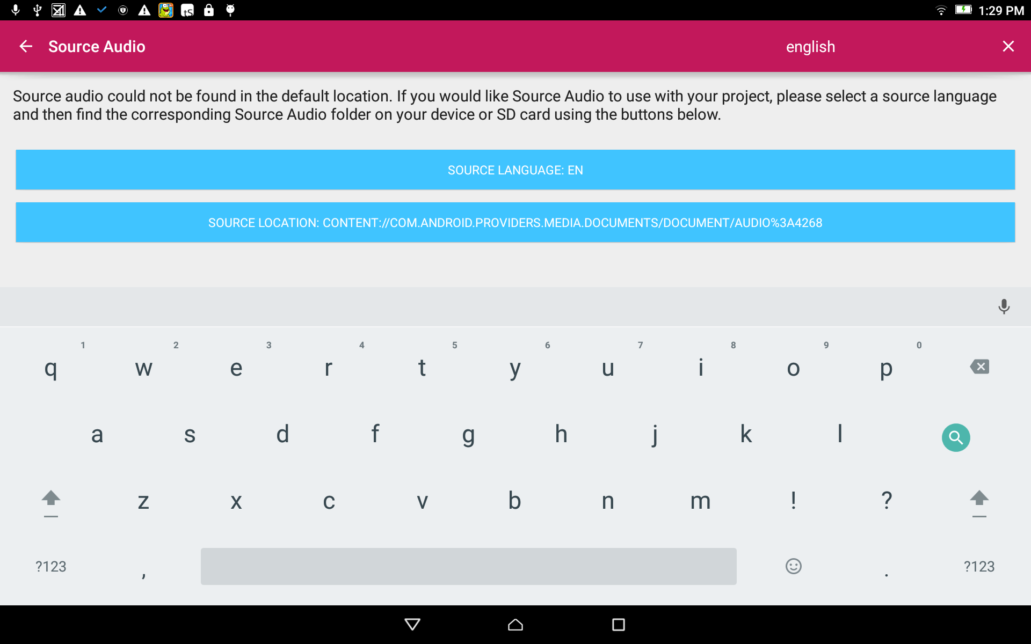
Choose the Source:
The source language file name now shows on the Source Location blue bar.

Slide 14
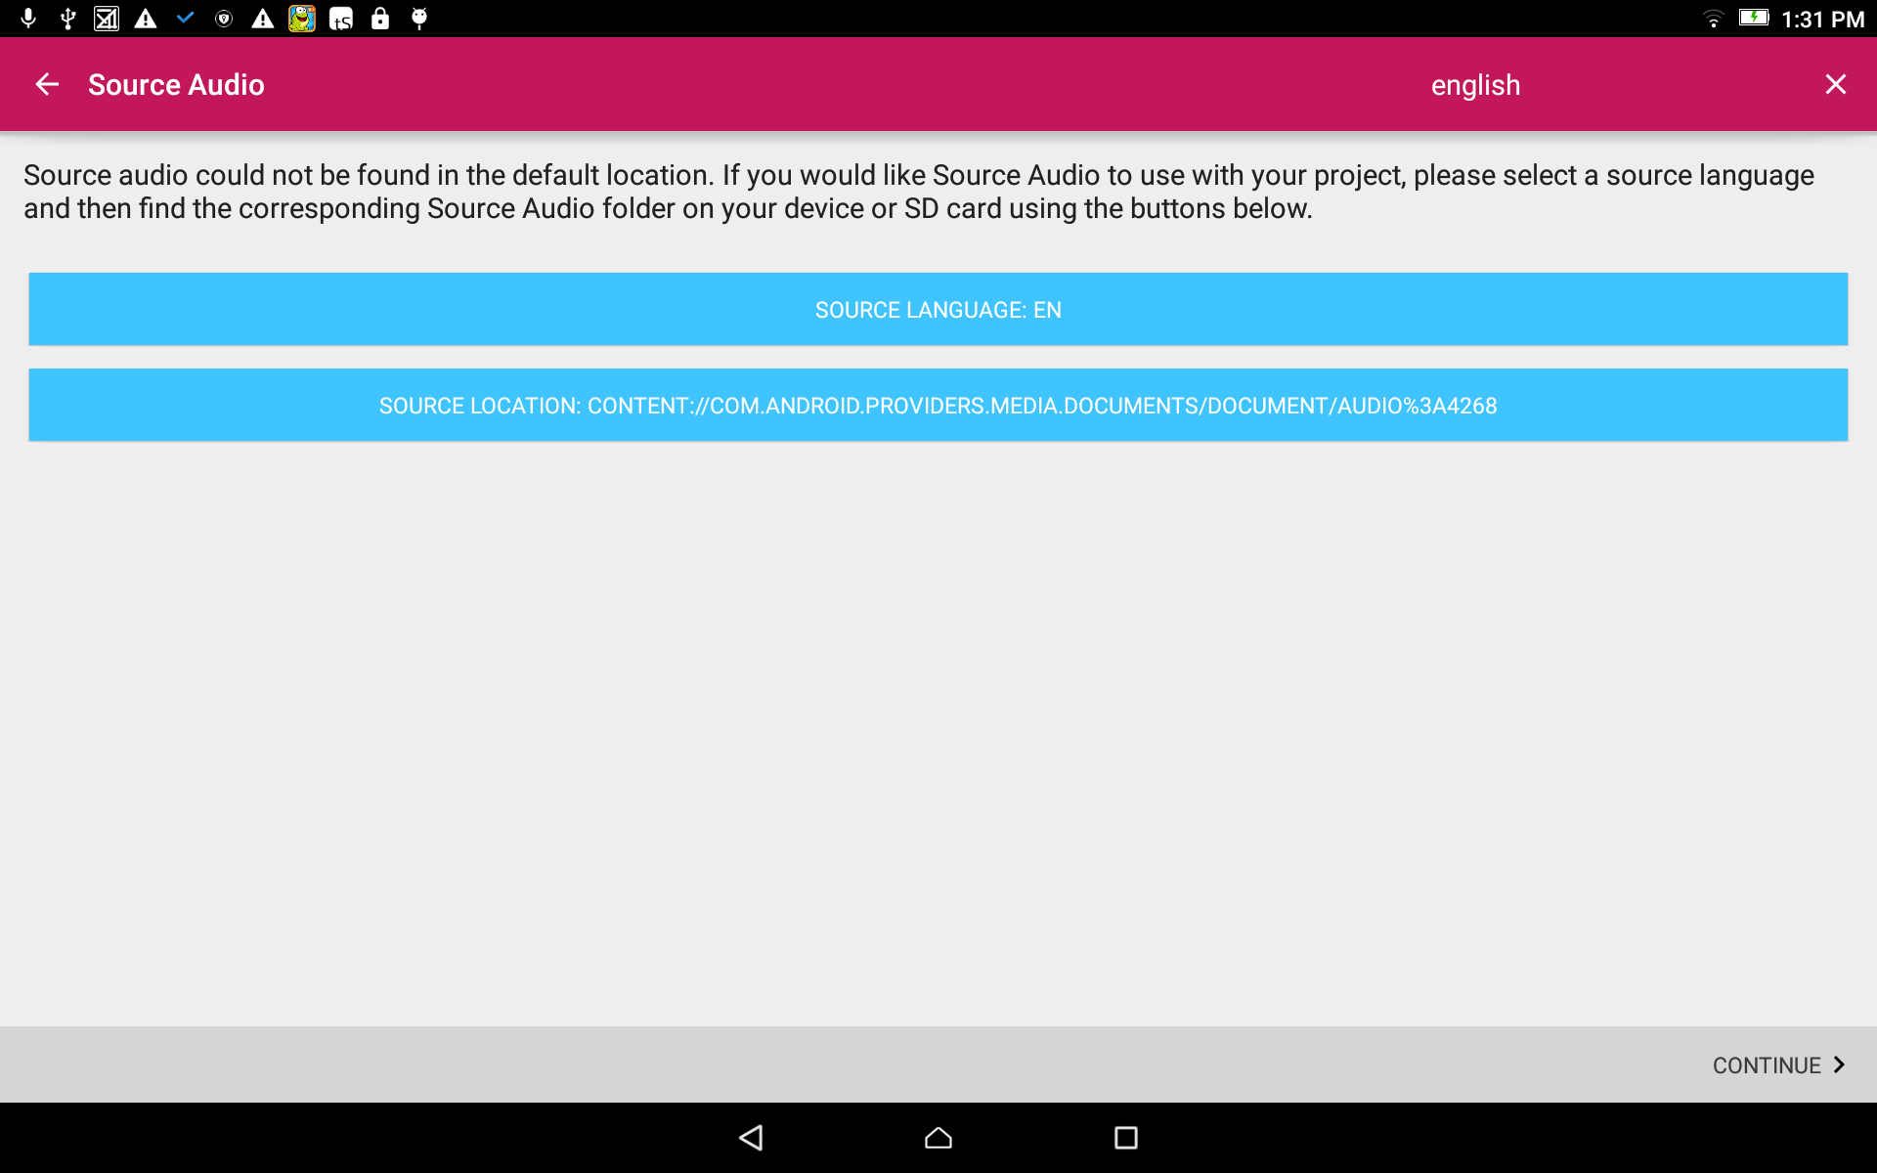
Choose the Source:
Close the keyboard.
Tap on the CONTINUE link at the bottom right.

Slide 15
Recording:
From the home screen, tap in the pink area to open the Recording Manager.

Slide 16
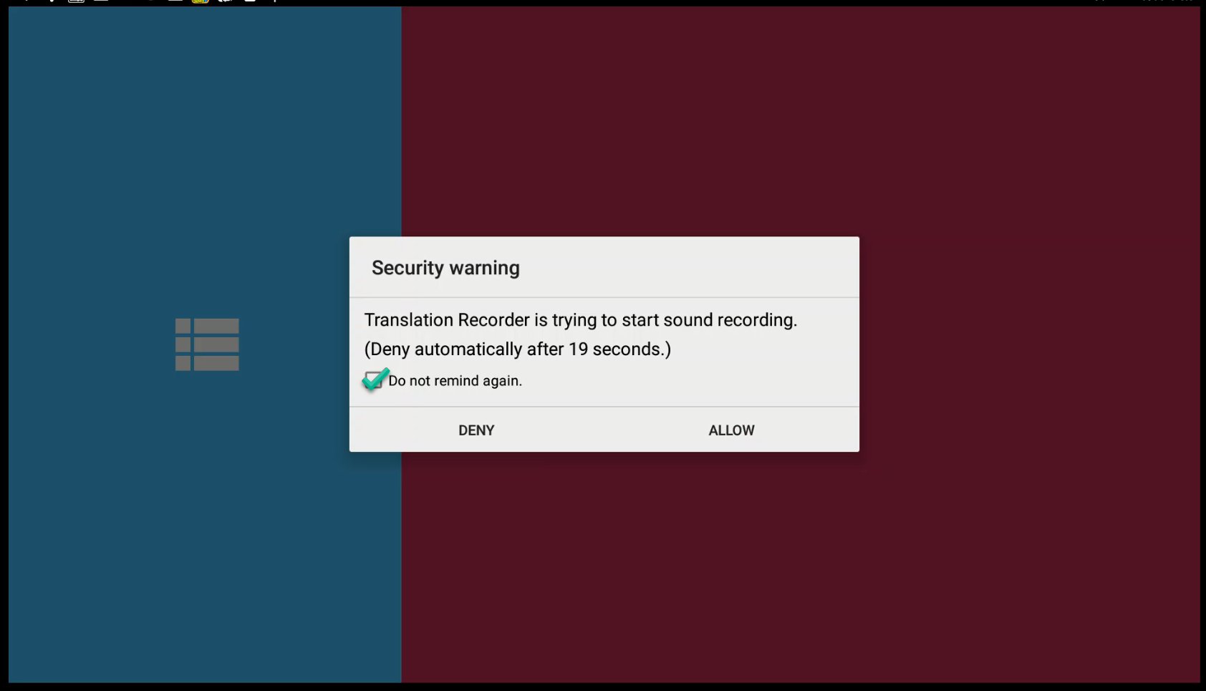
Recording:
Warning – you must allow the hardware to record.
Tap on the square check box to not be reminded again.
Tap on the ALLOW link to allow the program to have access to the hardware.

Slide 17
Recording:
Warning – you must allow the hardware to record.
Tap on the square check box to not be reminded again.
Tap on the ALLOW link to allow the program to have access to the hardware.

Slide 18
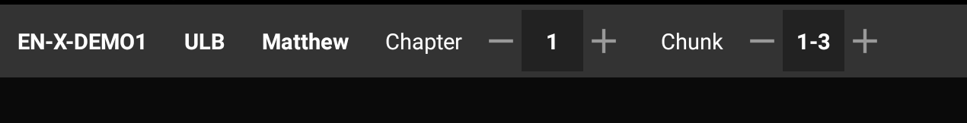
Recording:
Check the information on the top gray bar:
Target Language
Project Type
Book
Chapter
Verse or Chunk

Slide 19
Recording:
Check the information on the top gray bar:
Choose the plus and minus signs to change the numbers.

Slide 20
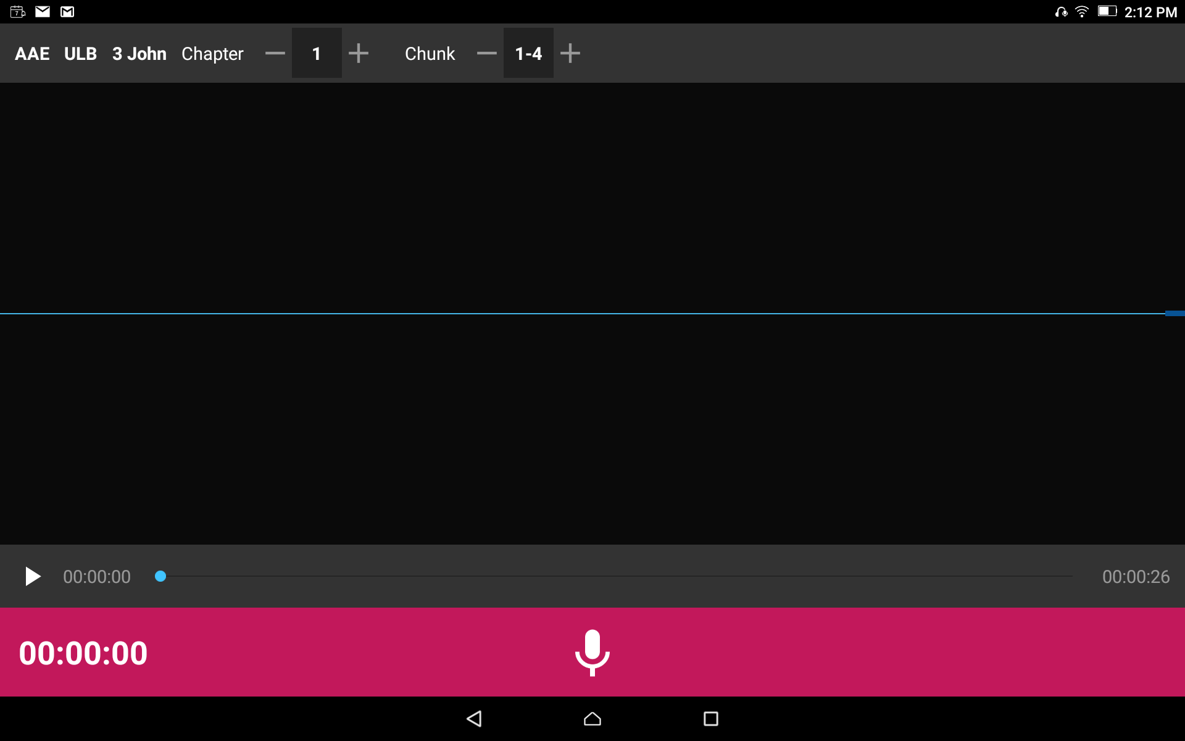
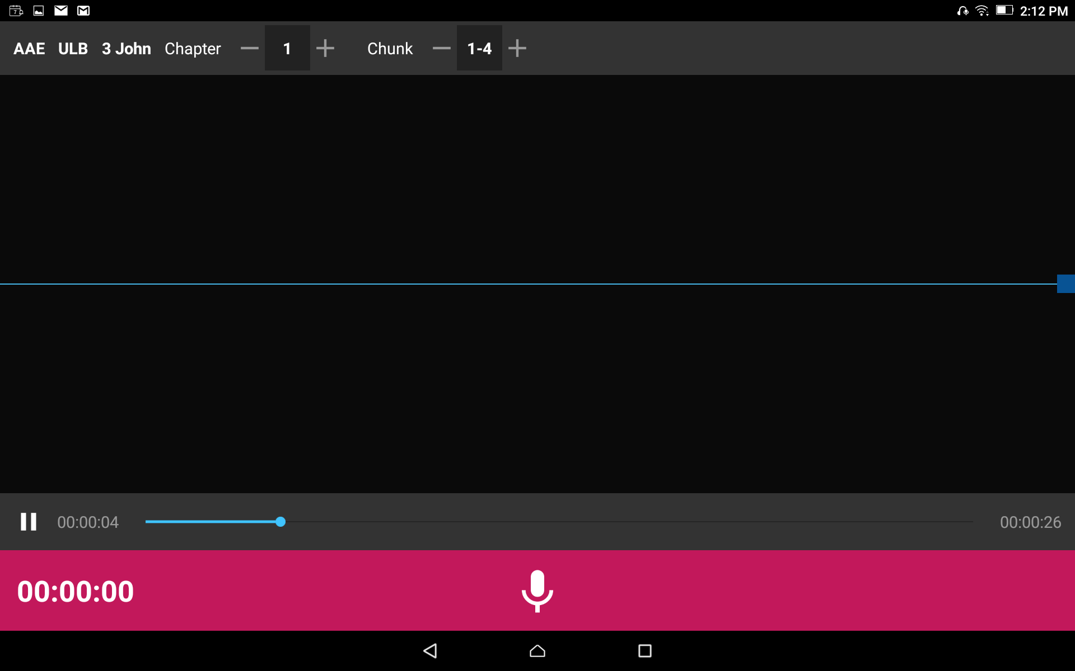
Recording:
Play the Source Audio
Tap on the play Source Audio icon.
Listen to ALL of the source audio. You may listen multiple times.

Slide 21
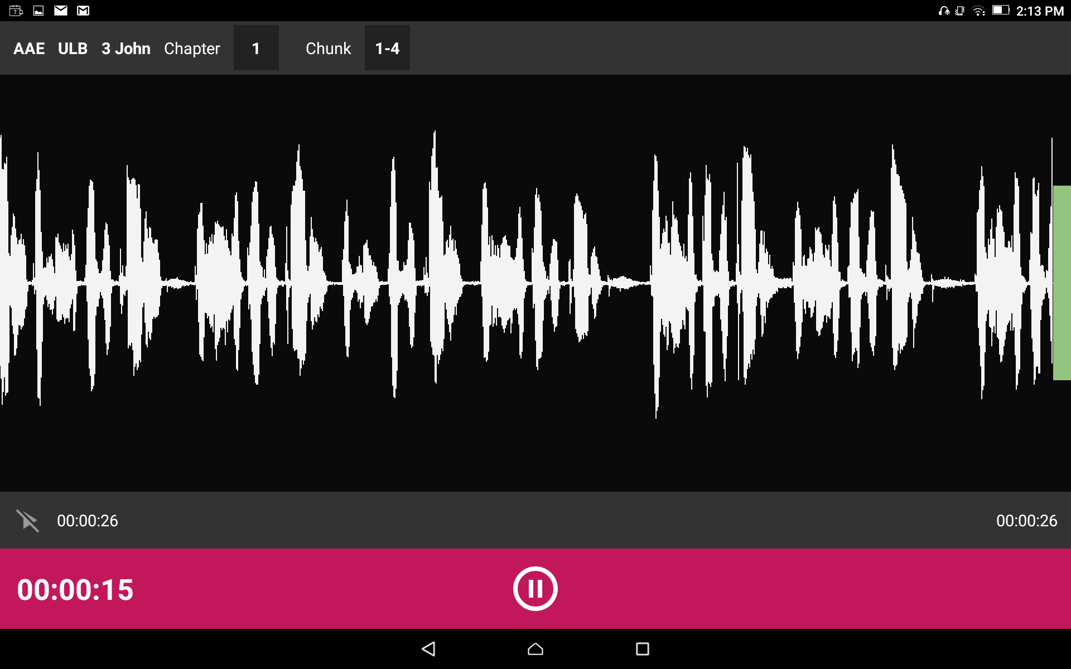
Recording:
Tap the microphone icon to start recording.
Speak clear and loudly into the microphone.
As you begin to speak you will see waves appear on the screen which is a result of the sound of your voice.

Slide 22
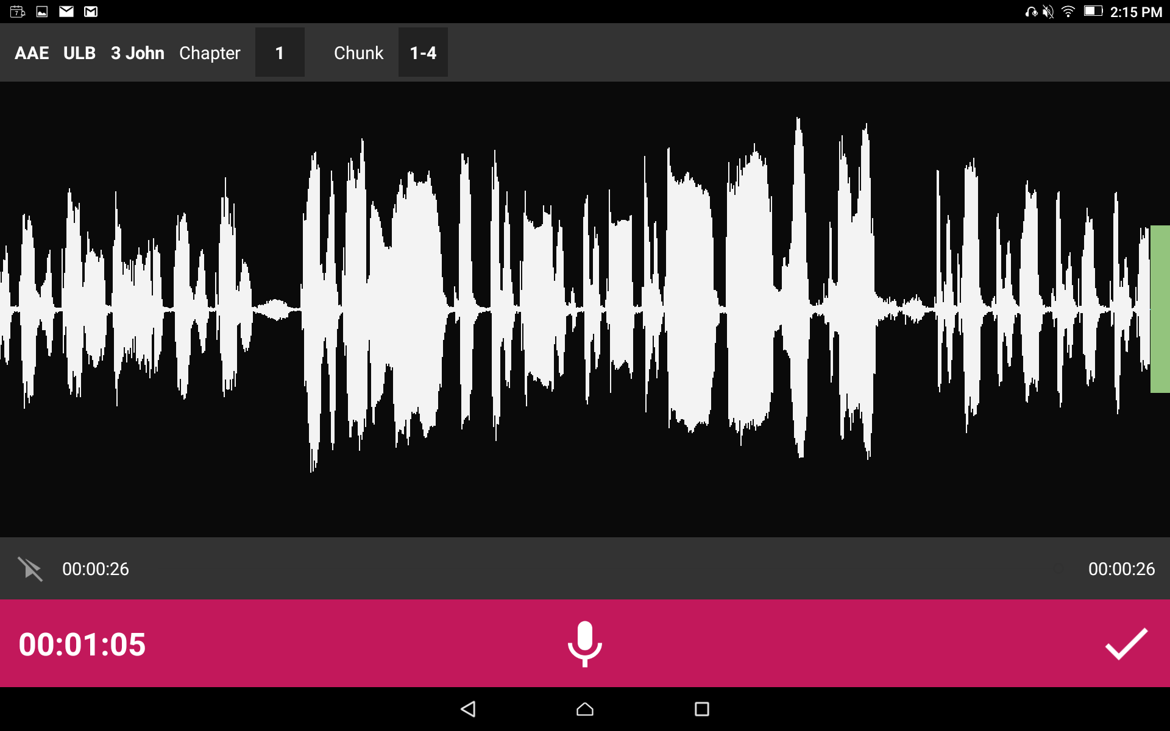
Recording:
Tap the microphone icon to start recording.
When done with that portion tap the pause button.
You can then start recording again or tap the checkmark to move to the checking screen.

