Slide 1
translationRecorder v1.2.4
eDITING An audio PROJECT

Slide 2
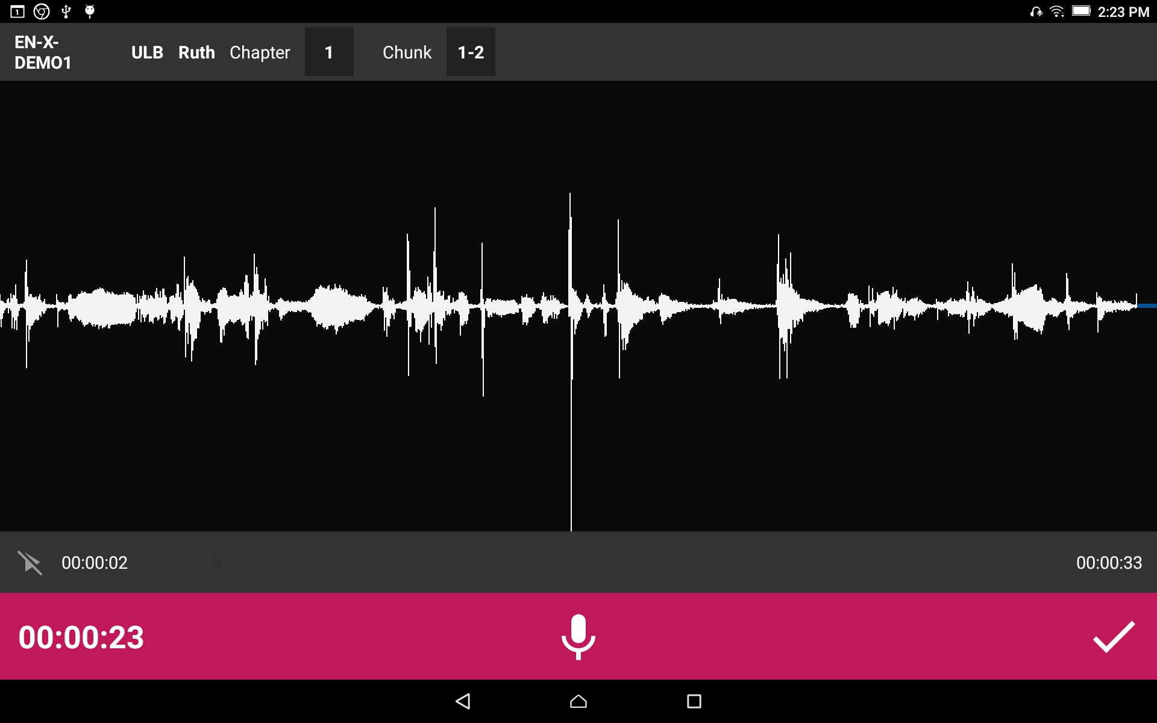
Editing:
Tap the checkmark to save the recording.

Slide 3



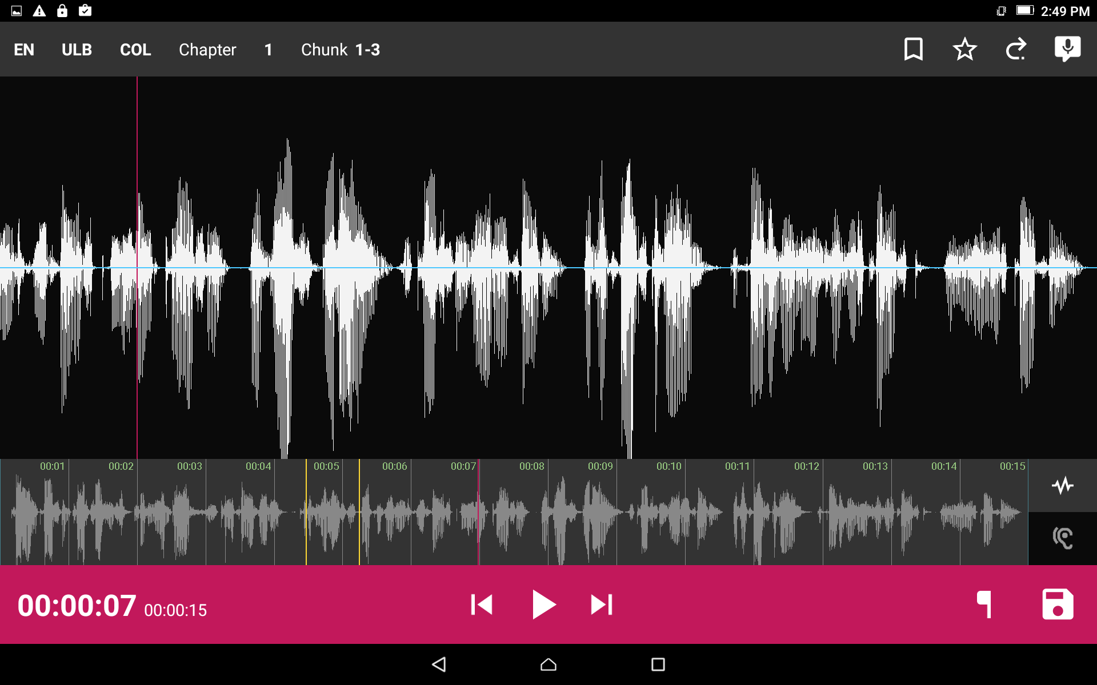
Editing:
To replay your recording simply press the play button .
To rewind the recording press and to fast forward press .

Slide 4

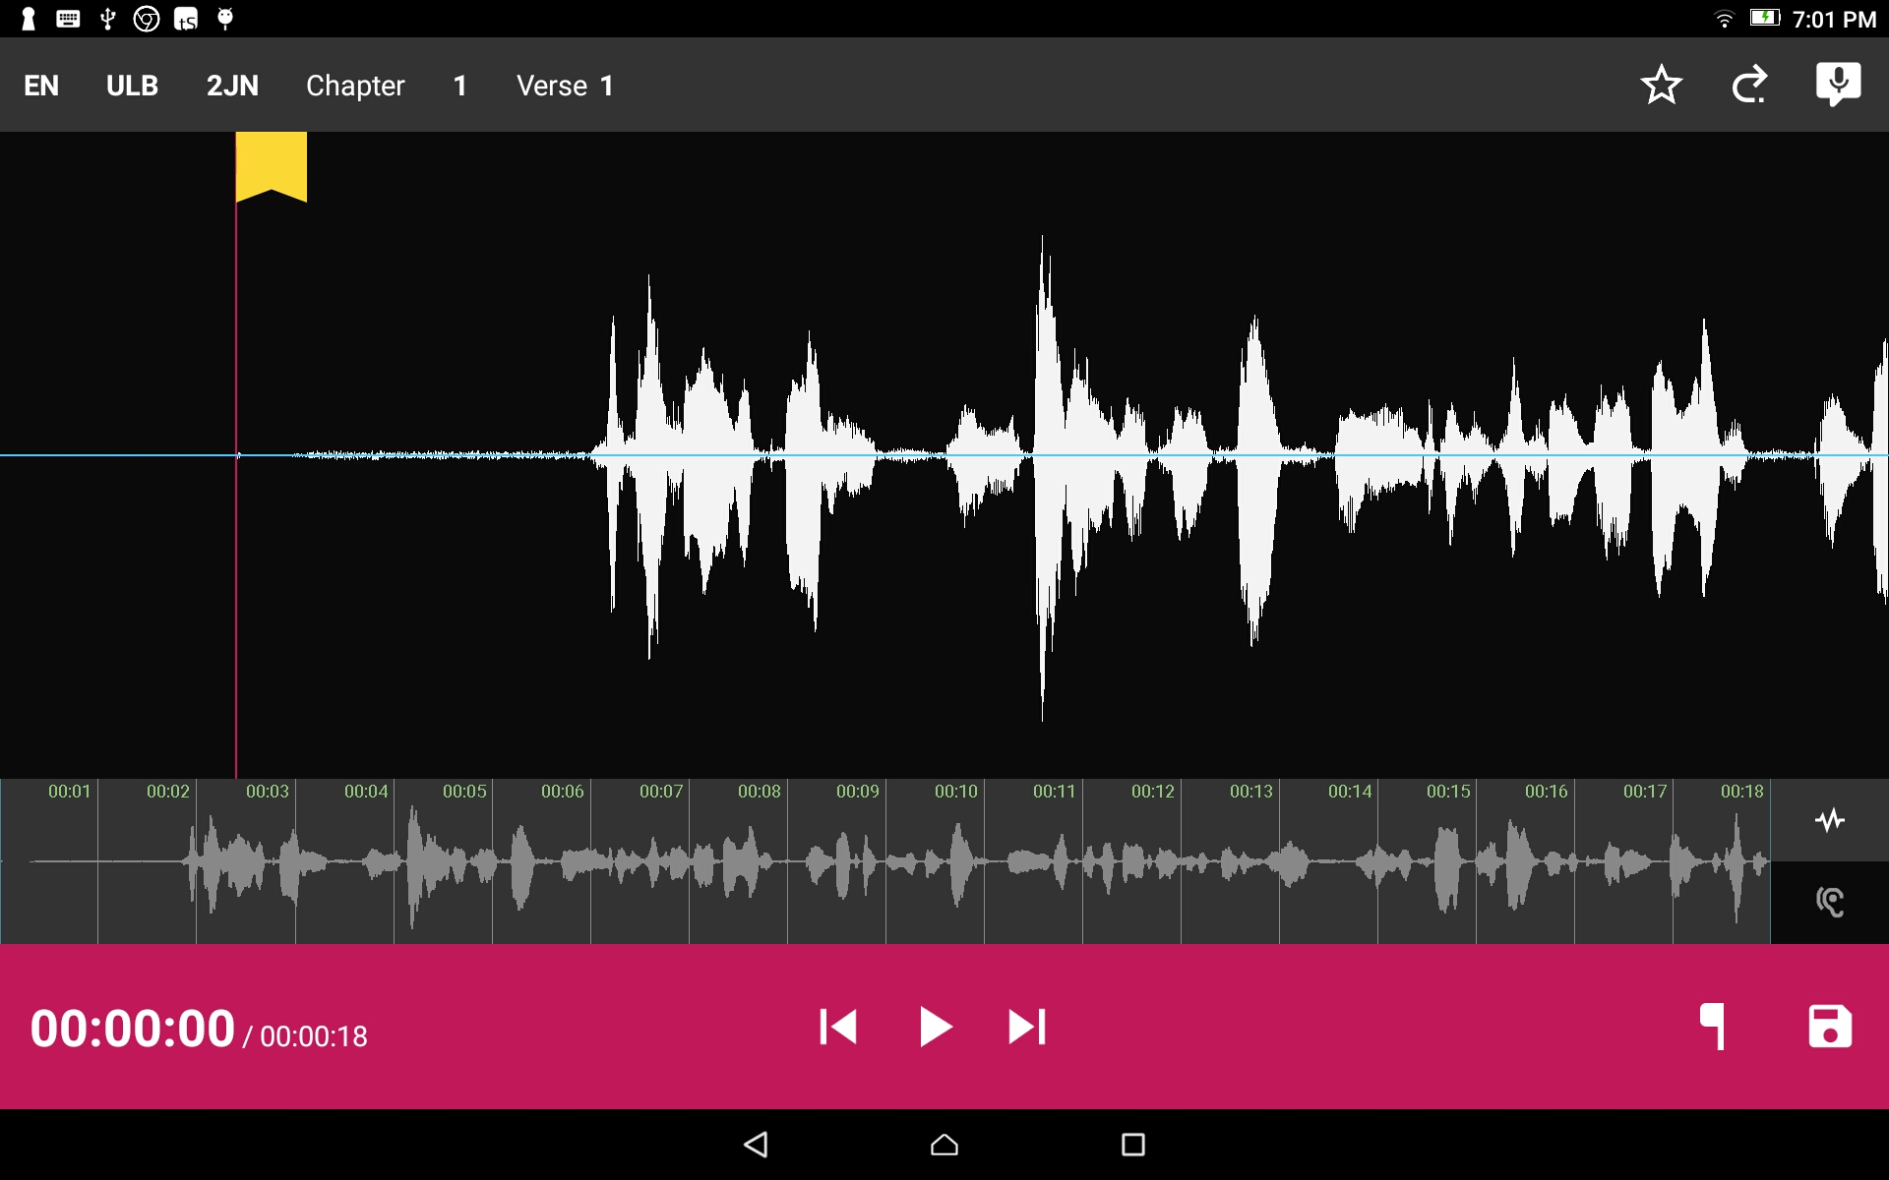
Remove a section of recording:
Position the audio at the thin red line for the beginning of the recording to be removed. Press the button.

Slide 5

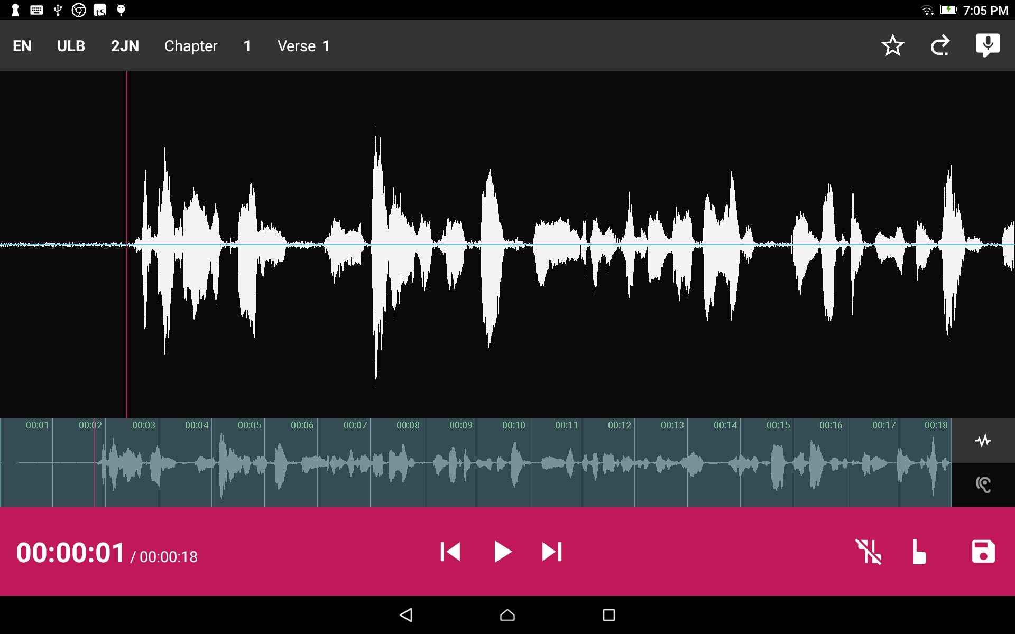

Remove a section of recording:
Use a press-drag motion and position the audio at the thin red line for the end of the recording to be removed. Press the button.
Tap the
to remove edit markings.

Slide 6

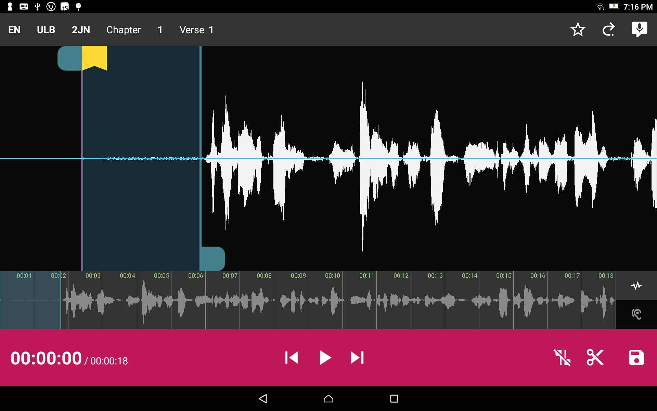

Remove a section of recording:
Use a press-drag to move the blue tab (optional.) to move the edit line.
Press the scissor icon.
Tap the
to remove edit markings.

Slide 7
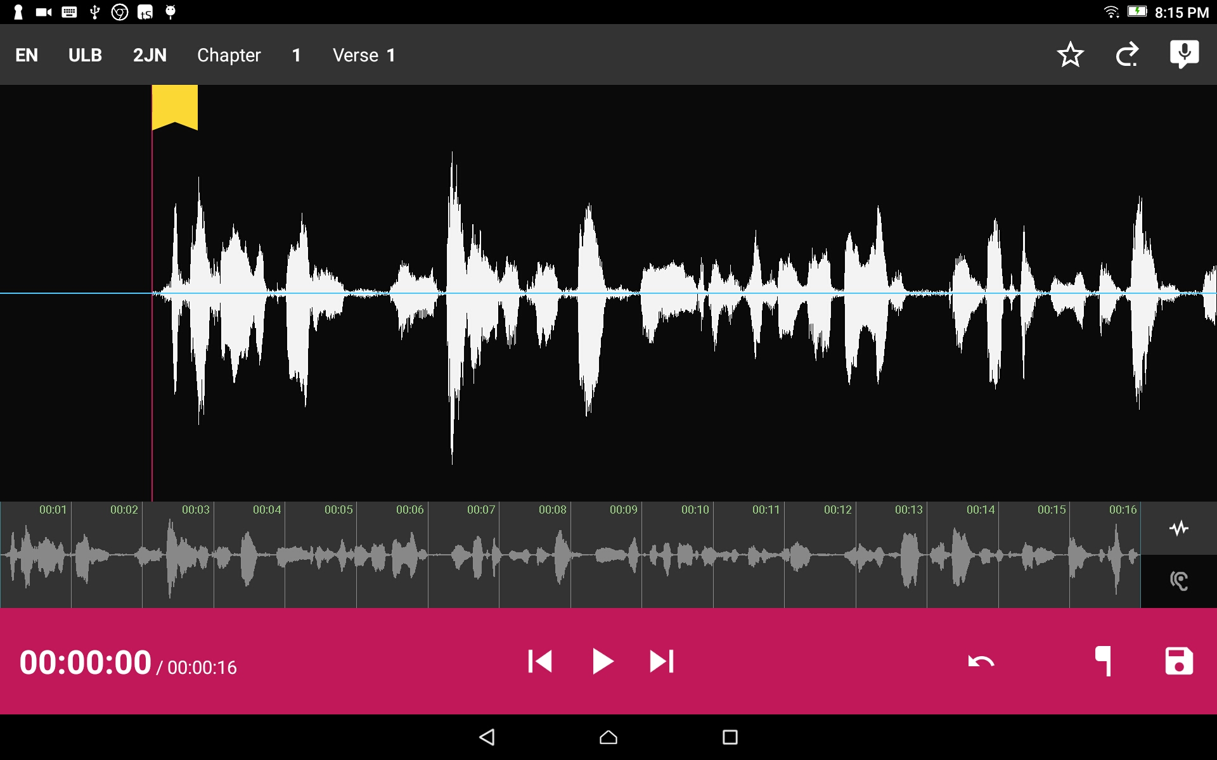
Remove a section of recording:
Press the disc icon to save the recording.

Slide 8

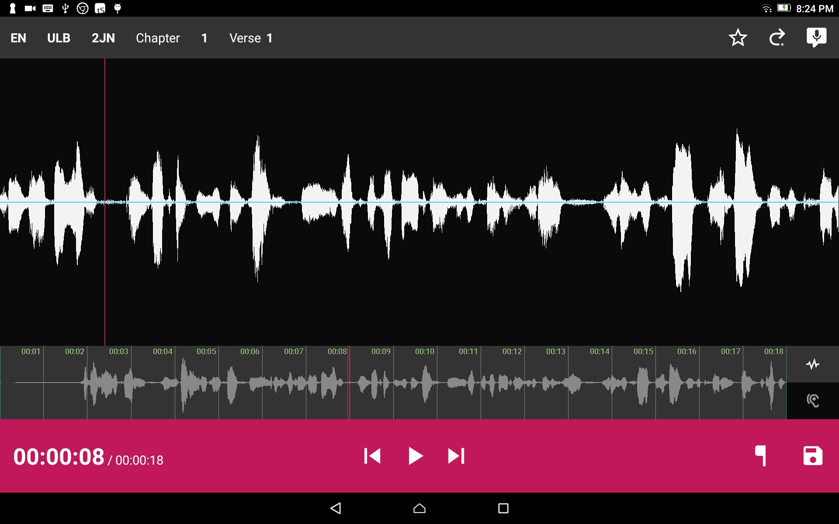
Add a recording piece into the recording:
Position the audio at the thin red line for where the new audio will be added in. Tap the Microphone icon to start a new recording session.

Slide 9
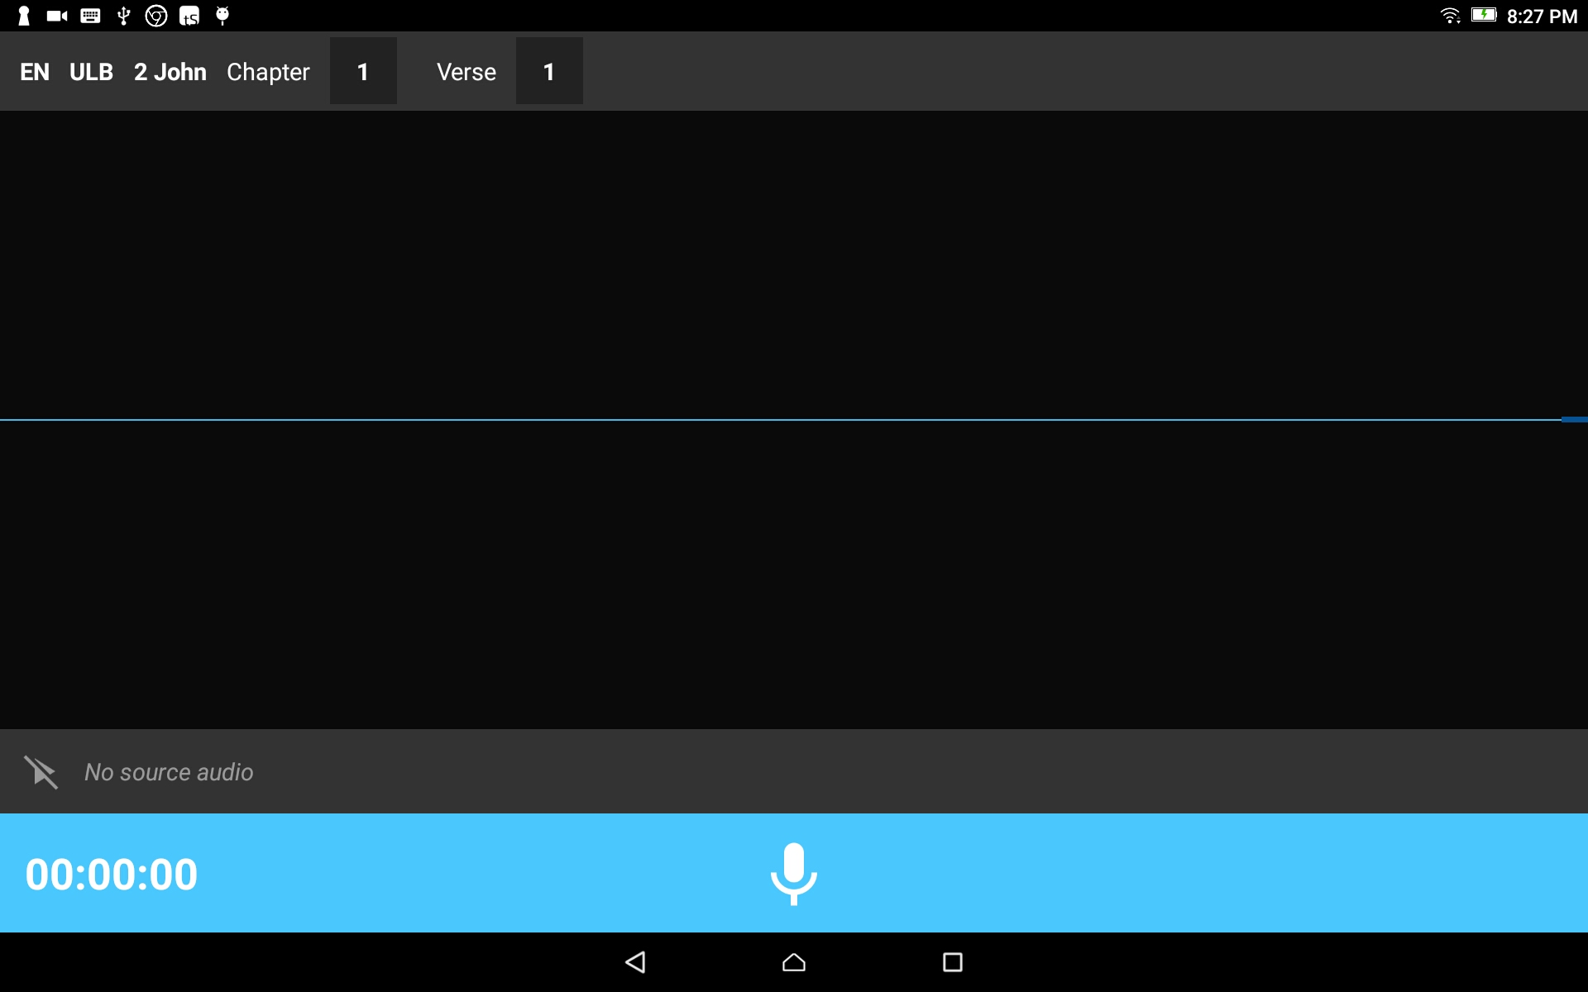
Add a recording piece into the recording:
The insert audio recording screen opens.
Tap the Microphone icon on the blue bar.

Slide 10
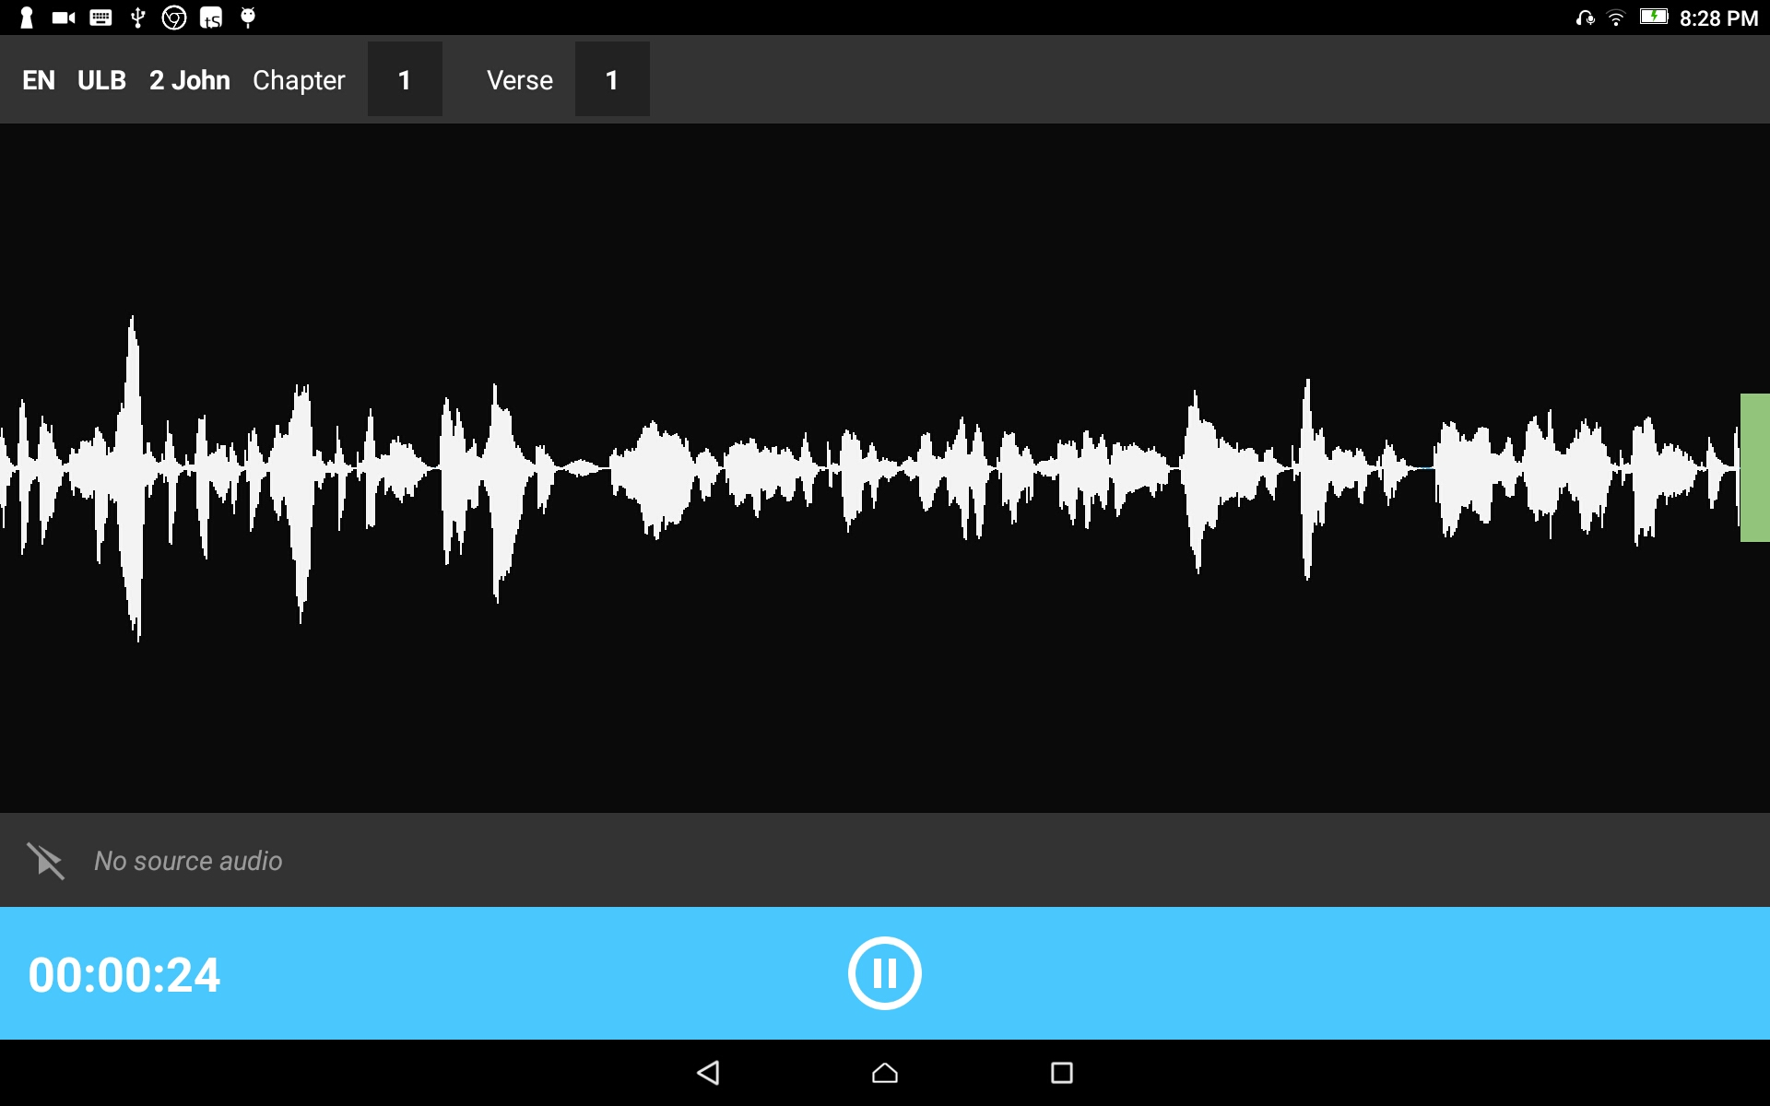
Add a recording piece into the recording:
Tap the pause icon to stop the recording.

Slide 11
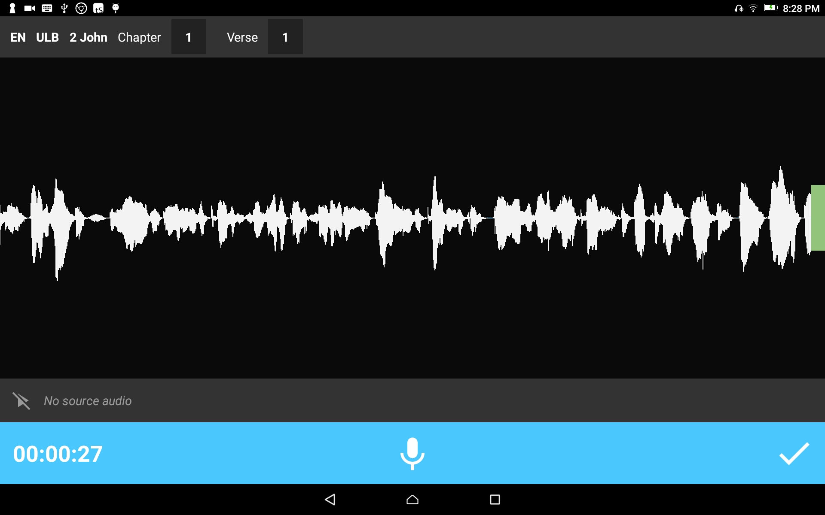
Add a recording piece into the recording:
Tap the check icon to save the recording.

Slide 12
Add a recording piece into the recording:
The main recording opens.
Tap the Play icon to play the audio with the new inserted recording.

Slide 13
Add a recording piece into the recording:
Tap the Save icon to save the recording.

