Slide 1
translationStudio for the Desktop
Uploading, Exporting, and Importing a Project

Slide 2
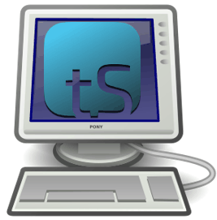
What Is This Presentation About?
In this presentation you learn to:
Explain why you should upload a project
Describe the upload options
Review a project
Upload a project to Door43
View a project on Door43
Delete a project from translationStudio
Import a project from Door43
Resolve merge conflicts

Slide 3
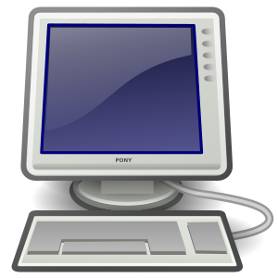
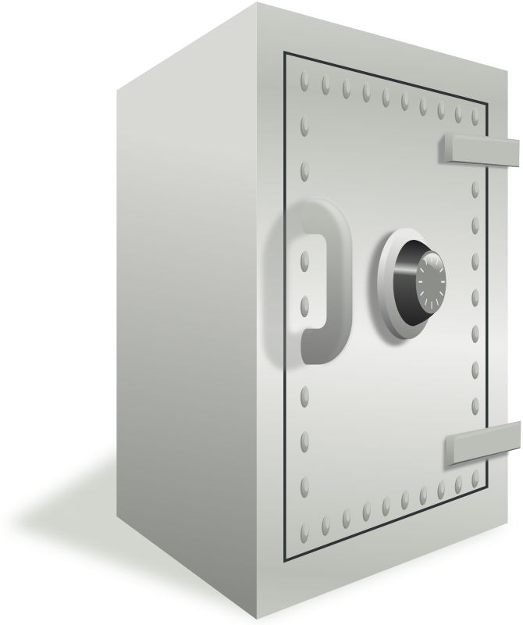
Uploading/Exporting a Project
tS saves work to your device every 5 min. by default (can change in Settings)
Good idea to create an offline backup in case:
Your files get corrupted
Your device crashes
Enables you to:
Share your work with others
Work on a different device by importing to any device that has translationStudio installed
tS provides several ways to back up and/or share your work

Slide 4
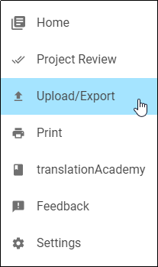
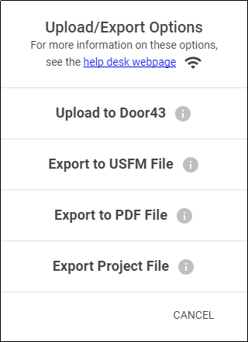
Options for Uploading/Exporting a Project
Options menu (3 dot icon) from Project Screen: Upload/Export
Several options:
Upload to Door43 server (requires internet connection and login to Door43 account)
Save a USFM file on your device
Save a PDF file on your device
Save project on your device with tstudio extension
Notes:
USFM – Unified Standard Format Markers – markup language that is widely used for encoding the digital text of scripture translations.

Slide 5
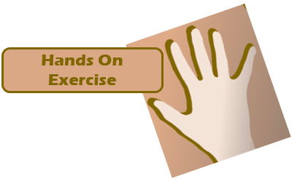
Reviewing/Uploading/Exporting a Project
Log in to Door43.
Review your project and add another contributor.
Export your project to Door43.
View the project on Door43.

Slide 6
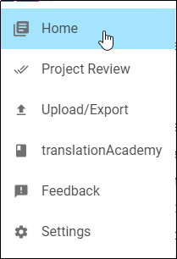
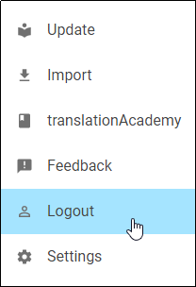

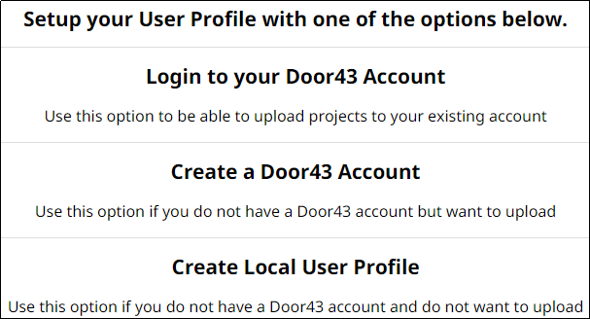
Step 1: Logging in to Door43
If you are using an offline account:
Log out of tS.
Create a Door43 account, or log into an existing one.
OR
OR

Slide 7
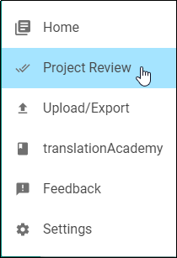
Step 2: Reviewing Your Project
Review your project and add another contributor.
Open your project
Click Project Review on Options menu (good idea to review before sharing or exporting).

Slide 8
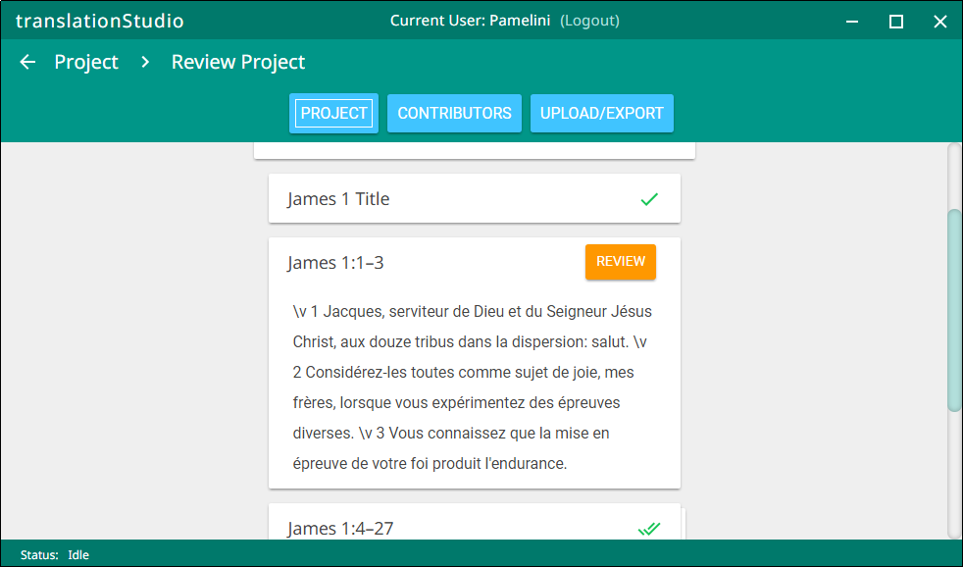
Step 2: Reviewing Your Project
Review your project and add another contributor.
Open your project
Click Project Review on Options menu (good idea to review before sharing or exporting).
Click Project.
Indication of incomplete
translation chunk

Slide 9

Step 2: Reviewing Your Project
Review your project and add another contributor.
Open your project
Project Review on Options menu (good idea to review before sharing or exporting).
Click Project.
Click Contributors.

Slide 10
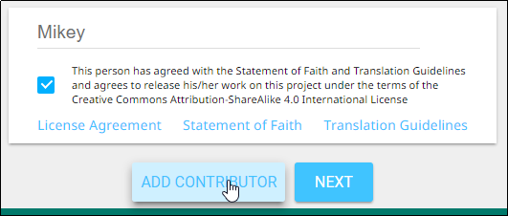
Step 2: Reviewing Your Project
Review your project and add another contributor.
Open your project
Project Review on Options menu (good idea to review before sharing or exporting).
Click Project.
Click Contributors.
Add contributor’s name and check the agreement box, then click Add Contributor.

Slide 11

Step 2: Reviewing Your Project
Review your project and add another contributor.
Open your project
Click Project Review on Options menu (good idea to review before sharing or exporting).
Click Project.
Click Contributors.
Click Add Contributor.
Add contributor’s name and check the agreement box, then click Add Contributor.
The new contributor has been added.

Slide 12

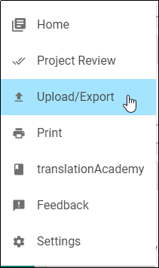
Step 3: Exporting the Project to Door43
Export your project to Door43.
Click Upload/Export from either the Project Review screen or from the Options menu.
OR

Slide 13
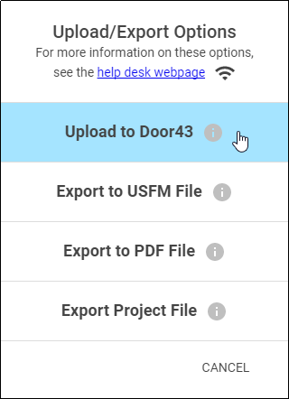
Step 3: Exporting the Project to Door43
Export your project to Door43.
Click Upload/Export from either the Project Review screen or from the Options menu.
Click Upload to Door43.

Slide 14
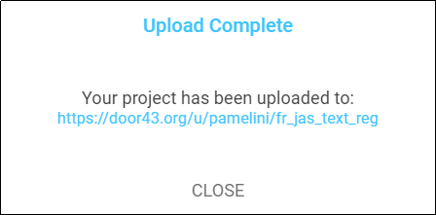
Step 3: Exporting the Project to Door43
Export your project to Door43.
Click Upload/Export from either the Project Review screen or from the Options menu.
Click Upload to Door43.
On the Upload Complete message, note the upload location (DON’T CLICK CLOSE YET).
File location
0
File name: LanguageCode_BookCode_FileType_TranslationType

Slide 15
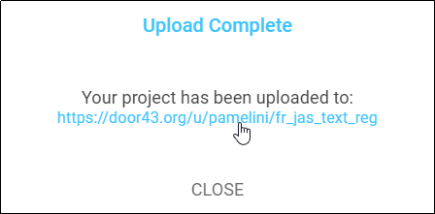
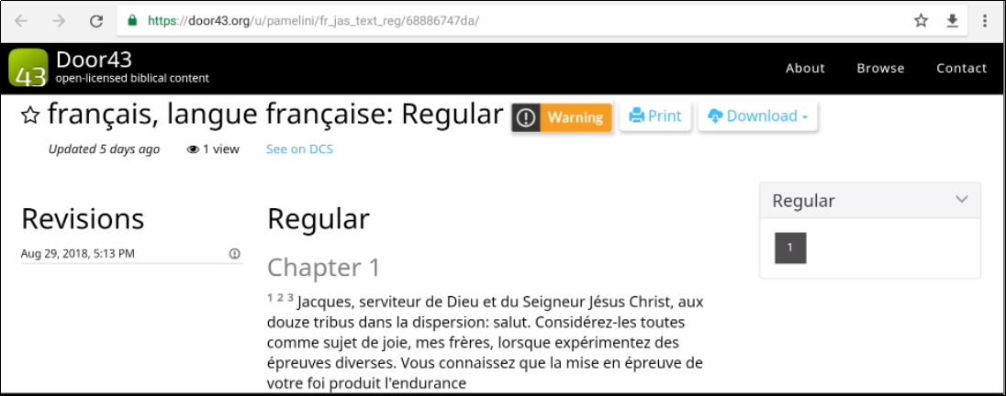
Step 4: Viewing the Project on Door43
Click the location link.
A browser window opens to display your project on Door43.

Slide 16
Deleting and Importing a Project
Delete your project from your device (to simulate loss of the file).
Import your project from Door43.

Slide 17


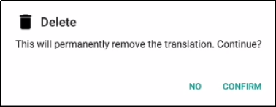
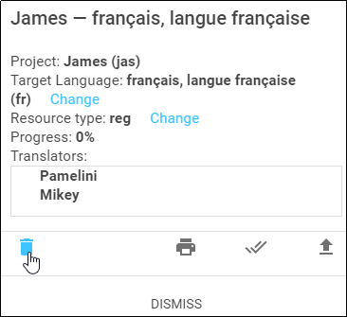
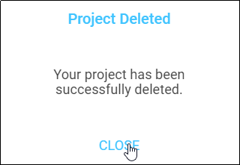
Step 1: Deleting Your Project from Your Device (to simulate loss of the file)
On the Home page, click the “i” icon next to your project.
Click the Delete icon (trash can), and then click Confirm.
Click Close to dismiss the Project Deleted message.
OTHER THINGS YOU CAN DO FROM THIS WINDOW:
Print
Project
Project Review
Upload
Export

Slide 18

Step 1: Deleting Your Project from Your Device (to simulate loss of the file)
On the Home page, click the “i” icon next to your project.
Click the Delete icon (trash can), and then click Confirm.
Click Close to dismiss the Project Deleted message.
The project disappears from your home screen – it has been deleted from your device.

Slide 19
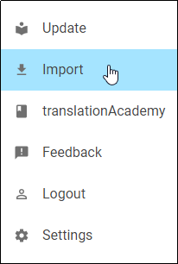
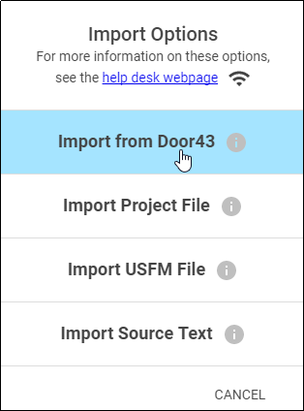
Step 2: Importing Your Project from Door43
On the Options menu, click Import.
Click Import from Door 43.

Slide 20
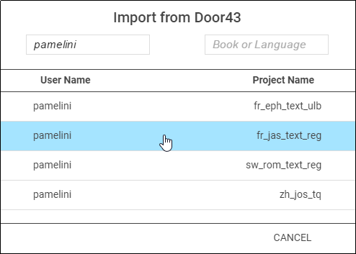
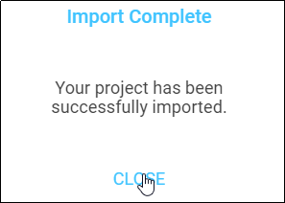
Step 2: Importing Your Project from Door43
On the Options menu, click Import.
Click Import from Door 43.
Select the project to import.
Close the Success message.
The project has been imported to your device.

Slide 21
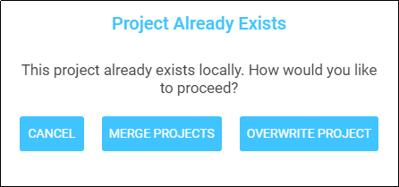
Merging Projects
If you try to import a project that already exists on your device, you have 2 import options:
Merge Projects:
The importing process continues.
When the message that the import is complete shows, click Close.
Open the project.
If the imported translation has recent changes, they now show in the text.
Overwrite Project:
Removes all information on the computer related to the previous local project and substitutes it with the information from the imported project.
We recommend that you do not choose this option if you have previously uploaded the project to Door43.
Problems? Email help@door43.org for or submit a ticket using the following link: http://help.door43.org/en/topics/new.

Slide 22
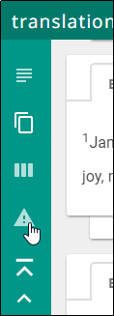
Resolving Merge Conflicts
When merging projects with differences between local and imported projects, tS tells you how many chunks have conflicts.
Click the triangle “Warning” icon in the left side of the screen to view only the chunks with a conflict.

Slide 23
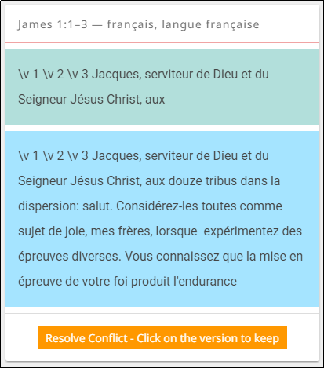
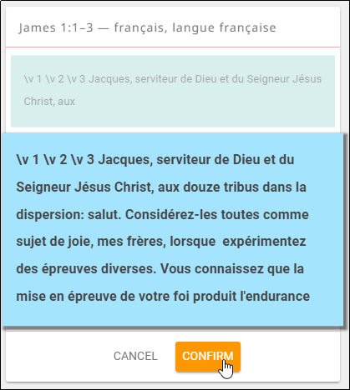
Resolving Merge Conflicts
When merging projects with differences between local and imported projects, tS tells you how many chunks have conflicts.
Click the triangle “Warning” icon in the left side of the screen to view only the chunks with a conflict.
For each chunk, select either:
The text prior to the import (green box)
OR
The text from the import (blue box)
Click Confirm; the other text disappears.

Slide 24
What Did You Learn?
In this presentation you learned to:
Explain why you should upload a project
Describe the upload options
Review a project
Upload a project to Door43
Look at a project on Door43
Delete a project from translationStudio
Import a project from Door43
Resolve merge conflicts

