Slide 1
translationStudio for Desktop
Getting Started

Slide 2
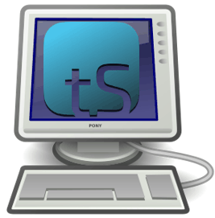
What Is This Presentation About?
In this presentation you learn to:
Explain what translationStudio for the desktop is used for
Define “gateway language”
Install translationStudio for the desktop
Open the program
Agree with terms of use
Create an account
Describe the home screen
Notes:
The translationStudio-Android is a mobile app where translators can do offline translating. It can be downloaded for Android devices.
The tool named translationStudio was created by Distant Shore Media programmers so that anyone with an Android tablet can translate the Bible into their heart language.
The translationStudio tool is open source (without cost) and copyright free (content is not copyrighted against translation)
Most Bibles and resources are copyrighted – can’t use as a translation source unless receiving permission from publisher, often involving paying royalties. For example, if you translate out of a single source, it is considered plagiarism to publish. You must use at least 3 sources for it not to be plagiarism.
It contains the content that needs to be translated as well as translationHelps (Bible resources – notes, words, questions) .
Information can be shared directly from device to device and finished content can be uploaded to Door43 and digitally published.

Slide 3
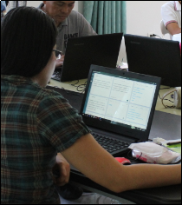
What Is translationStudio for the Desktop?
Desktop program for translating Bible & resources
Works on Linux, Windows, or Mac
Open source
Can be used for:
Translating Bible or OBS from English to a gateway language, or from a gateway language to a mother tongue
Translating Bible resources from English to a gateway language
Contains:
Content to be translated
Translation helps
Work can be shared and published
This can’t be done with tS for Android
Notes:
The translationStudio-Android is a mobile app where translators can do offline translating. It can be downloaded for Android devices.
The tool named translationStudio was created by Distant Shore Media programmers so that anyone with an Android tablet can translate the Bible into their heart language.
The translationStudio tool is open source (without cost) and copyright free (content is not copyrighted against translation)
Most Bibles and resources are copyrighted – can’t use as a translation source unless receiving permission from publisher, often involving paying royalties. For example, if you translate out of a single source, it is considered plagiarism to publish. You must use at least 3 sources for it not to be plagiarism.
It contains the content that needs to be translated as well as translationHelps (Bible resources – notes, words, questions) .
Information can be shared directly from device to device and finished content can be uploaded to Door43 and digitally published.

Slide 4

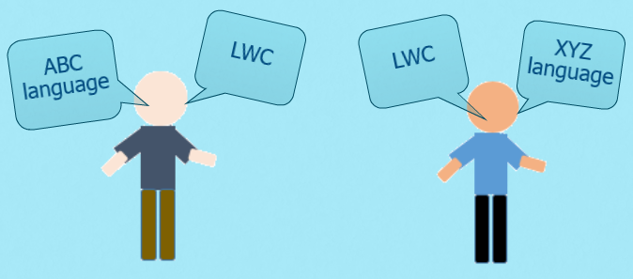
What Is a Gateway Language (GL)?
Language barriers are one of the biggest obstacles in Bible translation.
Most people groups speak more than one language: native language and Language of Wider Communication.
There are >7000 languages, but only a handful of LWCs.

Slide 5
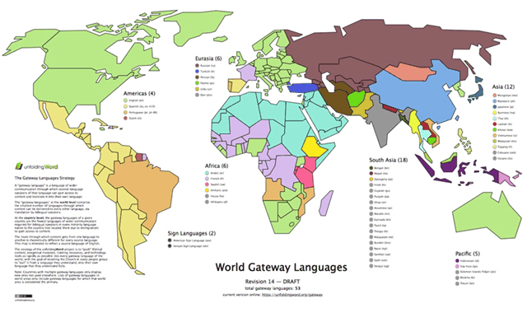

What Is a Gateway Language?
We call these Gateway Languages because they provide a path to Bible translation without the need for translators to learn English.
https://unfoldingword.org/gateway

Slide 6
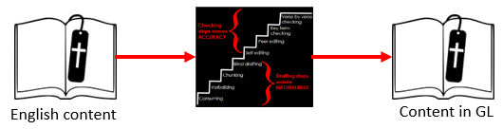
How Does the GL Strategy Work?
Translators use MAST methodology to translate content from English to the GL.

Slide 7
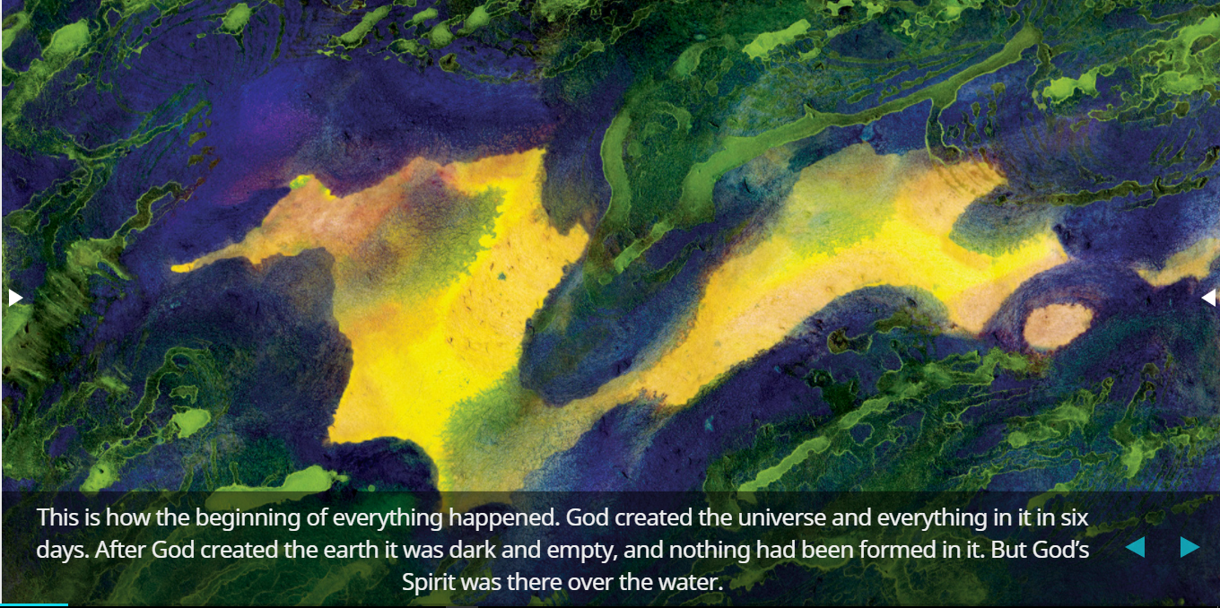
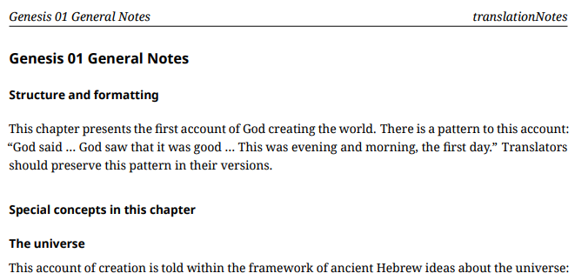
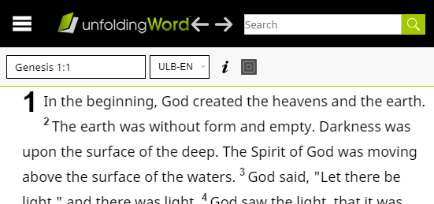
How Does the GL Strategy Work?
Translators use MAST methodology to translate content from English to the GL.
What content?
Open Bible stories
translationNotes and other resources
Open-licensed Bible translation(s)

Slide 8
How Does the GL Strategy Work?
Translators use MAST methodology to translate content from English to the GL.
What content?
Mother tongue speakers can then use the content that is in the GL as a source text for translating into their native language.
GL content
Content in mother tongue

Slide 9
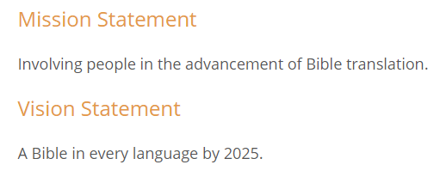
Benefits of the GL Strategy
Supports WA’s mission
and vision!
Anyone, anywhere, can work on GL if they know English and one gateway language.
Eliminates need for national translators to learn English, so translation is much faster.

Slide 10
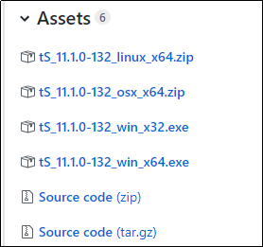
Installing translationStudio for the Desktop
In a browser, go to: https://github.com/unfoldingWord-dev/ts-desktop/releases
Click the appropriate file for your computer:
The file with linux in the name is for Linux.
The file with osx in the name is for Apple Macintosh.
The file with win_x32 in the name is for 32-bit Windows.
The file with win_x64 in the name is for 64-bit Windows.
(To determine if your Windows PC is a 32-bit or a 64-bit operating system, open the Control Panel and click System.)
Designate where you want to save the file.
After downloading, double-click the file name to start the installation..

Slide 11
Installing translationStudio for the Desktop
Click Run or Yes on any message windows.
Choose the installation language from the dropdown menu.
On the Welcome to the translationStudio Setup Wizard window, click Next.
Select the I accept the agreement radio button for the software license, and then click Next.
Select the choice to create a desktop icon, and then click Next.
Click Install.
The installation may take several minutes.
The installer installs translationStudio and Git, a version control system.
When the installation is complete, click Finish.

Slide 12

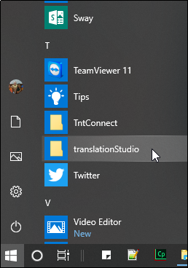
Opening translationStudio
If you chose to create a desktop icon during installation, double-click it.
If you did not choose to create a desktop icon, you can find the program on a Windows PC by:
Clicking the start icon on your computer (or pressing Windows key on your keyboard)
Finding translationStudio in the list of programs and clicking to open it

Slide 13
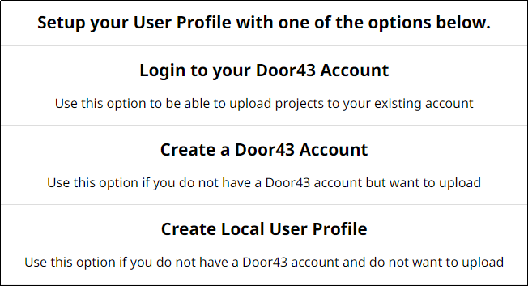
Choosing an Account Type
Door43 Account – user has full use of the program and can upload to Door43 (requires Internet connection)
Local User Profile (offline account) – user has full use of the program except for uploading to Door43 (no internet connection required)
}
Notes:
One of the first things you’ll need to do in tS is to decide which type of account to use. There are two types:
Offline Account – user has full use of the program except for uploading to Door43. NO INTERNET CONNECTION REQUIRED.
Door43 Account – user has full use of the program and can upload to Door43 (requires Internet connection.)
You can switch between these at any time, so you can do your work in an offline account, and then log in to a Door43 account when you want to upload your work.
The work is attached to the device, not to the account.
INSTRUCTOR NOTE: During a MAST event the translators may be directed to choose one of the types of accounts. As a facilitator - learn which the team lead is asking the translators to choose.
Today – choose to create an offline account.

Slide 14
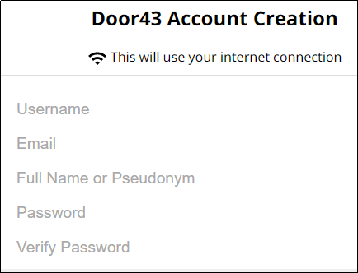
Creating a Door43 Account
Login name – no spaces (same as pseudonym if using)
Email – Used only if you forget your password
Full name (or pseudonym if you don’t want your name associated publicly with Bible work)
Password – something you can easily remember
Notes:
One of the first things you’ll need to do in tS is to decide which type of account to use. There are two types:
Offline Account – user has full use of the program except for uploading to Door43. NO INTERNET CONNECTION REQUIRED.
Door43 Account – user has full use of the program and can upload to Door43 (requires Internet connection.)
You can switch between these at any time, so you can do your work in an offline account, and then log in to a Door43 account when you want to upload your work.
The work is attached to the device, not to the account.
INSTRUCTOR NOTE: During a MAST event the translators may be directed to choose one of the types of accounts. As a facilitator - learn which the team lead is asking the translators to choose.
Today – choose to create an offline account.

Slide 15
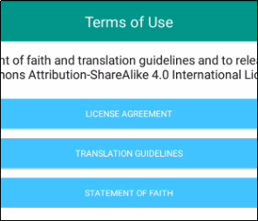
Agreeing to Terms of Use
Each translator or user of translationStudio must agree to these terms of use. Click each to read, scroll, and then click Close.
License Agreement: Explains what you are able to do with the content in the program and the content that you create
Translation Guidelines: Describes qualities of a good translation to help the translator clearly, accurately, and naturally translate the text
Statement of Faith: Lists common elements of the Christian faith
Click I AGREE.

Slide 16
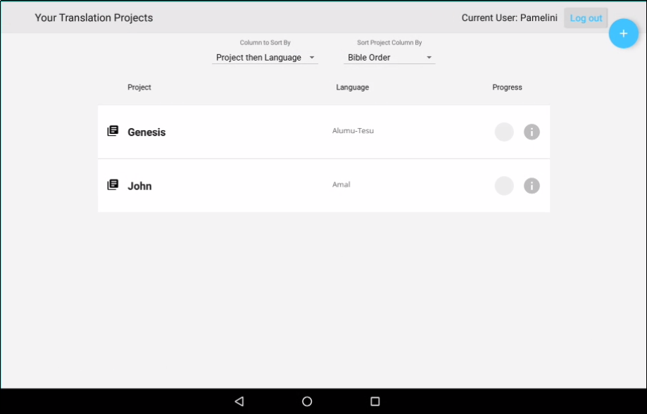
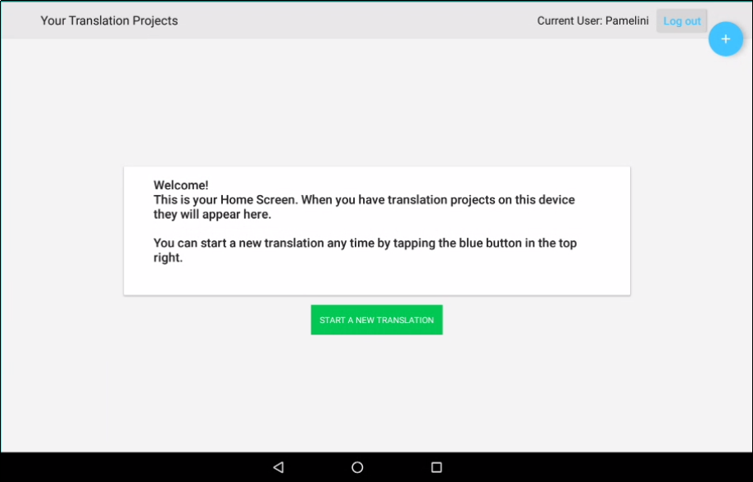
Viewing the Home Screen
, or welcomes you if you have no projects yet.
TranslationStudio opens to display the Home screen:
Lists all of your projects
User name
User name
Logout button
Logout button

Slide 17
What Did You Learn?
In this presentation you learned to:
Explain what translationStudio for the desktop is used for
Define “gateway language”
Install translationStudio for the desktop
Open the program
Agree with terms of use
Create an account
Describe the home screen
Notes:
The translationStudio-Android is a mobile app where translators can do offline translating. It can be downloaded for Android devices.
The tool named translationStudio was created by Distant Shore Media programmers so that anyone with an Android tablet can translate the Bible into their heart language.
The translationStudio tool is open source (without cost) and copyright free (content is not copyrighted against translation)
Most Bibles and resources are copyrighted – can’t use as a translation source unless receiving permission from publisher, often involving paying royalties. For example, if you translate out of a single source, it is considered plagiarism to publish. You must use at least 3 sources for it not to be plagiarism.
It contains the content that needs to be translated as well as translationHelps (Bible resources – notes, words, questions) .
Information can be shared directly from device to device and finished content can be uploaded to Door43 and digitally published.

