Slide 1
translationStudio for the Desktop
Performing Translation in Mother Tongue Projects

Slide 2

What Is This Presentation About?
In this presentation you learn to:
Implement MAST steps with translationStudio
Perform translations
Use translationStudio resources
Check and edit translations

Slide 3

As You Translate
Pray that God would help you make an easily- understandable, Scripturally-accurate translation
Translate everything that is in the source text language.
Do not add anything that that is not necessary for comprehension.
Always do your translation according to the Translation Guidelines (https://unfoldingword.org/guidelines/).
Ensure that you ascribe to the Statement of Faith (https://unfoldingword.org/faith/).
Use the translationWords (https://unfoldingword.bible/tq/), translationNotes (https://unfoldingword.org/tn/) and translationWords (https://unfoldingword.org/tw/) to help you make a better translation. These resources are also available within tS, in the Check view of the project.

Slide 4
Performing Mother Tongue Translation
When you translate from English or a Gateway Language into a mother tongue, you:
Use the MAST process
Work in a text project in translationStudio

Slide 5
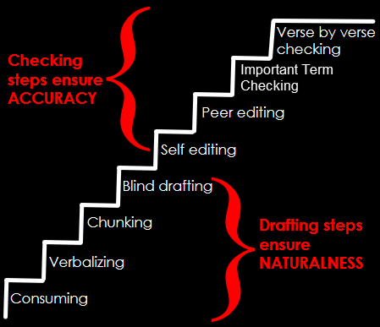
MAST and translationStudio
MAST is a method that :
Enables rapid and accurate translation of Bible text
Utilizes native speakers to do translation
Can be implemented with translationStudio
Consists of 8 steps

Slide 6

8 Steps of MAST
Consume: Read or listen to the entire chapter to be translated.

Slide 7

8 Steps of MAST
Consume: Read or listen to the entire chapter to be translated.
Verbalize: In the target language, tell another person what you read.

Slide 8

8 Steps of MAST
Consume: Read or listen to the entire chapter to be translated.
Verbalize: In the target language, tell another person what you read.
Chunk: Divide the chapter into chunks that you can retell without looking.

Slide 9

8 Steps of MAST
Consume: Read or listen to the entire chapter to be translated.
Verbalize: In the target language, tell another person what you read.
Chunk: Divide the chapter into chunks that you can retell without looking.
Blind draft: Close the source text and translate a chunk without looking at the source.

Slide 10

8 Steps of MAST
Consume: Read or listen to the entire chapter to be translated.
Verbalize: In the target language, tell another person what you read.
Chunk: Divide the chapter into chunks that you can retell without looking.
Blind draft: Close the source text and translate a chunk without looking at the source.
Self-edit: Compare translation draft with source and make corrections.

Slide 11

8 Steps of MAST
Consume: Read or listen to the entire chapter to be translated.
Verbalize: In the target language, tell another person what you read.
Chunk: Divide the chapter into chunks that you can retell without looking.
Blind draft: Close the source text and translate a chunk without looking at the source.
Self-edit: Compare translation draft with source and make corrections.
Peer edit: Have a partner compare translation draft with source and discuss corrections; translator makes any changes.

Slide 12

8 Steps of MAST
Consume: Read or listen to the entire chapter to be translated.
Verbalize: In the target language, tell another person what you read.
Chunk: Divide the chapter into chunks that you can retell without looking.
Blind draft: Close the source text and translate a chunk without looking at the source.
Self-edit: Compare translation draft with source and make corrections.
Peer edit: Have a partner compare translation draft with source and discuss corrections; translator makes any changes.
Important terms check: Check key terms to ensure they are present in the draft and translated clearly and consistently.

Slide 13

8 Steps of MAST
Consume: Read or listen to the entire chapter to be translated.
Verbalize: In the target language, tell another person what you read.
Chunk: Divide the chapter into chunks that you can retell without looking.
Blind draft: Close the source text and translate a chunk without looking at the source.
Self-edit: Compare translation draft with source and make corrections.
Peer edit: Have a partner compare translation draft with source and discuss corrections; translator makes any changes.
Important terms check: Check key terms to ensure they are present in the draft and translated clearly and consistently.
Verse-by-verse check: Back-translate the draft orally while someone checks it against a source text.

Slide 14
Implementing MAST in translationStudio
Consume
In Chapter view, read the entire chapter in the source text.
Verbalize
Do offline
Chunking has been done for you. In the Chunk view, read a chunk until you can retell it.
Chunk
Blind Draft
In Chunk view, click the “paper” behind the source text and translate the chunk; you can’t see the source while you are translating.
In Check view, compare translation draft with source and make corrections; use the resources; place the verse markers.
Self Check
In Check view, have a partner compare translation draft with source and discuss corrections; use the resources to help resolve issues.
Peer Check
Important Terms Check
Check the resources for the key terms
Verse by Verse Check
Can use the resources for in-depth checking
Notes:
Do this as a group exercise. Have them tell how they would implement each step in tS, then click to show the answer.

Slide 15
MAST Drafting Steps
The first four steps of MAST are the drafting steps.
The result of the drafting steps is a first draft of the translation.
Consume
Verbalize
Chunk
Blind Draft

Slide 16
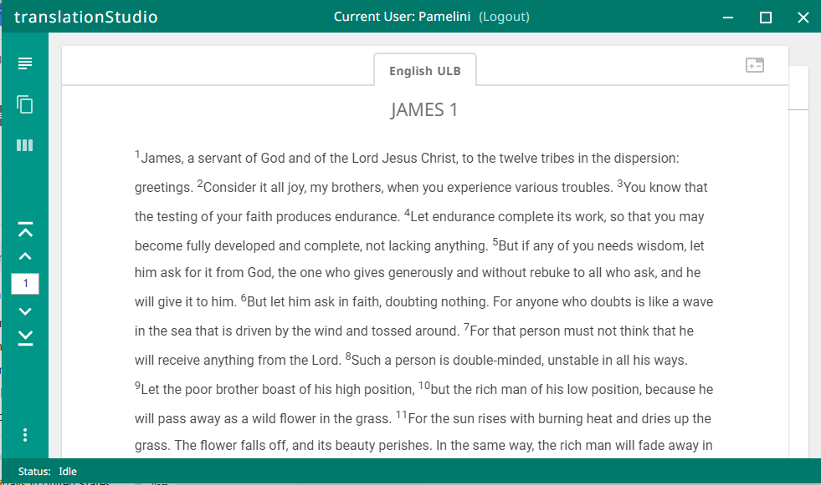
MAST Step 1: Consume
In Chapter view, read an entire chapter.
Get an overall picture of the story or passage.
Chapter view
Notes:
Demo this and then have them do it.

Slide 17
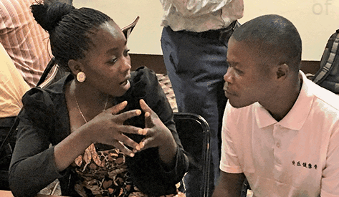
MAST Step 2: Verbalize
Do this offline.
Tell another person what you have read, or just say it out loud if no one else is available.
Notes:
Demo this and then have them do it.

Slide 18
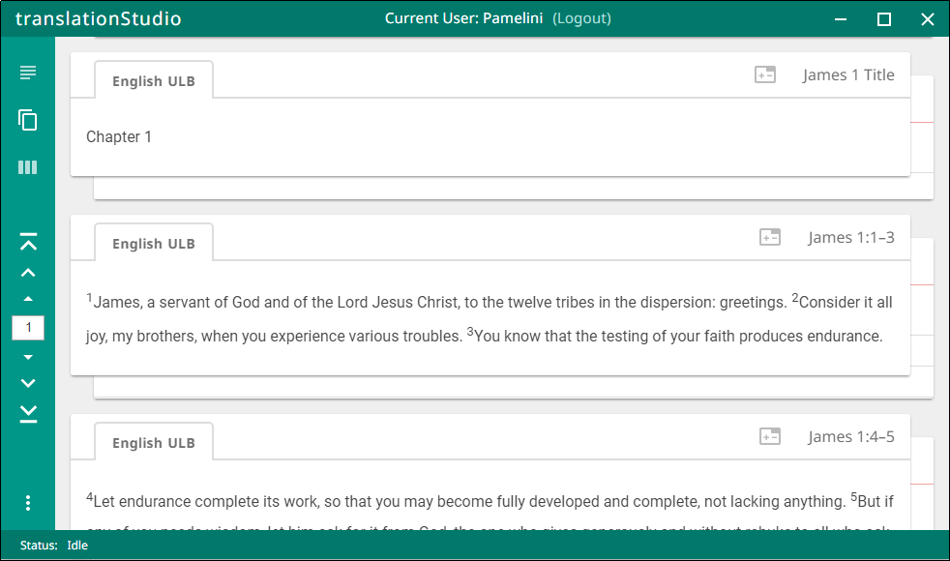
MAST Step 3: Chunk
The chunking has been done for you.
In chunk view, read a section until you think you can translate it without looking.
Chunk view
Notes:
Demo this and then have them do it.

Slide 19
MAST Step 4: Blind Draft
Click “piece of paper” behind the chunk.
Chunk view
Notes:
Demo this and then have them do it.

Slide 20
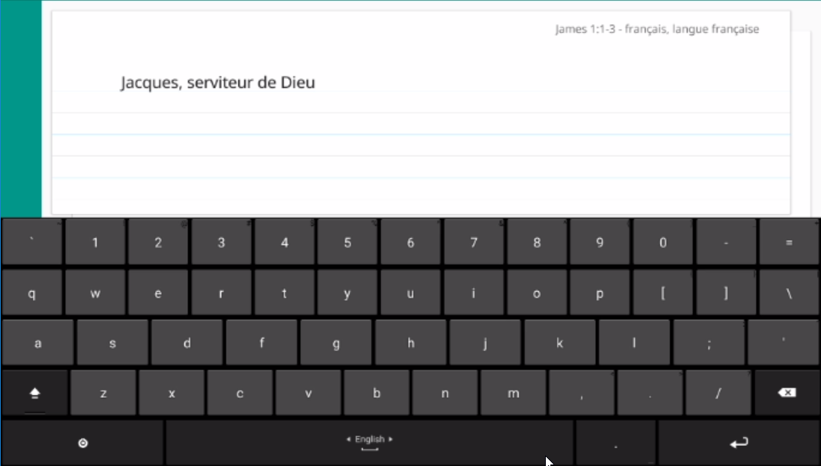
MAST Step 4: Blind Draft
Click “piece of paper behind the chunk.
Type your translation of the chunk into the “note card”.
Chunk view – translation “note card”
Notes:
Demo this and then have them do it.

Slide 21
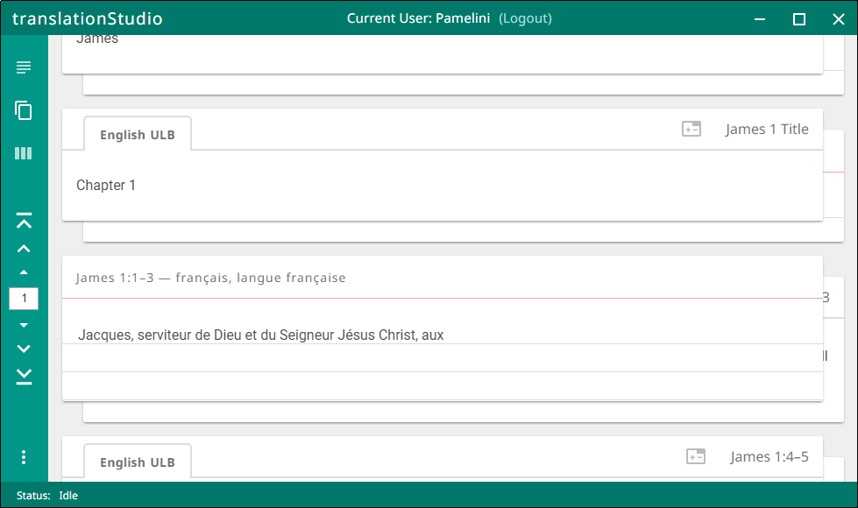
MAST Step 4: Blind Draft
Click “piece of paper behind the chunk.
Type your translation of the chunk into the “note card”.
When done, click “piece of paper” behind translated chunk to return to source.
Chunk view – translation “note card”
Notes:
Demo this and then have them do it.

Slide 22
MAST Step 4: Blind Draft
Click “piece of paper behind the chunk.
Type your translation of the chunk into the “note card”.
When done, click “piece of paper” behind translated chunk.
Translate each chunk in the chapter or passage, one by one.
Notes:
Demo this and then have them do it.

Slide 23
MAST Checking Steps
The last four steps of MAST are the checking steps.
The result of the checking steps is a level one checked translation.
Self Edit
Peer Edit
Important Terms Check
Verse by Verse Check

Slide 24
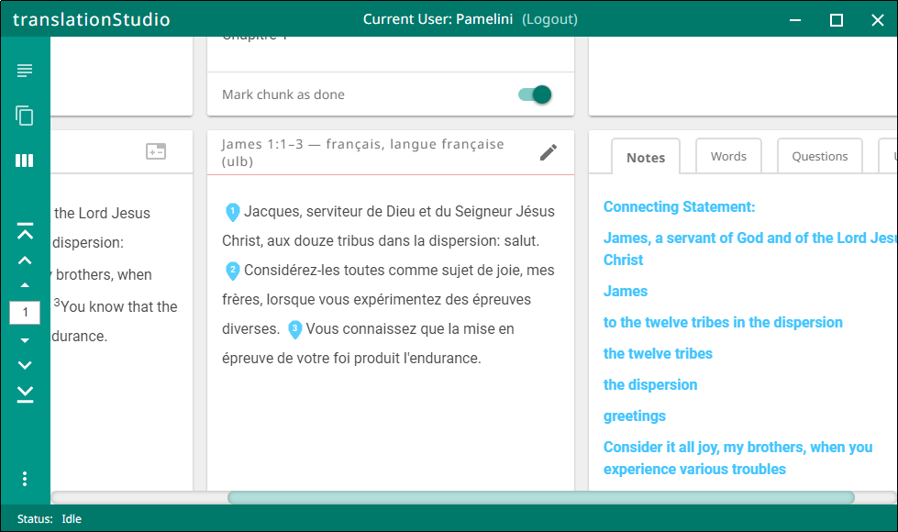
Using translationStudio Resources in Checking
During any of the checking steps, you can use translationStudio’s resources to help.
In the check view, scroll the screen to the right to show the resources.
Check view

Slide 25
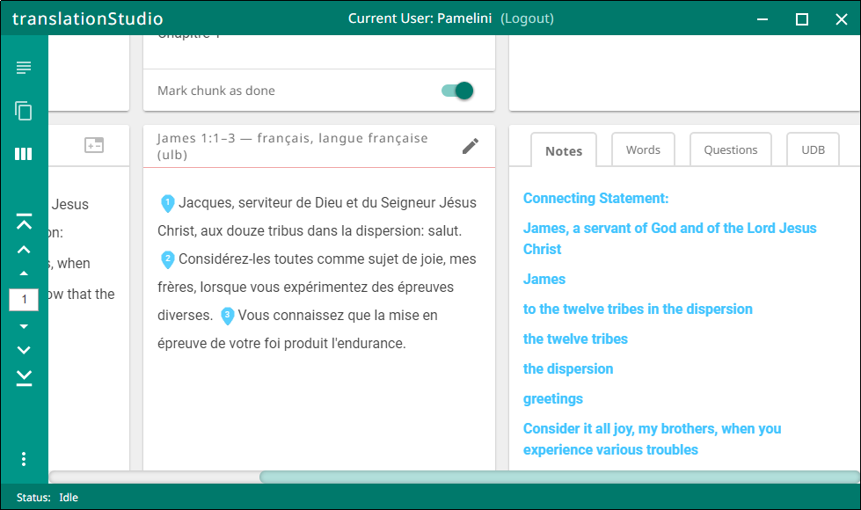
Using translationStudio Resources
Resources displayed pertain to each chunk.
Three tabs display the three types of resources:
Notes
Words
Questions
4th tab displays the UDB

Slide 26
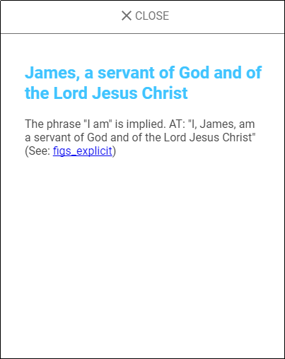
Using translationNotes
Notes show detailed information and/or translation suggestions about a word or phrase in the chunk.
Click the Notes tab.
Click a note to open it.
There may be links to additional information.
Click CLOSE to close the note.

Slide 27
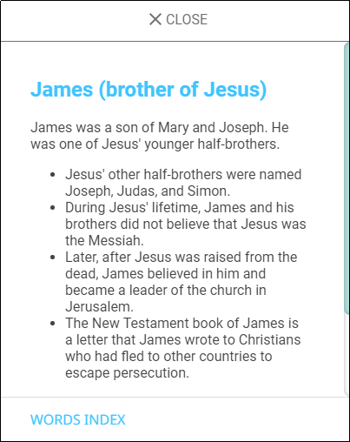
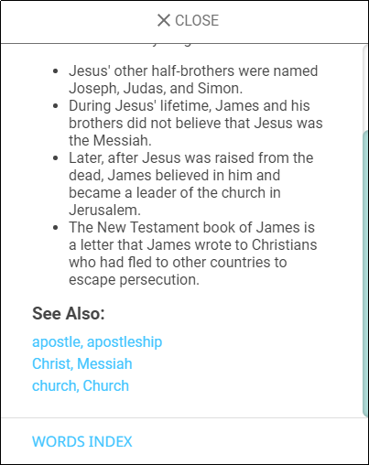
Using translationWords
Words are key words or terms in the passage with definitions, additional information, and/or translation suggestions.
Click the Words tab.
Click a word to open it.
There may be links to other words or additional information.
Click CLOSE to close the word.

Slide 28
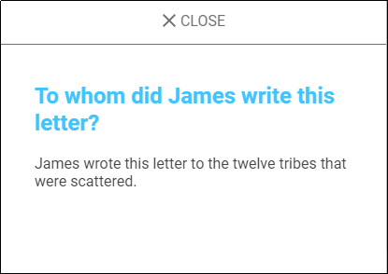
Using translationQuestions
Questions can be used in the checking steps to determine if the translation is clear and accurate.
Click the Questions tab.
Click a question to open it.
If someone cannot correctly answer the question just by reading the translation, the translation may not be clear and/or accurate.
Click CLOSE to close the question.

Slide 29
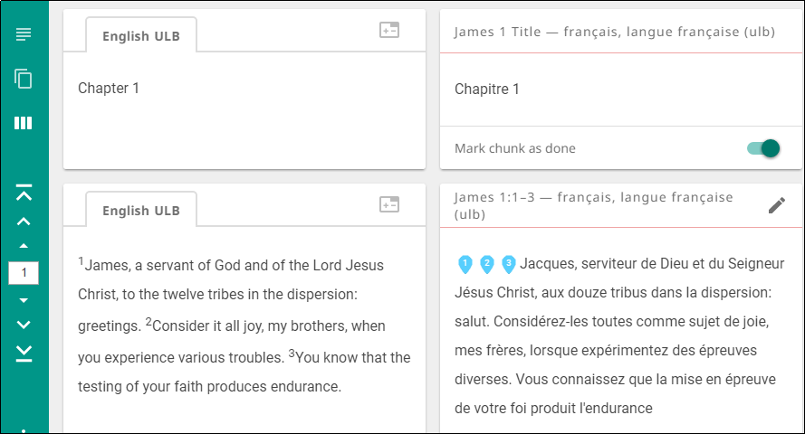
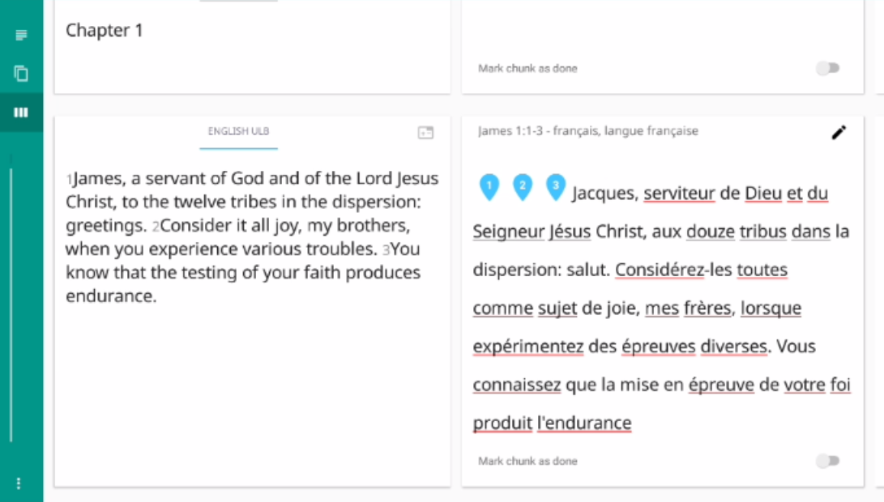
MAST Step 5: Self Edit
In check view you see the source and translation side by side.
Compare and make note of changes needed.
Click pencil icon to edit.
Check view
Missing word
Missing period
Notes:
Demo this and then have them do it.

Slide 30
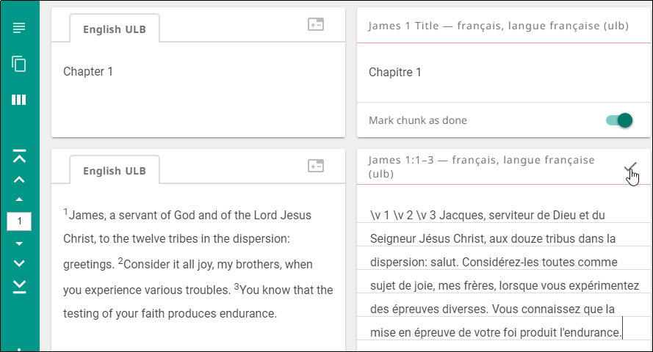
MAST Step 5: Self Edit
In check view you see the source and translation side by side.
Compare and make note of changes needed.
Click pencil icon to edit.
Make corrections.
Click check mark to save.
Notes:
Demo this and then have them do it.

Slide 31
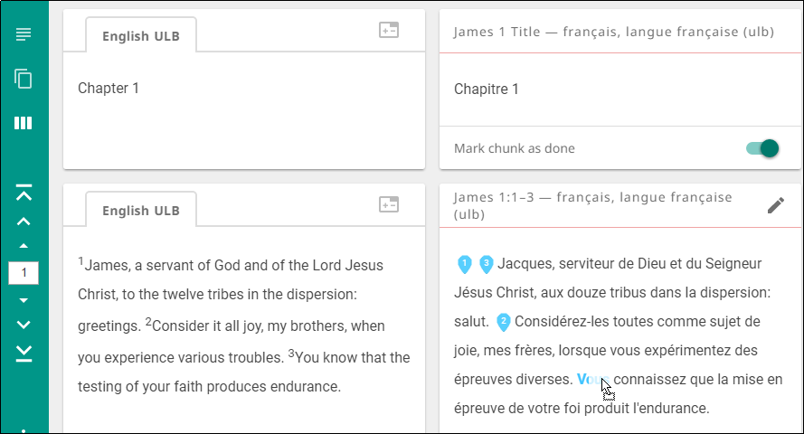
MAST Step 5: Self Edit
In check view you see the source and translation side by side.
Compare and make note of changes needed.
Click pencil icon to edit.
Make corrections.
Click check mark to save.
Drag verse markers to the first word of each verse.
Notes:
Demo this and then have them do it.

Slide 32
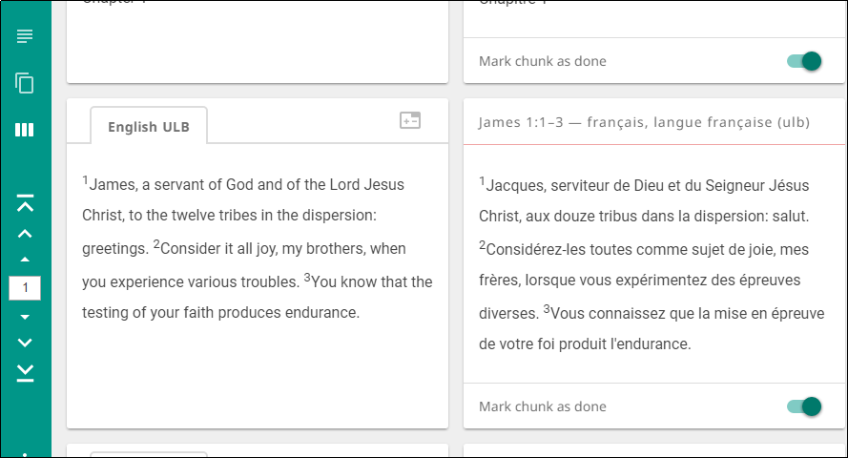
MAST Step 5: Self Edit
In check view you see the source and translation side by side.
Compare and make note of changes needed.
Click pencil icon to edit.
Make corrections.
Click check mark to save.
No more edit icon!
Drag verse markers.
When finished, mark chunk as Done.
Mark chunk complete.
Do all chunks in passage.
Notes:
Demo this and then have them do it.

Slide 33
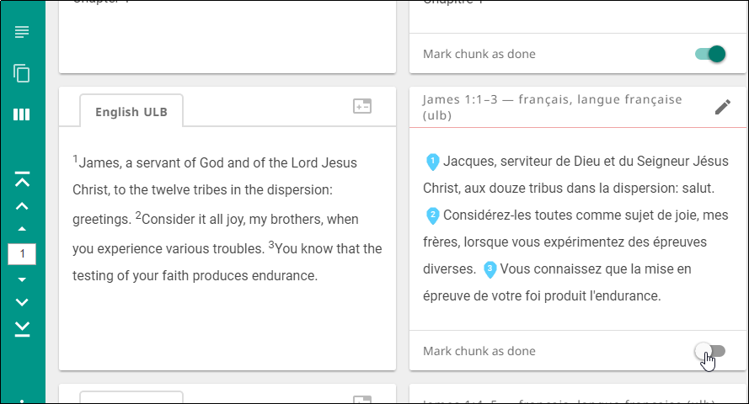
MAST Step 6: Peer Edit
In check view, have another person check your translation.
Discuss suggested corrections.
To edit a chunk, click the “Chunk Completed” toggle, and then click the pencil icon.
Notes:
Demo this and then have them do it.

Slide 34
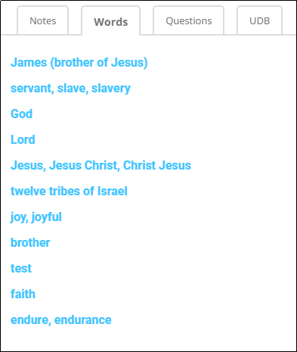
MAST Step 7: Important Terms Check
Use the translationWords resource.
Ensure that all important terms and concepts are:
Present in the translation
Translated clearly and accurately
Translated consistently
Notes:
Demo this and then have them do it.

Slide 35
MAST Step 8: Verse by Verse Check
Orally back-translate your translation into the language of the checker (may need an intermediate interpreter).
Checkers compare the meaning with source in their language.
Discuss suggested corrections; use the resources to resolve any disputes.
To edit a chunk, click the “Chunk Completed” toggle, and then click the pencil icon.
Notes:
Demo this and then have them do it.

Slide 36
What Did You Learn?
In this presentation you learned to:
Implement MAST steps with translationStudio
Perform translations
Use translationStudio resources
Check and edit translations

