Slide 1
translationStudio for Android
Changing Program Settings

Slide 2
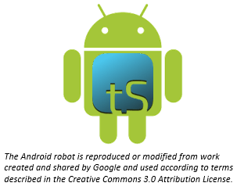
What Is This Presentation About?
In this presentation you learn to:
Open the Options menu
View program settings
Utilize settings tabs
Change program settings
Notes:
The translationStudio-Android is a mobile app where translators can do offline translating. It can be downloaded for Android devices.
The tool named translationStudio was created by Distant Shore Media programmers so that anyone with an Android tablet can translate the Bible into their heart language.
The translationStudio tool is open source (without cost) and copyright free (content is not copyrighted against translation)
Most Bibles and resources are copyrighted – can’t use as a translation source unless receiving permission from publisher, often involving paying royalties. For example, if you translate out of a single source, it is considered plagiarism to publish. You must use at least 3 sources for it not to be plagiarism.
It contains the content that needs to be translated as well as translationHelps (Bible resources – notes, words, questions) .
Information can be shared directly from device to device and finished content can be uploaded to Door43 and digitally published.

Slide 3
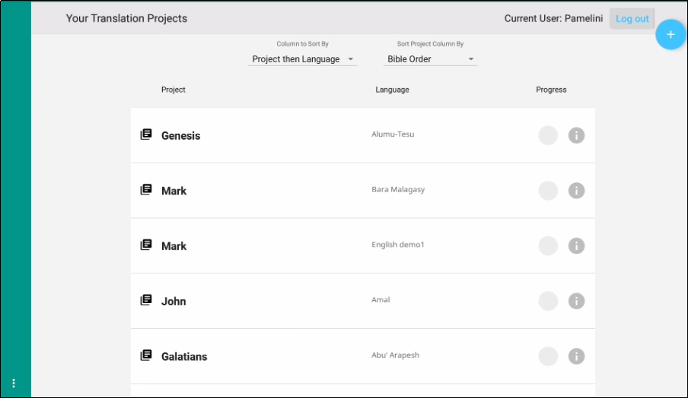
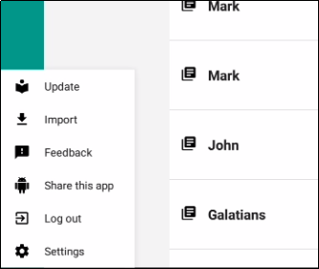
Accessing Settings
Tap 3-dot icon to access Options menu and tap Settings

Slide 4
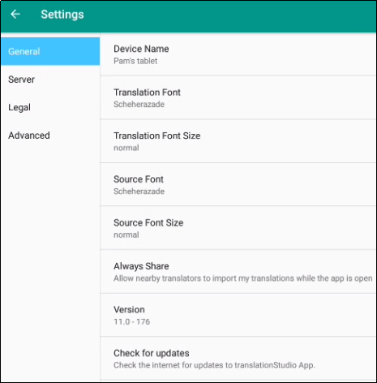
Settings Menu
General Settings
Device name – Naming the tablet is helpful when sharing with a friend.
Translation Font – The name of the chosen font is displayed.
Translation Font Size – The size of the chosen font is displayed.
Source Font – The name of the chosen font is displayed.
Source Font Size – The size of the chosen font is displayed.
Always Share – Choose whether you want the program to allow nearby translators to import my translations while the app is open.
Version – The version of the translationStudio program is displayed.
Check for updates – Tap to check for updates to translationStudio. This uses an internet connection.
Notes:
General
Device name - Tap on the words 'Device name' to name the tablet. Naming the tablet is helpful when sharing with a friend.
Translation Font - The name of the chosen font is displayed. Tap on the words 'Translation Font' to change the displayed font in the text.
Translation Font Size - The size of the chosen font is displayed. Tap on the words 'Translation Font size' to change the displayed font size in the text.
Source Font - The name of the chosen font is displayed. Tap on the words 'Source Font' to change the displayed font in the source.
Source Font Size -The size of the chosen font is displayed. Tap on the words 'Source Font Size' to change the displayed font size in the text.
Always Share – Choose whether you want the program to allow nearby translators to import my translations while the app is open.
Version - The version of the translationStudio program is displayed.
Check for updates - Tap to check for updates to translationStudio. This uses an internet connection.
Server - Keep all of the settings for the server as determined by the program. There is no need to edit any of the settings unless directed by an unfoldingWord technician.
Legal Settings - You can view important information about the program in this section of the Settings Menu.
License Agreement - read what you are able to do with the content in the program and the content that you create.
Statement of Faith - you, the user of the program, agreed to agree with this the first time the program was started. Read this to review what the Essentials Beliefs are.
Translation Guidelines - read this document to learn about the guidelines that can help the translator clearly, accurately and naturally translate the text.
Software Licenses - this file contains all the licenses for the various softwares that are used to create the translationStudio program.
Attribution - read this document to learn about the restrictions of using the derivative works and name branding.
Advanced
Backup Interval - The program sets the backup to occur every 5 minutes. This can be changed by the end user.
Logging Level and Developer Tools - The settings in this area are set by the program and should not be changed.

Slide 5
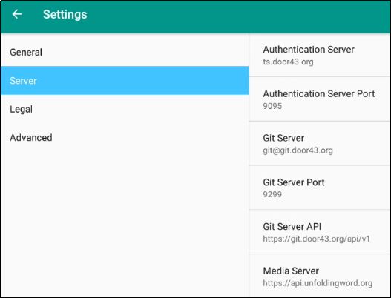
Settings Menu
Server Settings
Keep all of the settings for the server as determined by the program. There is no need to edit any of the settings unless directed by a support technician.
Notes:
General
Device name - Tap on the words 'Device name' to name the tablet. Naming the tablet is helpful when sharing with a friend.
Translation Font - The name of the chosen font is displayed. Tap on the words 'Translation Font' to change the displayed font in the text.
Translation Font Size - The size of the chosen font is displayed. Tap on the words 'Translation Font size' to change the displayed font size in the text.
Source Font - The name of the chosen font is displayed. Tap on the words 'Source Font' to change the displayed font in the source.
Source Font Size -The size of the chosen font is displayed. Tap on the words 'Source Font Size' to change the displayed font size in the text.
Always Share – Choose whether you want the program to allow nearby translators to import my translations while the app is open.
Version - The version of the translationStudio program is displayed.
Check for updates - Tap to check for updates to translationStudio. This uses an internet connection.
Server - Keep all of the settings for the server as determined by the program. There is no need to edit any of the settings unless directed by an unfoldingWord technician.
Legal Settings - You can view important information about the program in this section of the Settings Menu.
License Agreement - read what you are able to do with the content in the program and the content that you create.
Statement of Faith - you, the user of the program, agreed to agree with this the first time the program was started. Read this to review what the Essentials Beliefs are.
Translation Guidelines - read this document to learn about the guidelines that can help the translator clearly, accurately and naturally translate the text.
Software Licenses - this file contains all the licenses for the various softwares that are used to create the translationStudio program.
Attribution - read this document to learn about the restrictions of using the derivative works and name branding.
Advanced
Check Hardware Requirements – Tap the check box to have the app check for the required hardware each time it starts.
Backup Interval - The program sets the backup to occur every 5 minutes. This can be changed by the end user.
Logging Level and Developer Tools - The settings in this area are set by the program and should not be changed.

Slide 6
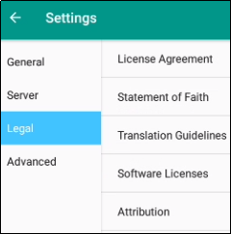
Settings Menu
Legal Settings
You can view important information about the program in this section of the Settings Menu.
License Agreement - what you are able to do with the content in the program and the content that you create.
Statement of Faith - you, the user of the program, agreed to agree with this the first time the program was started. Read this to review what the Essentials Beliefs are.
Translation Guidelines - learn about the guidelines that can help the translator clearly, accurately and naturally translate the text.
Software Licenses – show all the licenses for the various softwares that are used to create the translationStudio program.
Attribution - read this document to learn about the restrictions of using the derivative works and name branding.
Notes:
General
Device name - Tap on the words 'Device name' to name the tablet. Naming the tablet is helpful when sharing with a friend.
Translation Font - The name of the chosen font is displayed. Tap on the words 'Translation Font' to change the displayed font in the text.
Translation Font Size - The size of the chosen font is displayed. Tap on the words 'Translation Font size' to change the displayed font size in the text.
Source Font - The name of the chosen font is displayed. Tap on the words 'Source Font' to change the displayed font in the source.
Source Font Size -The size of the chosen font is displayed. Tap on the words 'Source Font Size' to change the displayed font size in the text.
Always Share – Choose whether you want the program to allow nearby translators to import my translations while the app is open.
Version - The version of the translationStudio program is displayed.
Check for updates - Tap to check for updates to translationStudio. This uses an internet connection.
Server - Keep all of the settings for the server as determined by the program. There is no need to edit any of the settings unless directed by an unfoldingWord technician.
Legal Settings - You can view important information about the program in this section of the Settings Menu.
License Agreement - read what you are able to do with the content in the program and the content that you create.
Statement of Faith - you, the user of the program, agreed to agree with this the first time the program was started. Read this to review what the Essentials Beliefs are.
Translation Guidelines - read this document to learn about the guidelines that can help the translator clearly, accurately and naturally translate the text.
Software Licenses - this file contains all the licenses for the various softwares that are used to create the translationStudio program.
Attribution - read this document to learn about the restrictions of using the derivative works and name branding.
Advanced
Check Hardware Requirements – Tap the check box to have the app check for the required hardware each time it starts.
Backup Interval - The program sets the backup to occur every 5 minutes. This can be changed by the end user.
Logging Level and Developer Tools - The settings in this area are set by the program and should not be changed.

Slide 7
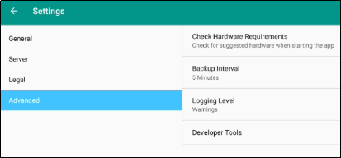
Settings Menu
Advanced Settings
Check Hardware Requirements – Choose whether to check the hardware when starting the app
Backup Interval - The program sets the backup to occur every 5 minutes. This can be changed by the end user.
Logging Level and Developer Tools - The settings in this area are set by the program and should not be changed
Notes:
General
Device name - Tap on the words 'Device name' to name the tablet. Naming the tablet is helpful when sharing with a friend.
Translation Font - The name of the chosen font is displayed. Tap on the words 'Translation Font' to change the displayed font in the text.
Translation Font Size - The size of the chosen font is displayed. Tap on the words 'Translation Font size' to change the displayed font size in the text.
Source Font - The name of the chosen font is displayed. Tap on the words 'Source Font' to change the displayed font in the source.
Source Font Size -The size of the chosen font is displayed. Tap on the words 'Source Font Size' to change the displayed font size in the text.
Always Share – Choose whether you want the program to allow nearby translators to import my translations while the app is open.
Version - The version of the translationStudio program is displayed.
Check for updates - Tap to check for updates to translationStudio. This uses an internet connection.
Server - Keep all of the settings for the server as determined by the program. There is no need to edit any of the settings unless directed by an unfoldingWord technician.
Legal Settings - You can view important information about the program in this section of the Settings Menu.
License Agreement - read what you are able to do with the content in the program and the content that you create.
Statement of Faith - you, the user of the program, agreed to agree with this the first time the program was started. Read this to review what the Essentials Beliefs are.
Translation Guidelines - read this document to learn about the guidelines that can help the translator clearly, accurately and naturally translate the text.
Software Licenses - this file contains all the licenses for the various softwares that are used to create the translationStudio program.
Attribution - read this document to learn about the restrictions of using the derivative works and name branding.
Advanced
Check Hardware Requirements – Tap the check box to have the app check for the required hardware each time it starts.
Backup Interval - The program sets the backup to occur every 5 minutes. This can be changed by the end user.
Logging Level and Developer Tools - The settings in this area are set by the program and should not be changed.

Slide 8
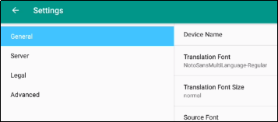
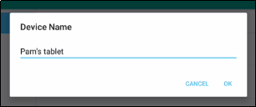
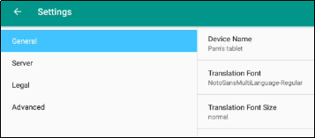
Changing the Device Name
It’s a good thing to do if sharing project with other tablets.
To change the device name in Settings:
Tap the General tab.
Tap Device Name.
Type the desired name and tap OK.
The new name is displayed.
1
2
3
4

Slide 9
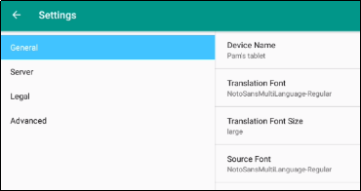
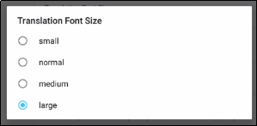
Changing the Translation Font Size
It’s a good thing to do if using language with non-Roman characters.
To change the translation font size in Settings:
Tap the General tab.
Tap Translation Font Size.
Tap the desired font size.
The new font size is displayed.
1
2
3
4

Slide 10
What Did You Learn?
In this presentation you learned to:
Open the Options menu
View program settings
Utilize settings tabs
Change program settings
Notes:
The translationStudio-Android is a mobile app where translators can do offline translating. It can be downloaded for Android devices.
The tool named translationStudio was created by Distant Shore Media programmers so that anyone with an Android tablet can translate the Bible into their heart language.
The translationStudio tool is open source (without cost) and copyright free (content is not copyrighted against translation)
Most Bibles and resources are copyrighted – can’t use as a translation source unless receiving permission from publisher, often involving paying royalties. For example, if you translate out of a single source, it is considered plagiarism to publish. You must use at least 3 sources for it not to be plagiarism.
It contains the content that needs to be translated as well as translationHelps (Bible resources – notes, words, questions) .
Information can be shared directly from device to device and finished content can be uploaded to Door43 and digitally published.

