Slide 1
translationStudio for Android
Performing Translation

Slide 2
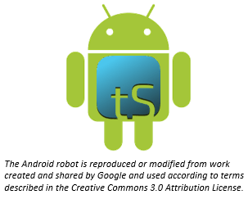
What Is This Presentation About?
In this presentation you learn to:
Implement MAST steps with translationStudio
Perform translations
Use translationStudio resources
Check and edit translations
Notes:
The translationStudio-Android is a mobile app where translators can do offline translating. It can be downloaded for Android devices.
The tool named translationStudio was created by Distant Shore Media programmers so that anyone with an Android tablet can translate the Bible into their heart language.
The translationStudio tool is open source (without cost) and copyright free (content is not copyrighted against translation)
Most Bibles and resources are copyrighted – can’t use as a translation source unless receiving permission from publisher, often involving paying royalties. For example, if you translate out of a single source, it is considered plagiarism to publish. You must use at least 3 sources for it not to be plagiarism.
It contains the content that needs to be translated as well as translationHelps (Bible resources – notes, words, questions) .
Information can be shared directly from device to device and finished content can be uploaded to Door43 and digitally published.

Slide 3
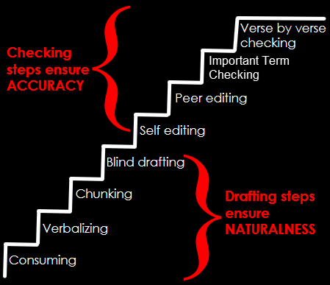
MAST and translationStudio
MAST is a method that :
Enables rapid and accurate translation of Bible text
Utilizes native speakers to do translation
Can be implemented with translationStudio
Consists of 8 steps

Slide 4

8 Steps of MAST
Consume: Read or listen to the entire chapter to be translated.

Slide 5

8 Steps of MAST
Consume: Read or listen to the entire chapter to be translated.
Verbalize: In the target language, tell another person what you read.

Slide 6

8 Steps of MAST
Consume: Read or listen to the entire chapter to be translated.
Verbalize: In the target language, tell another person what you read.
Chunk: Divide the chapter into chunks that you can retell without looking.

Slide 7

8 Steps of MAST
Consume: Read or listen to the entire chapter to be translated.
Verbalize: In the target language, tell another person what you read.
Chunk: Divide the chapter into chunks that you can retell without looking.
Blind draft: Close the source text and translate a chunk without looking at the source.

Slide 8

8 Steps of MAST
Consume: Read or listen to the entire chapter to be translated.
Verbalize: In the target language, tell another person what you read.
Chunk: Divide the chapter into chunks that you can retell without looking.
Blind draft: Close the source text and translate a chunk without looking at the source.
Self-edit: Compare translation draft with source and make corrections.

Slide 9

8 Steps of MAST
Consume: Read or listen to the entire chapter to be translated.
Verbalize: In the target language, tell another person what you read.
Chunk: Divide the chapter into chunks that you can retell without looking.
Blind draft: Close the source text and translate a chunk without looking at the source.
Self-edit: Compare translation draft with source and make corrections.
Peer edit: Have a partner compare translation draft with source and discuss corrections; translator makes any changes.

Slide 10

8 Steps of MAST
Consume: Read or listen to the entire chapter to be translated.
Verbalize: In the target language, tell another person what you read.
Chunk: Divide the chapter into chunks that you can retell without looking.
Blind draft: Close the source text and translate a chunk without looking at the source.
Self-edit: Compare translation draft with source and make corrections.
Peer edit: Have a partner compare translation draft with source and discuss corrections; translator makes any changes.
Important terms check: Check key terms to ensure they are present in the draft and translated clearly and consistently.

Slide 11

8 Steps of MAST
Consume: Read or listen to the entire chapter to be translated.
Verbalize: In the target language, tell another person what you read.
Chunk: Divide the chapter into chunks that you can retell without looking.
Blind draft: Close the source text and translate a chunk without looking at the source.
Self-edit: Compare translation draft with source and make corrections.
Peer edit: Have a partner compare translation draft with source and discuss corrections; translator makes any changes.
Important terms check: Check key terms to ensure they are present in the draft and translated clearly and consistently.
Verse-by-verse check: Back-translate the draft orally while someone checks it against a source text.

Slide 12
Implementing MAST in translationStudio
Consume
In Chapter view, read the entire chapter in the source text.
Verbalize
Do offline
Has been done for you – see the Chunk view; read a chunk until you can retell it.
Chunk
Blind Draft
Tap the “paper” behind the source text and translate the chunk; you can’t see the source while you are translating.
In Check view, compare translation draft with source and make corrections; use the resources; place the verse markers.
Self Check
In Check view, have a partner compare translation draft with source and discuss corrections; use the resources to help resolve issues.
Peer Check
Important Terms Check
Check the resources for the key terms
Verse by Verse Check
Can use the resources for in-depth checking
Notes:
Do this as a group exercise. Have them tell how they would implement each step in tS, then click to show the answer.

Slide 13
MAST Drafting Steps
The first four steps of MAST are the drafting steps.
The result of the drafting steps is a first draft of the translation.
Consume
Verbalize
Chunk
Blind Draft

Slide 14
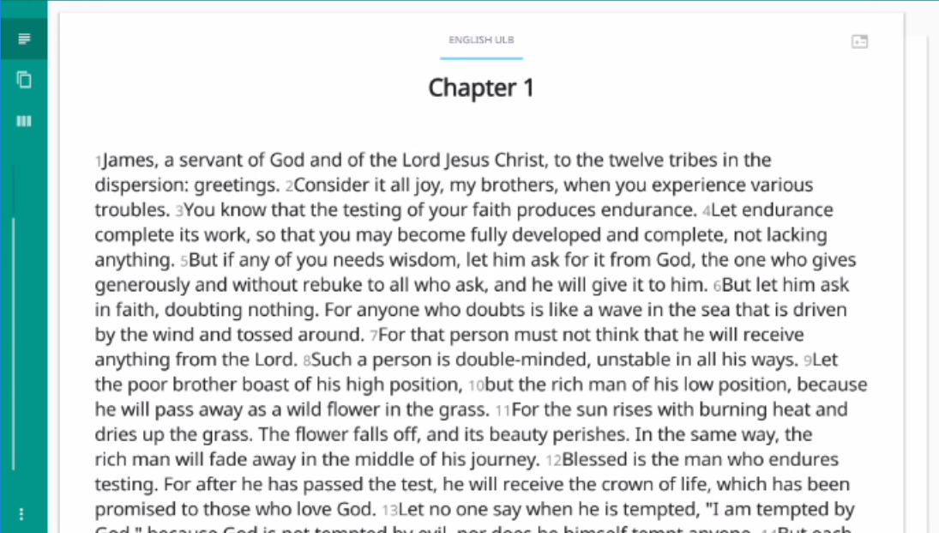
MAST Step 1: Consume
In Chapter view, read an entire chapter.
Get an overall picture of the story or passage.
Chapter view
Notes:
Demo this and then have them do it.

Slide 15
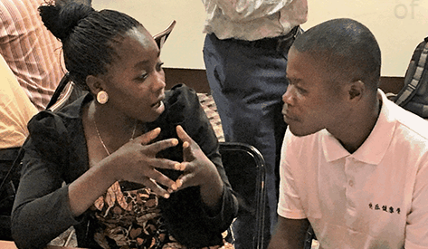
MAST Step 2: Verbalize
Do this offline.
Tell another person what you have read, or just say it out loud if no one else is available.
Notes:
Demo this and then have them do it.

Slide 16
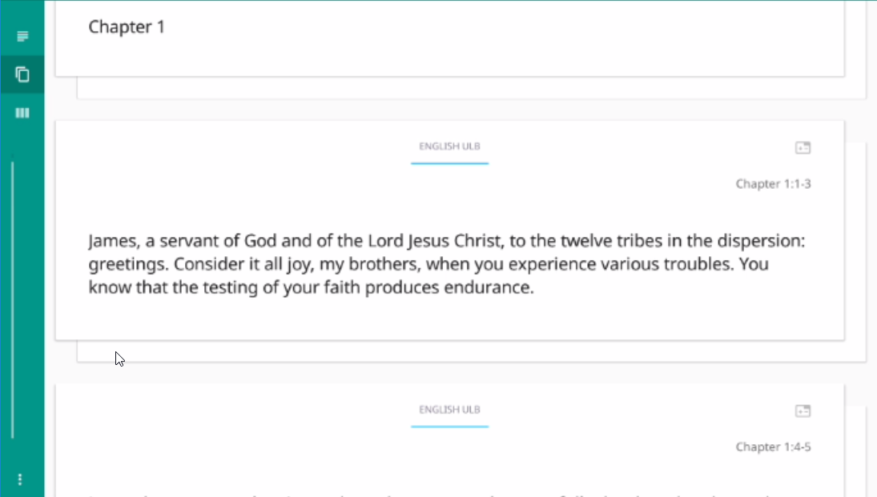
MAST Step 3: Chunk
The chunking has been done for you.
In chunk view, read a section until you think you can translate it without looking.
Chunk view
Notes:
Demo this and then have them do it.

Slide 17

MAST Step 4: Blind Draft
Tap “piece of paper behind the chunk.
Chunk view
Notes:
Demo this and then have them do it.

Slide 18
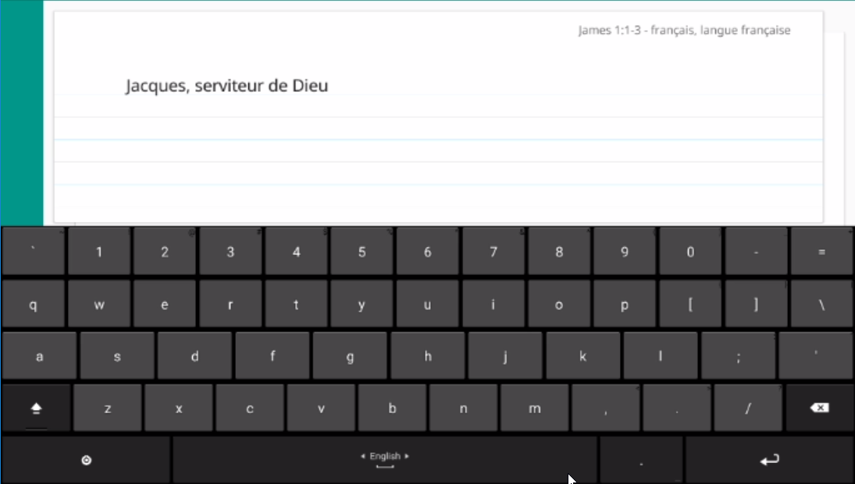
MAST Step 4: Blind Draft
Tap “piece of paper behind the chunk.
Type your translation of the chunk into the “note card”.
Chunk view – translation “note card”
Notes:
Demo this and then have them do it.

Slide 19
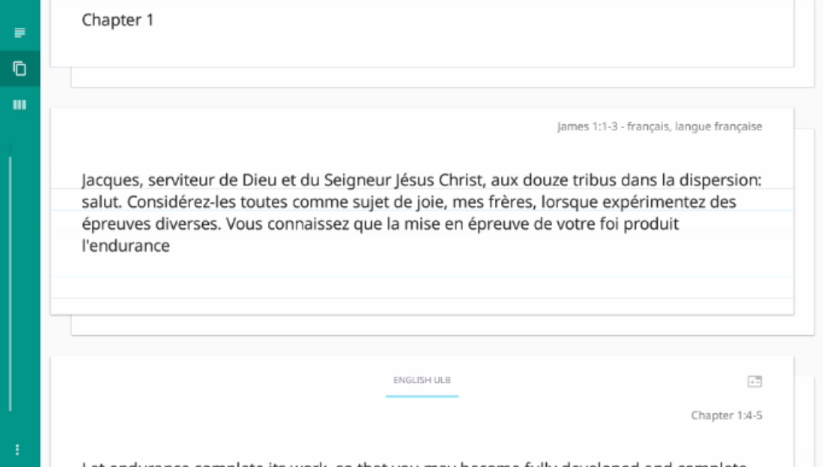
MAST Step 4: Blind Draft
Tap “piece of paper behind the chunk.
Type your translation of the chunk into the “note card”.
When done, tap “piece of paper” behind translated chunk to return to source.
Chunk view – translation “note card”
Notes:
Demo this and then have them do it.

Slide 20
MAST Step 4: Blind Draft
Tap “piece of paper behind the chunk.
Type your translation of the chunk into the “note card”.
When done, tap “piece of paper” behind translated chunk.
Translate each chunk in the chapter or passage, one by one.
Notes:
Demo this and then have them do it.

Slide 21
MAST Checking Steps
The last four steps of MAST are the checking steps.
The result of the checking steps is a level one checked translation.
Self Edit
Peer Edit
Important Terms Check
Verse by Verse Check

Slide 22
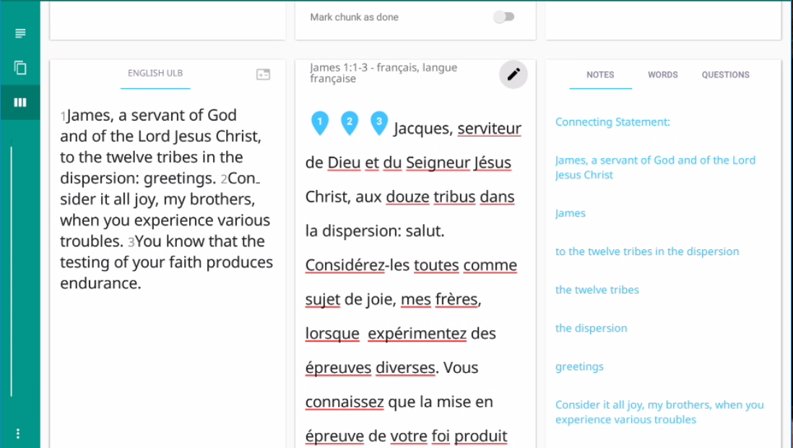
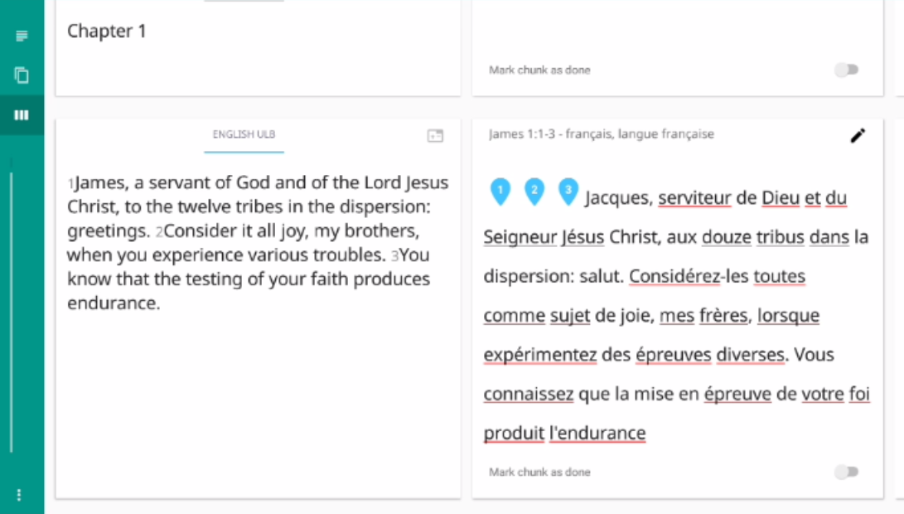
Using translationStudio Resources in Checking
During any of the checking steps, you can use translationStudio’s resources to help.
In the check view, swipe the screen left to show the resources.
Check view

Slide 23
Using translationStudio Resources
Resources displayed pertain to each chunk.
Three tabs display the three types of resources:
Notes
Words
Questions

Slide 24
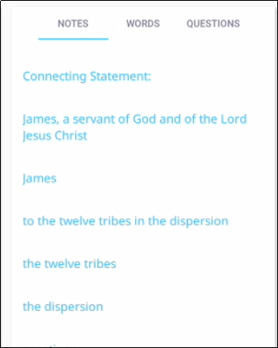
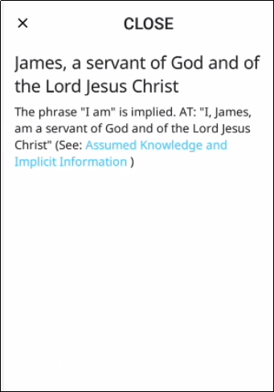
Using translationNotes
Notes show detailed information and/or translation suggestions about a word or phrase in the chunk.
Tap the Notes tab.
Tap a note to open it.
There may be links to additional information.
Tap CLOSE to close the note.

Slide 25
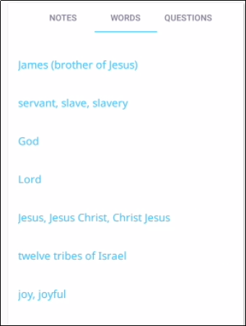
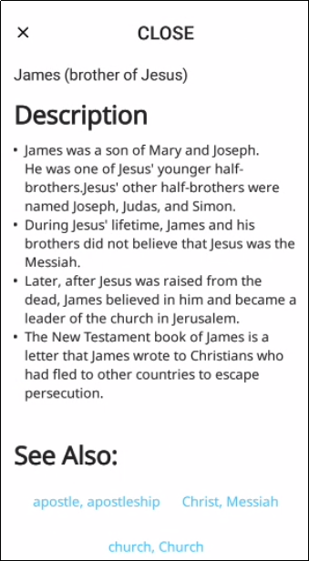
Using translationWords
Words are key words or terms in the passage with definitions, additional information, and/or translation suggestions.
Tap the Words tab.
Tap a word to open it.
There may be links to other words or additional information.
Tap CLOSE to close the word.

Slide 26
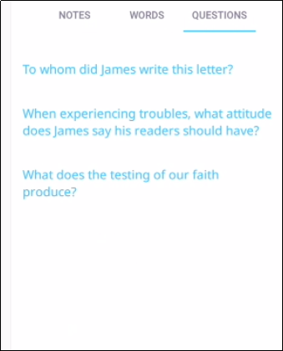
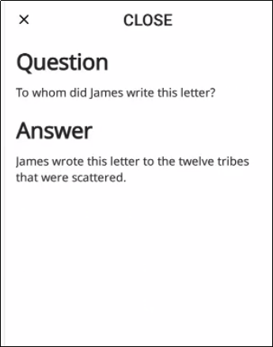
Using translationQuestions
Questions can be used in the checking steps to determine if the translation is clear and accurate.
Tap the Questions tab.
Tap a question to open it.
If someone cannot correctly answer the question just by reading the translation, the translation may not be clear and/or accurate.
Tap CLOSE to close the question.

Slide 27
MAST Step 5: Self Edit
In check view you see the source and translation side by side.
Compare and make note of changes needed.
Tap pencil icon to edit.
Check view
Missing word
Missing period
Notes:
Demo this and then have them do it.

Slide 28
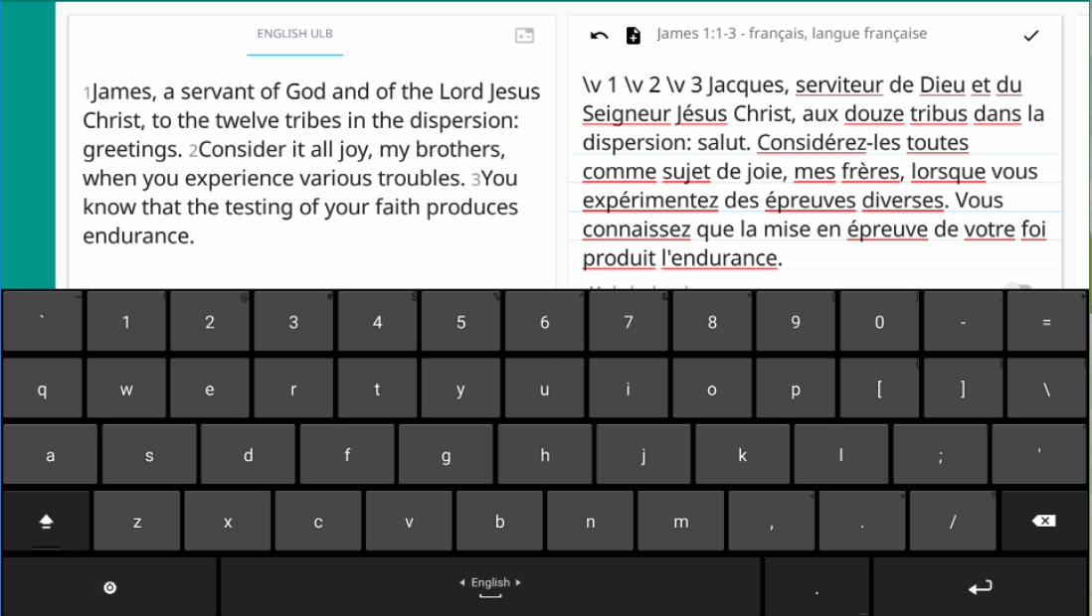
MAST Step 5: Self Edit
In check view you see the source and translation side by side.
Compare and make note of changes needed.
Tap pencil icon to edit.
Make corrections.
Tap check mark to save.
Notes:
Demo this and then have them do it.

Slide 29
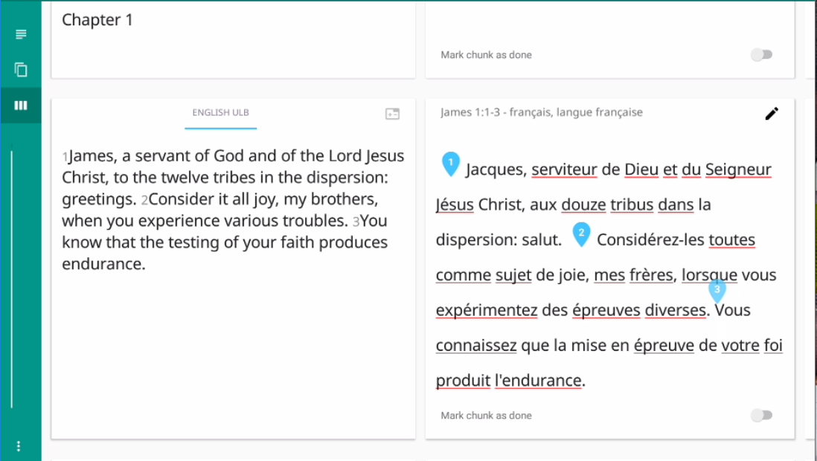
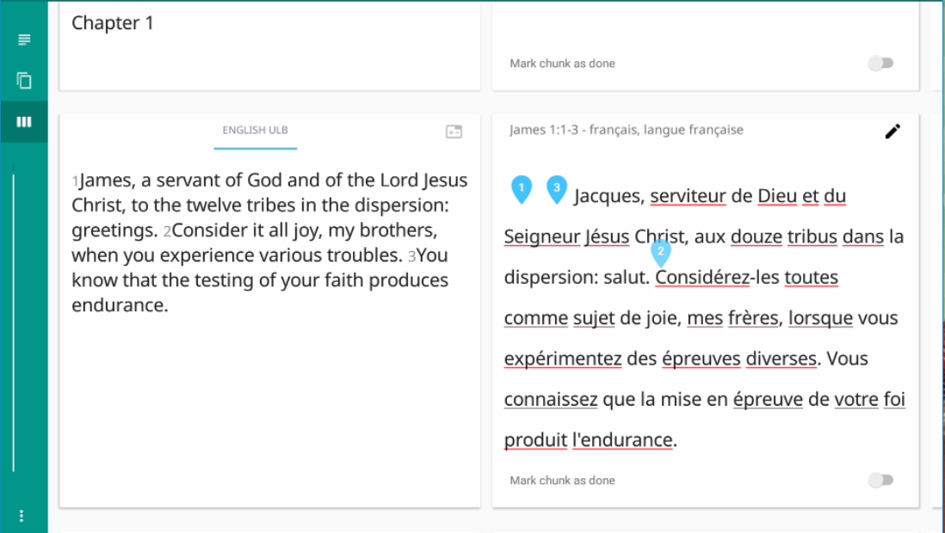
MAST Step 5: Self Edit
In check view you see the source and translation side by side.
Compare and make note of changes needed.
Tap pencil icon to edit.
Make corrections.
Tap check mark to save.
Drag verse markers.
Notes:
Demo this and then have them do it.

Slide 30
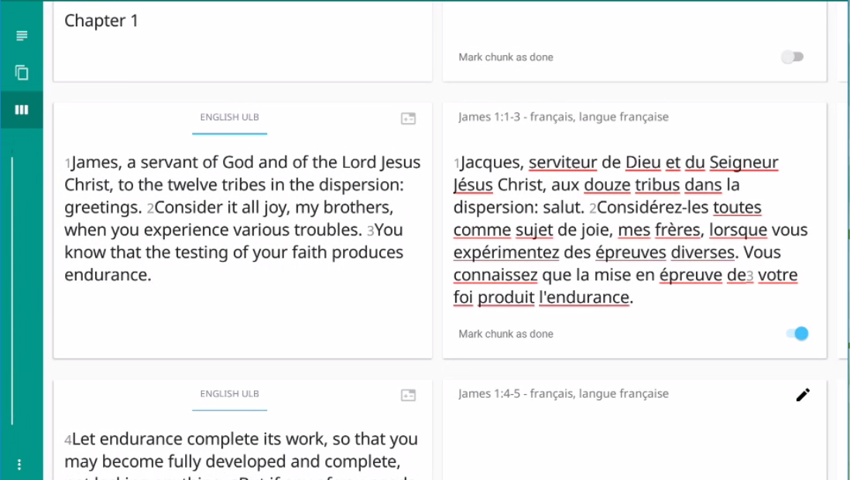
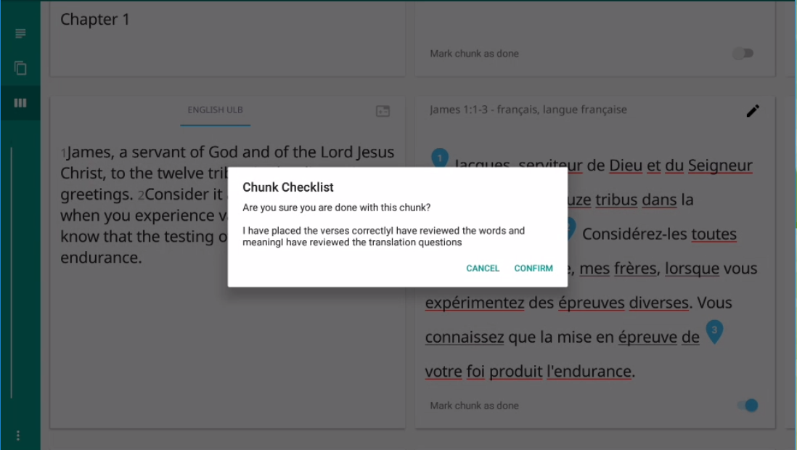
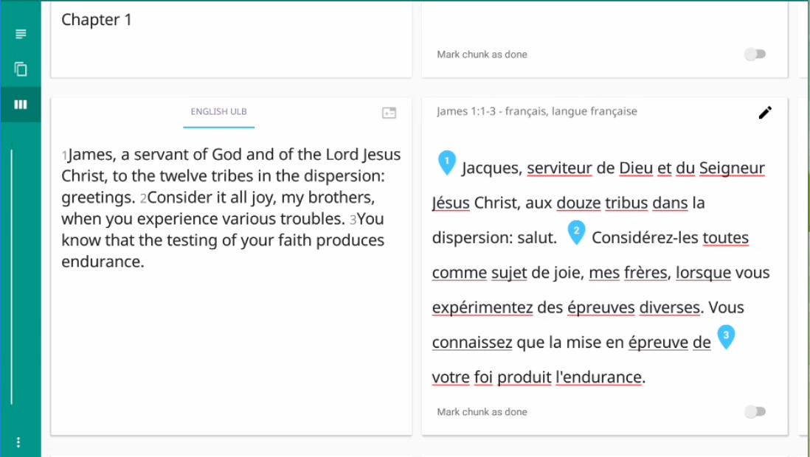
MAST Step 5: Self Edit
In check view you see the source and translation side by side.
Compare and make note of changes needed.
Tap pencil icon to edit.
Make corrections.
Tap check mark to save.
No more edit icon!
Drag verse markers.
Mark chunk complete.
Do all chunks in passage.
Notes:
Demo this and then have them do it.

Slide 31
MAST Step 6: Peer Edit
In check view, have another person check your translation.
Discuss suggested corrections.
To edit a chunk, tap the “Chunk Completed” toggle, and then tap the pencil icon.
Notes:
Demo this and then have them do it.

Slide 32
MAST Step 7: Important Terms Check
Use the translationWords resource.
Ensure that all important terms and concepts are:
Present in the translation
Translated clearly and accurately
Translated consistently
Notes:
Demo this and then have them do it.

Slide 33
MAST Step 8: Verse by Verse Check
Orally back-translate your translation into the language of the checker (may need an intermediate interpreter).
Checkers compare the meaning with source in their language.
Discuss suggested corrections; use the resources to resolve any disputes.
To edit a chunk, tap the “Chunk Completed” toggle, and then tap the pencil icon.
Notes:
Demo this and then have them do it.

Slide 34
What Did You Learn?
In this presentation you learned to:
Implement MAST steps with translationStudio
Perform translations
Use translationStudio resources
Check and edit translations
Notes:
The translationStudio-Android is a mobile app where translators can do offline translating. It can be downloaded for Android devices.
The tool named translationStudio was created by Distant Shore Media programmers so that anyone with an Android tablet can translate the Bible into their heart language.
The translationStudio tool is open source (without cost) and copyright free (content is not copyrighted against translation)
Most Bibles and resources are copyrighted – can’t use as a translation source unless receiving permission from publisher, often involving paying royalties. For example, if you translate out of a single source, it is considered plagiarism to publish. You must use at least 3 sources for it not to be plagiarism.
It contains the content that needs to be translated as well as translationHelps (Bible resources – notes, words, questions) .
Information can be shared directly from device to device and finished content can be uploaded to Door43 and digitally published.

