Slide 1
translationStudio for Android
Uploading, Exporting, and Importing a Project

Slide 2
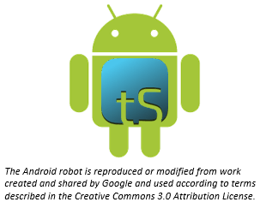
What Is This Presentation About?
In this presentation you learn to:
Explain why you should upload a project
Describe the upload options
Review a project
Upload a project to Door43
Look at a project on Door43
Delete a project from translationStudio
Import a project from Door43

Slide 3
Uploading/Exporting a Project
tS saves work to your device every 5 min. by default (can change in Settings)
Good idea to create an offline backup in case:
Your files get corrupted
Your device crashes
Enables you to:
Share your work with others
Work on a different device by importing to any device that has translationStudio installed
tS provides several ways to back up and/or share your work

Slide 4
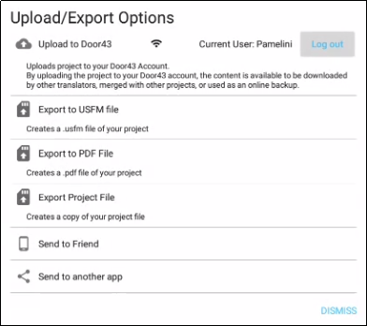
Options for Uploading/Exporting a Project
Options menu (3 dot icon) from Project Screen: Upload/Export
Upload to Door43 server (requires internet connection and login to Door43 account)
Save a USFM file on your device (can be imported)
Save a PDF file on your device
Save project on your device with tstudio extension
Allow another tablet to import
Send using Bluetooth, email, Google drive, or other app on your device
Notes:
USFM – Unified Standard Format Markers – markup language that is widely used for encoding the digital text of scripture translations.

Slide 5
Exporting/Importing a Project
Log in to Door43.
Review your project and add another contributor.
Export your project to Door43.
View the project on Door43.
Delete your project from your device (to simulate loss of the file).
Import your project from Door43.

Slide 6
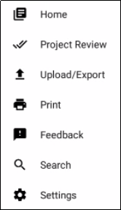
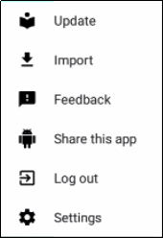

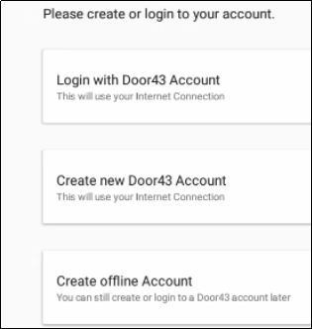
Step 1: Logging in to Door43
If you are using an offline account:
Log out of tS.
Create a Door43 account, or log into an existing one.
OR
OR

Slide 7
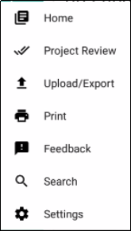
Step 2: Reviewing Your Project
Review your project and add another contributor.
Open your project
Tap Project Review on Options menu.

Slide 8
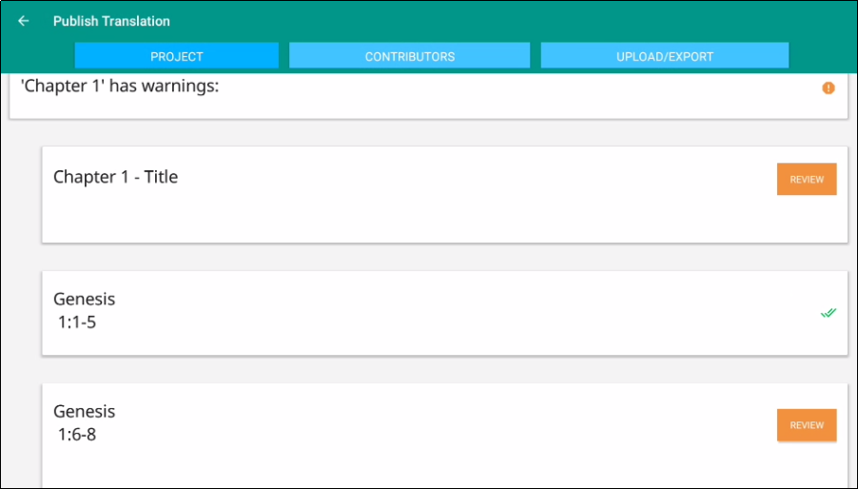
Step 2: Reviewing Your Project
Review your project and add another contributor.
Open your project
Tap Project Review on Options menu.
Tap Project.
Good idea to review before sharing or exporting
Indications of incomplete
translation chunks
Indications of incomplete
translation chunks

Slide 9
Step 2: Reviewing Your Project
Review your project and add another contributor.
Open your project
Tap Project Review on Options menu.
Tap Project.
Tap Contributors.

Slide 10

Step 2: Reviewing Your Project
Review your project and add another contributor.
Open your project
Tap Project Review on Options menu.
Tap Project.
Tap Contributors.
Tap Add Contributor.

Slide 11
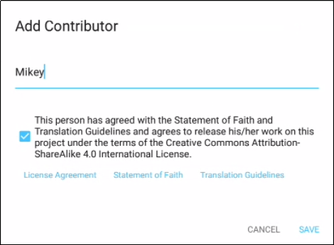

Step 2: Reviewing Your Project
Review your project and add another contributor.
Open your project
Tap Project Review on Options menu.
Tap Project.
Tap Contributors.
Tap Add Contributor.
Add contributor’s name and check the agreement box, then tap Save (you may have to tap the device’s back button to dismiss the keyboard so that you can see the Save button.)

Slide 12
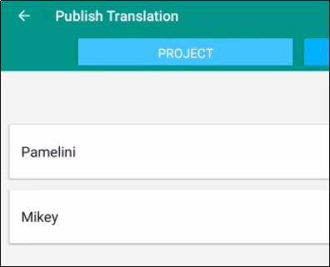
Step 2: Reviewing Your Project
Review your project and add another contributor.
Open your project
Tap Project Review on Options menu.
Tap Project.
Tap Contributors.
Tap Add Contributor.
Add contributor’s name and check the agreement box, then tap Save (you may have to tap the device’s back button to dismiss the keyboard so that you can see the Save button.)
Now you and the added contributor are both shown.

Slide 13
Step 3: Exporting the Project to Door43
Export your project to Door43.
Tap Upload/Export from either the Project Review screen or from the Options menu.
OR

Slide 14
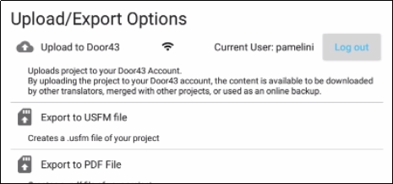
Step 3: Exporting the Project to Door43
Export your project to Door43.
Tap Upload/Export from either the Project Review screen or from the Options menu.]
Tap Upload to Door43.

Slide 15
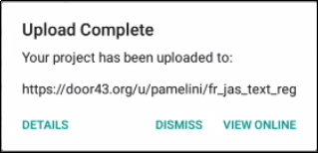
Step 3: Exporting the Project to Door43
Export your project to Door43.
Tap Upload/Export from either the Project Review screen or from the Options menu.]
Tap Upload to Door43.
On the Upload Complete message, note the upload location:
File location
0
File name: LanguageCode_BookCode_FileType_TranslationType

Slide 16
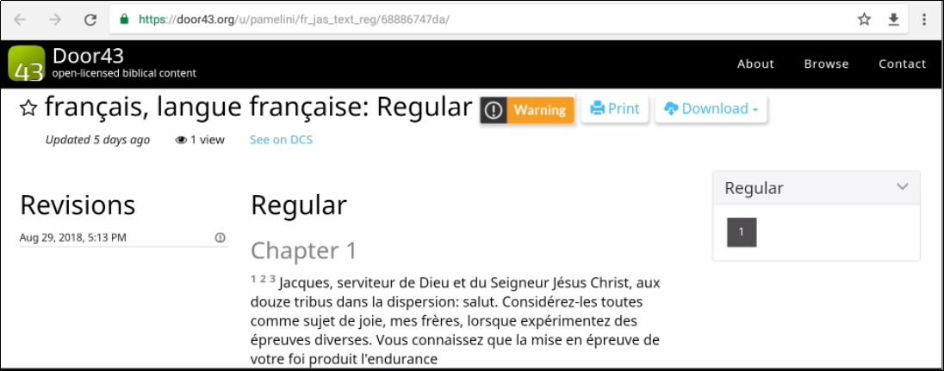
Step 4: Viewing the Project on Door43
Tap View Online.
A browser window opens to display your project on Door43.

Slide 17


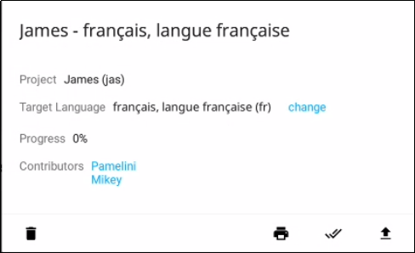
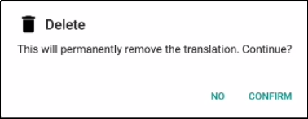
Step 5: Deleting Your Project from Your Device (to simulate loss of the file)
On the Home page, tap the “i” icon next to your project.
Tap the Delete icon (trash can), and then tap Confirm.
Print
Project
Project Review
Upload
Export

Slide 18
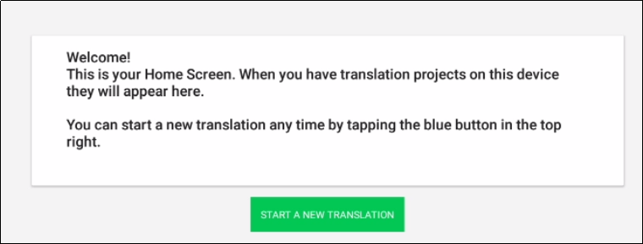
Step 5: Deleting Your Project from Your Device (to simulate loss of the file)
On the Home page, tap the “i” icon next to your project.
Tap the Delete icon (trash can), and then tap Confirm.
The project disappears from your home screen – it has been deleted from your device.

Slide 19
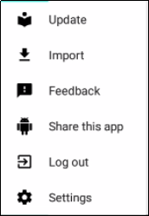
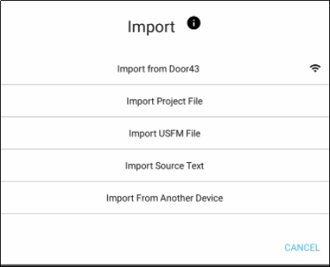
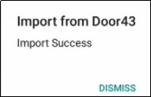
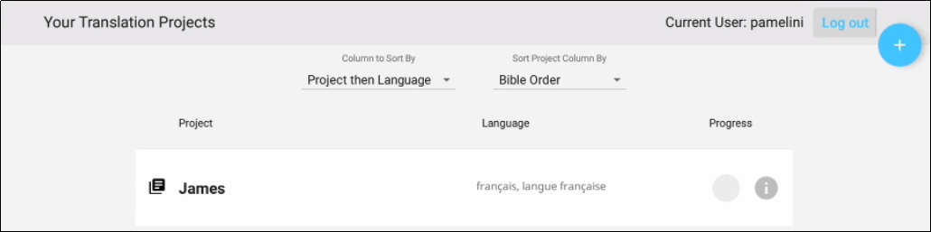
Step 6: ImportingYour Project from Door43
On the Options menu, tap Import.
Tap Import from Door 43.
Dismiss the Success message.
Your project has been imported to your device.

Slide 20
What Did You Learn?
In this presentation you learned to:
Explain why you should upload a project
Describe the upload options
Review a project
Upload a project to Door43
Look at a project on Door43
Delete a project from translationStudio
Import a project from Door43

