Slide 1
translationStudio for Android
Performing Navigation

Slide 2
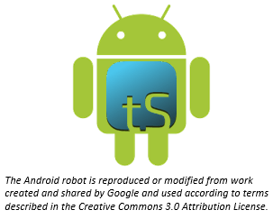
What Is This Presentation About?
In this presentation you learn to:
Explain the difference between the Home screen and a Project screen
Move between tS screens
Describe the three views of a project
Navigate within a project
Notes:
The translationStudio-Android is a mobile app where translators can do offline translating. It can be downloaded for Android devices.
The tool named translationStudio was created by Distant Shore Media programmers so that anyone with an Android tablet can translate the Bible into their heart language.
The translationStudio tool is open source (without cost) and copyright free (content is not copyrighted against translation)
Most Bibles and resources are copyrighted – can’t use as a translation source unless receiving permission from publisher, often involving paying royalties. For example, if you translate out of a single source, it is considered plagiarism to publish. You must use at least 3 sources for it not to be plagiarism.
It contains the content that needs to be translated as well as translationHelps (Bible resources – notes, words, questions) .
Information can be shared directly from device to device and finished content can be uploaded to Door43 and digitally published.

Slide 3
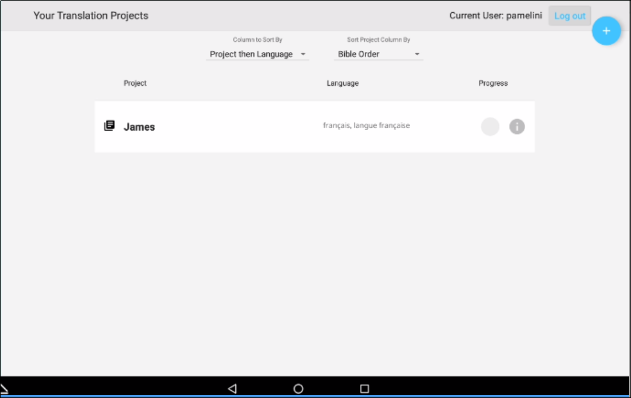
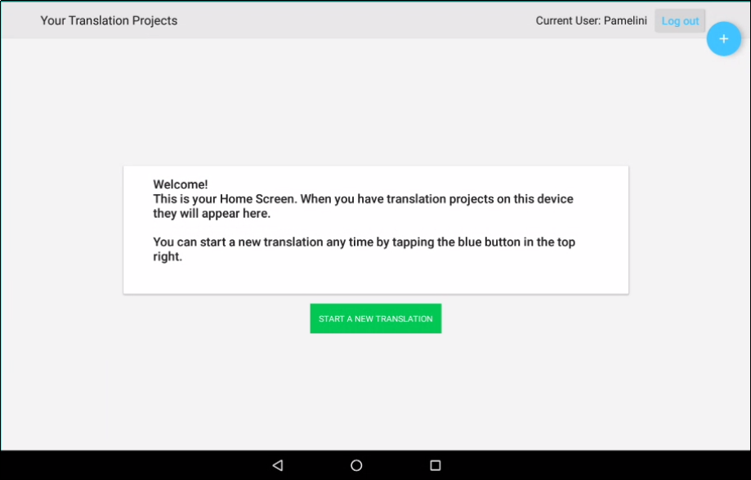
Two Types of Screens
, or welcomes you if you have no projects yet.
Home: Lists all of your projects
User name
User name
Logout button
Logout button

Slide 4


Navigating to the Project Screen
tap the project you want to open:
To navigate to the Project screen,

Slide 5
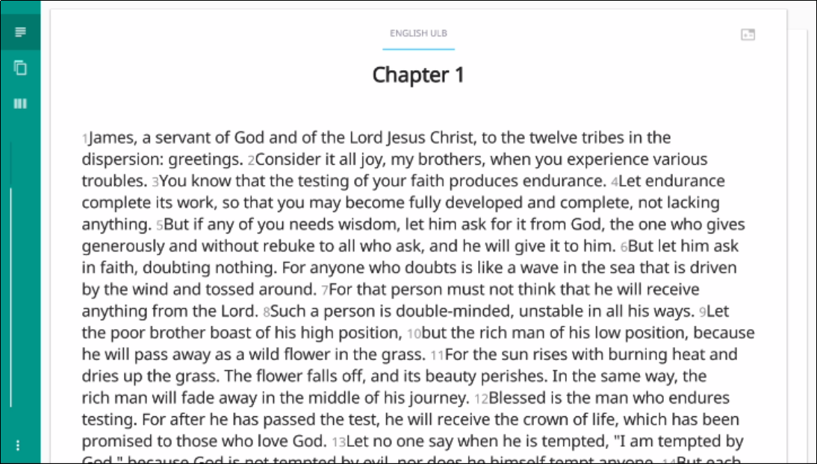
Two Types of Screens
Project: Your working area for a single project.
Has 3 different views:
Chapter
Slider moves through the text
Chapter view of the source text
Tap right to see translated text, if any

Slide 6
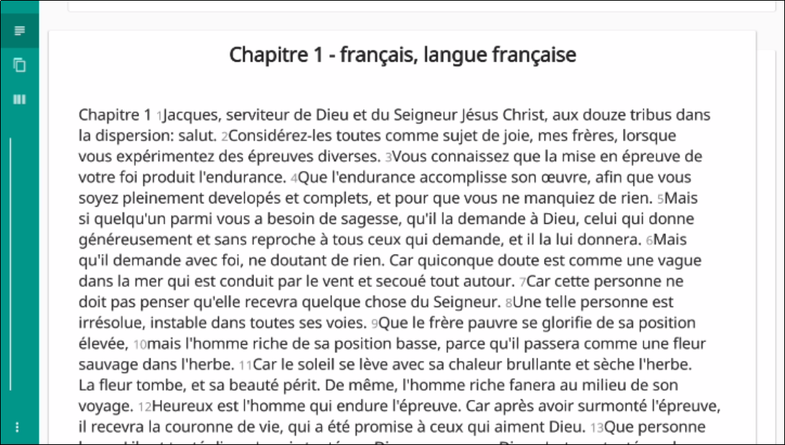
Two Types of Screens
Project: Your working area for a single project.
Has 3 different views:
Chapter
Slider moves through the text
Chapter view of the translated text
Tap right to return to source text.

Slide 7
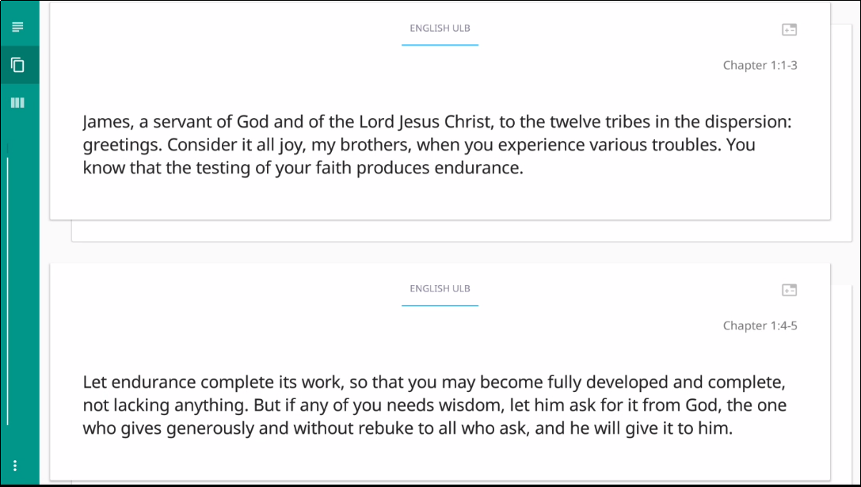
Two Types of Screens
Project: Your working area for a single project.
Has 3 different views:
Chapter
Chunk
Chunk view of the source text
Tap right to see translated text or to translate a chunk

Slide 8
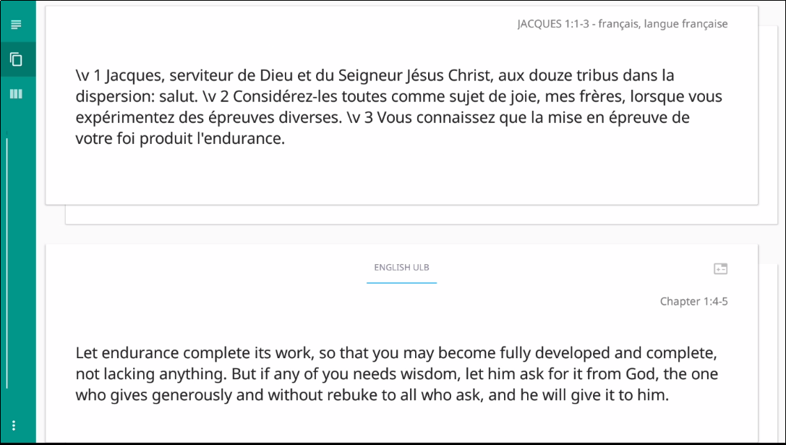
Two Types of Screens
Project: Your working area for a single project.
Has 3 different views:
Chapter
Chunk
Chunk view of the translated text
Tap right to return to source text chunk

Slide 9
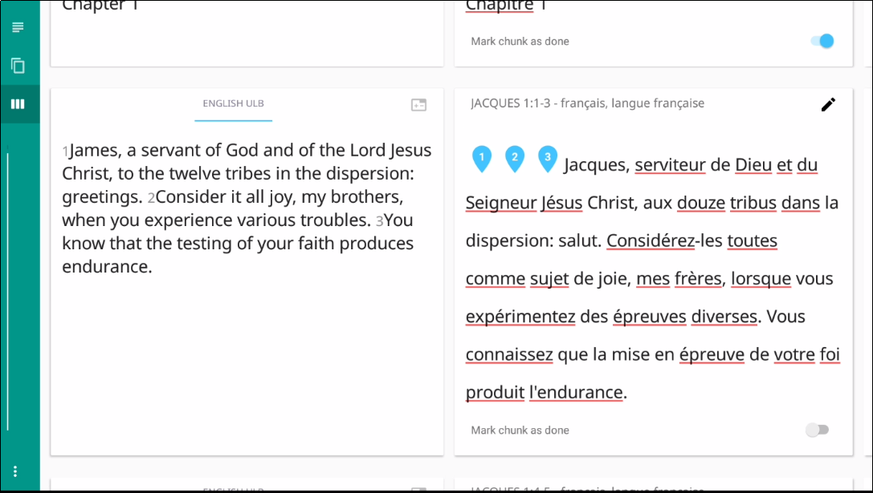
Two Types of Screens
Project: Your working area for a single project.
Has 3 different views:
Chapter
Chunk
Check
Check view with source and translation side by side
Check view with English ULB source text has helpful resources (swipe left to see)

Slide 10
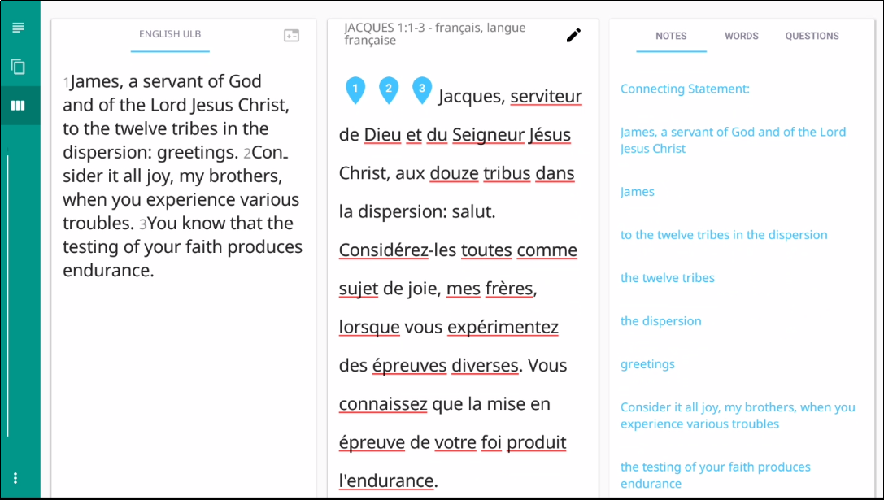
Two Types of Screens
Project: Your working area for a single project.
Has 3 different views:
Chapter
Chunk
Check
Check view with source, translation, and resources
Check view with English ULB source text has helpful resources (swipe left to see)

Slide 11
Two Types of Screens
Project: Your working area for a single project.
Has 3 different views:
Chapter
Chunk
Check
Check view with source, translation, and resources
Check view with English ULB source text has helpful resources (swipe left to see)
Edit by tapping the pencil.

Slide 12
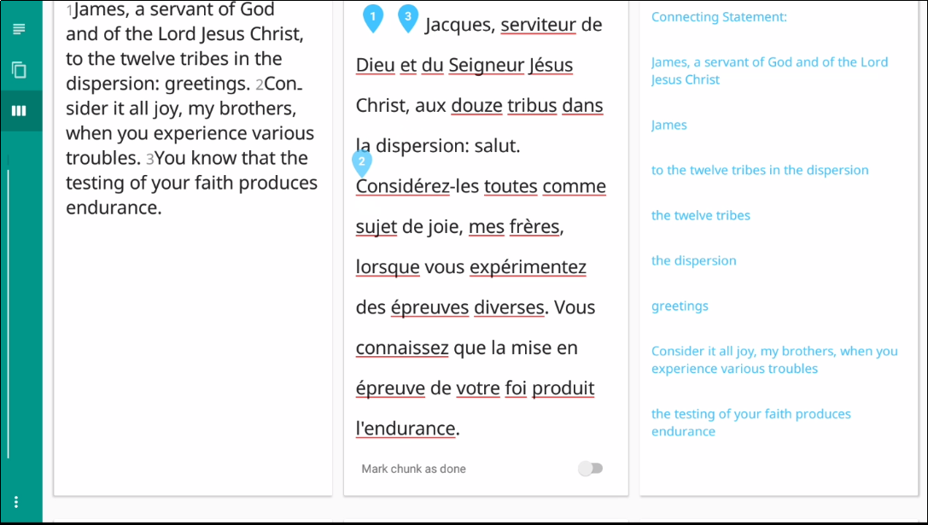
Two Types of Screens
Project: Your working area for a single project.
Has 3 different views:
Chapter
Chunk
Check
Check view with source, translation, and resources
Drag verse markers to correct locations.

Slide 13
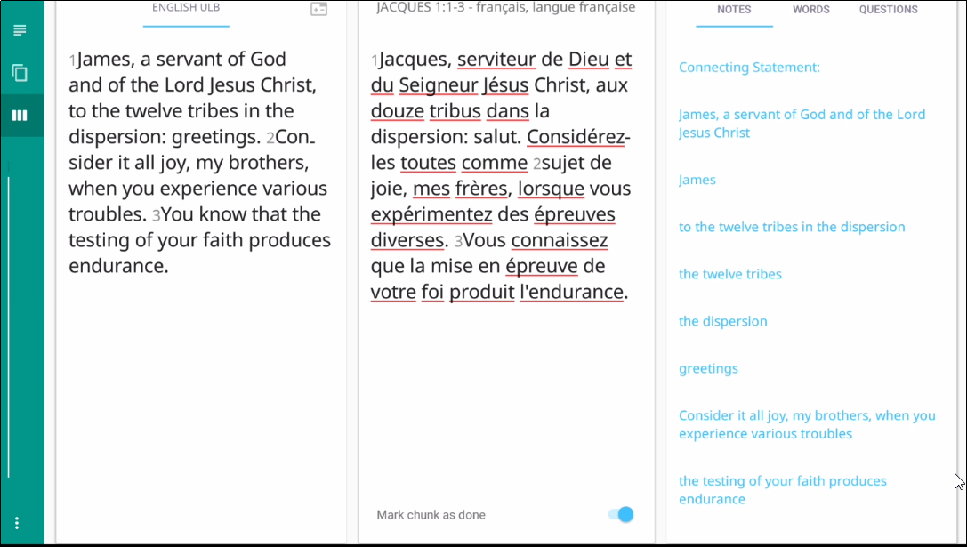
Two Types of Screens
Project: Your working area for a single project.
Has 3 different views:
Chapter
Chunk
Check
Check view with source, translation, and resources
Drag verse markers to correct locations.
Mark chunk as done

Slide 14

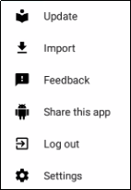
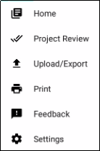
Options (3-dot) Menu
Click 3 dots in lower left (or right if holding tablet vertically):
2 different menus from the 2 different screens:
On the Home screen:
On the Project screen:
Source/target language files, tS
Return to Home screen
Project or source text
Prepare for publishing
Report a bug
Upload to Door43 or export to a file
Log out (so you can log in as a different user)
Modify program settings

Slide 15
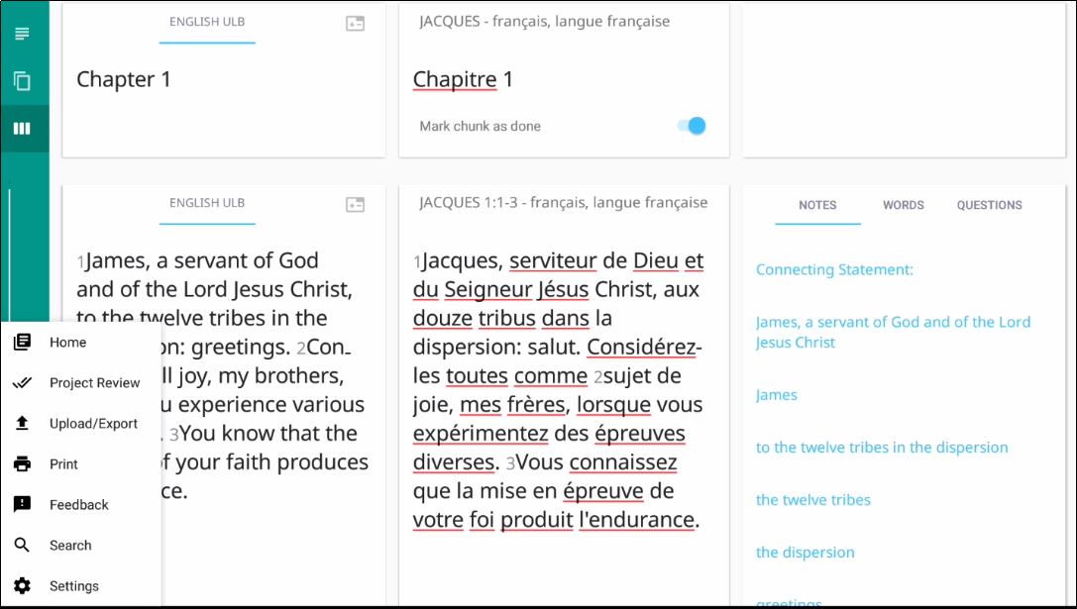
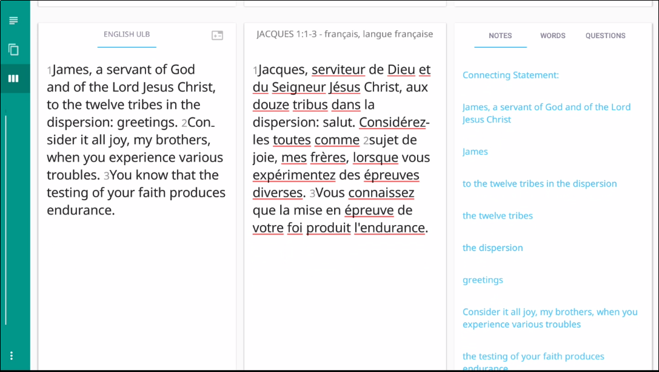
Return to the Home Screen
Tap the 3 dots to open options menu.
Tap Home.

Slide 16
What Did You Learn?
In this presentation you learned to:
List the two tS screens
Move between tS screens
Describe the three views of a project
Navigate within a project
Notes:
The translationStudio-Android is a mobile app where translators can do offline translating. It can be downloaded for Android devices.
The tool named translationStudio was created by Distant Shore Media programmers so that anyone with an Android tablet can translate the Bible into their heart language.
The translationStudio tool is open source (without cost) and copyright free (content is not copyrighted against translation)
Most Bibles and resources are copyrighted – can’t use as a translation source unless receiving permission from publisher, often involving paying royalties. For example, if you translate out of a single source, it is considered plagiarism to publish. You must use at least 3 sources for it not to be plagiarism.
It contains the content that needs to be translated as well as translationHelps (Bible resources – notes, words, questions) .
Information can be shared directly from device to device and finished content can be uploaded to Door43 and digitally published.

