Slide 1
translationStudio for Android
Starting a New Project

Slide 2
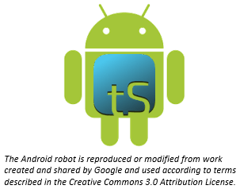
What Is This Presentation About?
In this presentation you learn to:
Explain what a translationStudio project is
Create a new translation project
Notes:
The translationStudio-Android is a mobile app where translators can do offline translating. It can be downloaded for Android devices.
The tool named translationStudio was created by Distant Shore Media programmers so that anyone with an Android tablet can translate the Bible into their heart language.
The translationStudio tool is open source (without cost) and copyright free (content is not copyrighted against translation)
Most Bibles and resources are copyrighted – can’t use as a translation source unless receiving permission from publisher, often involving paying royalties. For example, if you translate out of a single source, it is considered plagiarism to publish. You must use at least 3 sources for it not to be plagiarism.
It contains the content that needs to be translated as well as translationHelps (Bible resources – notes, words, questions) .
Information can be shared directly from device to device and finished content can be uploaded to Door43 and digitally published.

Slide 3
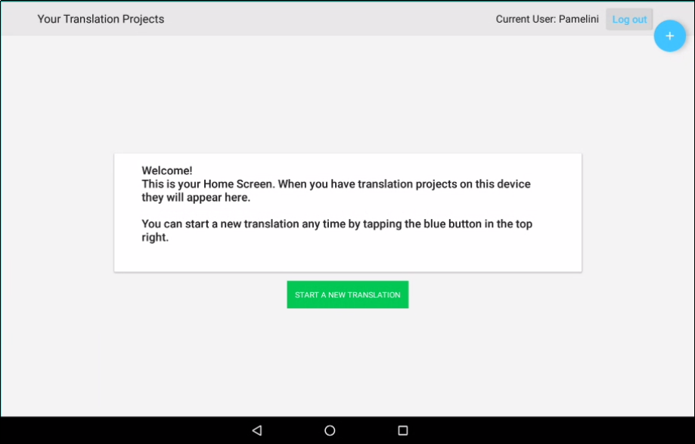
There Are Two Types of Screens
TranslationStudio opens to display the first type, the Home screen.
User name
Logout button

Slide 4
What Is a Project?
A project is a workspace to translate a specific portion of Scripture or Bible story into a target language
2 elements:
Target language: What language am I translating INTO?
Project category: What will I be translating?
Old or New Testament? Which book?
Open Bible Stories?
After creating a project, you must specify source text: What will I use to translate FROM?
Can be English or a gateway language, ULB or UDB
Can use multiple source texts

Slide 5
Steps to Create a New Project
Tap the icon to start a new project
Choose the target language (language you’re translating into) Suggestions: English Demo 1 or Demo 2
Choose the project category (what you will translate) Suggestion: Bible:NT → James
Specify a source text (language and text for the source translation) Suggestion: English (en) – Unlocked Literal Bible
These steps are shown in the next few slides.
Notes:
Demo this as you go through the next few slides and have them do the exercise on their tablet as you demo and guide them through it.

Slide 6


Starting a Project
Tap the blue plus or the green button

Slide 7
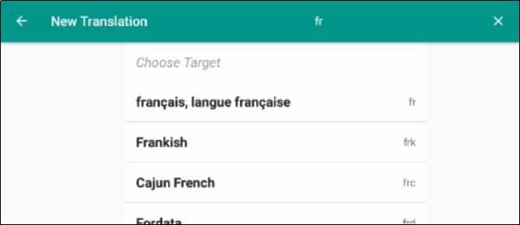

Starting a Project
Choose target language:
Tap magnifying glass
Search for language, such as “fr”
Tap desired target language
Language you’re translating into

Slide 8
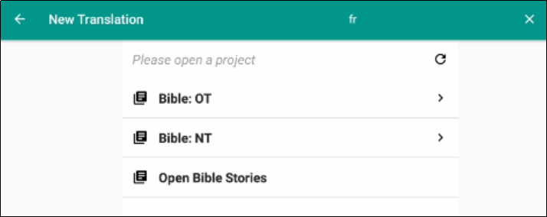
Starting a Project
Choose project category (what to translate):
Tap Bible:NT

Slide 9
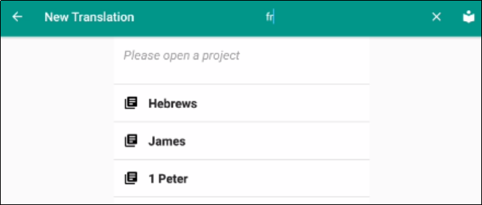
Starting a Project
Choose project category (what to translate):
Tap Bible:NT
Swipe up to scroll
Tap James

Slide 10
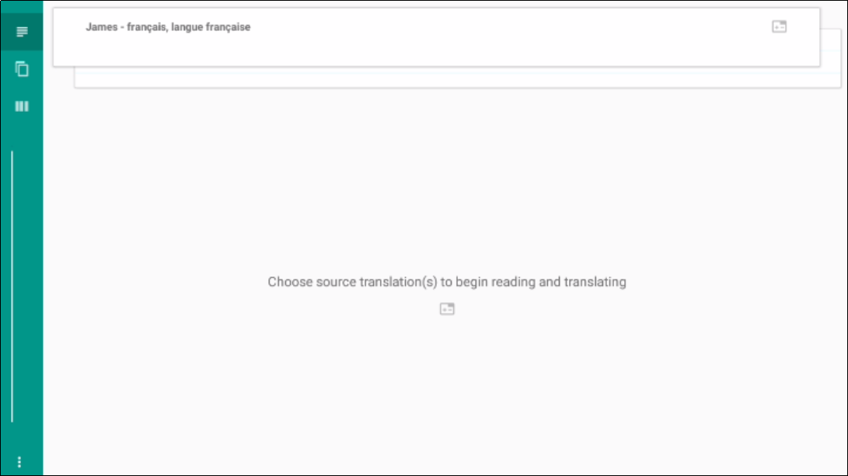
Starting a Project
Choose one or more source texts:
Project is created:
Can’t work until a source text is specified – tap anywhere in bottom part of screen.

Slide 11
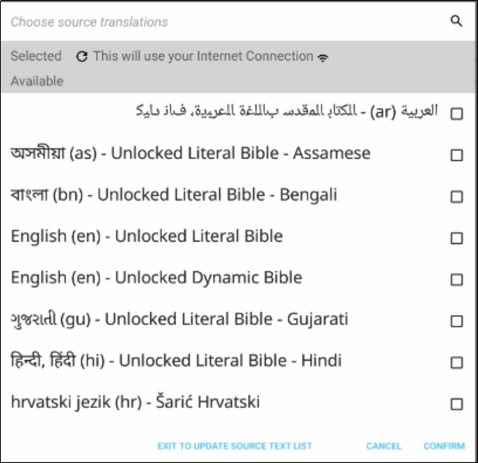
Starting a Project
Choose one or more source texts:
Project is created:
Can’t work until a source text is specified – tap anywhere in bottom part of screen.
Select one or more source texts (tap English ULB)

Slide 12
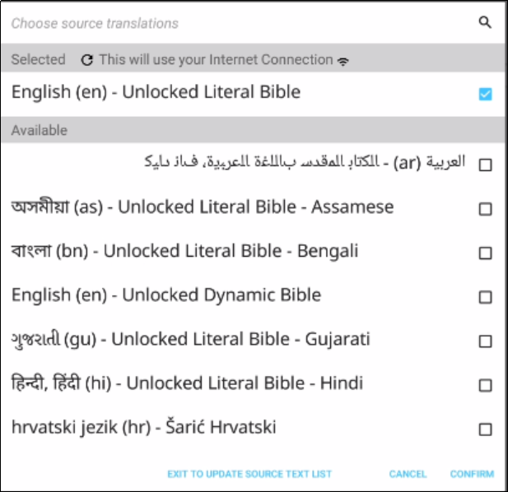
Starting a Project
Choose one or more source texts:
Project is created:
Can’t work until a source text is specified – tap anywhere in bottom part of screen.
Select one or more source texts (tap English ULB)
Tap Confirm.

Slide 13
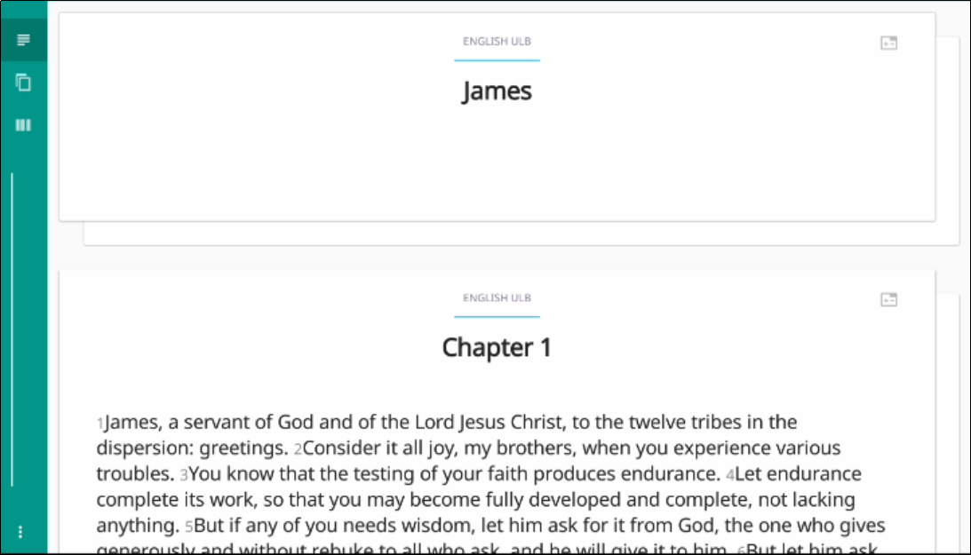
Second Type of Screen
The Project screen opens: Your working area for a single project. You are now ready to begin translating.

Slide 14
What Did You Learn?
In this presentation you learned to:
Explain what a translationStudio project is
Create a new translation project
Notes:
The translationStudio-Android is a mobile app where translators can do offline translating. It can be downloaded for Android devices.
The tool named translationStudio was created by Distant Shore Media programmers so that anyone with an Android tablet can translate the Bible into their heart language.
The translationStudio tool is open source (without cost) and copyright free (content is not copyrighted against translation)
Most Bibles and resources are copyrighted – can’t use as a translation source unless receiving permission from publisher, often involving paying royalties. For example, if you translate out of a single source, it is considered plagiarism to publish. You must use at least 3 sources for it not to be plagiarism.
It contains the content that needs to be translated as well as translationHelps (Bible resources – notes, words, questions) .
Information can be shared directly from device to device and finished content can be uploaded to Door43 and digitally published.

