Slide 1
translationStudio for the Desktop
Updating Program Elements

Slide 2

What Is This Presentation About?
In this presentation you learn to:
Update the list of available source texts
Download available source texts
Update list of available target languages
Check for updates to translationStudio

Slide 3
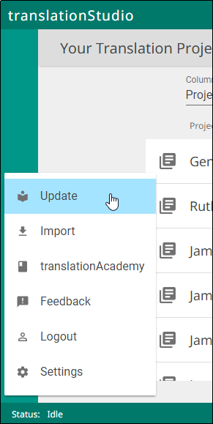
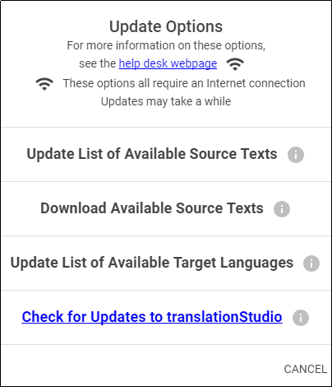
What Can I Update?
New source texts and languages are constantly being added to Door43 as work is completed.
Select Update from the options menu on Home page:
Must be connected to internet to update
Update options:
Update list of available source texts
Download available source texts
Update list of available target languages
Check for updates to translationStudio

Slide 4
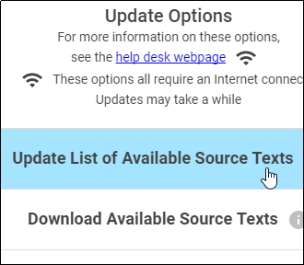
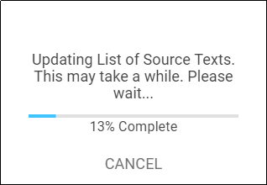
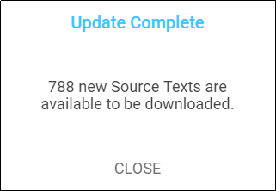
Updating Source Text Lists
Updates only the list displayed in tS, not the texts themselves
Reduces files to be downloaded
Must download source text before using
Takes several minutes
When complete, message shows number of available source texts – close that message.
You now have option to download selected texts; you can click Home in breadcrumbs to return to Home page.

Slide 5
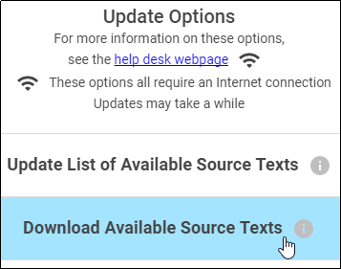
Downloading Available Source Texts
When you choose Download Available Source Texts from the Update menu, you can view the source texts in one of two ways:
By language
OR
By book

Slide 6
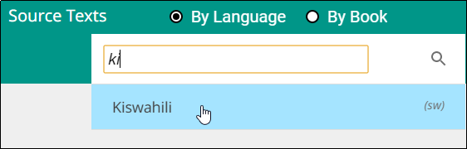
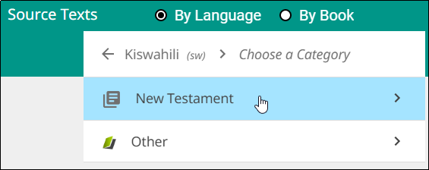
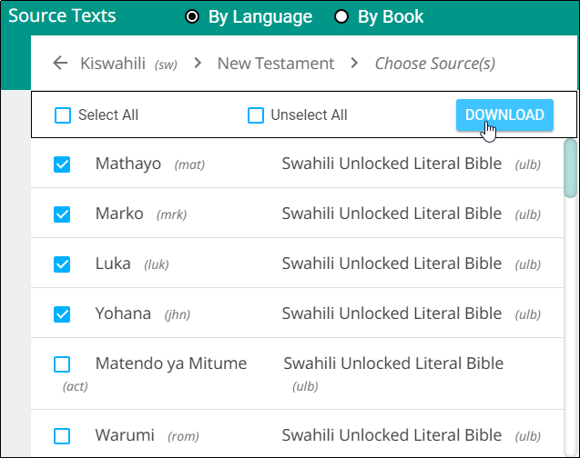
Viewing Source Texts by Language
Enables you to download multiple books at once for a single language
When you select a language, it shows only books available for that language.
To view by language:
Scroll to or search for a language.
Click a language to select it.
Select a category of available texts.
Check desired text(s) and click Download.
1
2
3
4

Slide 7
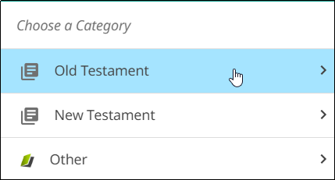
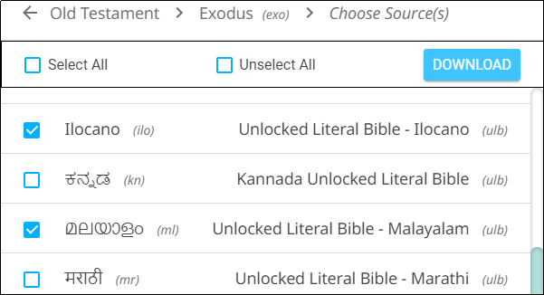
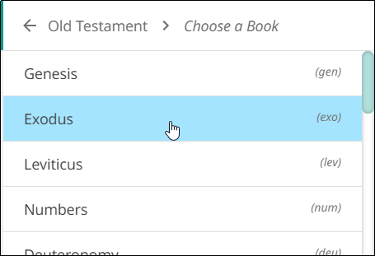
Viewing Source Texts by Book
Enables you to download multiple languages at once for a single book
When you select a book, it shows only languages available for that book.
To view by book:
Select a category.
Select a book.
Check desired language(s) and click Download.
1
3
2

Slide 8
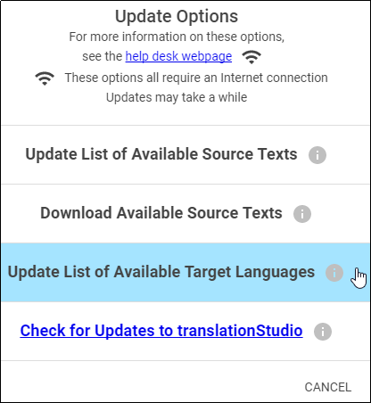
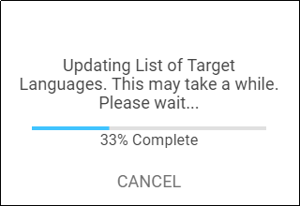
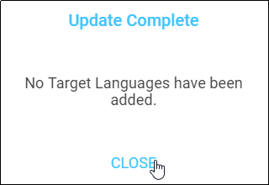
Updating the List of Available Target Languages
To update list of all target languages available in the program:
Select Update List of Available Target Languages from the Update menu.
A progress window opens.
At the end of the process a message shows how many new target languages were added. Click CLOSE to return to the Home screen.
1
2
3

Slide 9
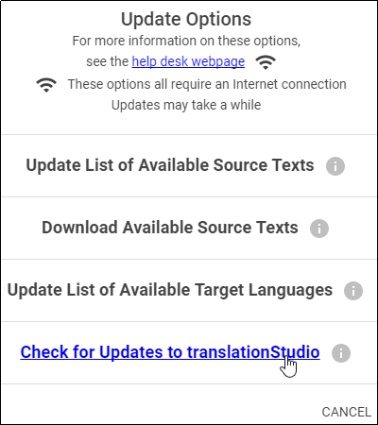
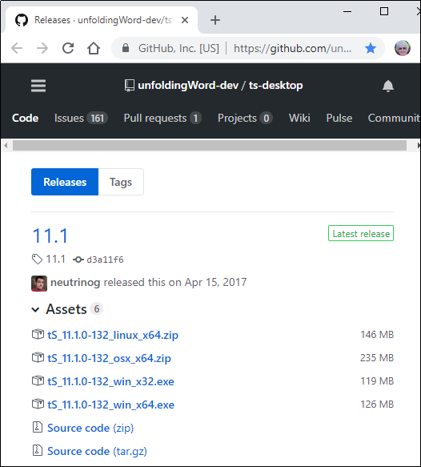
Checking for Updates to translationStudio
Click the Check for Updates to translationStudio link from the Update menu
The web page with the latest translationStudio-Desktop release opens.
If there is a release later than the version you have installed, you may wish to update:
Close translationStudio.
See Installation for instructions to install.

Slide 10
What Did You Learn?
In this presentation you learned to:
Update the list of available source texts
Download available source texts
Update list of available target languages
Check for updates to translationStudio

