Slide 1
translationStudio for Android
Getting Started

Slide 2
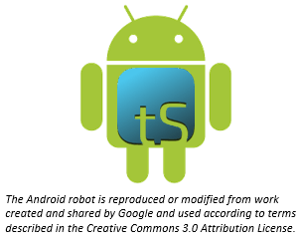
What Is This Presentation About?
In this presentation you learn to:
Install translationStudio for Android
Open the program
Agree with terms of use
Create an account
Understand the home screen
Notes:
The translationStudio-Android is a mobile app where translators can do offline translating. It can be downloaded for Android devices.
The tool named translationStudio was created by Distant Shore Media programmers so that anyone with an Android tablet can translate the Bible into their heart language.
The translationStudio tool is open source (without cost) and copyright free (content is not copyrighted against translation)
Most Bibles and resources are copyrighted – can’t use as a translation source unless receiving permission from publisher, often involving paying royalties. For example, if you translate out of a single source, it is considered plagiarism to publish. You must use at least 3 sources for it not to be plagiarism.
It contains the content that needs to be translated as well as translationHelps (Bible resources – notes, words, questions) .
Information can be shared directly from device to device and finished content can be uploaded to Door43 and digitally published.

Slide 3
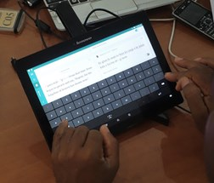
What Is translationStudio for Android?
Mobile app for translating Bible & resources
Created by Distant Shores Media
Open source
Contains:
Content to be translated
Translation helps
Work can be shared and published
Notes:
The translationStudio-Android is a mobile app where translators can do offline translating. It can be downloaded for Android devices.
The tool named translationStudio was created by Distant Shore Media programmers so that anyone with an Android tablet can translate the Bible into their heart language.
The translationStudio tool is open source (without cost) and copyright free (content is not copyrighted against translation)
Most Bibles and resources are copyrighted – can’t use as a translation source unless receiving permission from publisher, often involving paying royalties. For example, if you translate out of a single source, it is considered plagiarism to publish. You must use at least 3 sources for it not to be plagiarism.
It contains the content that needs to be translated as well as translationHelps (Bible resources – notes, words, questions) .
Information can be shared directly from device to device and finished content can be uploaded to Door43 and digitally published.

Slide 4

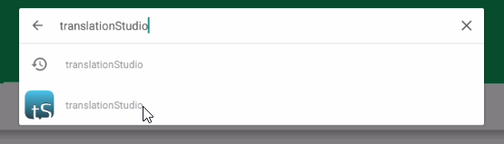
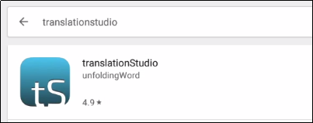

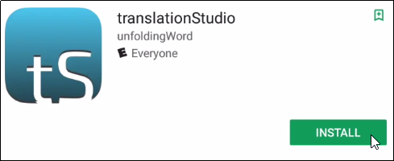
Installing translationStudio for Android
Tap Play Store.
Type translationStudio in search bar.
Tap translationStudio.
Tap Install.

Slide 5
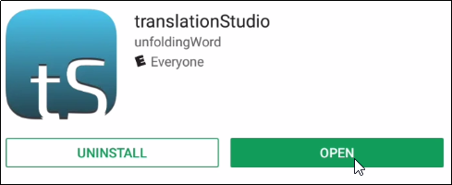

Opening translationStudio
From Google Play:
After installing tS, click Open.
From your tablet screen:
Tap the tS icon.

Slide 6
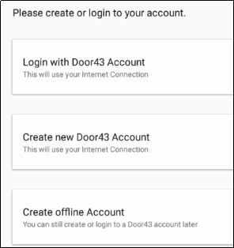
Choosing an Account Type
}
Door43 Account – user has full use of the program and can upload to Door43 (requires Internet connection.)
Offline Account – user has full use of the program except for uploading to Door43.
Notes:
One of the first things you’ll need to do in tS is to decide which type of account to use. There are two types:
Offline Account – user has full use of the program except for uploading to Door43. NO INTERNET CONNECTION REQUIRED.
Door43 Account – user has full use of the program and can upload to Door43 (requires Internet connection.)
You can switch between these at any time, so you can do your work in an offline account, and then log in to a Door43 account when you want to upload your work.
The work is attached to the device, not to the account.
INSTRUCTOR NOTE: During a MAST event the translators may be directed to choose one of the types of accounts. As a facilitator - learn which the team lead is asking the translators to choose.
Today – choose to create an offline account.

Slide 7
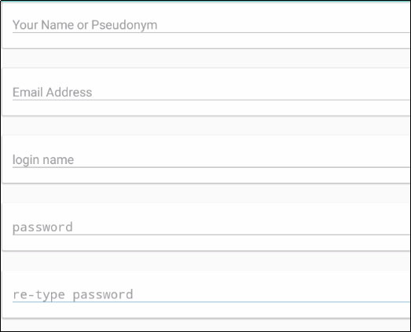
Creating a Door43 Account
Full name (or pseudonym if you don’t want your name associated publicly with Bible work)
Email – Used only if you forget your password
Login name – no spaces (same as pseudonym if using)
Password – something you can easily remember
Notes:
One of the first things you’ll need to do in tS is to decide which type of account to use. There are two types:
Offline Account – user has full use of the program except for uploading to Door43. NO INTERNET CONNECTION REQUIRED.
Door43 Account – user has full use of the program and can upload to Door43 (requires Internet connection.)
You can switch between these at any time, so you can do your work in an offline account, and then log in to a Door43 account when you want to upload your work.
The work is attached to the device, not to the account.
INSTRUCTOR NOTE: During a MAST event the translators may be directed to choose one of the types of accounts. As a facilitator - learn which the team lead is asking the translators to choose.
Today – choose to create an offline account.

Slide 8
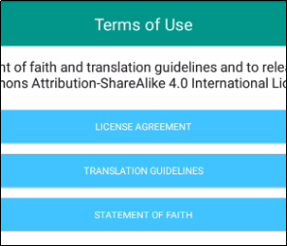
Agreeing to Terms of Use
Each translator or user of translationStudio must agree to these terms of use. Tap each to read, scroll, and then tap Close.
License Agreement: Explains what you are able to do with the content in the program and the content that you create
Translation Guidelines: Describes qualities of a good translation to help the translator clearly, accurately, and naturally translate the text
Statement of Faith: Lists common elements of the Christian faith
Tap I AGREE.

Slide 9
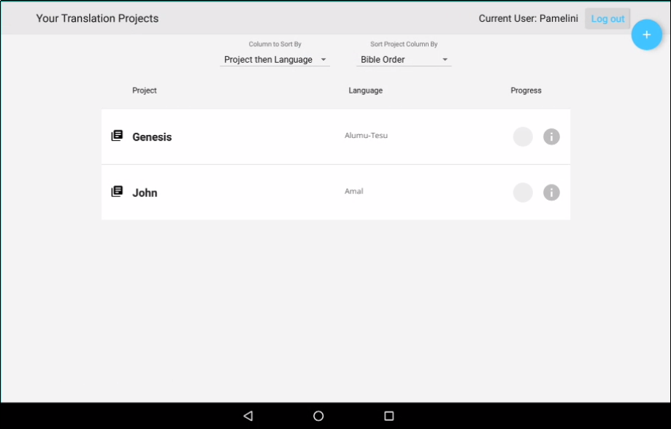
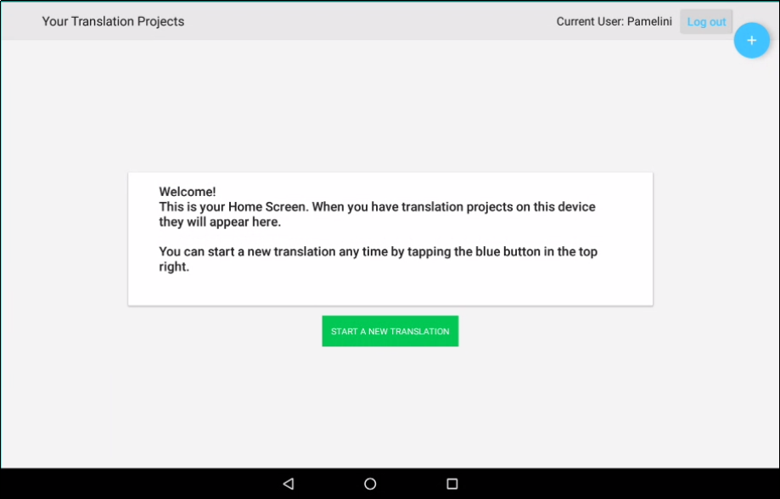
Viewing the Home Screen
, or welcomes you if you have no projects yet.
TranslationStudio opens to display the Home screen:
Lists all of your projects
User name
User name
Logout button
Logout button

Slide 10
What Did You Learn?
In this presentation you learned to:
Install translationStudio for Android
Open the program
Agree with terms of use
Create an account
Understand the home screen
Notes:
The translationStudio-Android is a mobile app where translators can do offline translating. It can be downloaded for Android devices.
The tool named translationStudio was created by Distant Shore Media programmers so that anyone with an Android tablet can translate the Bible into their heart language.
The translationStudio tool is open source (without cost) and copyright free (content is not copyrighted against translation)
Most Bibles and resources are copyrighted – can’t use as a translation source unless receiving permission from publisher, often involving paying royalties. For example, if you translate out of a single source, it is considered plagiarism to publish. You must use at least 3 sources for it not to be plagiarism.
It contains the content that needs to be translated as well as translationHelps (Bible resources – notes, words, questions) .
Information can be shared directly from device to device and finished content can be uploaded to Door43 and digitally published.

