Slide 1
translationStudio for the Desktop
Performing Navigation

Slide 2

What Is This Presentation About?
In this presentation you learn to:
Explain the difference between the Home screen and a Project screen
Move between tS screens
Describe the three views of a project
Describe the columns of Notes, Questions, and Words projects
Navigate within a project

Slide 3
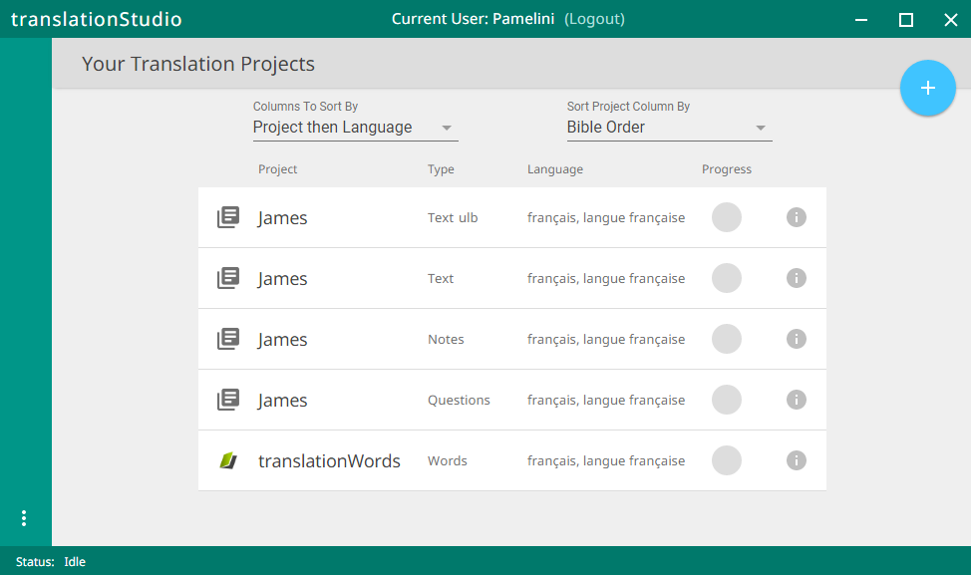
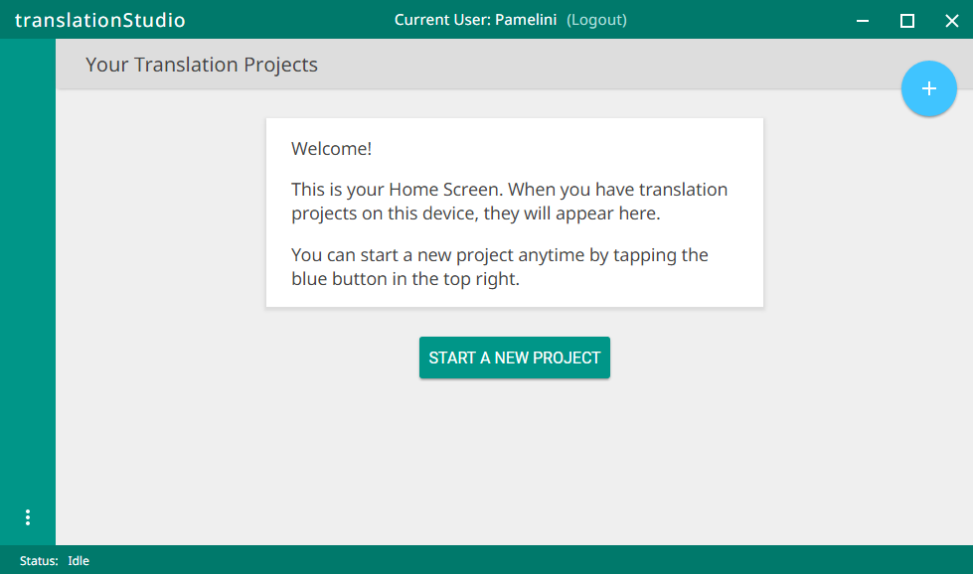
Two Types of Screens
, or welcomes you if you have no projects yet.
Home: Lists all of your projects
User name
Logout button
User name
Logout button
Project List

Slide 4
Navigating to the 2nd Screen (Project Screen)
The project screen looks different depending on the type of project.
To navigate to the Project screen,
click the project you want to open.

Slide 5
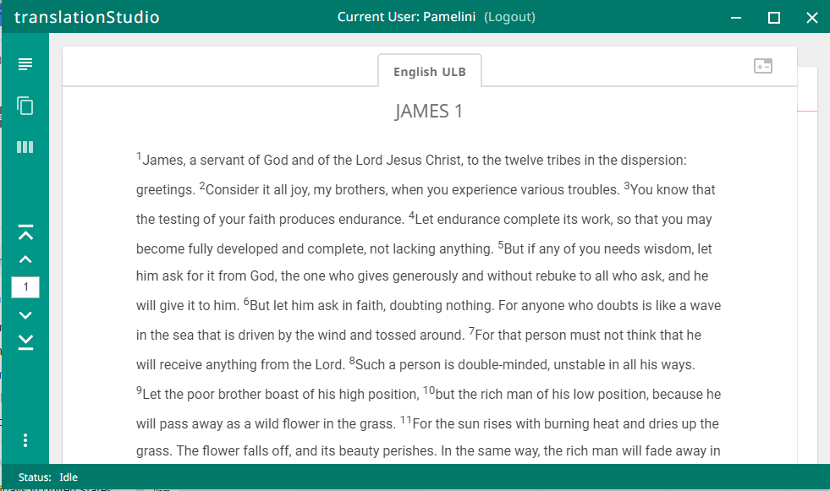
Project Screen for a Text Project
Project: Your working area for a single project.
Has 3 different views:
Chapter or Read view
Up and down arrows move through the text
Chapter view of the source text
Top
Click right to see translated text, if any
Previous Chapter
Enter Chapter #
Next Chapter
Bottom

Slide 6
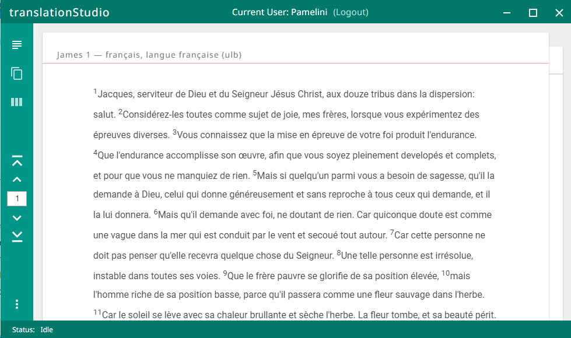
Project Screen for a Text Project
Project: Your working area for a single project.
Has 3 different views:
Chapter or Read view
Up and down arrows move through the text
Chapter view of the source text
Click right to see translated text, if any

Slide 7
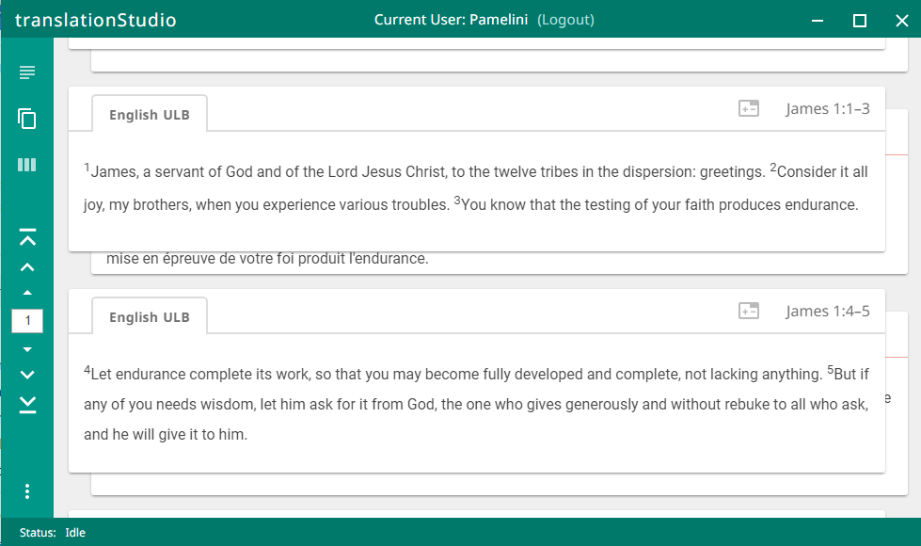
Project Screen for a Text Project
Project: Your working area for a single project.
Has 3 different views:
Chapter
Chunk
Chunk view of the source text
Click right to see translated text or to translate a chunk

Slide 8
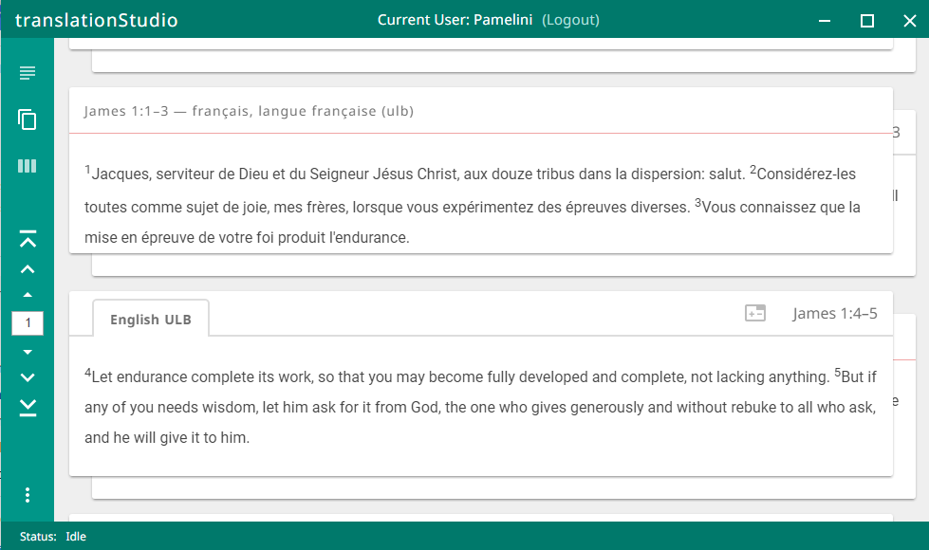
Project Screen for a Text Project
Project: Your working area for a single project.
Has 3 different views:
Chapter
Chunk
Chunk view of the source text
Click right to see translated text or to translate a chunk

Slide 9
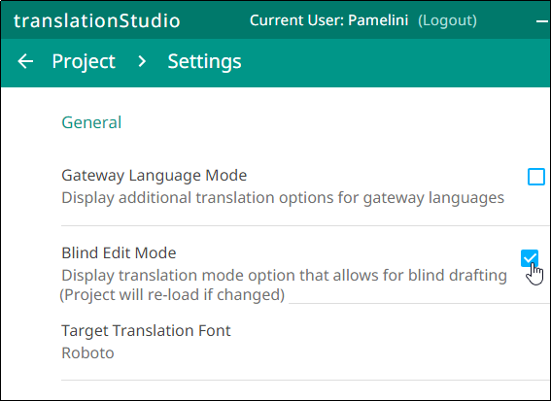
Project Screen for a Text Project
Project: Your working area for a single project.
Has 3 different views:
Chapter
Chunk
Note: If you don’t see the chunk view, open Settings and set Blind Edit Mode to On.

Slide 10
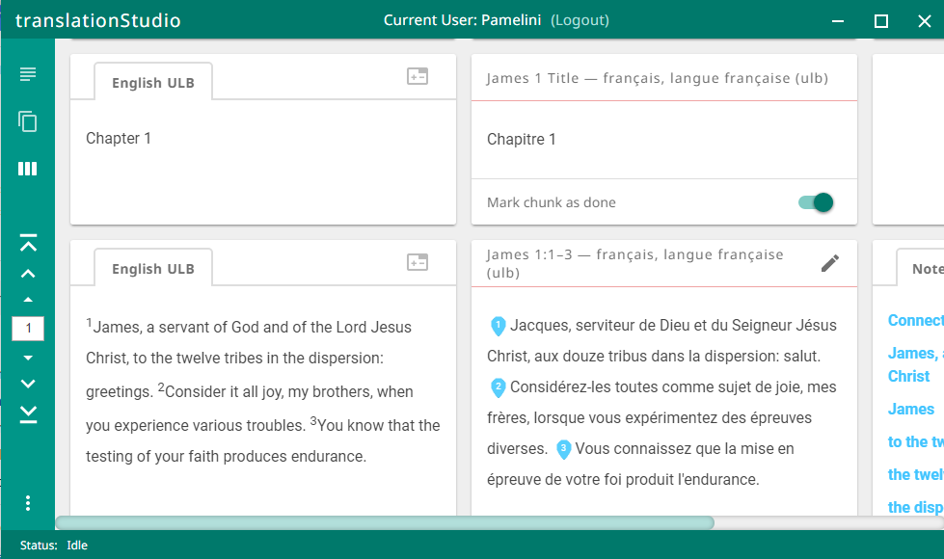
Project Screen for a Text Project
Project: Your working area for a single project.
Has 3 different views:
Chapter
Chunk
Check
Check view with source and translation side by side
Check view with English ULB source text has helpful resources (Scroll right to see)

Slide 11
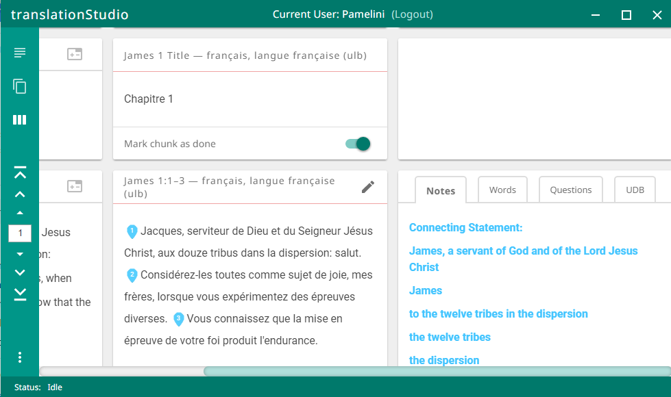
Project Screen for a Text Project
Project: Your working area for a single project.
Has 3 different views:
Chapter
Chunk
Check
Check view with source, translation, and resources
Check view with English ULB source text has helpful resources (Scroll right to see)
Click the tabs to see Notes, Words, Questions, and UDB.

Slide 12
Project Screen for a Text Project
Project: Your working area for a single project.
Has 3 different views:
Chapter
Chunk
Check
Check view with source, translation, and resources
Translated text is in center panel.
Check view with English ULB source text has helpful resources (Scroll right to see)
Click the tabs to see Notes, Words, Questions, and UDB.

Slide 13

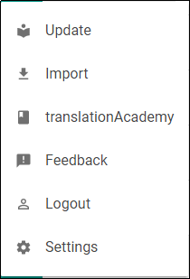
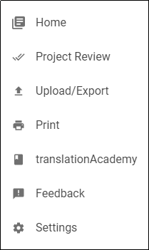
Using the Options (3-dot) Menu
Click 3 dots in lower left
2 different menus from the 2 different screens:
On the Home screen:
On the Project screen:
Update source or target language files, tS
Return to Home screen
Prepare for publishing
Project or source text
Access translation manuals
Upload to Door43/export to file
Report a bug
Print the translation
Log out (so you can log in as a different user)
Access translation manuals
Modify program settings
Report a bug
Modify program settings

Slide 14
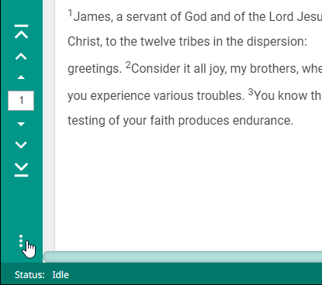
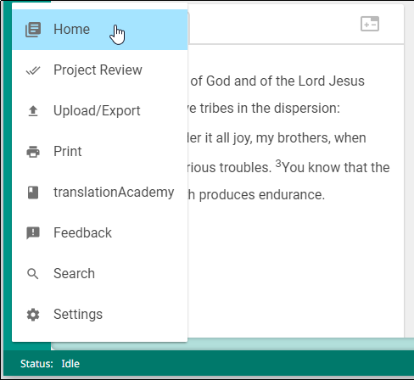
Return to the Home Screen
Click the 3 dots to open options menu.
Click Home.

Slide 15
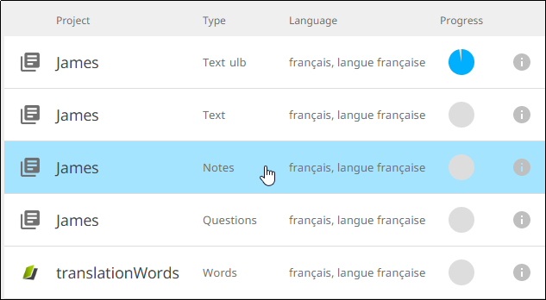
Opening a Notes Project
Click a Notes project to open it:

Slide 16
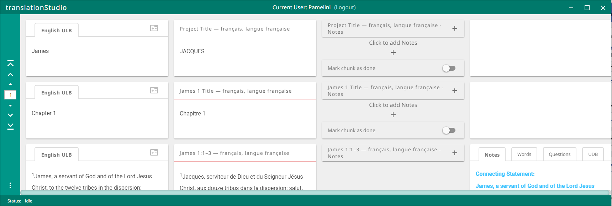
Project Screen for a Notes Project
Only 1 view
Rows across are divided into chunks.
Columns are:
Translation (may be blank)
Work area (to add translated notes)
Notes to be translated
English ULB

Slide 17
Navigation in a Notes Project
Top
Previous Chapter
Previous Chunk
Enter Chapter #
Next Chunk
Next Chapter
Bottom

Slide 18
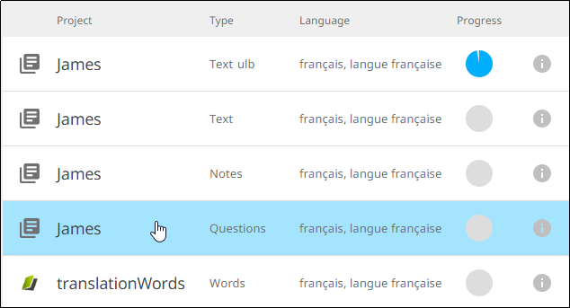
Opening a Questions Project
Click a Questions project to open it:

Slide 19
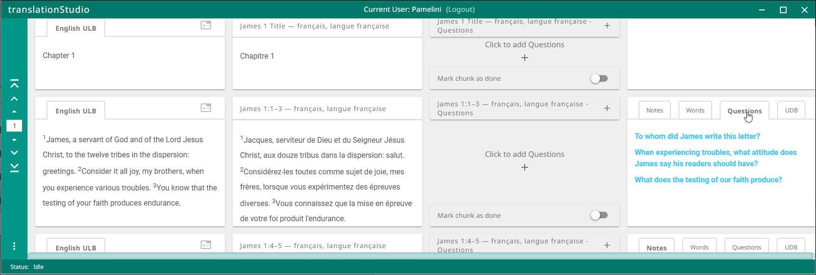
Project Screen for a Questions Project
Only 1 view
Rows across are divided into chunks.
Columns are:
Translation (may be blank)
Work area (to add translated questions)
Questions to be translated
English ULB
Click the Questions tab

Slide 20
Navigation in a Questions Project (same as Notes project)
Top
Previous Chapter
Previous Chunk
Enter Chapter #
Next Chunk
Next Chapter
Bottom

Slide 21
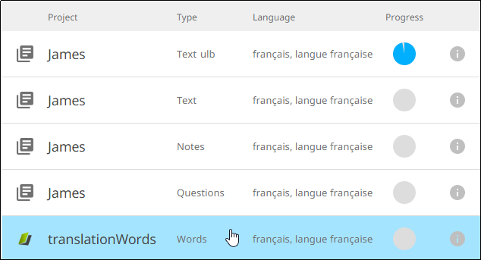
Opening a Words Project
Click a Words project to open it:

Slide 22
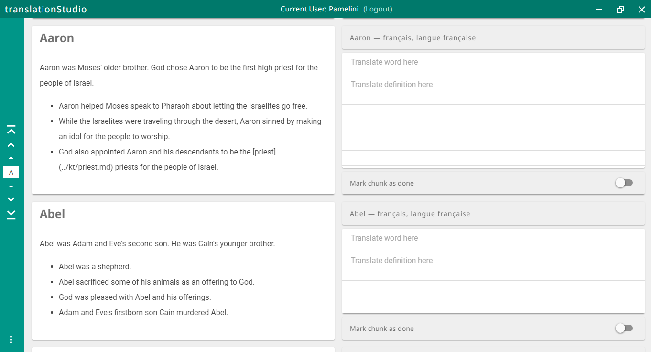
Project Screen for a Words Project
This is the only project type that is not specific to a section of the Bible.
Columns are:
English word and definition
Work area

Slide 23
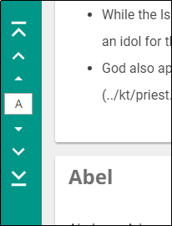
Navigation in a Words Project
Top
Previous Letter
Previous Word
Enter Letter
Next Word
Next Letter
Bottom

Slide 24
What Did You Learn?
In this presentation you learned to:
List the two tS screens
Move between tS screens
Describe the three views of a text project
Describe the columns of Notes, Questions, and Words projects
Navigate within a project

