Slide 1
translationStudio for Desktop
Changing Program Settings

Slide 2
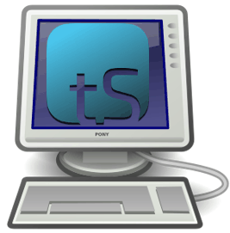
What Is This Presentation About?
In this presentation you learn to:
Open the Options menu
View program settings
Change program settings

Slide 3
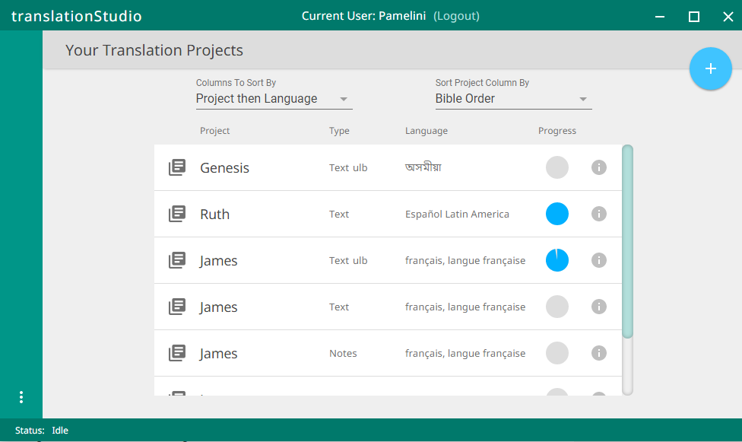
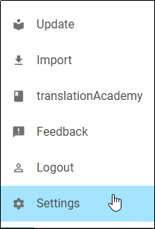
Accessing Settings
Click the 3-dot icon to access the Options menu, and then click Settings.

Slide 4
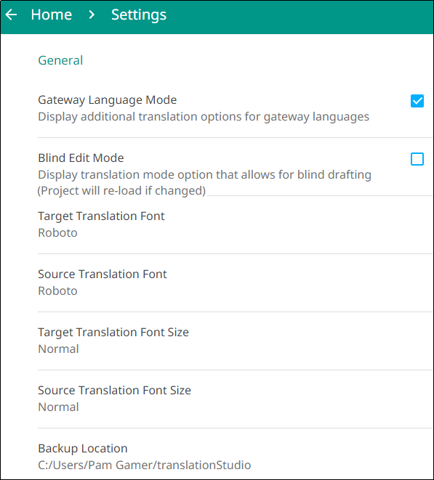
Settings Menu
General Settings
Gateway Language Mode– Check to provide GL options.
Blind Edit Mode– Check to provide options for blind drafting.
Target Translation Font – The name of the chosen font is displayed; click to change the font.
Source Translation Font – The name of the chosen font is displayed; click to change the font.
Target Translation Font Size – The size of the chosen font is displayed; click to change the font size.
Source Translation Font Size – The size of the chosen font is displayed ; click to change the font size.
Backup Location – The location on the file system where project files are stored (tS backs up to this location automatically every 5 minutes); click to change the location.

Slide 5
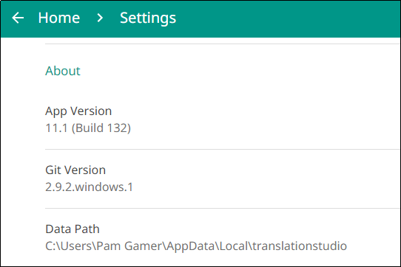
Settings Menu
Scroll down to see more settings:
About Settings (these settings are view-only and cannot be changed)
App Version – The installed version of the translationStudio program
Git Version – The installed version of Git, which is a version control system used by translationStudio
Data Path – Path to data used by the program

Slide 6
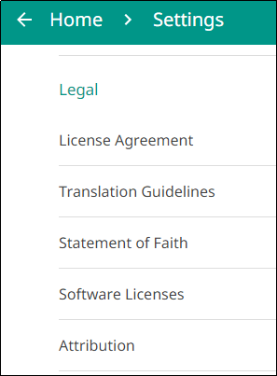
Settings Menu
Legal Settings (these settings are view-only and cannot be changed)
License Agreement - click to read what you agreed that you are permitted to do with the content in the program and the content that you create.
Statement of Faith - click to review the Essentials Beliefs that you agreed to.
Translation Guidelines - click to learn about the guidelines that can help the translator clearly, accurately and naturally translate the text.
Software Licenses - click to view all the licenses for the code packages and libraries that are used by the translationStudio program.
Attribution - click to learn about the restrictions of using the derivative works and name branding.

Slide 7
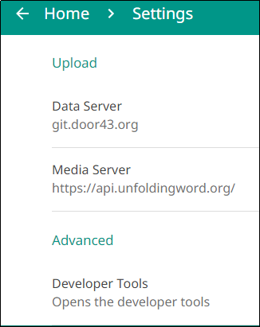
Settings Menu
Upload Settings (these settings are view-only and cannot be changed)
Data Server – the Door43 content server
Media Server – the unfoldingWord server
Advanced
Developer Tools– opens developer tools, which you should not do unless directed by a translationStudio support technician

Slide 8
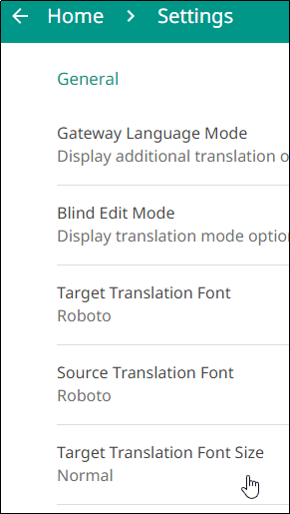
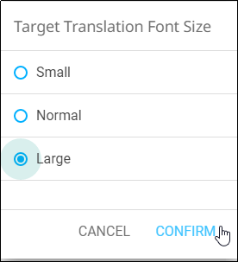
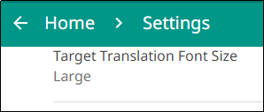
Changing the Translation Font Size
It’s a good thing to do if using language with non-Roman characters.
To change the translation font size in Settings:
Click Target Translation Font Size.
Select the desired font size and click CONFIRM.
The new font size is displayed.
2
1
3

Slide 9
What Did You Learn?
In this presentation you learned to:
Open the Options menu
View program settings
Change program settings

