Slide 1


Scientific Data Analysis for Post-Graduate Students Using R Programming Language.
Strengthening Research skills in Eastern and Southern Africa

Slide 2


CLASS ONE: INTRODUCTION TO R PROGRAMMING LANGUAGE
Facilitators:
Prof. Susan Balaba Tumwebaze
Dr. Thomas Odong
Dr. Hellen Namawejje

Slide 3
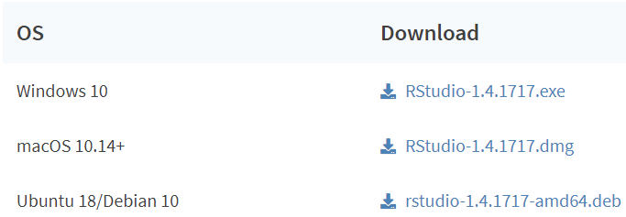
R-programming and RStudio
R soft ware
Download R
The R Project for Statistical Computing
or
http://cran.r-project.org/
Use updated/latest version always
RStudio software
https://www.rstudio.com/products/rstudio/download/

Slide 4
What is R?
R is a free statistical programming language
Can be used by either a scientist or non scientist
You do not need to be a statistician to use R
A widely used data management, statistical analysis and graphics software program
R is an open source tool used in data analysis.

Slide 5
Why R?
The language is designed for data analysis.
R has a set of tools available that makes writing code easier.
Reproducibility
Lots of libraries (ways of extending R language)

Slide 6
What is RSTUDIO?
RStudio provides free and open source tools for R
Often referred to as an Integrated Development Environment (IDE) for R
Rstudio features include: a console, syntax-highlighting editor, environment, history, tutorials, tools for plotting, packages, and help space
Rstudio provides features to make using R and managing R much earlier

Slide 7
Difference between R and RStudio
R
R is a programming language used for statistical computing
You can write a program and run the code independently of any other computer program
R may be used without RStudio
RStudio
RStudio uses the R language to develop statistical programs
Must be used alongside R in order to properly function
RStudio may not be used without R

Slide 8
Installing R and Rstudio (Option B)
Install R
Go to R project or CRAN
(Comprehensive R Archive Network)
Select the link to download in R
Select the R download for your operating system (Windows/Mac/Linux)
Note: You can install R and RStudio directly by typing it in Google URLs
Install RStudio
Go to RStudio
In the menu, go to Products > RStudio
Select download RStudio Desktop
Select the download for your operating system

Slide 9
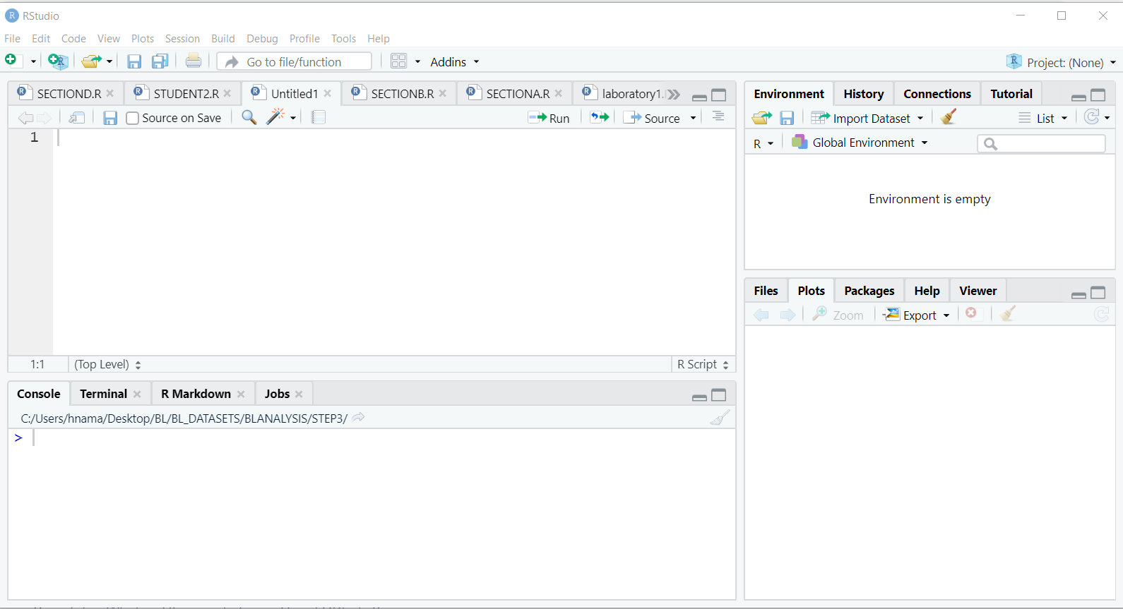
R and RSTUDIO workspace

Slide 10
How to update R and RStudio
Updating R: R 4.1.3 is the latest R version
Option One
The easiest way to update R is to simply download the newest version.
Install that, and it will overwrite your current version.

Slide 11
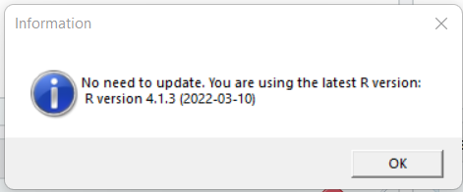
Updating R
Option 2: Use packages
updateR for Mac,
and installr for Windows
R Codes
>install.packages(“installr”)
>library(installr)
>updateR()

Slide 12
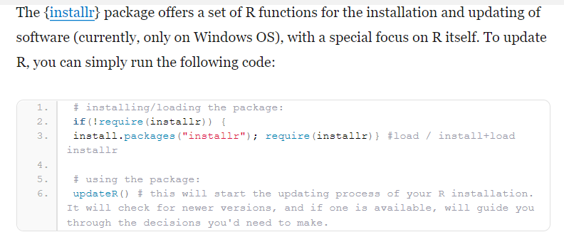
Updating R
Alternatively

Slide 13
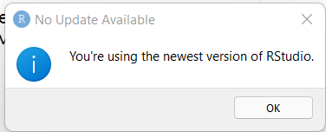
Updating RStudio
Go to the Help menu in the top menu bar of Rstudio
In the Help menu, select Check for Updates, i.e.,
Click Help in RStudio > check for updates
If RStudio is updated, you see this window
Otherwise, will direct you to the website to download the latest version.

Slide 14
R and its associated packages
Once R/RStudio is installed
You will have base R and its associated packages
We will use many add on packages throughout this training
You can install packages using different options

Slide 15
Adding/installing packages in R
Options include
install.packages(“package_name”) command
Tools > install packages in Rstudio
search for the package to install
Packages > install on RHS bottom workspace
Install multiple packages
install.packages (c(“tidyverse”, “readxl”, “dplyr”, “ggbupr”))
readxl to read Microsoft Excel files

Slide 16
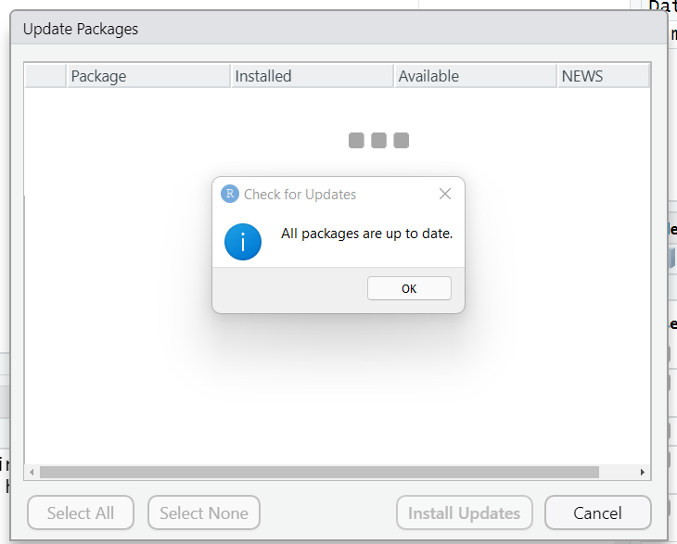
Update Packages in R
Click packages in the right bottom window, then update.
If all packages are updated, you will see the window below, otherwise select packages you want to update.

Slide 17
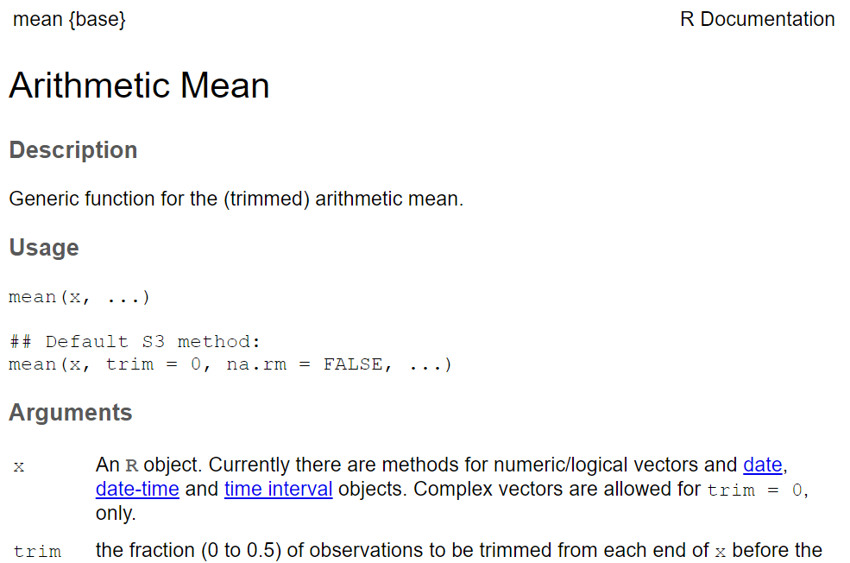
Getting help in R
Help about a specific command can be got using the following commands:
>help(mean)
>?mean
>? t.test
or
>help(t.test)

Slide 18
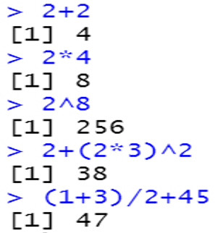
Basic concepts in R
Factors
Data is sometimes categorized
e.g. Type of Colours
( Blue, Red, Orange, Green)
Academic Rank;
e.g (AsstProf, AssocProf, Prof)
In R, categorical data is stored as factor
R as a calculator
R use = or < - to assign values to a variable name
e.g. x = 2 is same as x < - 2
R is case sensitive

Slide 19
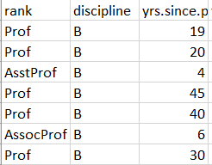
DATA FRAME in R
Data frame: represents a typical data table that researchers come up with – like a spreadsheet.
e.g.
Characteristics of a Data frame
The column names should be non-empty
The row names should be unique
The data stored in a data frame can be numeric, factor or character type
Each column should contain same number of data items

Slide 20
Level of measurement Some Definitions
Variable
Gender
Attribute
Attribute
Female
Male

Slide 21
What Is Level of Measurement?
The relationship of the values that are assigned to the attributes for a variable
Variable
Party Affiliation
Attributes
Republican
Independent
Democrat
1
2
3
Values
Relationship

Slide 22
Types of level of measurement
Nominal
Ordinal
Interval
Ratio
Note:
Interval and Ratio are times referred to as Scale measurements
Nominal: The values “name” the attribute uniquely; The name does not imply any ordering of the cases
Ordinal: Attributes can be rank-ordered…
Interval: When distance between attributes has meaning, e.g temperature: distance from 30-40 is the same as distance from 70-80

Slide 23
Why is Level of measurement important?
Helps you to decide what statistical analysis is appropriate on the value that were assigned
Helps you decide how to interpret the data from that variable
Ratio: absolute zero is meaningful. E.g number of clients in past one months
It is meaningful to say that “...we had twice as many clients in this period as we did in the previous six months

Slide 24
The Hierarchy of Levels
Ratio
Absolute zero
Interval
Distance is meaningful
Ordinal
Attributes can be ordered
Nominal
Attributes are only named; weakest

Slide 25
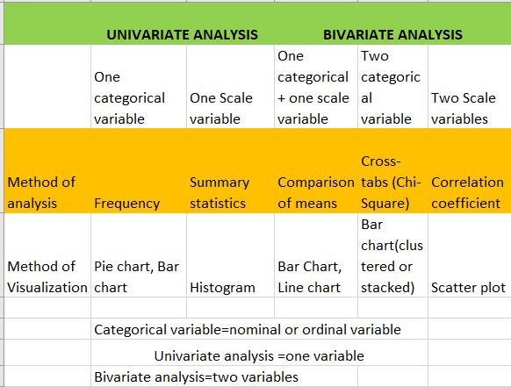
Variable Type and Data Analysis

Slide 26
R scripts and comments
R scripts
It is generally better to write your code in a script, RMarkdown or other document.
Why:
So that you can easily save, edit and share your code
File> New File> R script
Comments
You can add a comment on your code
Comments act as remainders
In R, use (#) icon to comment

Slide 27
Importing data
Before we can work with our data in R
We need to first import the data into R
Importing data from different file types and sources using add on packages
For example, csv files, excel files, tab delimited files
Data files from other programs e.g., SAS.sas files, SPSS.sav files, or STATA.dta files etc can be used

Slide 28
Importing data
Packages
From Text (readr) to import csv files
From Excel(readxl) to import excel files
dplyr, tidyverse, ggpubr, ggplot2
haven packages contain functions to read in SAS, SPSS, and STATA
Importing the most commonly used file types of CSV and excel files using the data.
Using (Option 1)
File > Import Dataset

Slide 29
Importing data : Option 2
Step one: Set working directory (SWD)
Common ways of setting SWD
Go to Session> Set Working Directory and choose the folder that contains your dataset
Set the working directory manually using the function
Setwd(“/path_to_folder/”)

Slide 30
Importing data: Path/direction
Step two: use step one to create a path to a folder with your data
Give an object/ name to your dataset
Use read.csv() command

Slide 31
Importing Data
When setting the working directory for Windows or Mac/Linux
For Windows: the default directory structure involves a single backslash “\” but R interprets these as escape characters, so you must replace these with forward slashes “/” or two backslashes “\\”
For Mac/Linux: The default directory structure already uses forward slashes

Slide 32
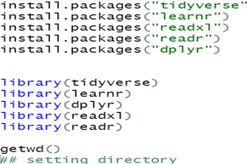
IMPORTING DATA IN R
Using ABC dataset
Install required packages
Set working directory using getwd() command
After installing the various packages, remember to load them as libraries.

Slide 33
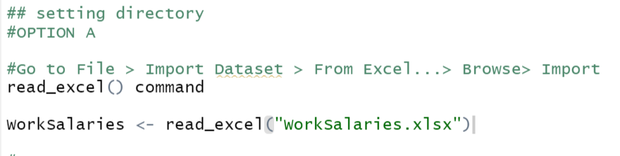
Importing data in R we use the read_excel() function from readxl package

Slide 34
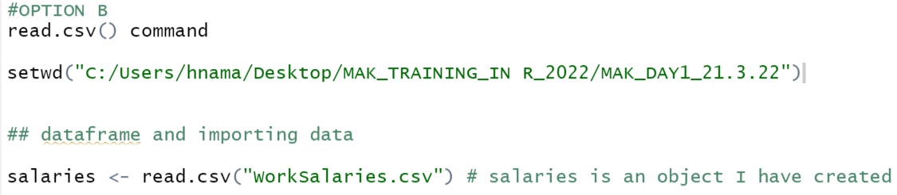
Importing data in R we use the read_csv() function from readr package

Slide 35
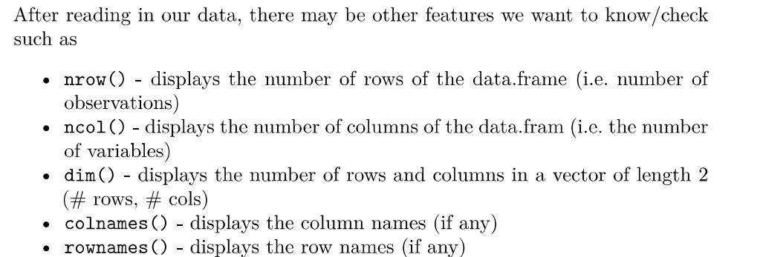
Features you can check in your data

Slide 36
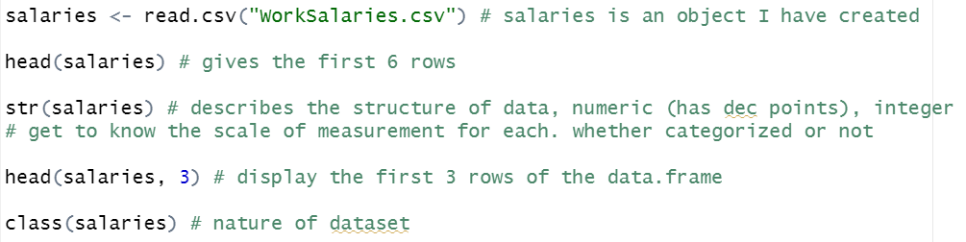
Comments in R (#)
Anything to the right of a comment symbol on the same line will be ignored by R

Slide 37
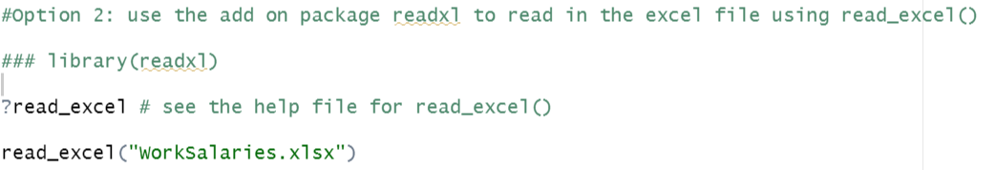
Reading data from excel to R-continued

Slide 38
Other important features
How to save the R script (File > save > choose location to save)
Clear environment in R just type: rm(list=ls())
To clear the console type: Ctrl+L
Calling rm() removes/deletes an objects in your working environment.
ls() command # reads/lists current objects

Slide 39
Data Manipulation(DM)/ Inspecting Variables

Slide 40
Variable Type and Data Analysis

Slide 41
Data Manipulation (DM)
Creating new/add variables
Recording an existing variable
Rename columns of a data frame (df)
Subset rows/columns of a data frame
Remove columns of df
Level of measurements in R
Dealing with missing values-Delete/remove
Merging data
Descriptive analysis
Note: To perform the above operations we will use dplyr and tidyverse packages. dplyr provide functions to make these operations more intuitive and codes more readable.

Slide 42
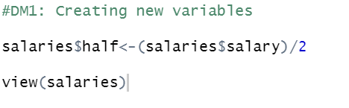
DM1: Creating new/adding a variable(s)
Use the assignment operator <- to create new variables.
A wide array of operators and functions are available here

Slide 43
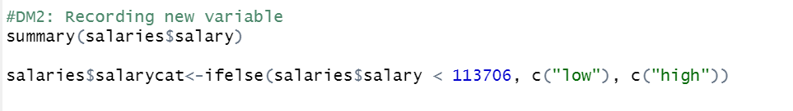
DM2:Recording an existing variable
Converting a continuous variable into a categorical variable, e.g
Creating two salary categories, that is, low and high

Slide 44
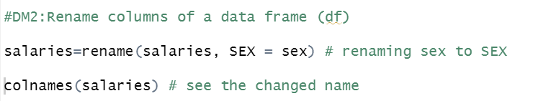
DM3: Rename columns of a data frame
We can change column names using the rename() function from the R package dplyr
We could rename the column “sex” to SEX in the dataset

Slide 45
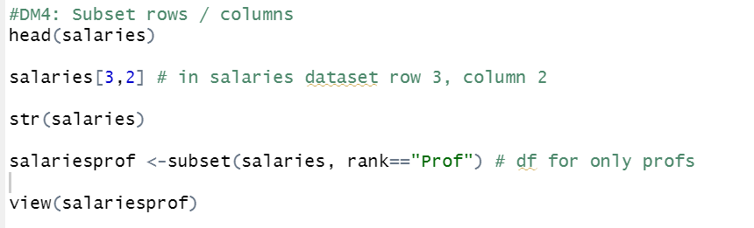
DM4: Subset rows/columns of a data frame
df are accessed with “[ ]” by specifying their index, or their name

Slide 46
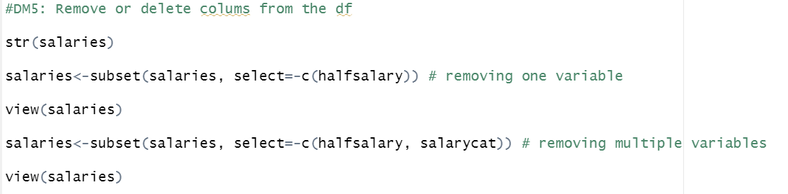
DM5: Remove/delete a column in a data frame
Delete a column you are no longer interested in.

Slide 47
DM6: Level of measurements in R
Nominal and ordinal (categorical variables)
as.factor() function for nominal data
df$variable of interest<-as.factor(df$variable of interest)
e.g.
salaries$rank <-as.factor(salaries$rank)
check
class(df$rank)
levels(df $ rank)

Slide 48
DM6: Continued_Continuous variables
Scale (ratio and interval) –numerical /integer
df$variable of interest<- as.numeric (df$variable of interest)
e.g.
salaries $ salary<-as.numeric (salaries$salary)
check
class(salaries $ salary)

Slide 49
DM7: Dealing with missing variables
It might happen that your dataset is not complete.
And when information is not available we call it missing values.
In R the missing values are coded by the symbol NA
To identify missings in your dataset the function is “is.na()”
Using an example in the next slide, since salaries has no missing data

Slide 50
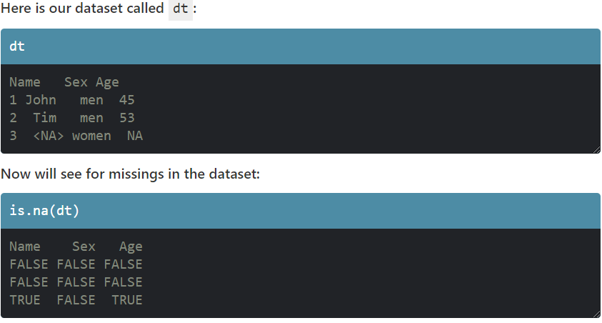
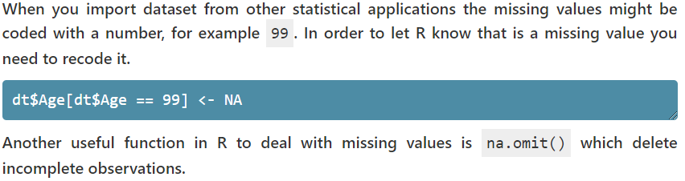
DM7:Continued
Example

Slide 51
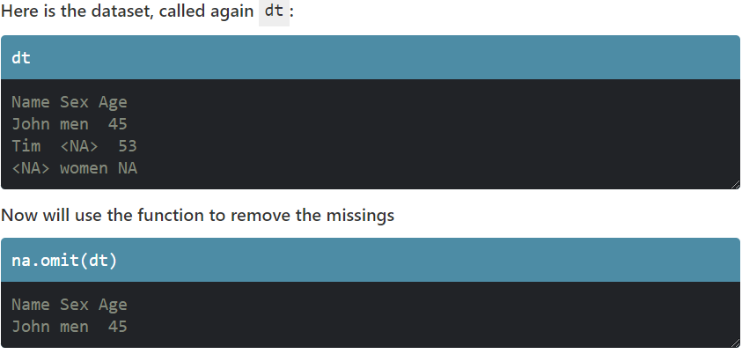
DM7:Considering only complete cases

Slide 52
DM7:Continued
This is just the basic way of dealing with missing values in a df
Other ways not mentioned here can be applied
There are advanced ways that can be used to impute missing data.
If missing values are all deleted, a lot of information is lost, so imputing methods can be applied to avoid this.

Slide 53
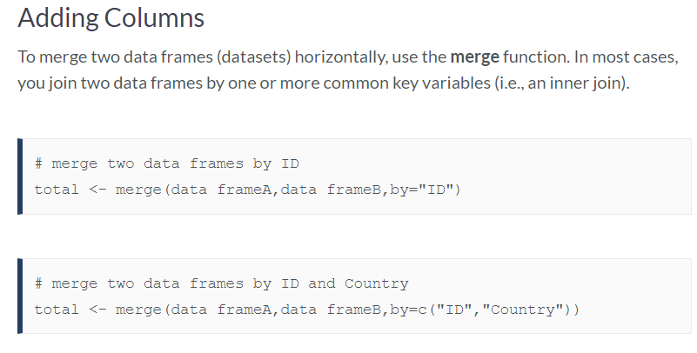
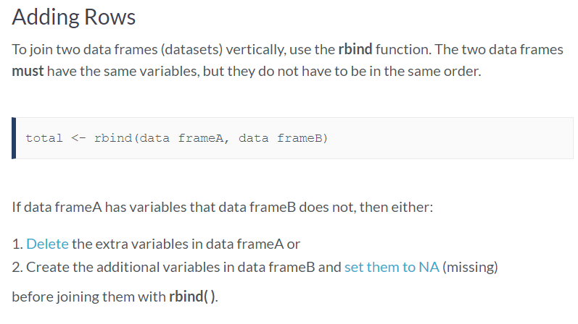
DM8: Merging datasets
H
K

Slide 54
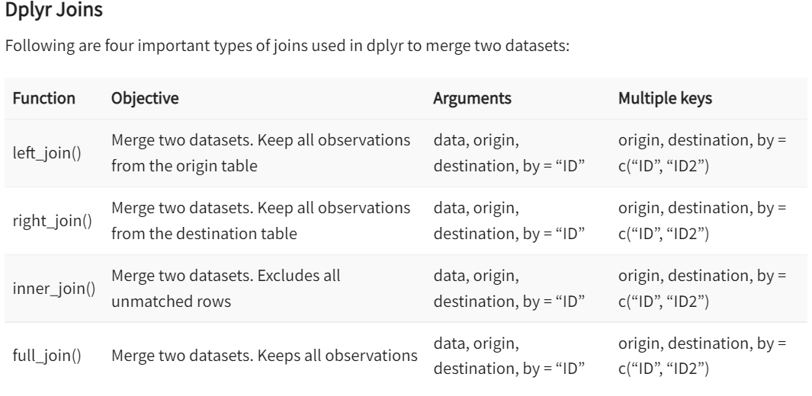
DM8: Merging data with R dplyr package

Slide 55
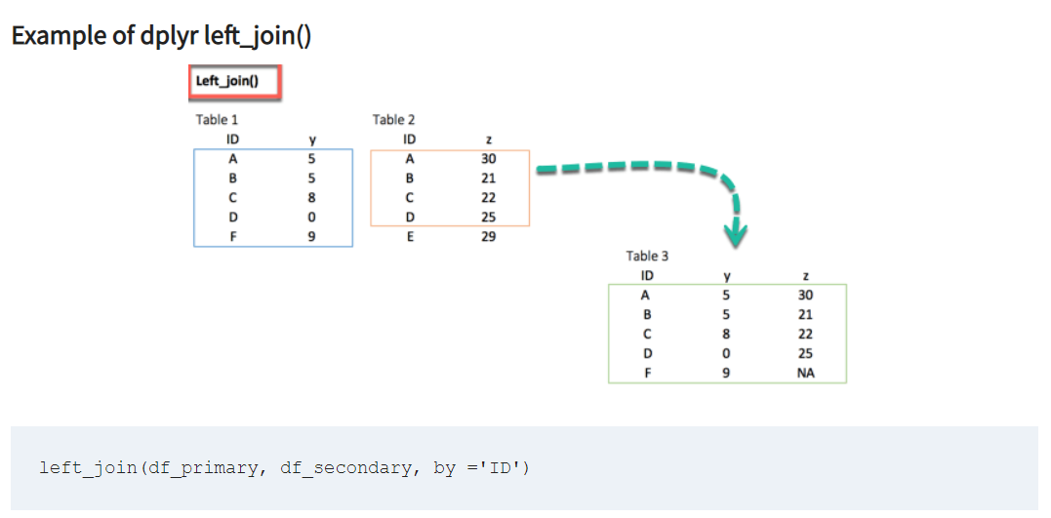
DM8: Using the left_join()

Slide 56
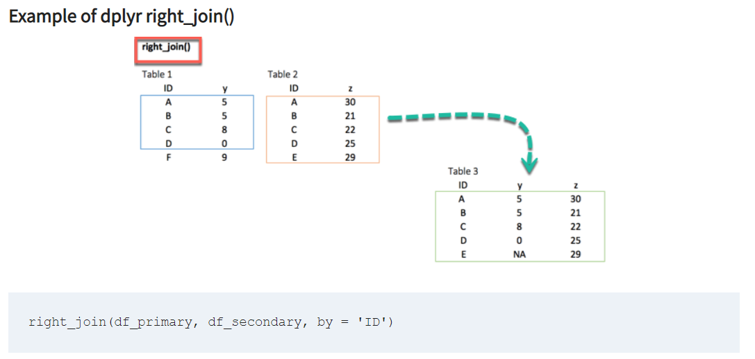
DM8: Using the right_join()

Slide 57
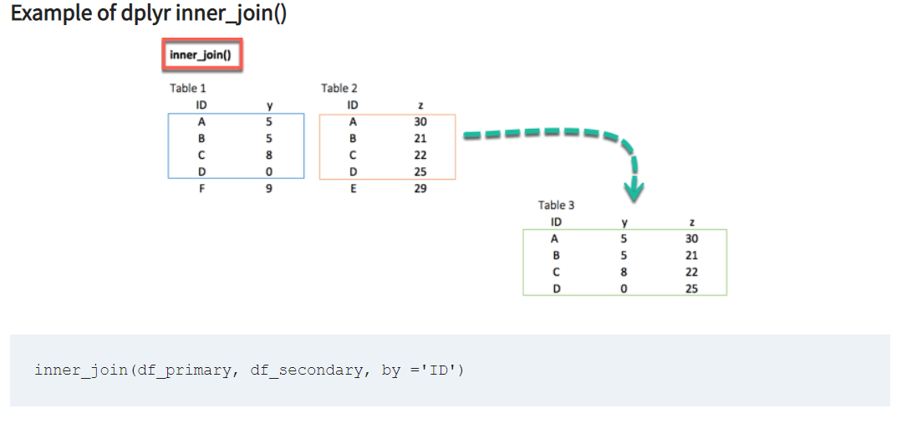
DM8: Using the inner_join()

Slide 58
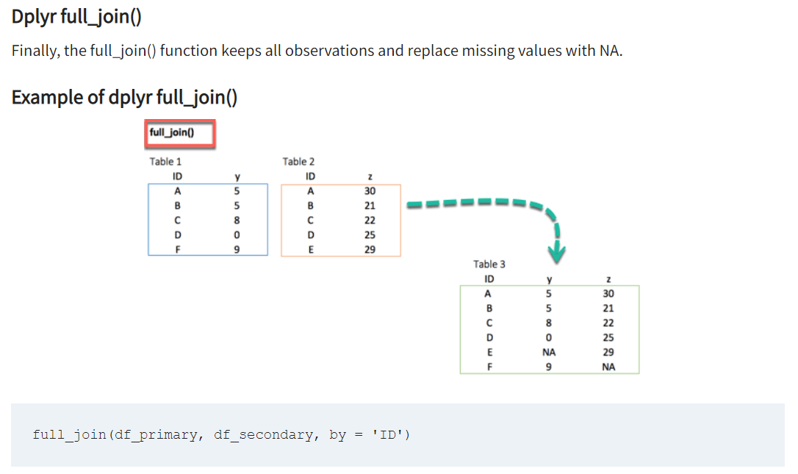
DM8: Using the full_join()

Slide 59

DM7: Merging datasets in R_Practicals

Slide 60
DM9: Descriptive Analysis

Slide 61
Descriptive analysis
Frequency
table() command for categorical
Prop.table() #percentages
summary() command for scale
Measure of central tendency and dispersion
Go to

Slide 62
Graphical methods in

Slide 63
R packages for data visualization
tidyverse() and ggplot2() packages
tidyverse is a set of packages for data tidying, manipulation, and visualization. We’ll look specifically at dplyr (manipulation) and ggplot2 (visualization) today
With ggplot , Wickham adapted Leland Wilkinson’s Grammar of Graphics (1999) for the modular construction of graphs.

Slide 64
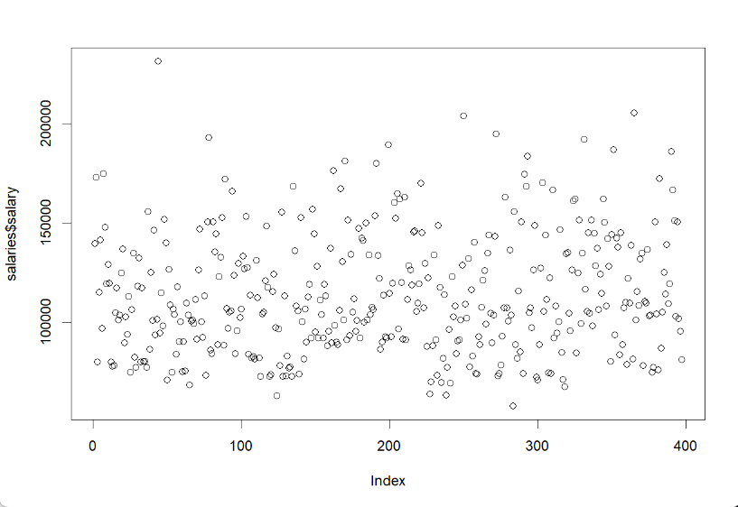
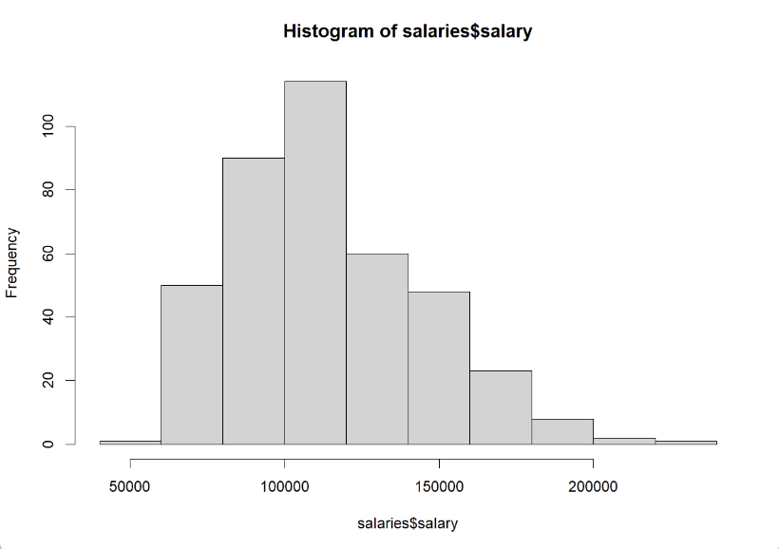
Graphics for one scale variable (Scatterplot or Histogram)
Scatterplot
Histogram

Slide 65
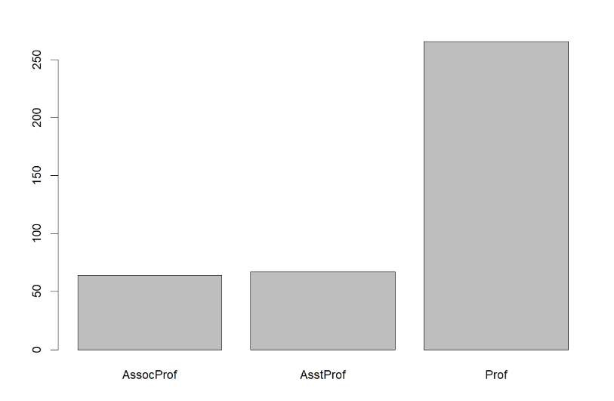
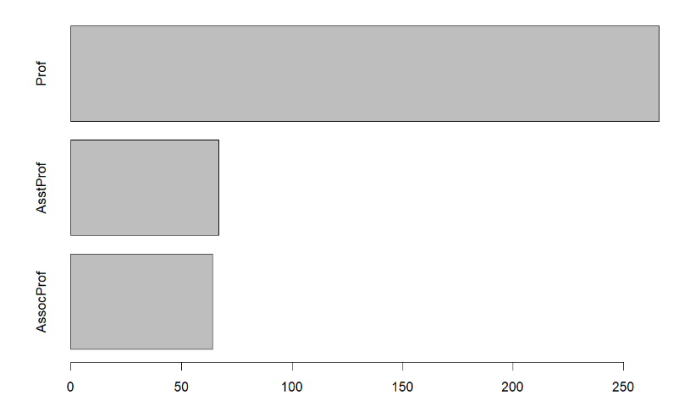
Graphics for one categorical variable
Option A: rank of professor
Option B

Slide 66
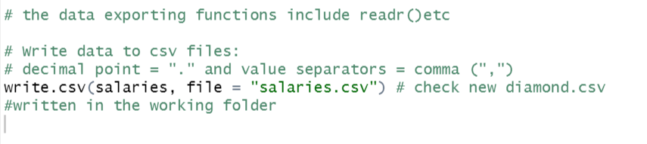
Exporting data from R-Continued

Slide 67
DATA VISUALISATION with ggplot2()

Slide 68

ggplot2 philosophy
Written by Hadley Wickham (Rice Univ.)
Extends The Grammar of Graphics (Wilkinson, 2005)
All graphs can be constructed by combining specifications with data (Wilkinson, 2005).
A specification is a structured way to describe how to build the graph from geometric objects (points, lines, etc.) projected on to scales (x, y, color, size, etc.)

Slide 69
ggplot2 philosophy
When you can describe the content of the graph with the grammar, you don’t need to know the name of a particular type of plot…
Dot plot, forest plot, Manhattan plot are just special cases of this formal grammar.
…a plotting system with good defaults for a large set of components that can be combined in flexible and creative ways…

Slide 70
Building a plot in ggplot2
data to visualize (a data frame)
map variables to aesthetic attributes
geometric objects – what you see (points, bars, etc)
scales map values from data to aesthetic space
ggplot(salaries) + geom_point(aes(x = years.service, y = salary))
Aesthetics map variables to scales
Data
Geometric objects to display
Wickham 2009

Slide 71
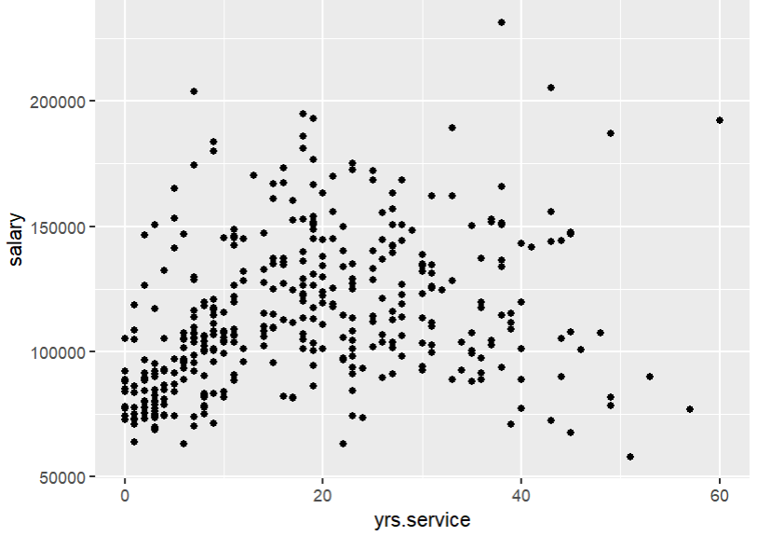
A basic ggplot2 graph
ggplot(salaries) + geom_point(aes(x = years.service, y = salary))
Aesthetics map variables to scales
Data
Geometric objects to display

Slide 72
ggplot2: the parts of speech aesthetics
aesthetics map variables in the data to visual properties of geoms
aesthetics include:
x, y position (the first two by default),
color, fill,
shape, linetype,
size, group,
(depending on the geom)
Done within a call to aes(x, y, ...)
If done in a call to ggplot(), mappings inherited by all geoms by default:
ggplot(salaries, aes(x = years.service, y = salary)) + geom_point()
But you can add, override, or remove these for subsequent layers

Slide 73
END

