Slide 1

Innovative Monitoring System for TeleICU Patients Using Video Processing and Deep Learning
Problem Statement 07
Santhosh. S

Slide 2
Introduction
Overview
Remote monitoring of ICU Patients to reduce on-site intensivist workload.
It enables healthcare professionals to oversee multiple patients simultaneously from a remote location, potentially improving efficiency and patient outcomes.
Objectives
Develop a Deep Learning model to identify various individuals (intensivist, nurse, patient, and family member ) in the ICU room. Monitor patient activity when the patient is alone.
Implement real-time monitoring with minimal latency. Ensure high accuracy and reliability in object detection and motion recognition.

Slide 3
Major Challenges
Dataset Creation
Creating a comprehensive dataset for this application is challenging due to the sensitive nature of ICU environments.The data were annotated to create a labeled dataset for training the deep learning models.
Video Processing
Processing high-quality video footage in real-time requires robust and efficient algorithms. The system needs to handle large volumes of data while maintaining low latency to provide timely alerts and updates.
Accuracy Requirements
Given the critical nature of ICU monitoring, the system must operate with narrow error margins. Misidentifications or missed detections can have serious implications for patient care, necessitating high precision and recall in our models.

Slide 4
Technical Approach
Data Collection and Preprocessing
Obtained data through YouTube videos, search engine photos, and websites. Gathered a total of 3000 images for object detection and 5680 for motion detection without data augmentation and after data augmentation, total of 11440 images for object detection and 21547 images for motion detection.
The annotation is the critical component. Annotating each object and the patient's activities required a significant amount of time. Annotated 8680 images (object and motion detection data) in total, marked everything using bounding boxes in Roboflow.
Then generated two versions of the dataset. One is with data augmentation and the other is without data augmentation.
This annotated dataset was split into training, validation, and test sets to facilitate model development and evaluation.

Slide 5
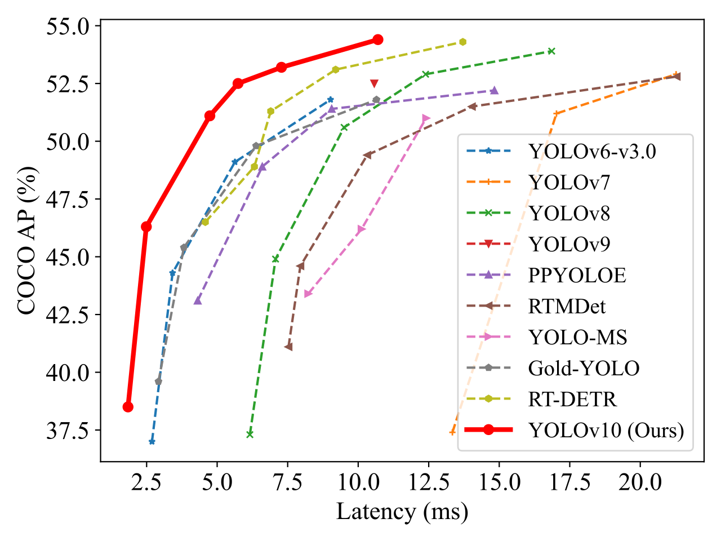
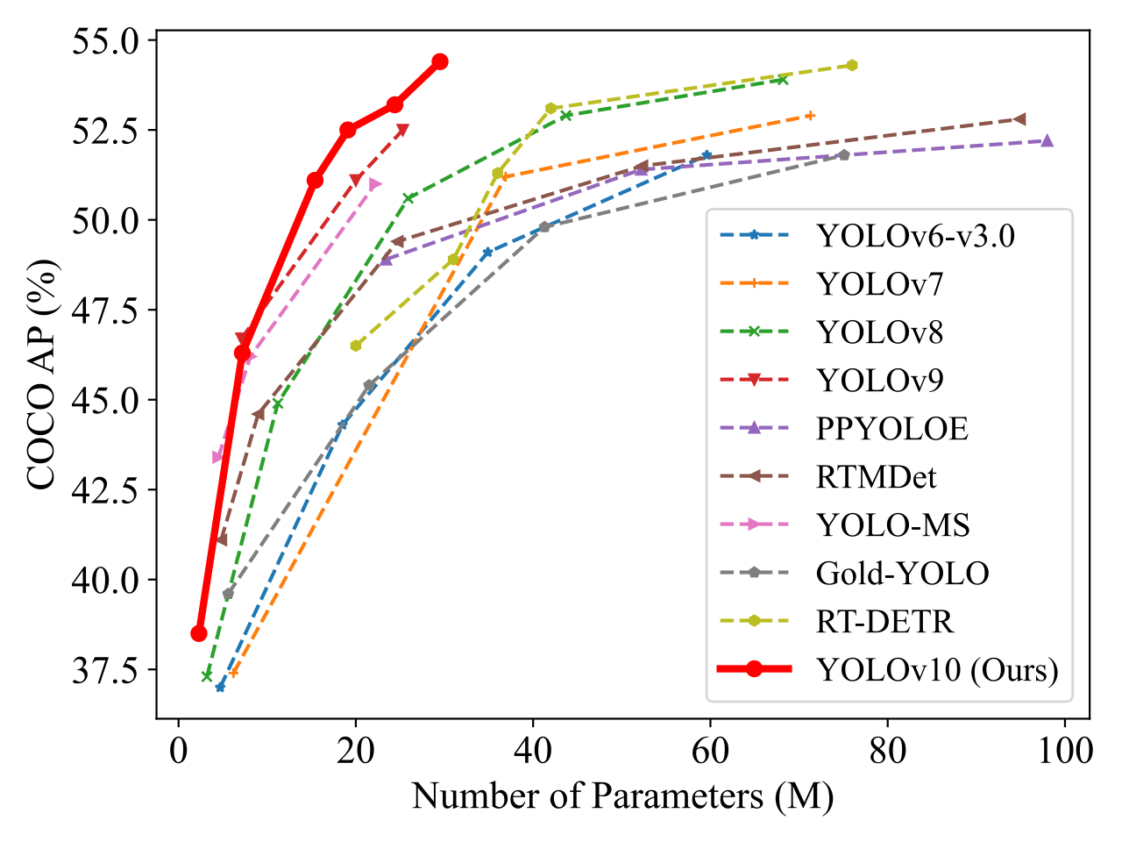
Model Training
Used the YOLOv10 (You Only Look Once) model, a state-of-the-art object detection algorithm, for identifying individuals in the ICU room and for motion detection also.
YOLOv10 is known for its real-time performance and high accuracy, making it suitable for the application.
The model was trained on annotated dataset, with specific classes for nurse, intensivist, family member for object detection and patient, falling, walking, standing, sitting, sleeping for motion detection.

Slide 6
Training Process
Training Set (70%): The majority of the annotated data used for training the model.
Validation Set (20%): A portion of the data used to tune hyperparameters and prevent overfitting.
Test Set (10%): A separate set used to evaluate the model’s performance.
Training was performed using a high-performance GPU to accelerate the process. Utilized NVIDIA Tesla T4, NVIDIA L4, and NVIDIA A10G GPUs for different models.
Trained YOLOv10 nano, small, medium, and large models using a dataset without data augmentation and only YOLOv10 small model for data augmented dataset for both object detection and and motion detection.

Slide 7
Real-time Monitoring
To achieve real-time monitoring, developed a web application using Flask, a lightweight web framework and a normal application using PyQT5 in Python.
The application processes video feeds in real-time, utilizing the trained YOLOv10 model to detect and classify individuals in the ICU room.
In addition to identifying individuals, implemented an motion detection module to monitor patient activities when the patient is alone. This module analyzes the patient's movements and behaviors like sleeping, sitting, walking, standing, falling.

Slide 8
Result
Model Performance
Object Detection - YOLOv10 Small Model - Data Augmentation
Motion Detection - YOLOv10 Small Model - No Data Augmentation
Class | Precision | Recall | mAP50 | mAP50-95
Intensivist | 0.802 | 0.711 | 0.82 | 0.519
Nurse | 0.674 | 0.792 | 0.763 | 0.469
Patient | 0.788 | 0.762 | 0.795 | 0.419
Family Member | 0.821 | 0.753 | 0.796 | 0.466
Falling | 0.554 | 0.778 | 0.755 | 0.564
Sitting | 0.903 | 0.599 | 0.798 | 0.457
Sleeping | 0.944 | 611 | 0.883 | 0.524
Standing | 0.946 | 0.658 | 0.827 | 0.449
Walking | 0.642 | 0.65 | 0.644 | 0.333

Slide 9
Limitations
Dataset Limitations
The quality and variety of the sourced footage posed challenges. The use of publicly available videos/pictures may not fully represent the diversity and complexity of real ICU environments.
Future work should focus on collecting more diverse and realistic data to improve the model's robustness.
Technical Limitations
The larger the model size, the better the accuracy and precision, requiring advanced hardware (CPU, GPU, and RAM). So the training will be faster.
Handling high-resolution video in real-time requires significant computational resources. Ensuring low latency and high accuracy simultaneously is challenging.

Slide 10
Conclusion
Developed an innovative monitoring system for TeleICU patients using video processing and deep learning. The system leverages the YOLOv10 model for real-time detection and classification of individuals in the ICU room, coupled with an motion detection module to monitor patient activities.
Flask-based web application provides a user-friendly interface for real-time monitoring, ensuring timely and accurate alerts for healthcare professionals.
The system demonstrates high accuracy and efficiency, with potential for significant impact in reducing the burden on remote healthcare professionals and improving patient care.
This project represents a significant step towards more efficient and comprehensive TeleICU monitoring solutions.

Slide 11
THANK YOU!!

