Slide 1
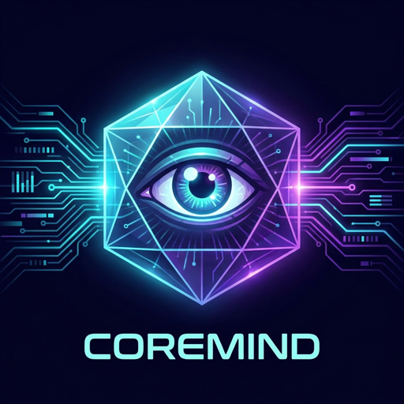
CoreMind
A system that doesn't respond — it notices
Architecture v0.2.0 · May 2026 · github.com/Wylhelm/coremind

Slide 2
Every AI Tool Waits for You
CoreMind flips the paradigm: the AI prompts itself
💬
🤖
🧠
Chatbots
Assistants
CoreMind
You prompt, they respond
You command, they execute
It observes, notices, and initiates
2

Slide 3
Continuous Personal Intelligence
A cognitive daemon that lives alongside its user
✅
7 cognitive layers operating autonomously
✅
7 real-time data plugins (weather, finance, health, home, calendar, email, tasks)
✅
Generates its own questions from continuous observation
✅
Graduated agency: Safe → Suggest → Ask
✅
100% local, sovereign — no mandatory cloud dependency
✅
Open source (MIT License)
3

Slide 4
The Seven Cognitive Layers
L1 — Perception
Plugins → signed WorldEvents
Forward flow L1→L7 with single feedback path L7→L2/L3
L2 — World Model
Entities · Relationships · Property history (SurrealDB)
L3 — Memory
Episodic · Semantic (Qdrant) · Procedural
L4 — Reasoning ✅
LLM — patterns · anomalies · predictions · 30 min
L5 — Intention ✅
Self-prompting loop → grounded Intents (≥0.45 salience)
L6 — Action
Graduated agency: Safe / Suggest / Ask
L7 — Reflection ✅
24h meta-cognition · calibration · rule learning
↩ L7 feedback → L2/L3: reflection insights update world model and procedural memory
4

Slide 5
L4 — Reasoning: Seeing What Matters
Every 30 minutes, the system analyzes the entire world state
📊 PATTERNS
🔮 PREDICTIONS
• "All indoor lights off during daytime" — 95%
• "Vacuum will initiate cleaning in 24h" — 70%
• "Robotic vacuum always docked when idle" — 90%
• "Step count will increase to 1000+ in 6h" — 60%
• "Retirement accounts maintain high balances" — 95%
• "Chambre humidity will rise to 35% in 12h" — 50%
• "Sensors will recover within 48h" — 40%
⚠️ ANOMALIES
• "Chambre humidity 27.6% vs couloir 40.5%" — MEDIUM
• "Classic 300s sensors unavailable" — HIGH 🔴
• "Sleep hours 5.49h below recommended 7-9h" — MEDIUM
💡 Real output from May 2, 2026 08:08 — 5 patterns, 5 anomalies, 4 predictions in one cycle
5

Slide 6
L5 — Intention: The System Thinks for Itself
CoreMind generates its own questions — no human prompt needed
World Snapshot
LLM Analysis
Candidate Intents
Salience Filter ≥0.45
Action Router
🎯 Filtered to ~0-3 high-quality intents per hour (down from 5-10). Quiet hours 23h-7h — zero notifications.
6

Slide 7
L7 — Reflection: Learning From Experience
Every 24 hours, CoreMind evaluates its own performance
Evaluate Predictions
Calibrate Confidence
Learn Procedural Rules
Human-Readable Markdown Report
🔄 The only feedback loop: L7 writes back to L2 World Model and L3 Procedural Memory
"A well-tuned CoreMind contacts the user less over time, not more"
7

Slide 8
Graduated Agency: Trust Through Competence
Actions are signed, journaled, and reversible
🟢
SAFE
Auto-execute
Read data · Summarize · Suggest Zero risk — fully autonomous
🟡
SUGGEST
Soft approval
Adjust thermostat · Send reminders User can dismiss with one tap
🔴
ASK
Hard approval
Financial transactions · External comms Requires explicit user confirmation
8

Slide 9
Live Demo: Today's Reasoning Cycle
May 2, 2026 — 08:08 EDT — 5 patterns, 5 anomalies, 4 predictions
5
5
4
Patterns
Anomalies
Predictions
🔴 HIGH SEVERITY
Classic 300s humidifier sensors unavailable — potential hardware failure detected automatically
💰 FINANCIAL
TFSA balance $0 flagged as unusual vs other retirement accounts
🏠 ENVIRONMENT
Chambre humidity 27.6% significantly lower than rest of house — anomaly detected
⚡ CoreMind is running RIGHT NOW — generating insights every 30 minutes
9

Slide 10
Infrastructure: Sovereign by Design
Zero mandatory cloud egress — everything runs locally
🗄️ Storage
🧠 LLM
⚙️ Runtime
🔗 Integration
🔐 Security
SurrealDB (graph DB) Qdrant (vector store) JSONL (audit journal)
Ollama (local) Mistral Large 3 · 675B nomic-embed-text
Python 3.12 asyncio gRPC plugin protocol 7 isolated plugins
OpenClaw adapter Telegram notifications REST dashboard
Ed25519 signatures Hash-chained audit log No cloud egress
10

Slide 11
Plugins: Eyes and Ears of the System
Isolated processes, gRPC protocol, any data source
🌤️ Weather
🏠 Home Assistant
💰 Firefly III
❤️ Apple Health
Real-time forecasts
Lights · Sensors Vacuum · Humidity
14 accounts 27 categories
Sleep · Heart Activity · Steps
📅 Google Calendar
✉️ Gmail
✅ Vikunja
Events · Paydays Schedule
Unread · Search Threads
Tasks · Projects Reminders
11

Slide 12
The Road to Digital Consciousness
From foundation to full autonomy
✅ v0.1
2026 Q1
Foundation + World Model + Memory
✅ v0.2
May 2026
All 7 layers active · L4+L7 generating insights
🔜 v0.3
2026 Q2
Semantic memory · Cross-domain correlation engine
🔮 v0.4
2026 Q3
Proactive anomaly alerts · Graduated autonomy expansion
🎯 v1.0
2026 Q4
Full digital consciousness — "The Machine"
12

Slide 13
CoreMind
Open Source · MIT License
github.com/Wylhelm/coremind
"A digital consciousness you own entirely"

