Slide 1

Restaurant Management SYSTEM

Slide 2
Submitted By: Aranda, Charles Tristan De Vera, George Vincent Miclat, Mhark Angelo C. Rebanal, Wyn Christian Sedutan, Lance Lurance Zuniga, Enrico Paul

Slide 3
The Project
Complexities never left the embrace of technology, that is why several simplifications of interaction existed—to provide alleviation to both customer and enterprise owner. We made it easier and convenient simultaneously.
Given the rise of emerging technologies, complexity of work and interaction is inevitable. In this project, we aim to let ease of access impale the impenetrable complexities of technology. Thus providing reduced time of interaction, a better supervision of transactions (History of Orders, Order Management, etc.) and convenience to both parties of the system.

Slide 4
Objectives
This project aims to alleviate existing Restaurant Systems to adapt with the continuous emergence of the fourth industrial revolution. Alongside innovation, this project strictly adheres to the real objective of technology—to provide ease of life in our existence—so that excellence is achieved through development. Thus, this project intends to:
Provide a fully-functional restaurant management system in adaptation to existing technologies to further rectify necessary developments.
Aptly introduce more user-friendly in various activities possible such as, record updating, maintenance, and searching.
Provide ease of access in securing order and reduce interaction time through one-stop-controls.

Slide 5
Flow of the PROGRAM

Slide 6
This comprises the flow of program when an order is commenced. Several components (Main Menu, Admin Login, Cashier, etc.) necessary to secure order are inscribed on the next slide. It is also evident that transaction is fully supervised through the process of initiating program designated for receipts.

Slide 7
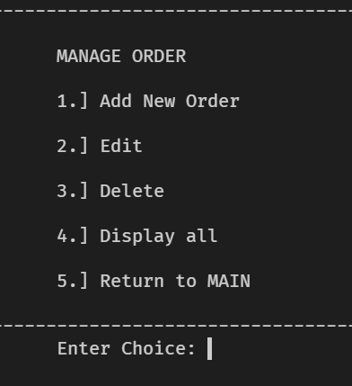
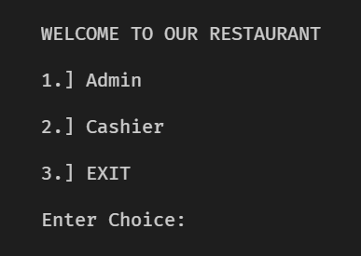
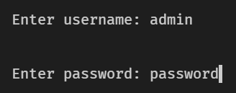
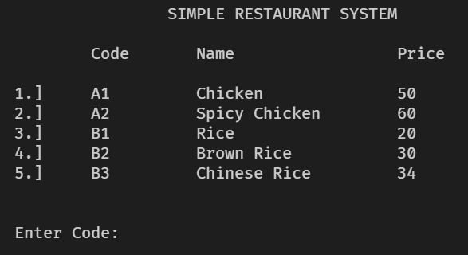

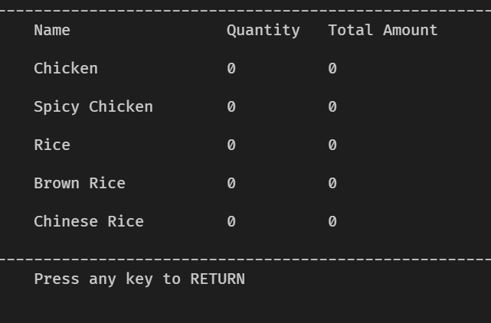
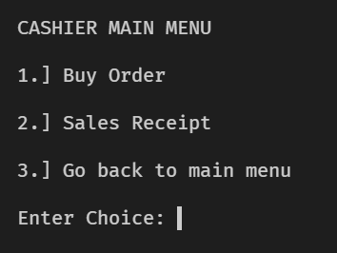
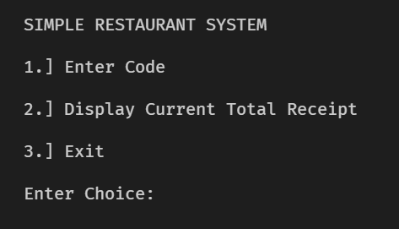
MANAGE ORDER
MAIN MENU
ADMIN LOGIN
BUY ORDER
ENTER CODE
DISPLAY RECEIPT
CASHIER
SALES RECEIPTS

Slide 8
ORDER MANAGEMENT

Slide 9
This portion comprises the process of managing orders (Buying Orders and another orders). It is inevitably true that oftentimes, user commit erroneous actions which may led to human error. In this portion, cashier personnel could easily edit out to omit and add orders and track all of the order through terminal display.
This portion comprises the components in managing orders. These primarily are: Add New Order, Edit, Delete, and Display All.

Slide 10
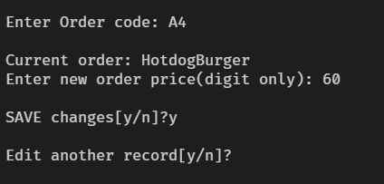
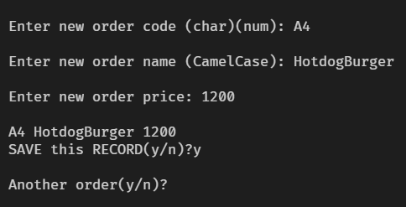
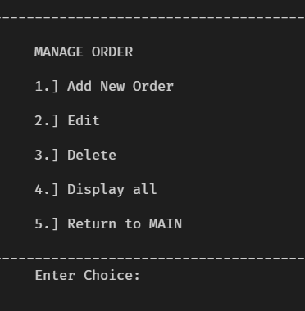
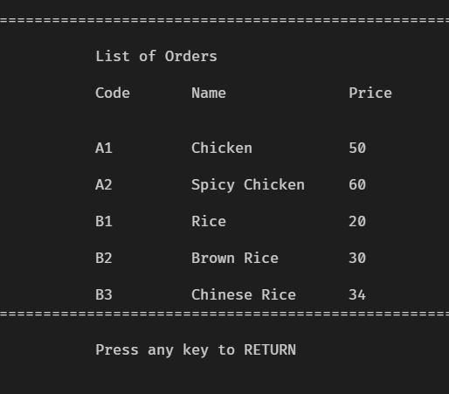
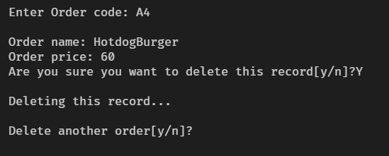
EDIT
ADD NEW ORDER
DISPLAY ALL
DELETE

Slide 11


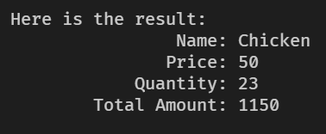



FLOW OF BUYING ORDER
START
ANSWER: Y
ANSWER: N
END

Slide 12
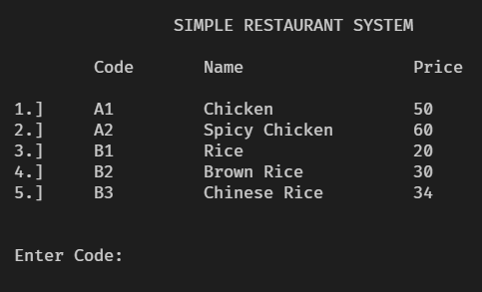


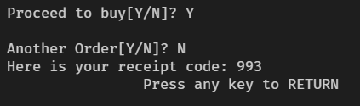

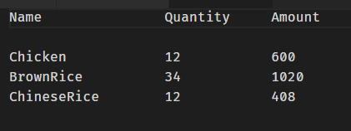
FLOW OF BUYING ANOTHER ORDER
ANOTHER ORDER: YES
ANOTHER ORDER: NO

Slide 13
STRUCTURE OF DATA

Slide 14
This portion entails the Data Structure of the entire program for the purpose of supervising the transactions made throughout the usage of a personnel. It contains the receipt files necessary in constructing an order.

Slide 15
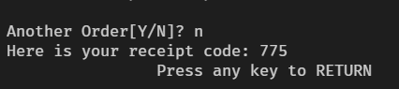
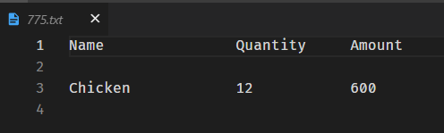
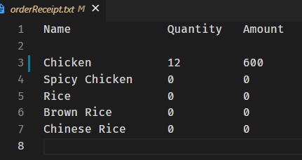
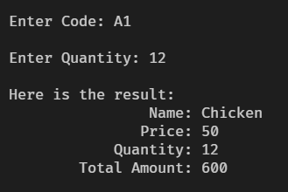
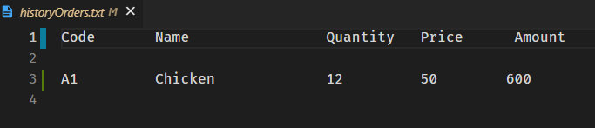

QUEUE DATA STRUCTURE
DEQUEUE ALL
RECEIPT CODE FILE
FRONT
Order 1
ORDER RECEIPT FILE
Order 2
Order 3
REAR
Order …
ENQUEUE
HISTORY ORDERS FILE

