Slide 1
SmartDog
Oscar Peng
20150306

Slide 2

Overview
Introduction
Dog Command
Dog Start, Stop, Force-stop
Dog Start flow
Watchdog Configuration
Dog.xml
TX Flow
Log
Status Monitor

Slide 3
Introduction
什麼是Dog
  一個應用(application)程序平台定期應用
與scheduler的差異
  設計容易
  獨立運作
  Service Oriented Architecture (SOA)
  Alert Mechanism

Slide 4
Dog Command
Path
  /home/prjmgr/smartdog/bin
Usage
  ./smartdog.sh {start|stop|force-stop|restart}

Slide 5
Dog Start, Stop, Force-stop
Start
  Main.java ➔ DogManager.java
Stop
  Kill PID
  Monitor: DogShutDown.java
Force-stop
  Kill -3 PID

Slide 6
Dog Start flow
Load Configuration
(dog.xml)
Prepare each dogs
Dog wakeup()
Dog Process()
Dog sleep()
Y
Next or Time to run?
N

Slide 7
dog.xml mandatory setting
Watchdog Configuration
  <watchdog>
  <SSLB2BDog class="com.ardentec.tools.watchdog.sslb2b.SSLB2BDog" enabled=“true">
  <interval>30m</interval>
  <notify>
  <default>SSL_B2B_email</default>
  </notify>
  </SSLB2BDog>
  </watchdog>
  Btw, <elapsed_time_limit> default =3600s

Slide 8
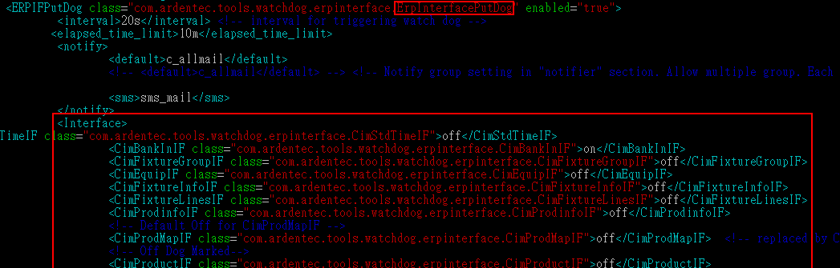
dog.xml mandatory setting
Watchdog Configuration
  ErpInterfacePutDog 控制其他MIS 相關抄寫的Dog(下一週有詳細介紹)

Slide 9
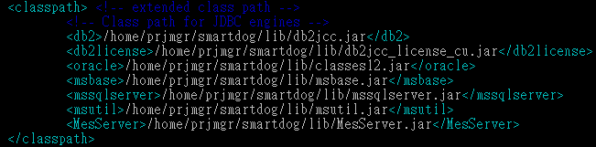
dog.xml mandatory setting
classpath
  Dog 會使用到的Jar

Slide 10
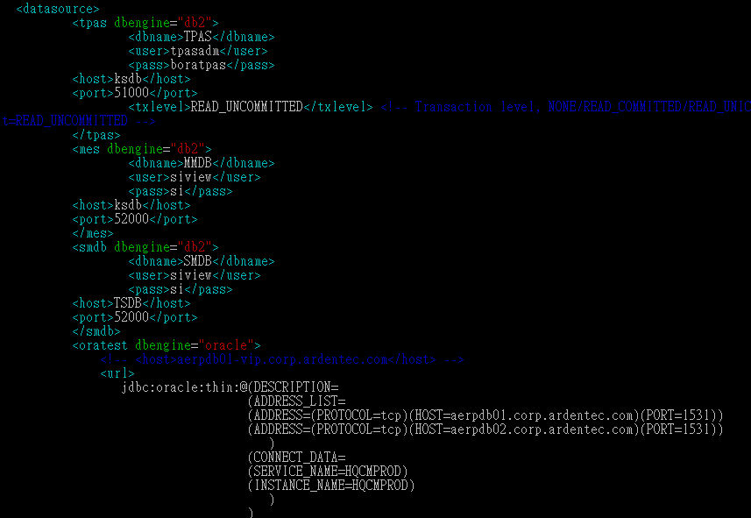
dog.xml mandatory setting
datasource

Slide 11
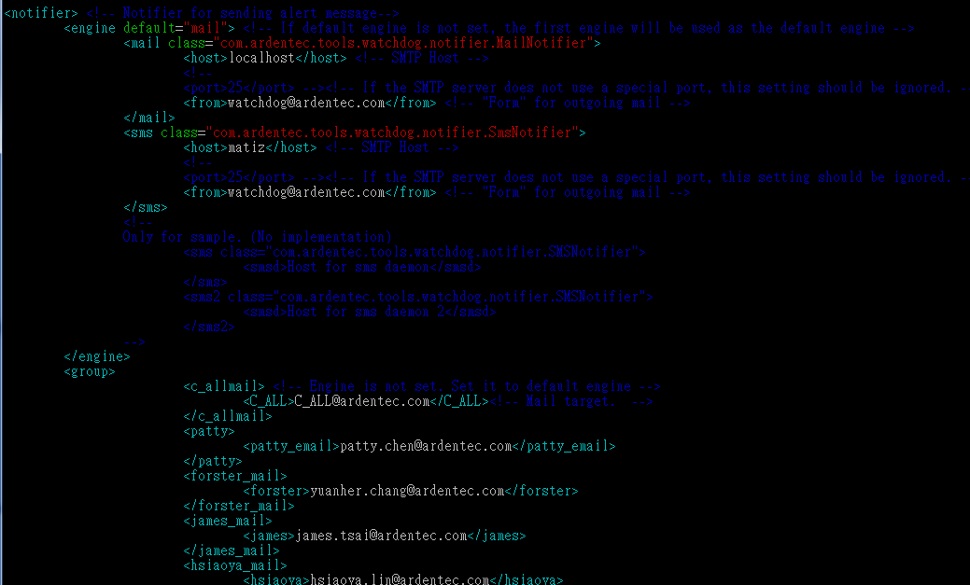
dog.xml mandatory setting
Notifier

Slide 12
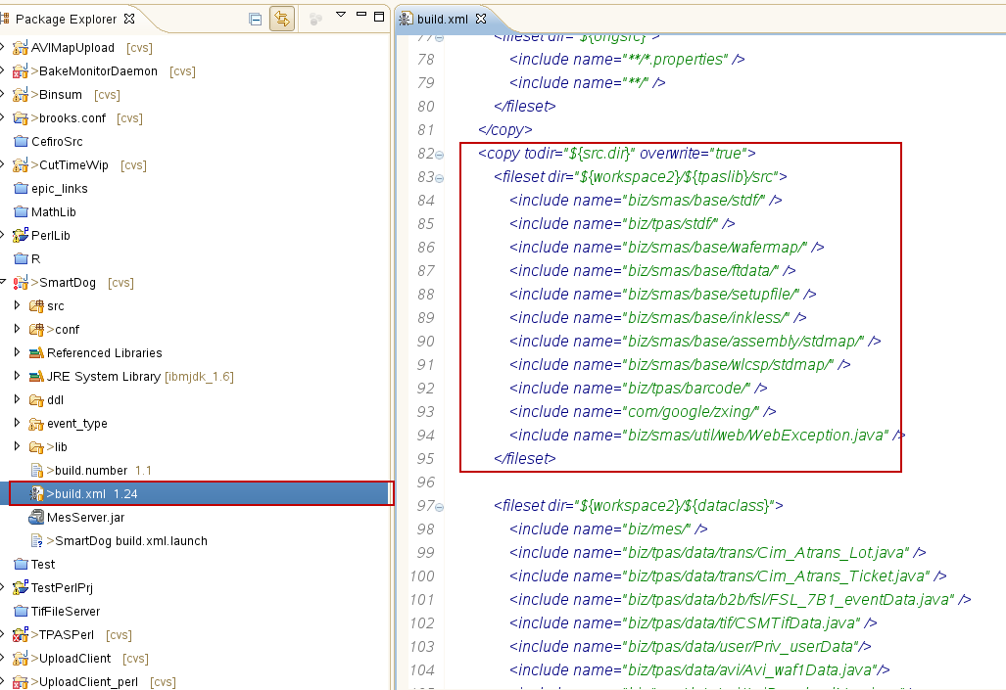
External library
Dog 有使用tpaslib.jar and dataclass…etc, 不需要寫一份相同的程式於smart dog.
執行build.xml, 會根據設定 copy file to Dog.jar

Slide 13
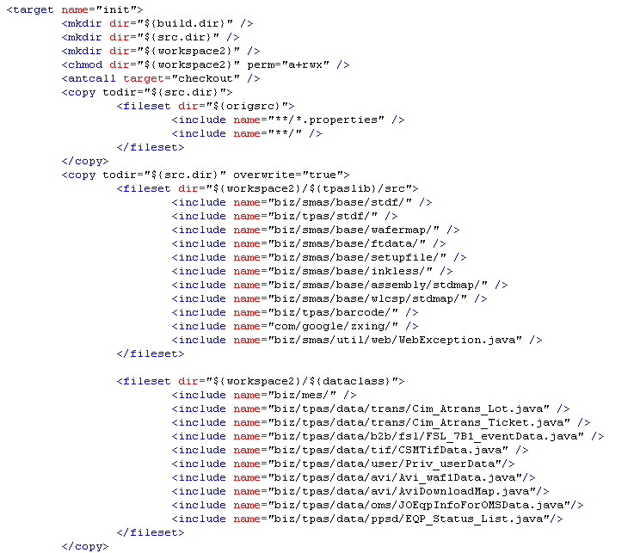
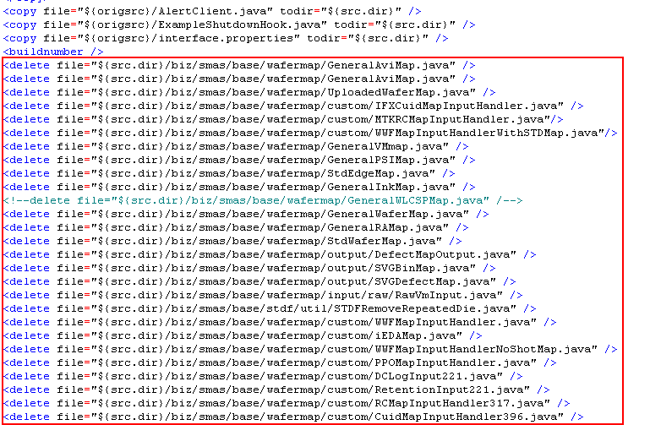
External library
Library copy setting
Library delete setting
tpaslib.jar
dataCalss.jar

Slide 14
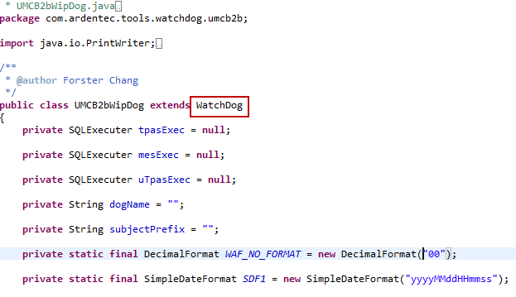
Watchdog
Extends WatchDog
子類別實作
  protected void init();
  protected void process() throws Throwable;
  protected void configure(Category conf);
  protected void TxBegin() throws SQLException;
  protected void TxCommit() throws SQLException;
  protected void TxRollBack() throws SQLException;

Slide 15
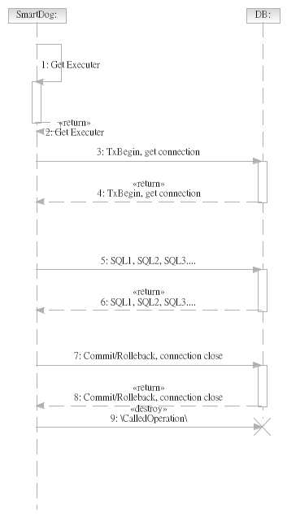
TX Flow
TxBegin()
TxCommit()
TxRollBack()

Slide 16
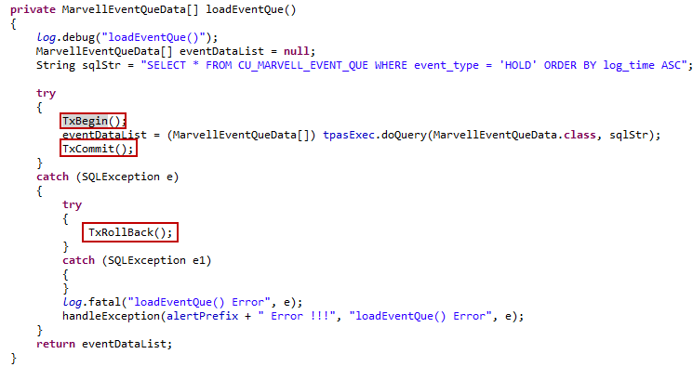
TX Flow
Sample Code

Slide 17
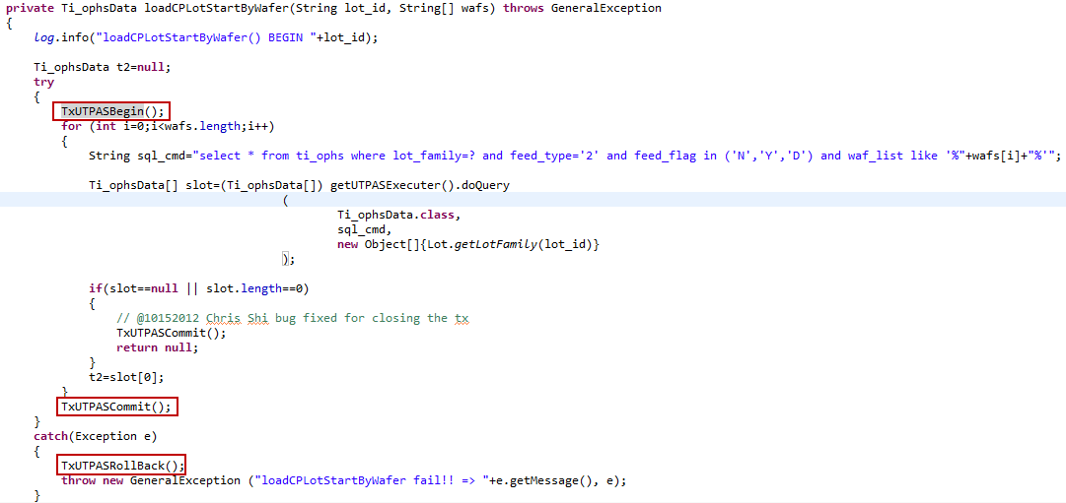
TX Flow
Sample Code

Slide 18
LOG
Levels
  SEVERE (highest value)
  WARNING
  INFO
  CONFIG
  FINE
  FINER
  FINEST (lowest value)
In addition there is a level OFF that can be used to turn off logging, and a level ALL that can be used to enable logging of all messages.

Slide 19
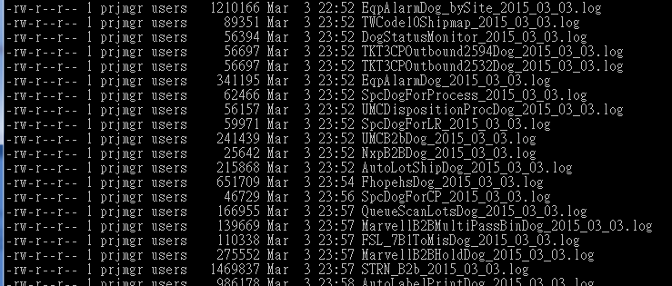
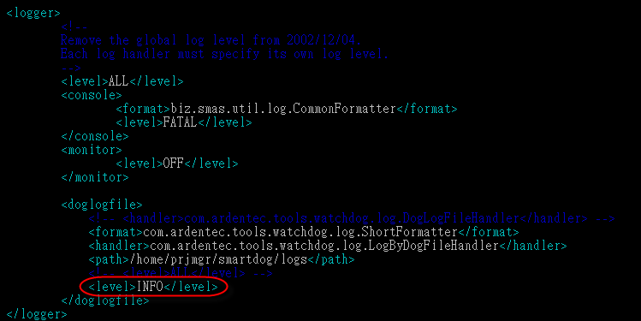
LOG
Path for each Dogs
  /home/prjmgr/smartdog/logs
  Setting

Slide 20
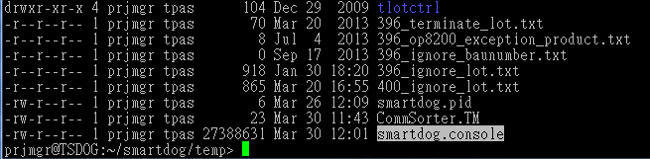
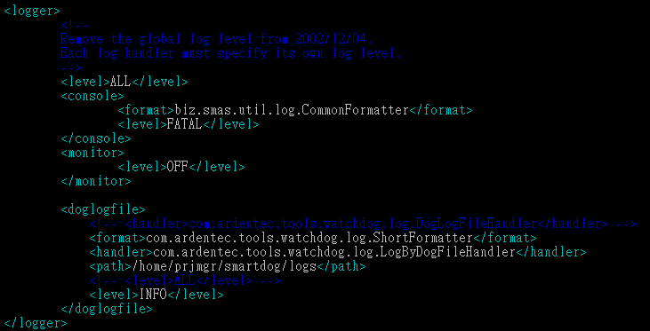
LOG
Console Path
  /home/prjmgr/smartdog/temp/smartdog.console

Slide 21
Status Monitor
DogStatusMonitor.java
  Format control: DogStatusReport.java
  Send SMS/Mail if error occurred
DogHttpAdmin.java
  Format control: DogStatusReport.java
  Provide a web site for status monitor

Slide 22
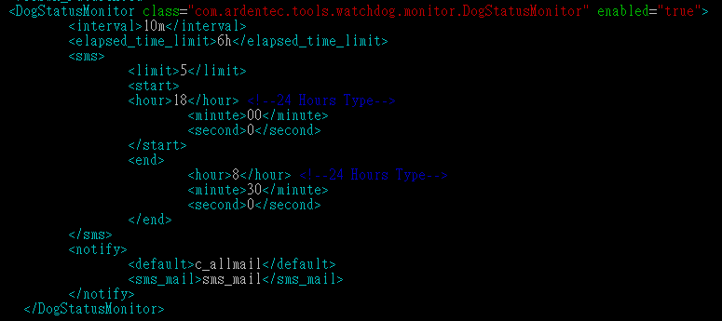
Status Monitor
DogStatusMonitor.java
SMS “連續”send 次數上限
SMS 作用時間區間

Slide 23
Status Monitor
DogStatusMonitor
Load Active Dogs
Limit= ElapsedTimeLimit/Interval
Verify Amount Of Enable Dogs
Active dogs = enable dogs(dog.xml)
End
runCounte <= limit and no error type
Routine or Alarm
Check alarm type
Mail
Y
Routine
Alarm
lost
hang
N
Routine: Normal or Has error type
Alarm: Has alarm type
elapsedTime > elapsedTimeLimit or
lastExecuteTime > elapsedTimeLimit
Mail
Has error type?
SMS count > SMS limit
END
LastStatus is not empty and LastStatus !="Successful"
Y
Y
N
N
Reset SMS count
And run count
SMS time interval between 08:30 and 18:00
SMS
N
Y
Send normal mail
Mail

Slide 24
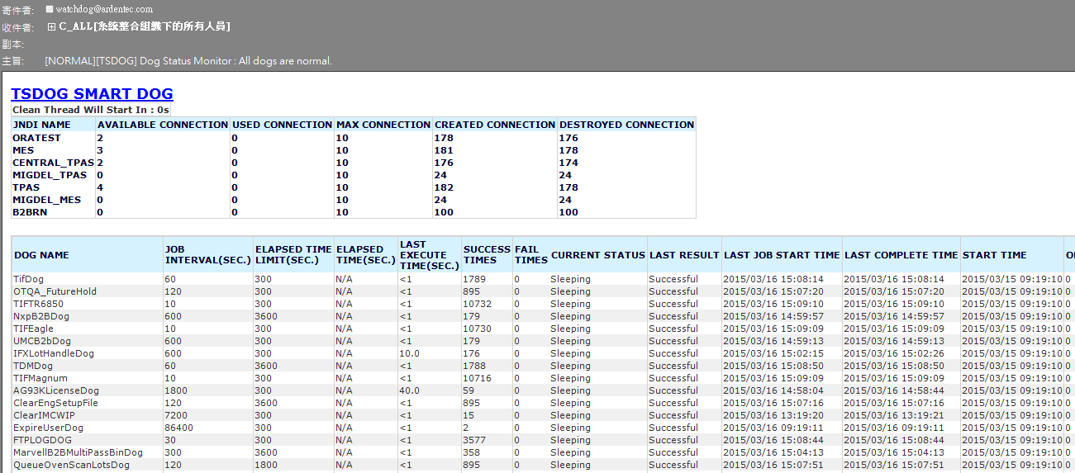
Status Monitor
DogStatusMonitor :Normal

Slide 25
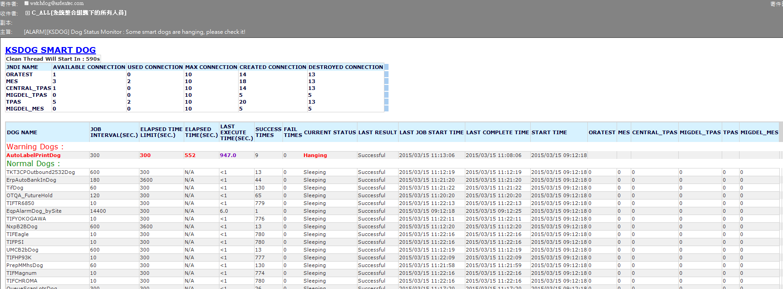
Status Monitor
DogStatusMonitor :Alarm

Slide 26
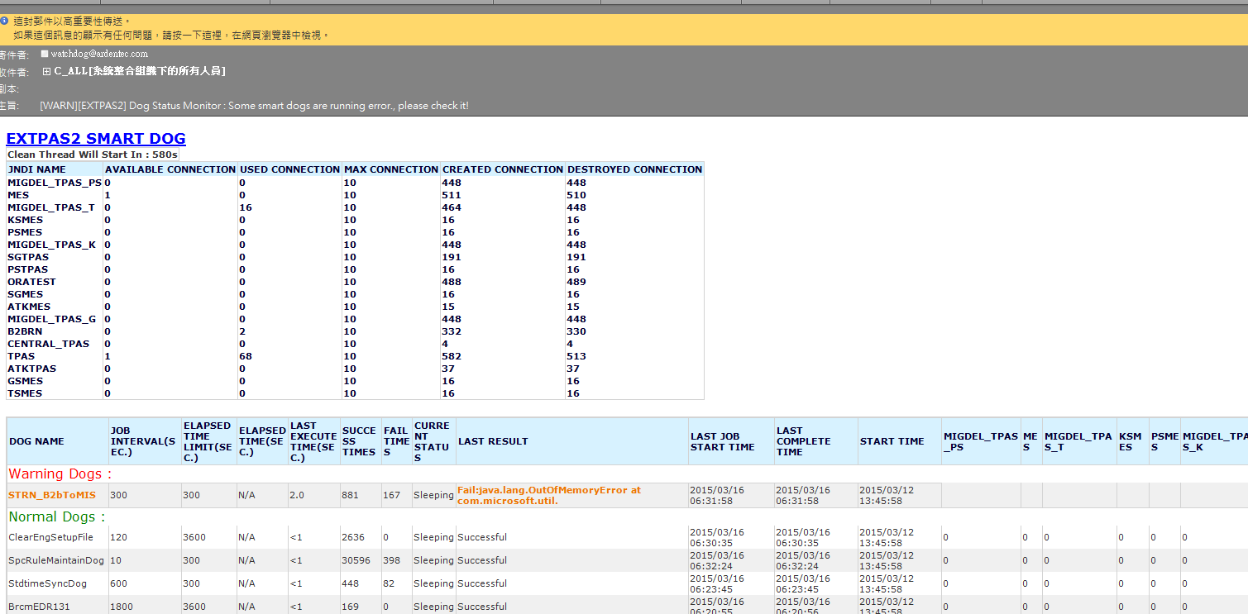
Status Monitor
DogStatusMonitor :Error

Slide 27
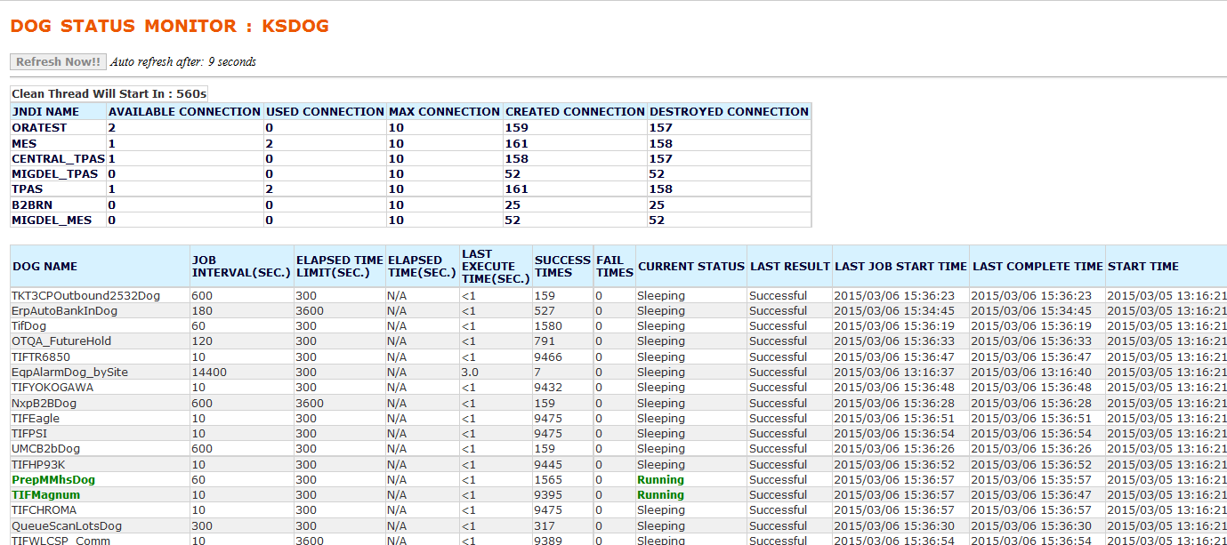
Status Monitor
DogHttpAdmin.java
URL:
  KS: http://ksdog:8090/
  TS: http://tsdog:8090/
  GS: http://gsdog:8090/
  …

