Slide 1
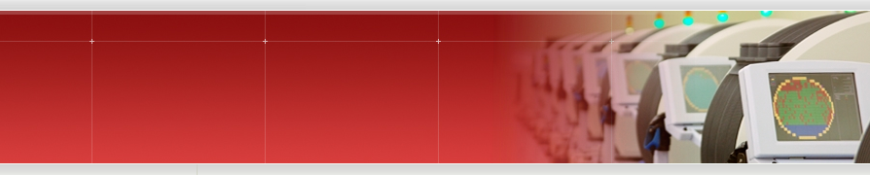
Tester Interface
MES/TPAS
Interface Server
Upload Server
Tester UI
Lot
Operation Start
1) lot info from MES
Lot Start
Watchdog
Lot Start
2) PGM info from TPAS
WinTif.exe gets
Lot Start file
3) Test data upload
Upload Procedure
Upload
Dispatching
Wafer End
Upload Client packs
upload_data.zip

