Slide 1
Infrastructure Introduction
San

Slide 2
Topic
Production Environment
Development Environment
For further details, please refer to http://cvs:8080/cb/project/17

Slide 3
Production Environment
T-Site(鼎新廠)
K-Site(開源廠)
G-Site(高昇廠)
P-Site(寶慶廠)
SG-Site(新加坡廠)
ATDK-Site(韓國廠)
DW(鼎新廠）

Slide 4






TPAS Architecture
Factory Work
Planning
Dispatching
Daemon(s)
DB Server
Upload Clients
1
IBM
AsmView
4
MES
2
WebRPC
AP Server
5
3
JDBC
TPAS
TPAS
(J2EE 1.4)

Slide 5
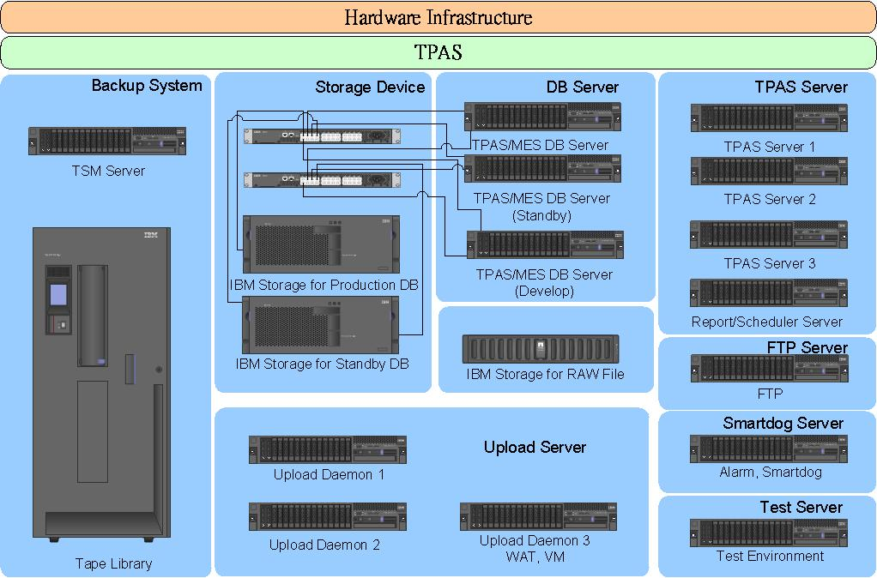
Hardware Infrastructure-each site

Slide 6
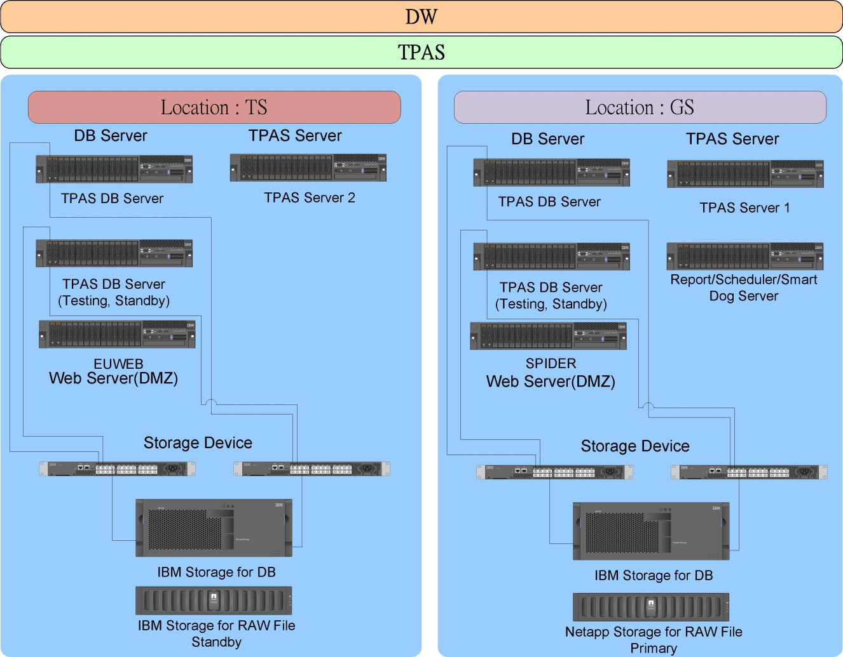
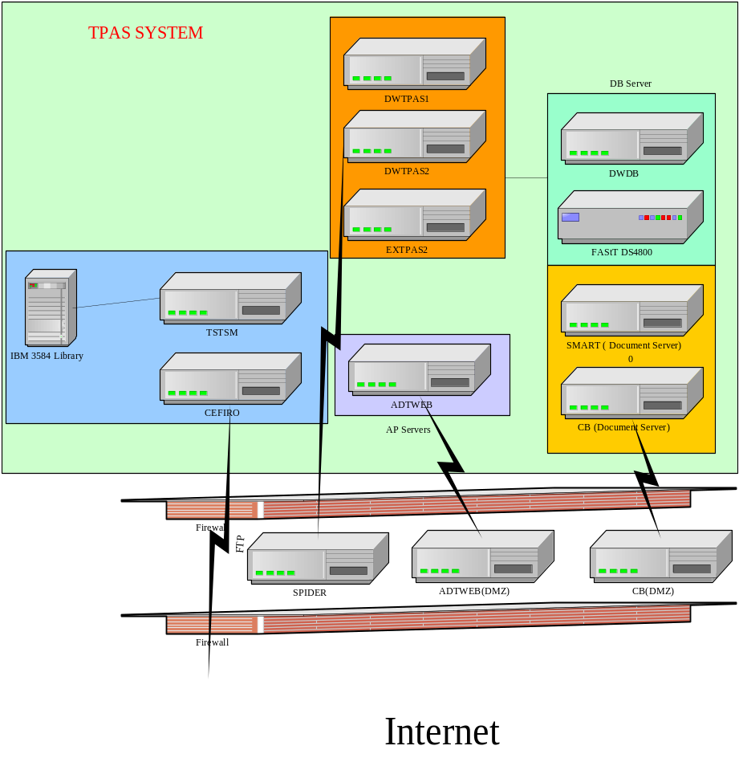
Hardware Infrastructure -DW

Slide 7
Production - TPAS
  OS - SUSE Enterprise 11 SP2/SP3 64Bit
X = TS, KS, GS, PS
Upload Daemon
  XUP1、XUP2、XUP3
Database Server
  XDB1、XDB2、XSDB3
  IBM DB2 9.7 FixPak7
SmartDog Server
  XDOG

Slide 8
Production - TPAS
TPAS AP Server
  XTPAS1、XTPAS2、XTPAS3、XSCH、 DWTPAS1、DWTPAS2、EXTPAS2
  WebSphere Advance Server Edition 7.0.0.21
FTP Server
  XFTP

Slide 9
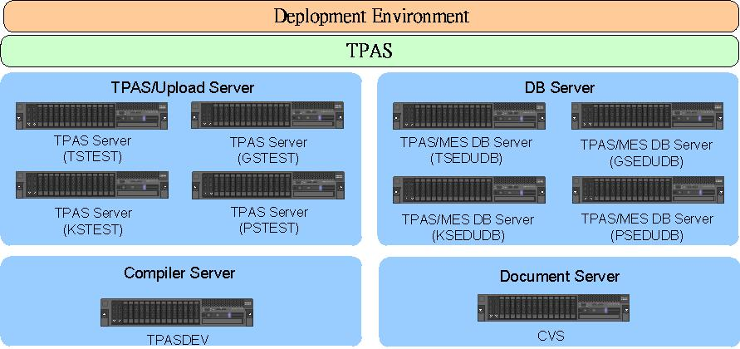
Development Enviroment

Slide 10
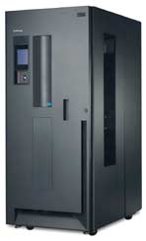
TSM Server
TSTSM/KSTSM/GSTSM/PSTSM
  IBM x3650M4
  TSM Server V6.2 level 5.0
IBM 3584 Library
  4 LTO5 Drivers
  287 Tape

