Slide 1
Introduction replication
San Lai

Slide 2
Topic
Q replication--Overview
SQL replication—Overview
Infrastructure for an SQL replication environment
Registration of sources in SQL replication
Subscription sets in SQL replication
Capture of data from DB2 UDB sources in SQL replication
Application of data to DB2 UDB targets in SQL replication
Capture of data from non-DB2 sources in SQL replication
Application of data to non-DB2 targets in SQL replication

Slide 3
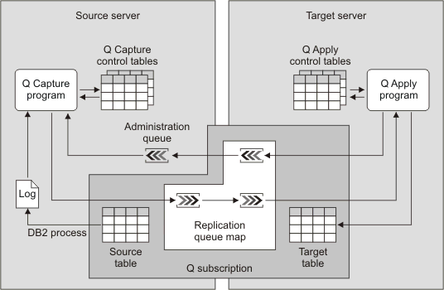
Q replication--Overview

Slide 4
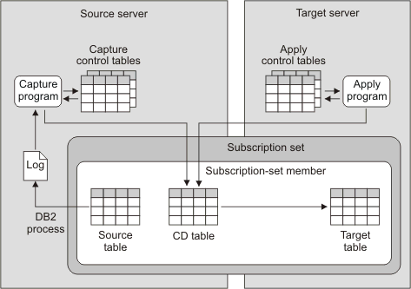
SQL replication--Overview

Slide 5
Infrastructure for an SQL replication environment
SQL replication allows you to replicate data from DB2(R) UDB sources to targets by using two programs: Capture and Apply. The Capture program runs on the source system. The Capture program reads DB2 recovery logs for changed source data and saves the committed changed data to staging tables. The Apply program typically runs on the target system. The Apply program retrieves captured data from staging tables and delivers the data to targets. Both programs use a set of DB2 tables to track the information that they require to do their tasks and to store information that they generate themselves, such as information that you can use to find out how well they are performing. You create these tables before you tell SQL replication what your replication sources and targets are.

Slide 6
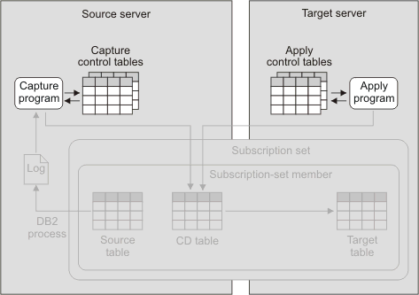
Infrastructure for an SQL replication environment

Slide 7
Registration of sources in SQL replication
When you know what you want your replication sources to be, you tell SQL replication about them by registering them. You can register sources that are DB2(R) UDB tables and views, or tables on non-DB2 relational databases.

Slide 8
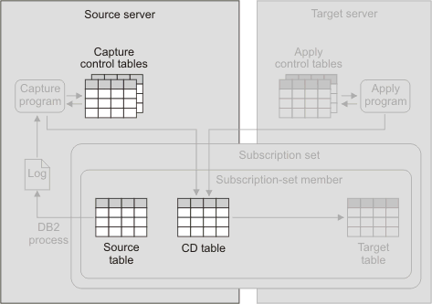
Registration of sources in SQL replication

Slide 9
Subscription sets in SQL replication
After you register your sources, you create subscription sets , in which you pair your sources with targets. Each source-target pair is referred to as a member of the subscription set in which it is created. You can use subscription sets to schedule the replication of data in one or more source-target pairs from one source server to one target server. The Apply program coordinates this replication so that it applies data to targets in a manner consistent with the original transactions on the source server.

Slide 10
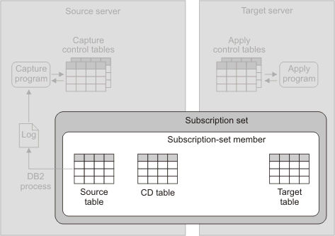
Subscription sets in SQL replication

Slide 11
Capture of data from DB2 UDB sources in SQL replication
The Capture program reads the DB2 recovery log for changes made to your sources and then stages those changes in relational tables. In the figure, the Capture program reads the DB2 log for changes to the source table and stages committed transactional data in the source's change-data (CD) table. The Capture program continuously updates its control tables with information that you can use to monitor its progress.

Slide 12
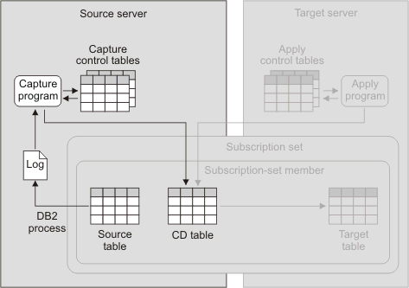
Capture of data from DB2 UDB sources in SQL replication

Slide 13
Application of data to DB2 UDB targets in SQL replication
The Apply program reads data from staging tables and makes the appropriate changes to targets. In the figure, the Apply program reads data from the source table's CD table and then makes the appropriate changes to the target table. The Apply program continuously updates its control tables with information that you can use to monitor its progress.

Slide 14
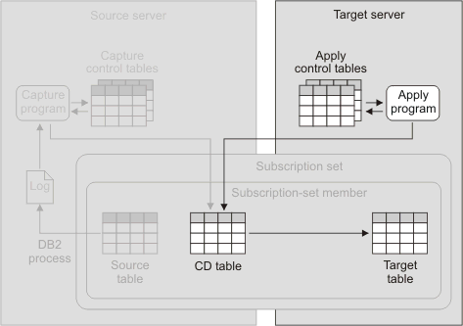
Application of data to DB2 UDB targets in SQL replication

Slide 15
Capture of data from non-DB2 sources in SQL replication
Replicating data from non-DB2 sources to DB2 UDB targets.
Triggers populate a staging table called a consistent-change-data (CCD) table with records of changes made to a source table. The Apply program reads the CCD table through that table's nickname on the DB2 II federated database. The Apply program then makes the appropriate changes to the target table.

Slide 16
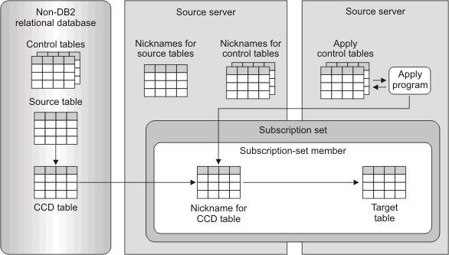
Capture of data from non-DB2 sources in SQL replication

Slide 17
Application of data to non-DB2 targets in SQL replication
Replicating from DB2 UDB sources to non-DB2 targets.
The Capture program populates a CD table with the changes made to the corresponding source table. The Apply program reads the data in the CD table and applies the changes to the target table through the target's nickname on the DB2 Information Integrator federated database.

Slide 18
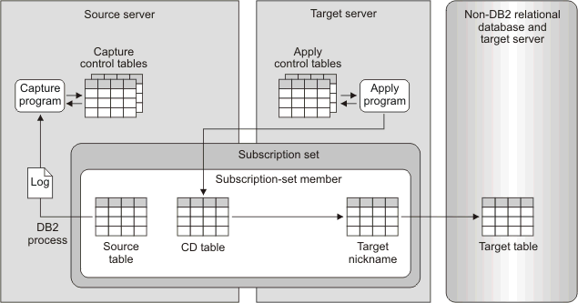
Application of data to non-DB2 targets in SQL replication

Slide 19
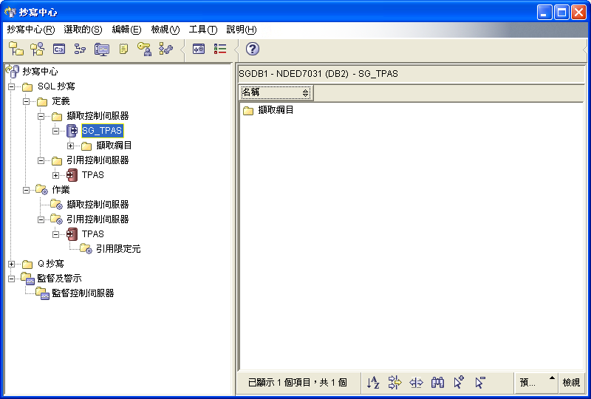
Replication center

