Slide 1
Training for DB2 V
San lai

Slide 2
Topic
IBM data server client types
Java Database Connectivity(JDBC)
DB2 Information Center
DB2 Trouble Shooting

Slide 3
IBM data server client types
There are several types of IBM® data server clients and drivers available. Each provides a particular type of support.
The following lists the IBM data server client and driver types available to you:
IBM Data Server Driver for JDBC and SQLJ
IBM Data Server Driver for ODBC and CLI
IBM Data Server Driver Package
IBM Data Server Runtime Client
IBM Data Server Client

Slide 4
IBM data server client types
Each IBM data server client and driver provides a particular type of support:
For Java applications only, use IBM Data Server Driver for JDBC and SQLJ.
For applications using ODBC or CLI only, use IBM Data Server Driver for ODBC and CLI. (Also referred to as cli driver.)
For applications using ODBC, CLI, .NET, OLE DB, PHP, Ruby, JDBC, or SQLJ, use IBM Data Server Driver Package.
For applications using DB2CI, use IBM Data Server Client.
If you need DB2® Command Line Processor Plus (CLPPlus) support, use IBM Data Server Driver Package.
To have command line processor (CLP) support and basic client support for running and deploying applications, use IBM Data Server Runtime Client.
To have support for database administration, and application development using an application programming interface (API), such as ODBC, CLI, .NET, or JDBC, use IBM Data Server Client.

Slide 5
Java Database Connectivity(JDBC)
JDBC can be especially useful for accessing DB2 databases across the Internet. Using the Java programming language, you can develop JDBC applets and applications that access and manipulate data in remote DB2 databases using a network connection. You can also create JDBC stored procedures that reside on the server, access the database server, and return information to a remote client application that calls the stored procedure.

Slide 6
JDBC
JDBC Type 2
Java applications based on the JDBC type 2 driver rely on the DB2 client to connect to DB2. You start your application from the desktop or command line, like any other application. The DB2 JDBC driver handles the JDBC API calls from your application, and uses the client connection to communicate the requests to the server and to receive the results. You cannot create Java applets using the JDBC type 2 driver.
Note：
The JDBC type 2 driver is recommended for WebSphere(R) Application Servers.
JDBC Type 3
If you use the JDBC type 3 driver, you can only create Java applets. Java applets do not require the DB2 client to be installed on the client machine. Typically, you would embed the applet in a HyperText Markup Language (HTML) web page.

Slide 7
JDBC
JDBC Type 4
You can use the JDBC type 4 driver, which is new for Version 8, to create both Java applications and applets. To run an application or an applet that is based on the type 4 driver, you only require the db2jcc.jar file.

Slide 8
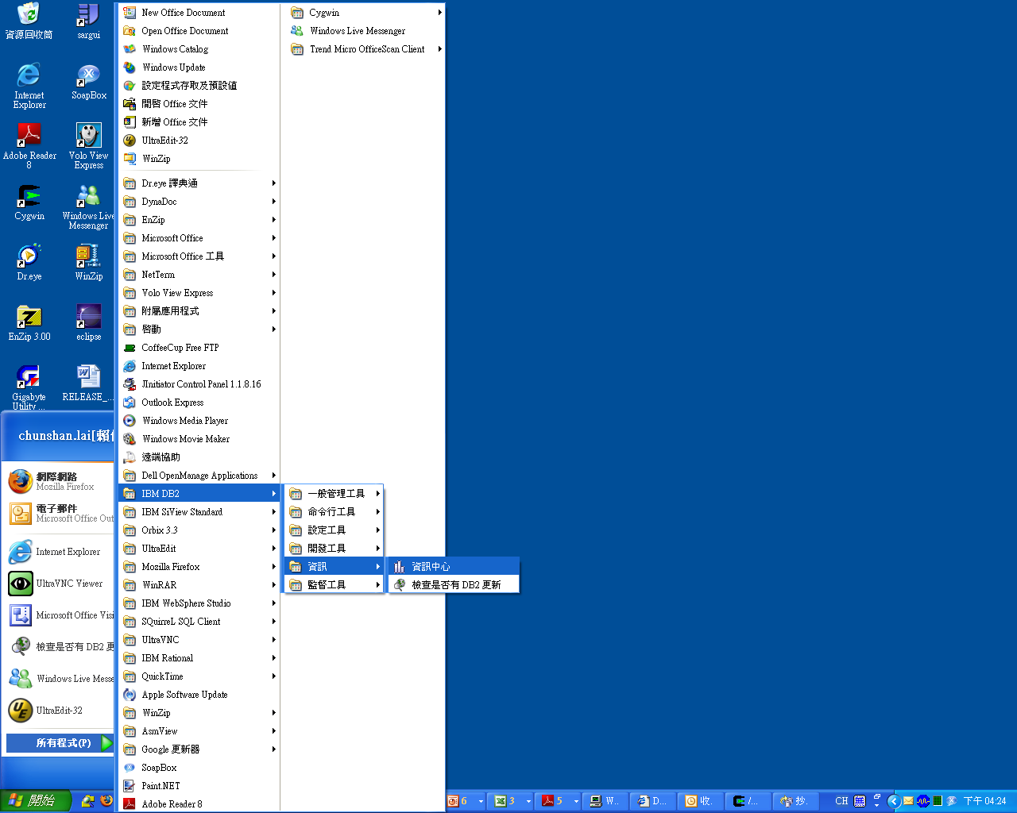
DB2 Information Center

Slide 9
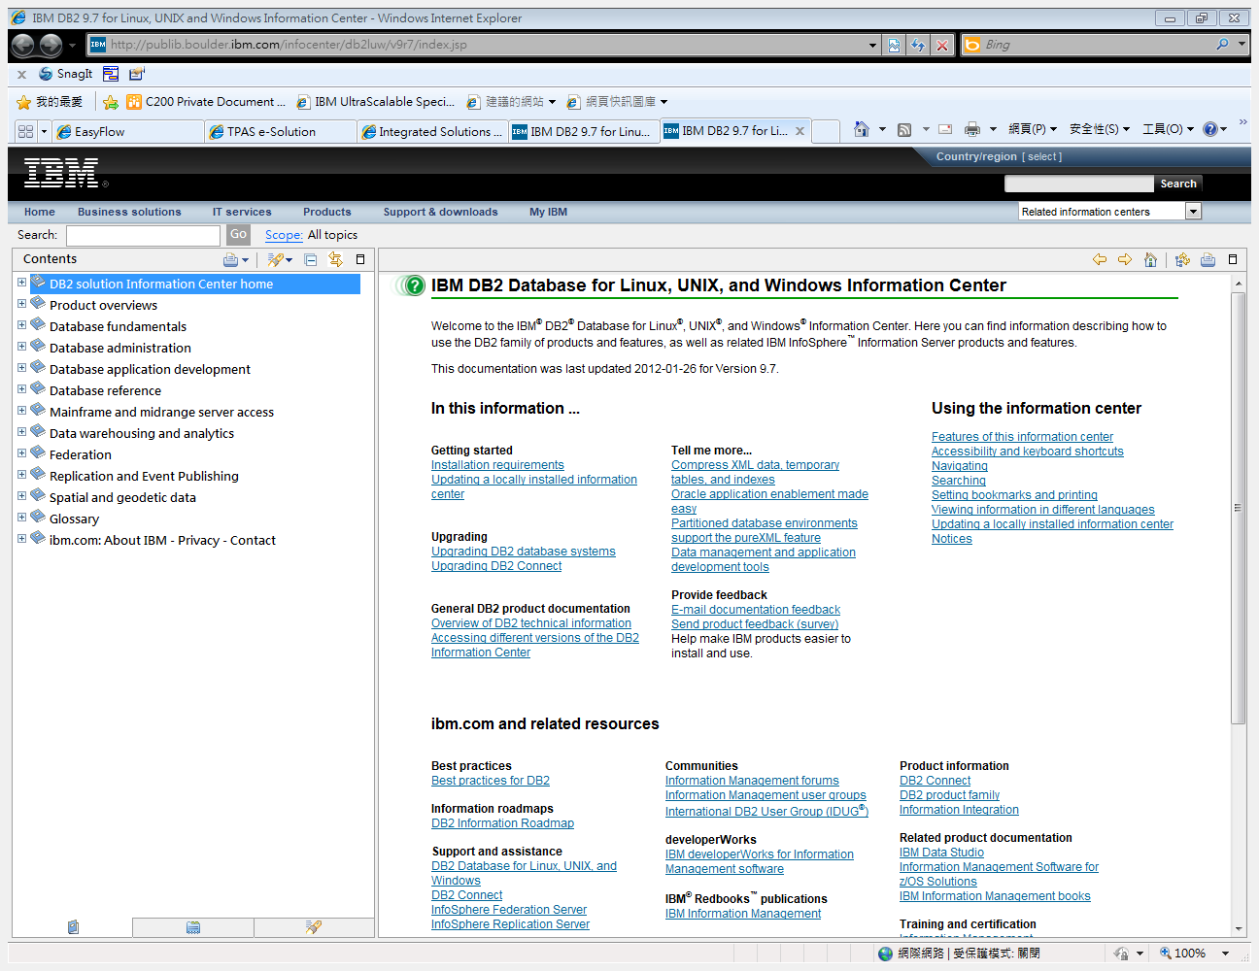
DB2 Information Center

Slide 10
DB2 Trouble Shooting
Message Reference Volume 1
Message Reference Volume 2
DB2 ? SQL????

Slide 11
db2 ? SQL0911N
SQL0911N The current transaction has been rolled back because of
a deadlock or timeout. Reason code "<reason-code>".
Explanation:
The current unit of work was involved in an unresolved contention
for use of an object and had to be rolled back.
The reason codes are as follows:
2 transaction rolled back due to deadlock.
68 transaction rolled back due to lock timeout.
72 transaction rolled back due to an error concerning a DB2 Data
Links Manager involved in the transaction.
Note: The changes associated with the unit of work must be
entered again.
The application is rolled back to the previous COMMIT.
User Response:
To help avoid deadlock or lock timeout, issue frequent COMMIT
operations, if possible, for a long-running application, or for
an application likely to encounter a deadlock.
Federated system users: the deadlock can occur at the federated
server or at the data source. There is no mechanism to detect
deadlocks that span data sources and potentially the federated
system. It is possible to identify the data source failing the
request (refer to the problem determination guide to determine
which data source is failing to process the SQL statement).
Deadlocks are often normal or expected while processing certain
combinations of SQL statements. It is recommended that you
design applications to avoid deadlocks to the extent possible.
sqlcode : -911
sqlstate : 40001

Slide 12
db2pd - Monitor and troubleshoot DB2 Universal Database Command
The db2pd utility retrieves information from the DB2 UDB memory sets.
http://publib.boulder.ibm.com/infocenter/db2luw/v9r7/index.jsp

