Slide 1
Introduction DB2
San lai

Slide 2
Topic
Licesing
Overview of Database Objects
Overview of Storage Objects
Overview of System Objects

Slide 3
Licesing
The db2licm tool performs basic license functions in the absence of the
Control Center. It adds, removes, lists, and modifies licenses registered on the local system. Execute db2licm tool with -l parameter to find out the product identifier for your product:
db2licm [-a filename]
[-e product-identifier HARD | SOFT]
[-p product-identifier CONCURRENT | OFF]
[-r product-identifier]
[-u product-identifier num-users]
[-c product-identifier num-connectors]
[-g filename]
[-x]
[-l][show detail]
[-v]
[-?]

Slide 4
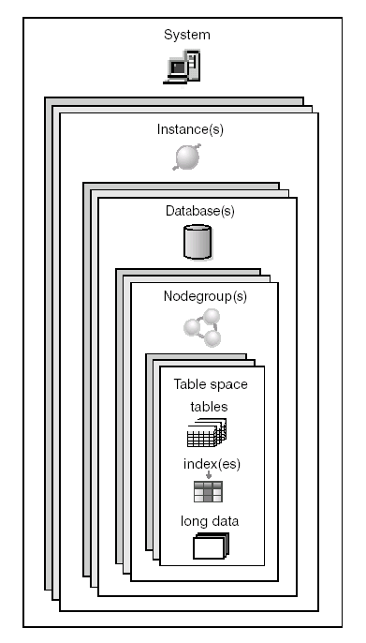
Overview of Database Objects
System
Instances
Databases
Nodegroups
Tables
Views
Indexes
Schemas
System catalog tables

Slide 5
Database Objects
Systems:
DB2 databases are organized around a hierarchy of database objects. The highest-level object in the hierarchy is a system. A system represents an installation of DB2. The Control Center maintains a list of systems that it knows about and records the information needed to communicate with each system (such as its network address, operating system, and communication protocol). The Control Center supports both DB2 and IMS™ systems.
A system can have one or more DB2 instances, each of which can manage one or more databases. The databases may be partitioned with their table spaces residing in database partition groups. The table spaces in turn store table data.
Instances:
An instance (sometimes called a database manager) is DB2® code that manages data. It controls what can be done to the data, and manages system resources assigned to it. Each instance is a complete environment. It contains all the database partitions defined for a given parallel database system. An instance has its own databases (which other instances cannot access), and all its database partitions share the same system directories. It also has separate security from other instances on the same machine (system).

Slide 6
Database Objects
Databases:
A relational database presents data as a collection of tables. A table consists of a defined number of columns and any number of rows. Each database includes a set of system catalog tables that describe the logical and physical structure of the data, a configuration file containing the parameter values allocated for the database, and a recovery log with ongoing transactions and transactions to be archived.
Database partition groups:
A database partition group is a set of one or more database partitions. When you want to create tables for the database, you first create the database partition group where the table spaces will be stored, then you create the table space where the tables will be stored.
In earlier versions of DB2 UDB, database partition groups were known as nodegroups.
Table spaces:
A database is organized into parts called table spaces. A table space is a place to store tables. When creating a table, you can decide to have certain objects such as indexes and large object (LOB) data kept separately from the rest of the table data. A table space can also be spread over one or more physical storage devices.

Slide 7
Database Objects
Tables:
A relational database presents data as a collection of tables. A table consists of data logically arranged in columns and rows. All database and table data is assigned to table spaces. The data in the table is logically related, and relationships can be defined between tables. Data can be viewed and manipulated based on mathematical principles and operations called relations.
Table data is accessed through Structured Query Language (SQL), a standardized language for defining and manipulating data in a relational database.
Views:
A view is an efficient way of representing data without the need to maintain it. A view is not an actual table and requires no permanent storage. A ″virtual table″ is created and used.
Indexes:
As data is added to a table, unless other actions have been carried out on the table or the data being added, it is simply appended to the bottom of the table. There is no order to the data. When searching for a particular row of data, each row of the table from first to last must be checked. Indexes are used as a means to access the data within the table in an order that might otherwise not be available.

Slide 8
Management instances
db2icrt
db2idrp
db2ilist
db2iupdt

Slide 9
Overview of Storage Object
Table space
Container
Buffer pool

Slide 10
Table spaces and storage management
A table space is a storage structure containing tables, indexes, large objects, and long data. They are used to organize data in a database into logical storage groupings that relate to where data is stored on a system. Table spaces are stored in database partition groups.
Table spaces can be set up in different ways, depending on how you want them to use available storage. You can have the operating system manage allocations of space, or you can have the database manager allocate space for your data, based on parameters you specify. Or you can create table spaces that allocate storage automatically.
The three types of table spaces are known as:
System managed space (SMS), in which the operating system's file manager controls the storage space once you have defined the location for storing database files
Database managed space (DMS), in which the database manager controls the usage of storage space one you have allocated storage containers.
Automatic storage table spaces, in which the database manager controls the creation of containers as needed.

Slide 11
SMS vs DMS
System-managed space (SMS)
The operating system manages SMS table spaces. Containers are defined as regular operating system files, and they are accessed using operating system calls. This means that all the regular operating system functions handle the following:
I/O is buffered by the operating system
Space is allocated according to the operating system conventions
The table space is automatically extended when needed
However, containers cannot be dropped from SMS table spaces, and adding new ones is restricted to partitioned databases. In version 9.1 and above, the only default SMS tablespace created during database creation is TEMPSPACE1.
Database-managed space (DMS)
DB2 manages DMS table spaces. Containers can be defined either as files, which will be fully allocated with the size given when the table space is created, or as devices. DB2 manages as much of the I/O as the allocation method and the operating system allow. Extending the containers is possible using the ALTER TABLESPACE command. Unused portions of DMS containers can be also released (starting with version 8).

Slide 12
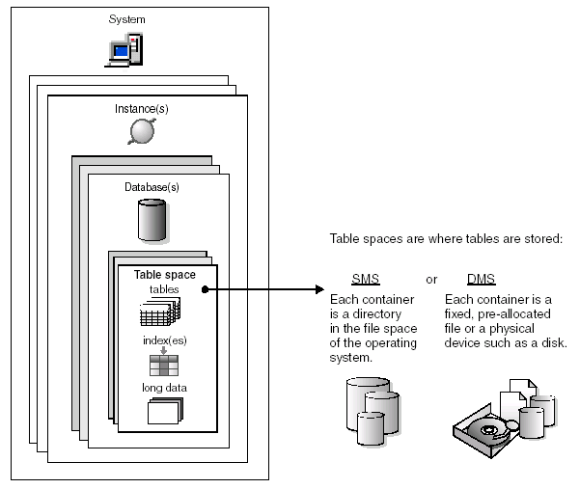
Table Space – DMS vs SMS

Slide 13
Automatic storage table spaces
Automatic storage table spaces can be created in an automatic storage database using the CREATE TABLESPACE command. By default, new tables spaces in a database where automatic storage is enabled are automatic storage table spaces, so the MANAGED BY AUTOMATIC STORAGE clause is optional. You can also specify options when creating the automatic storage table space, such as its initial size, the amount that the table space will be increased when the table space is full, and the maximum size that the table space can grow to.

Slide 14
Table space - Type
Because there are different uses for table spaces, they are classified according to their usage and how they will be managed. There are five different table spaces, named according to their usage:
Catalog table space
There is only one catalog table space per database, and it is created when the CREATE DATABASE command is issued. Named SYSCATSPACE by DB2, the catalog table space holds the system catalog tables. This table space is always created when the database is created.
Regular table space
A regular table space stores all permanent data, including regular tables and indexes. It can also hold large data such as LOBs (Large Objects) unless they are explicitly stored in a large table space. A table and its indexes can be divided into separate regular table spaces, if the table spaces are database-managed space (DMS) for non-partitioned tables or system-managed space (SMS) for partitioned tables. DMS and SMS are described in the section Table space management. Catalog table space is an example of a regular table space. By default, the catalog table space is the only regular table space created during the database creation.

Slide 15
Table space - Type
Large table space
A large table space stores all permanent data just as a regular table space does, including LOBs. This table space type must be DMS, which is the default type. A table created in a large table space can be larger than a table in a regular table space. A large table can support more than 255 rows per data page improving space utilization on data pages. DB2 creates one large table space named USERSPACE1 when a database is created.
System temporary table space
A system temporary table space stores internal temporary data required during SQL operations such as sorting, reorganizing tables, creating indexes, and joining tables. At least one system temporary must exist per database. The default created with the database is named TEMPSPACE1.
User temporary table space
A user temporary table space stores declared global temporary tables. No user temporary table spaces exist when a database is created. At least one user temporary table space should be created to allow definition of declared temporary tables. User temporary table spaces are optional. No user temporary table space is created by default.

Slide 16
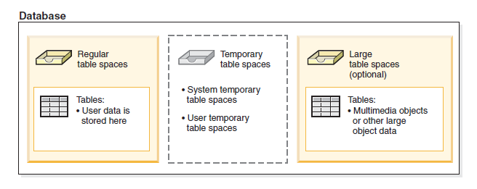
Table Space - type

Slide 17
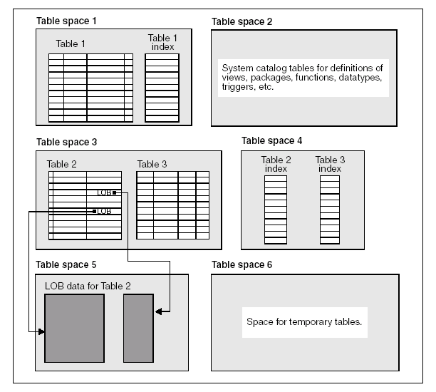
Table Space

Slide 18
Container
A container is a physical storage device. It can be identified by a directory name, a device name, or a file name.
A container is assigned to a table space. A single table space can span many containers, but each container can belong to only one table space.

Slide 19
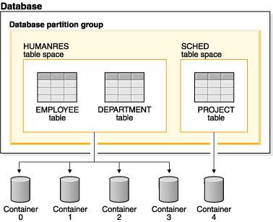
Container

Slide 20
Buffer Pool
A buffer pool is the amount of main memory allocated to cache table and index data pages as they are being read from disk, or being modified. The purpose of the buffer pool is to improve system performance. Data can be accessed much faster from memory than from disk; therefore, the fewer times the database manager needs to read from or write to a disk (I/O), the better the performance. (You can create more than one buffer pool, although for most situations only one is required.)
A buffer pool is associated with a single database and can be used by more than one table space. When considering a buffer pool for one or more table spaces, you must ensure that the table space page size and the buffer pool page size are the same for all table spaces that the buffer pool services. A table space can only use one buffer pool.

Slide 21
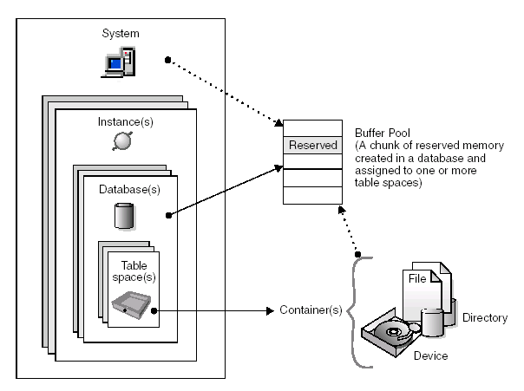
Buffer Pool

Slide 22
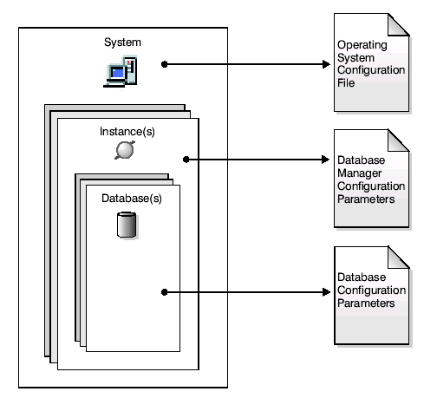
Overview of System Object - Configuration Parameter

Slide 23
Db2 command(con’t)
Get database manager configuration (get dbm cfg)
Get database configuration for db_name (get db cfg for db_name)
Update dbm cfg /update db cfg for db_name

Slide 24
db2set
The db2set command supports the local declaration of the registry variables(and environment variables).
db2set [[[variable=[value]]
[-g|-i instance[node-number]]]
[-all] [-null]
[-r [instance[node-number]]]
[-n DAS node[
-u user[-p password]]]
[-l|-lr] [-v] [-ul|-ur]
[-?|-h]

Slide 25
resource
Administrator Guide – Implementation
Administrator Guide – Performance
Administrator Guide - Planning

