Slide 1
San lai

Slide 2
Topic
HA Take Over
Snapshot Status
DB2 DIAG
Application Handling

Slide 3
HA Take Over
High Availability
  Virtual IP
  HADR

Slide 4
HADR Feature
The DB2® Data Server High Availability Disaster Recovery (HADR) feature is a database replication feature that provides a high availability solution for both partial and complete site failures. HADR protects against data loss by replicating data changes from a source database, called the primary, to a target database, called the standby.
The standby database is kept in synch with the primary database through log data that is generated on the primary and shipped to the standby. The standby constantly rolls forward through the logs.

Slide 5
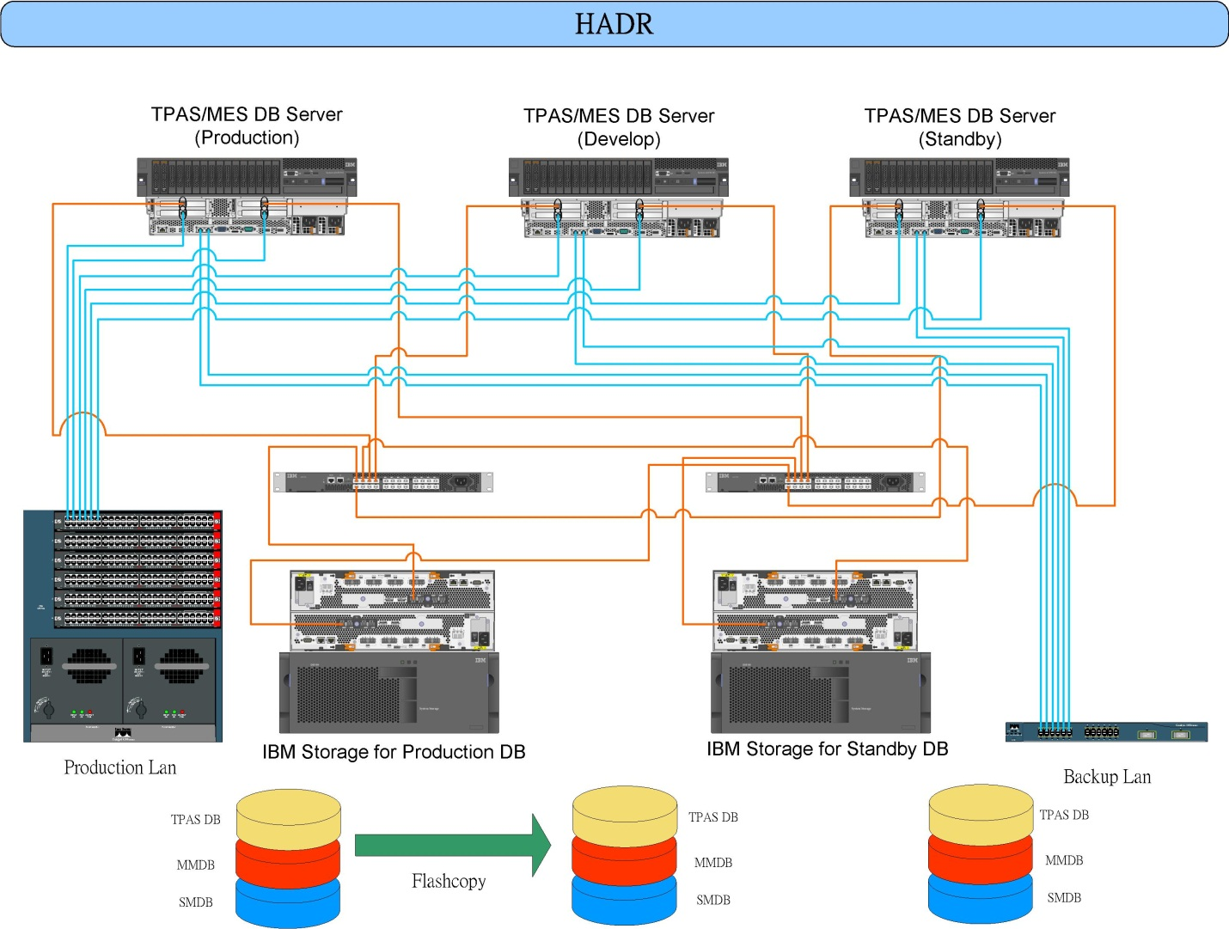
HADR Architecture

Slide 6
HADR commands
There are three high availability disaster recover (HADR) commands used to manage HADR:
Start HADR
Stop HADR
Takeover HADR

Slide 7
Start/Stop/Takeover HADR
Start HADR
Primary
start hadr on db db_name as primary
Standby
start hadr on db db_name as standby
Stop HADR
Primary
stop hadr on db db_name
Standby
deactivate db db_name
stop hadr on db db_name
Takeover HADR
Standby
takeover hadr on db db_name [by force [peer window only]]

Slide 8
Get snapshot Status
Collects status information and formats the output for the user. The information returned represents a snapshot of the database manager operational status at the time the command was issued.

Slide 9
Get snapshot Status
>>-GET SNAPSHOT FOR--------------------------------------------->
>--+-+-DATABASE MANAGER-+-----------------------------------+--->
| +-DB MANAGER-------+ |
| '-DBM--------------' |
+-ALL--+-----+--DATABASES--------------------------------+
| '-DCS-' |
+-ALL--+-----+--APPLICATIONS-----------------------------+
| '-DCS-' |
+-ALL BUFFERPOOLS----------------------------------------+
+-+-----+--APPLICATION--+-APPLID--appl-id------+---------+
| '-DCS-' '-AGENTID--appl-handle-' |
+-FCM FOR ALL DBPARTITIONNUMS----------------------------+
+-LOCKS FOR APPLICATION--+-APPLID--appl-id------+--------+
| '-AGENTID--appl-handle-' |
+-ALL REMOTE_DATABASES-----------------------------------+
+-ALL REMOTE_APPLICATIONS--------------------------------+
+---DYNAMIC SQL--ON--database-alias--+---------------+---+
| '-WRITE TO FILE ' |
'-+-ALL-------------------+--ON--database-alias----------'
+-+-----+--+-DATABASE-+-+
| '-DCS-' '-DB-------' |
+-+-----+--APPLICATIONS-+
| '-DCS-' |
+-TABLES----------------+
+-TABLESPACES-----------+
+-LOCKS-----------------+
+-BUFFERPOOLS-----------+
+-REMOTE_DATABASES------+
'-REMOTE_APPLICATIONS---'
>--+----------------------------------------+------------------><
+-AT DBPARTITIONNUM--db-partition-number-+
'-GLOBAL---------------------------------'

Slide 10
Snapshot Status
GET DATABASE MANAGER MONITOR SWITCHES
DBM System Monitor Information Collected
Switch list for db partition number 0
Buffer Pool Activity Information (BUFFERPOOL) = OFF
Lock Information (LOCK) = ON 10/01/2007 17:25:52.915916
Sorting Information (SORT) = OFF
SQL Statement Information (STATEMENT) = OFF
Table Activity Information (TABLE) = OFF
Take Timestamp Information (TIMESTAMP) = ON 10/01/2007 17:25:21.152195
Unit of Work Information (UOW) = OFF
GET MONITOR SWITCHES
Monitor Recording Switches
Switch list for db partition number 0
Buffer Pool Activity Information (BUFFERPOOL) = OFF
Lock Information (LOCK) = OFF
Sorting Information (SORT) = OFF
SQL Statement Information (STATEMENT) = OFF
Table Activity Information (TABLE) = OFF
Take Timestamp Information (TIMESTAMP) = ON 10/01/2007 17:25:21.152195
Unit of Work Information (UOW) = OFF

Slide 11
Snapshot Status
EX1.
LOCKS ON database-alias
Provides information about every lock held by each application connected to a specified database.
get snapshot for locks on testdb
EX2.
DYNAMIC SQL ON database-alias
Returns a point-in-time picture of the contents of the SQL statement cache for the database.
update monitor switches using statement on
get snapshot for dynamic sql on testdb
update monitor switches using statement off

Slide 12
Get snapshot for locks
Database Lock Snapshot
Database name = TPAS
Database path = /db/tpas/tpasinst/NODE0000/SQL00001/
Input database alias = TPAS
Locks held = 0
Applications currently connected = 19
Agents currently waiting on locks = 0
Snapshot timestamp = 02/09/2012 11:10:37.414385
Application handle = 12368
Application ID = AC1C0D37.D11E.120209042243
Sequence number = 00023
Application name = db2jcc_application
CONNECT Authorization ID = TPASADM
Application status = UOW Waiting
Status change time = Not Collected
Application code page = 1208
Locks held = 0
Total wait time (ms) = Not Collected

Slide 13
Application handle = 315
Application ID = AC1C0203.IF9E.03BA21082104
Sequence number = 0003
Application name = prep_ctwip
CONNECT Authorization ID = TPASADM
Application status = UOW Executing
Status change time = Not Collected
Application code page = 819
Locks held = 2
Total wait time (ms) = 0
List Of Locks
Lock Name = 0x4943555457495020FF345E4041
Lock Attributes = 0x00000000
Release Flags = 0x40000000
Lock Count = 1
Hold Count = 0
Lock Object Name = 0
Object Type = Internal Plan Lock
Mode = S
Lock Name = 0x08000400000000000000000054
Lock Attributes = 0x00000000
Release Flags = 0x40000000
Lock Count = 1
Hold Count = 0
Lock Object Name = 4
Object Type = Table
Tablespace Name = WIP
Table Schema = TPASADM
Table Name = CUT_TIME_WIP
Mode = IX

Slide 14
Get snapshot for dyncmic sql
Number of executions = 3
Number of compilations = 1
Worst preparation time (ms) = 4
Best preparation time (ms) = 4
Internal rows deleted = 0
Internal rows inserted = 0
Rows read = 3
Internal rows updated = 0
Rows written = 0
Statement sorts = 0
Statement sort overflows = 0
Total sort time = 0
Buffer pool data logical reads = Not Collected
Buffer pool data physical reads = Not Collected
Buffer pool temporary data logical reads = Not Collected
Buffer pool temporary data physical reads = Not Collected
Buffer pool index logical reads = Not Collected
Buffer pool index physical reads = Not Collected
Buffer pool temporary index logical reads = Not Collected
Buffer pool temporary index physical reads = Not Collected
Total execution time (sec.ms) = 0.005807
Total user cpu time (sec.ms) = 0.000000
Total system cpu time (sec.ms) = 0.000000
Statement text = SELECT distinct a.custlot_id as custlot_id,a.prod_id as prod_id,a.pd_name as pd_name,a.waf_qty as waf_qty,a.waf_list as waf_list,rtrim(b.attribute1) as attribute1 FROM LOT_OPHS a,ORDER b, PROD_MAP c WHERE a.lot_id= ? AND a.customer_id= ? AND a.order_no=b.internal_order AND a.custlot_id=b.custlot_id AND a.pd_name='LOC1' AND a.ope_category='STB' AND a.prod_id=c.prod_id

Slide 15
DB2 DIAG
GET DATABASE MANAGER CONFIGURATION
Diagnostic error capture level (DIAGLEVEL) = 3
Notify Level (NOTIFYLEVEL) = 3
Diagnostic data directory path (DIAGPATH) = /home/tpasinst/sqllib/db2dump
Alternate diagnostic data directory path (ALT_DIAGPATH) =
Size of rotating db2diag & notify logs (MB) (DIAGSIZE) = 0
db2diag.log
tpasinst.nfy
FODC_Panic_2012-02-06-13.39.56.495072_0000
XXXXX.YYY.000.dump.bin(XXXXX = Process ID)
XXXXX.YYY.000.stack.txt

Slide 16
db2diag.log
2012-02-08-14.43.32.666586+480 E13325E1423 LEVEL: Event
PID : 16477 TID : 47897353644352PROC : db2syscr
INSTANCE: tpasinst NODE : 000
FUNCTION: DB2 UDB, base sys utilities, DB2main, probe:1
START : DB2 DBM
DATA #1 : Build Level, 152 bytes
Instance "tpasinst" uses "64" bits and DB2 code release "SQL09074"
with level identifier "08050107".
Informational tokens are "DB2 v9.7.0.4", "s110330", "IP23243", Fix Pack "4".
DATA #2 : System Info, 440 bytes
System: Linux KSDB2 6 2 x86_64
CPU: total:16 online:16 Cores per socket:2 Threading degree per core:2
Physical Memory(MB): total:32188 free:24533
Virtual Memory(MB): total:48575 free:40918
Swap Memory(MB): total:16387 free:16385
Kernel Params: msgMaxMessageSize:65536 msgMsgMap:65536 msgMaxQueueIDs:31744
msgNumberOfHeaders:65536 msgMaxQueueSize:65536
msgMaxSegmentSize:16 shmMax:9223372036854775807 shmMin:1
shmIDs:7936 shmSegments:7936 semMap:256000 semIDs:7936
semNum:256000 semUndo:256000 semNumPerID:250 semOps:32
semUndoSize:20 semMaxVal:32767 semAdjustOnExit:32767
Cur cpu time limit (seconds) = 0xFFFFFFFF
Cur file size limit (bytes) = 0xFFFFFFFF
Cur data size (bytes) = 0xFFFFFFFF
Cur stack size (bytes) = 0x00800000
Cur core size (bytes) = 0x00000000
Cur memory size (bytes) = 0xFFFFFFFF
nofiles (descriptors) = 0x00000800

Slide 17
Db2diag.log
2007-09-26-17.20.56.593798+480 I299646E436 LEVEL: Error
PID : 2147 TID : 182968442752PROC : db2agent (TPAS) 0
INSTANCE: tpasinst NODE : 000 DB : TPAS
APPHDL : 0-542 APPID: *LOCAL.tpasinst.070914050733
FUNCTION: DB2 UDB, buffer pool services, sqlbDMScheckObjAlloc, probe:830
RETCODE : ZRC=0x85020021=-2063466463=SQLB_END_OF_CONTAINER
"DMS Container space full“
2007-10-01-16.40.02.873779+480 E380678E464 LEVEL: Warning (OS)
PID : 29404 TID : 182968442752PROC : db2loggr (TPAS) 0
INSTANCE: tpasinst NODE : 000 DB : TPAS
FUNCTION: DB2 UDB, oper system services, sqloseekwrite64, probe:40
MESSAGE : ZRC=0x860F0003=-2045837309=SQLO_DERR "disk error occurred (DOS)"
DIA8402C A disk error has occurred.
CALLED : OS, -, unspecified_system_function OSERR: EIO (5)

Slide 18
Tpasinst.nfy
2012-02-08-14.43.34.224318 Instance:tpasinst Node:000
PID:16439(db2star2) TID:2935956608 Appid:none
base sys utilities DB2StartMain Probe:911
ADM7513W Database manager has started.
^^
2012-02-08-14.43.42.979785 Instance:tpasinst Node:000
PID:16479(db2agent (TPAS) 0) TID:3237996864 Appid:*LOCAL.tpasinst.120208064342
recovery manager sqlpresr Probe:410 Database:TPAS
ADM1530E Crash recovery has been initiated.
^^
2012-02-08-14.43.46.393717 Instance:tpasinst Node:000
PID:16479(db2agent (TPAS) 0) TID:3237996864 Appid:*LOCAL.tpasinst.120208064342
recovery manager sqlpresr Probe:3170 Database:TPAS
ADM1531E Crash recovery has completed successfully.

Slide 19
Application Handling
Displays to standard output the application program name, authorization ID (user name), application handle, application ID, and database name of all active database applications.
List applications
Auth Id Application Appl. Application Id DB # of
Name Handle Name Agents
-------- -------------- ---------- ------------------------------ -------- -----
TPASADM db2jcc_applica 419 NF000001.KDCA.071031063651 TEST 5
TPASADM db2jcc_applica 930 AC1C021B.C9D5.071031064453 TEST 5
TPASADM db2jcc_applica 925 AC1C021B.P8D3.071031052450 TEST 5
Force application all
Force application(419,930)

