Slide 1





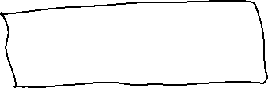



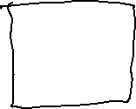



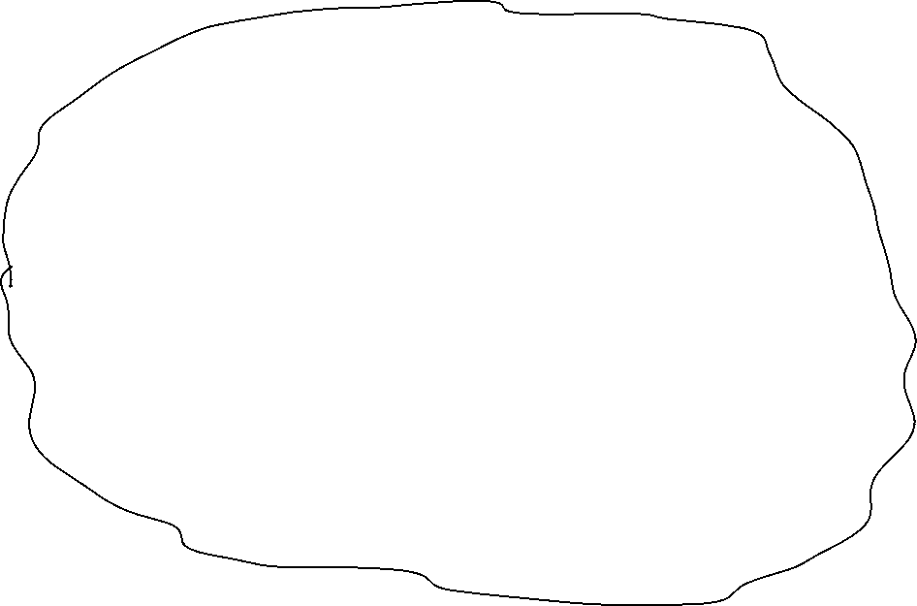


Slide 2

























VM1
VM3
ZooKeeper
Producer
Database
Inference Consumer
VM2
VM4
DB Consumer
Kafka Broker
ML Server Inference

Slide 3


VM1
VM3
Producer 1
ZooKeeper
Database
Inference Consumer
Producer 4
VM2
VM4
DB Consumer
Producer 3
Producer 2
Kafka Broker
ML Server Inference

