Slide 1
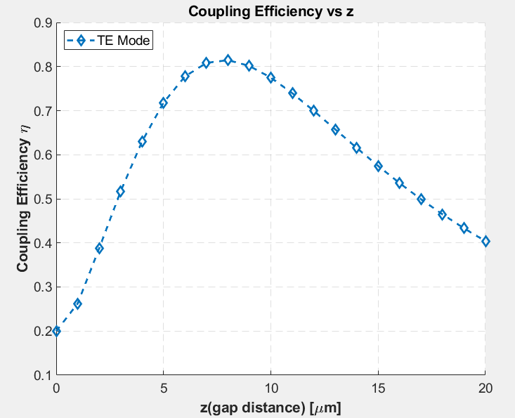
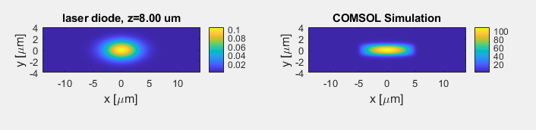
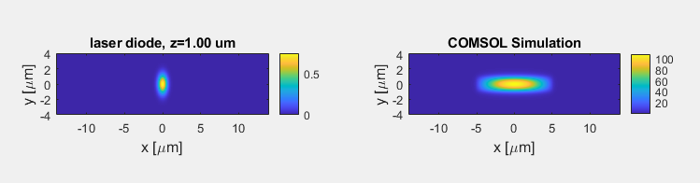
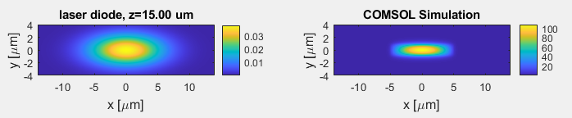
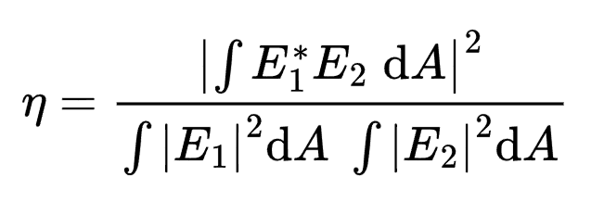
2025/1/25
Best: z=8um
Best: z=8um.
2x10um PECVD Clad.@520nm
Laser Diode is modelled as elliptical gaussian
Divergence angle: x = 22deg, y=8deg

Slide 2
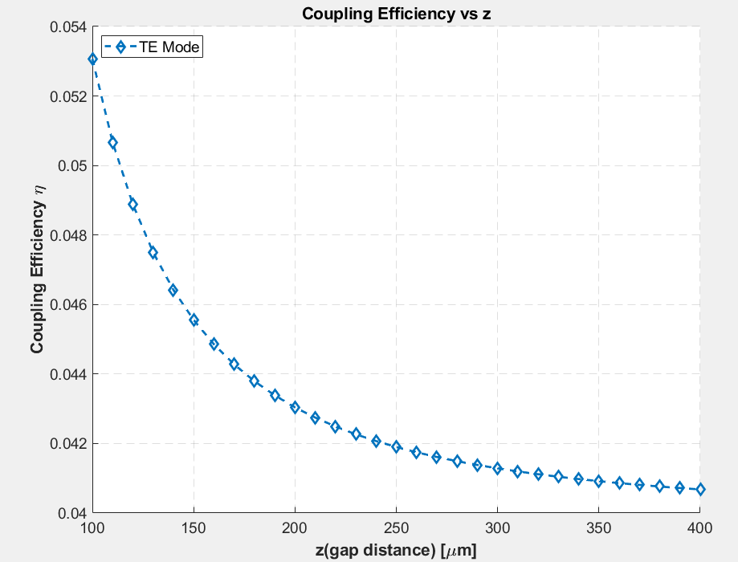
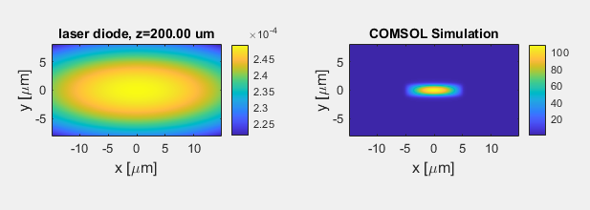
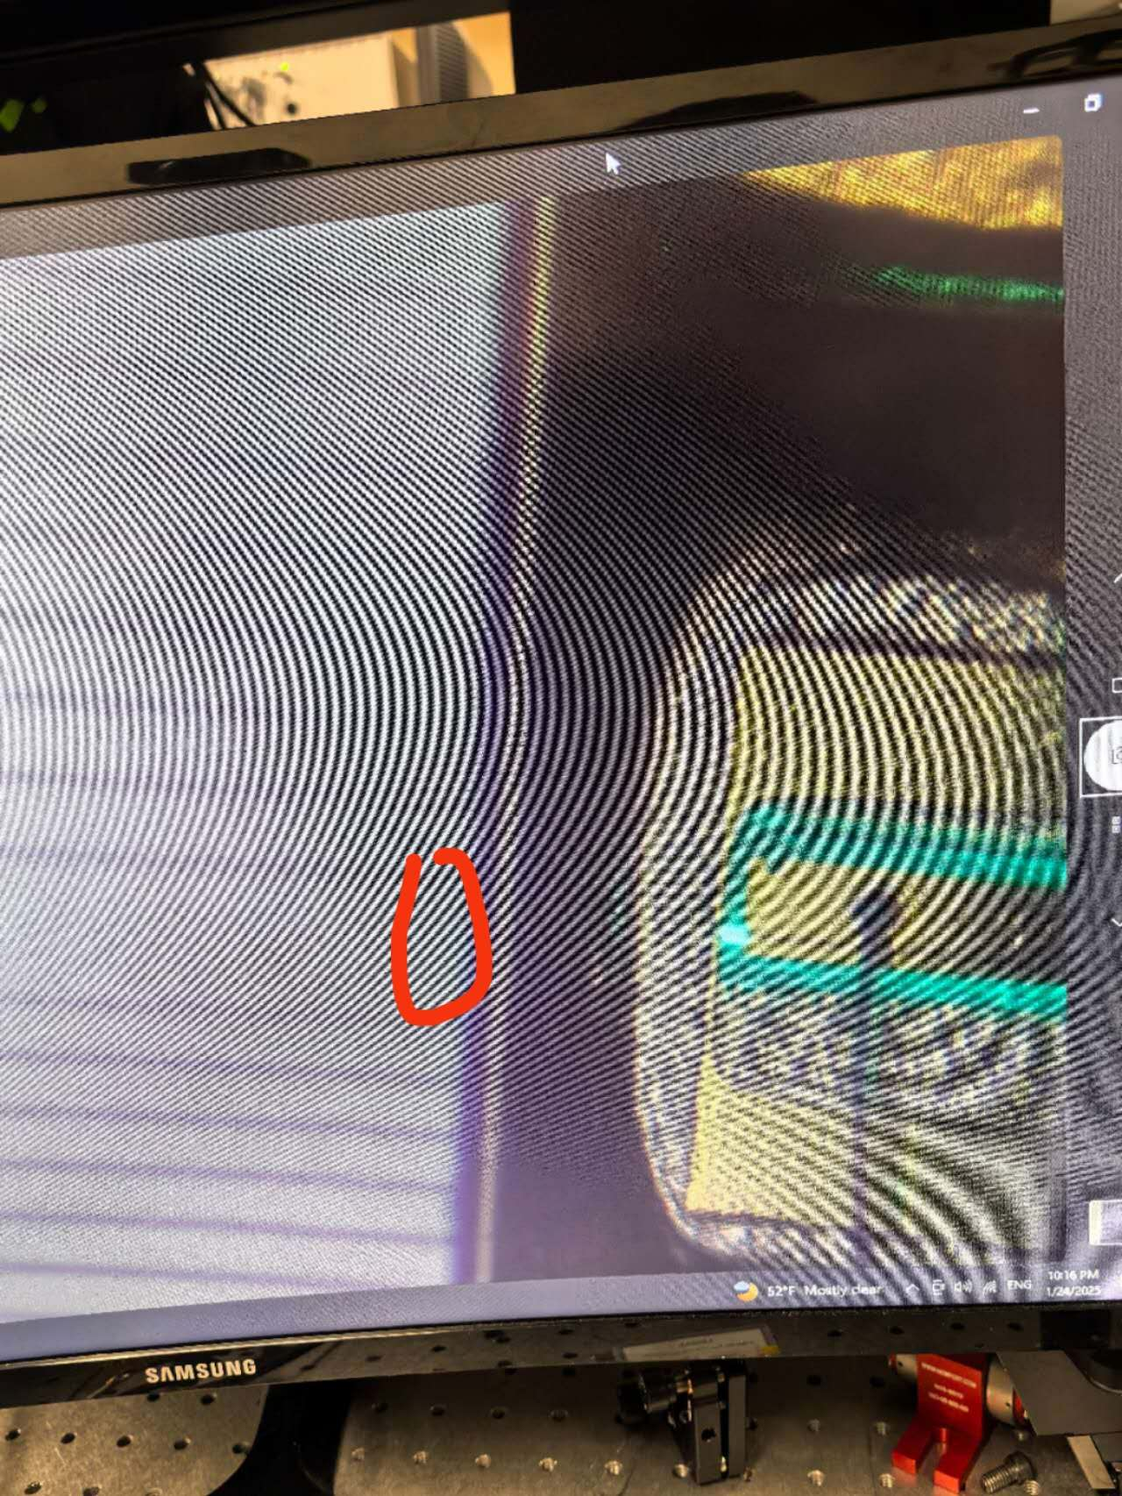
Long Z case
Roughly z= 200um

Slide 3
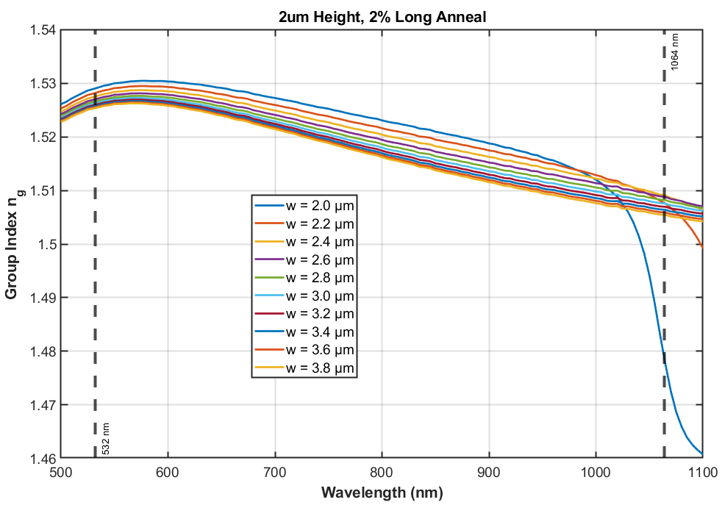
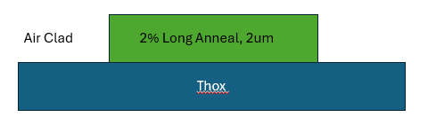
2025/2/14
Find a width that
ng(1064) = ng(532)

Slide 4
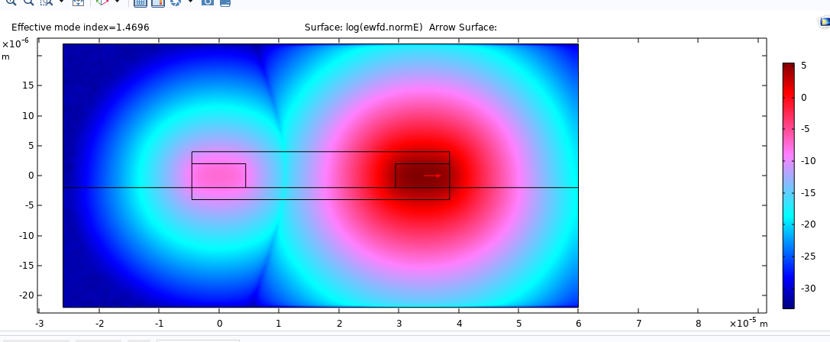
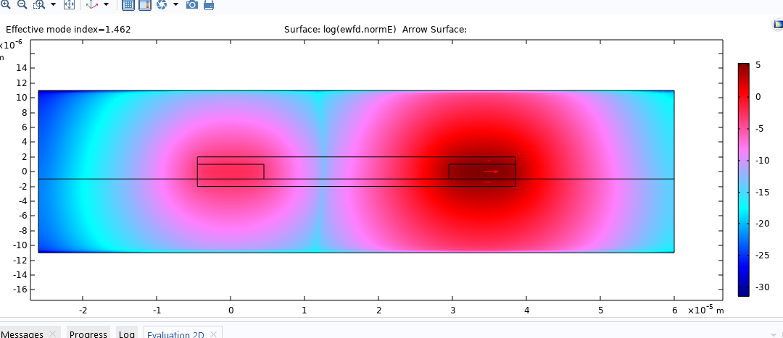

Slide 5
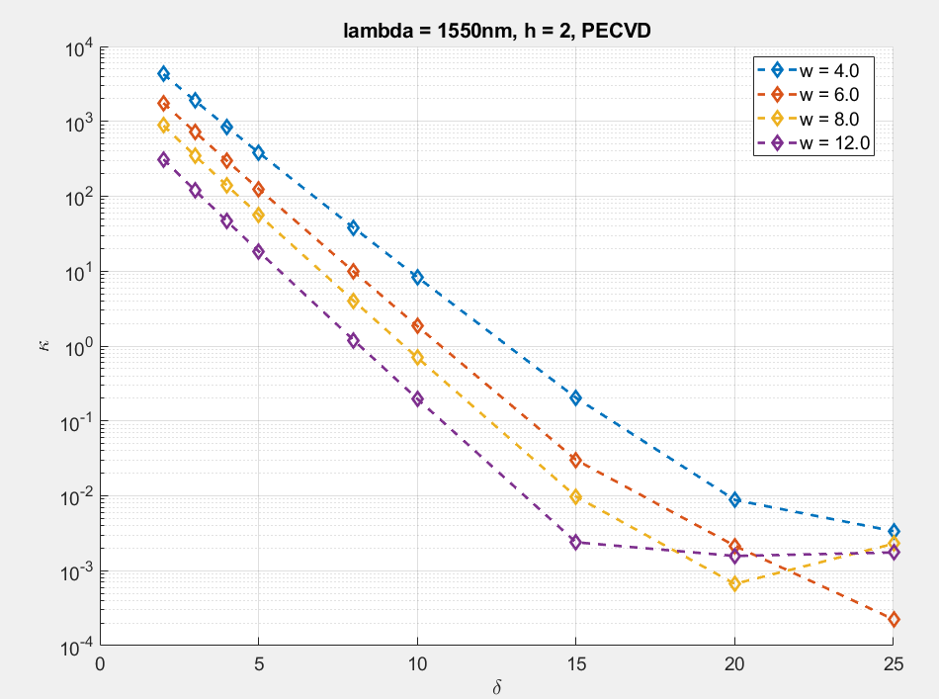
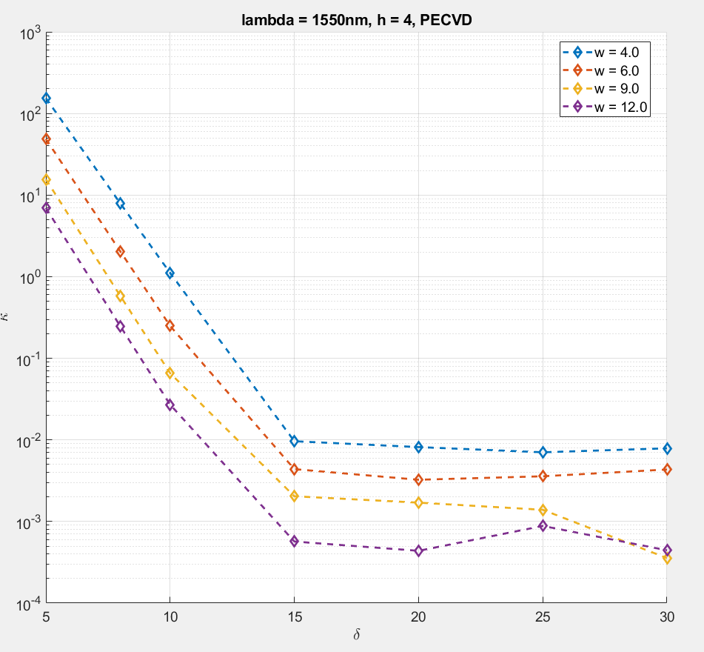
Personal Education Of Coupler

Slide 6
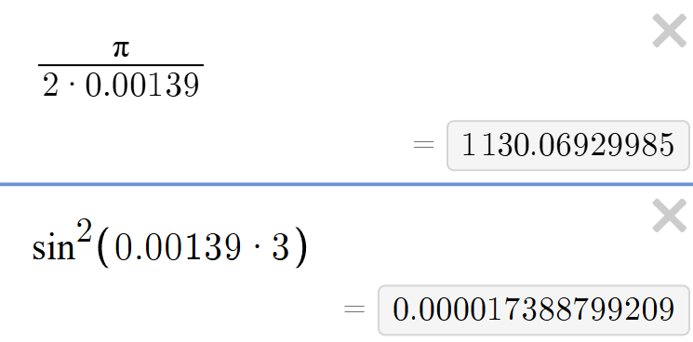
Spiral is 9um width, 4um height
Kappa ~ 0.0013
Take z = 3m,
P_couple/P_input = 0.0017%

Slide 7
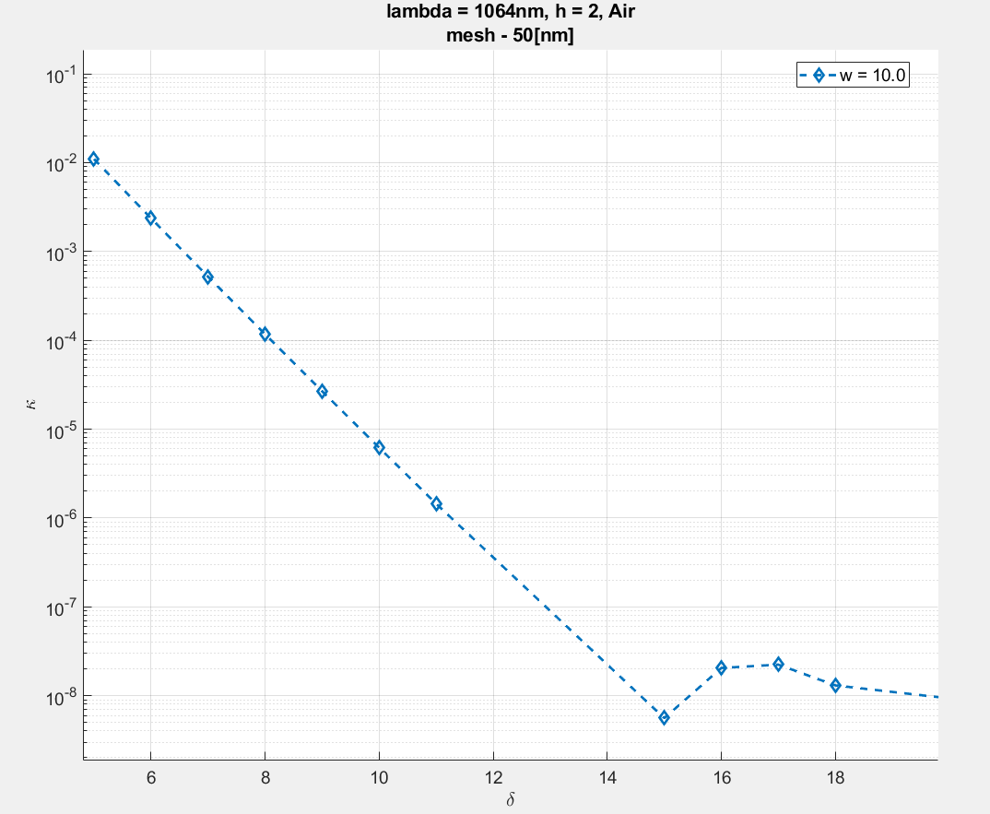
To do: Scan group dispersion 2x10

Slide 8
2 % Long Anneal
Sub 15 um THOX
Air clad

Slide 9
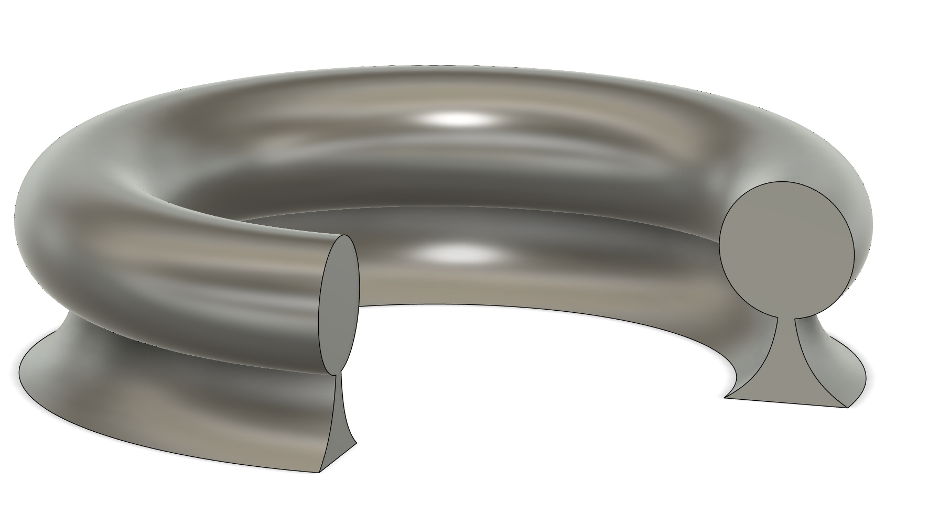
2025/4/20 THG
THG
3rd 450→150
Aeff
Large Device:
radius = 6,10, 15,20, 30
r= 3 4 5 6
Small Device:
radius = 3,6,10
r= 1.5,3
radius
r

Slide 10
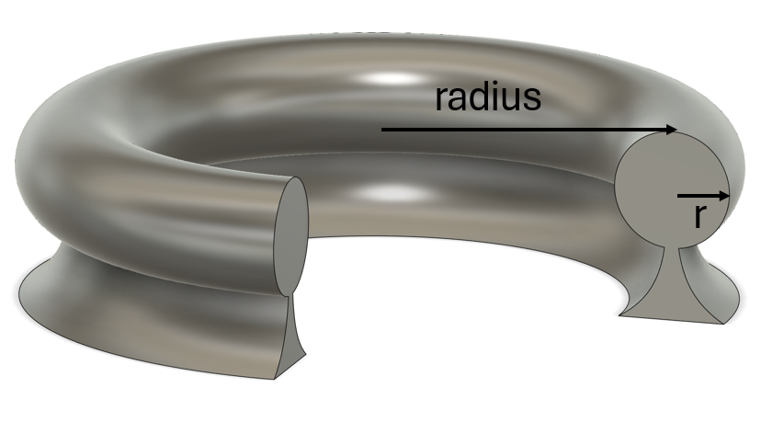
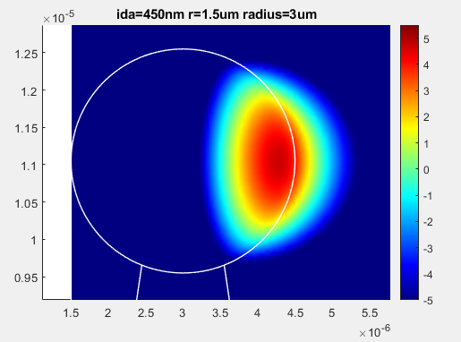
 | Aeff(um^2) | P_leak/P_tot | Q_rad(M) | Note
Large Size
ida=450nm r=3um radius=10um | 0.104277921 | 0.014691 | 8.06E+10
ida=450nm r=3um radius=15um | 0.112012335 | 0.010489 | 6.36E+11
ida=450nm r=3um radius=20um | 0.118598213 | 0.008152 | 9.34E+09
ida=450nm r=3um radius=30um | 0.129572988 | 0.005638 | 8.97E+11
ida=450nm r=3um radius=6um | 0.097639998 | 0.013852 | 8.24E+13 | TM
ida=450nm r=4um radius=10um | 0.112597492 | 0.013588 | 1.86E+12
ida=450nm r=4um radius=15um | 0.120337058 | 0.009907 | 9.21E+10
ida=450nm r=4um radius=20um | 0.126948975 | 0.007792 | 4.39E+11
ida=450nm r=4um radius=30um | 0.137974963 | 0.005458 | 2.48E+10
ida=450nm r=4um radius=6um | 0.104540469 | 0.012366 | 8.86E+13 | TM
ida=450nm r=5um radius=10um | 0.11943393 | 0.012643 | 9.08E+10
ida=450nm r=5um radius=15um | 0.127113669 | 0.009391 | 1.72E+11
ida=450nm r=5um radius=20um | 0.133707475 | 0.007467 | 1.46E+11
ida=450nm r=5um radius=30um | 0.144745766 | 0.005294 | 1.67E+11
ida=450nm r=5um radius=6um | 0.112173723 | 0.017467 | 3.80E+11
ida=450nm r=6um radius=10um | 0.126087494 | 0.011821 | 1.39E+12
ida=450nm r=6um radius=15um | 0.133747007 | 0.008928 | 4.58E+11
ida=450nm r=6um radius=20um | 0.140356929 | 0.00717 | 8.90E+11
ida=450nm r=6um radius=30um | 0.151471417 | 0.005141 | 4.47E+11
ida=450nm r=6um radius=6um | 0.118894769 | 0.015944 | 1.30E+11
Small Size
ida=450nm r=1.5um radius=10um | 0.088392198 | 0.016799 | 1.94E+10
ida=450nm r=1.5um radius=3um | 0.074741296 | 0.045627 | 27023160
ida=450nm r=1.5um radius=6um | 0.080980529 | 0.026309 | 3.82E+09
ida=450nm r=3.0um radius=10um | 0.102384638 | 0.014692 | 4.79E+09
ida=450nm r=3.0um radius=3um | 0.088982976 | 0.033261 | 3.35E+09
ida=450nm r=3.0um radius=6um | 0.09520921 | 0.021593 | 2.1E+10
By default, they are TE mode
The Yellow one is the best for THG generation
among all of the parameters explored.
As it has the least Aeff, but the most power leak out

Slide 11
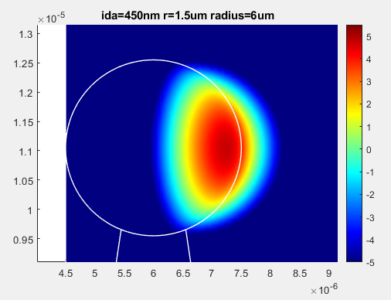
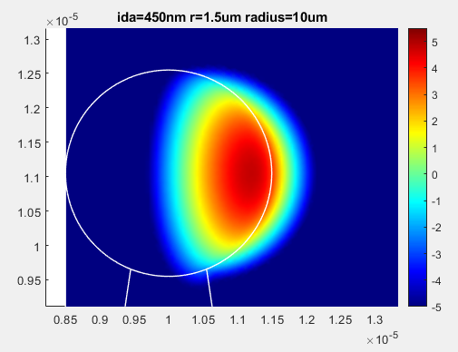
LOG SCALE
Larger radius, larger A_eff, but lower leakage energy, and the energy are more spreaded(not favorable for THG)

