Slide 1
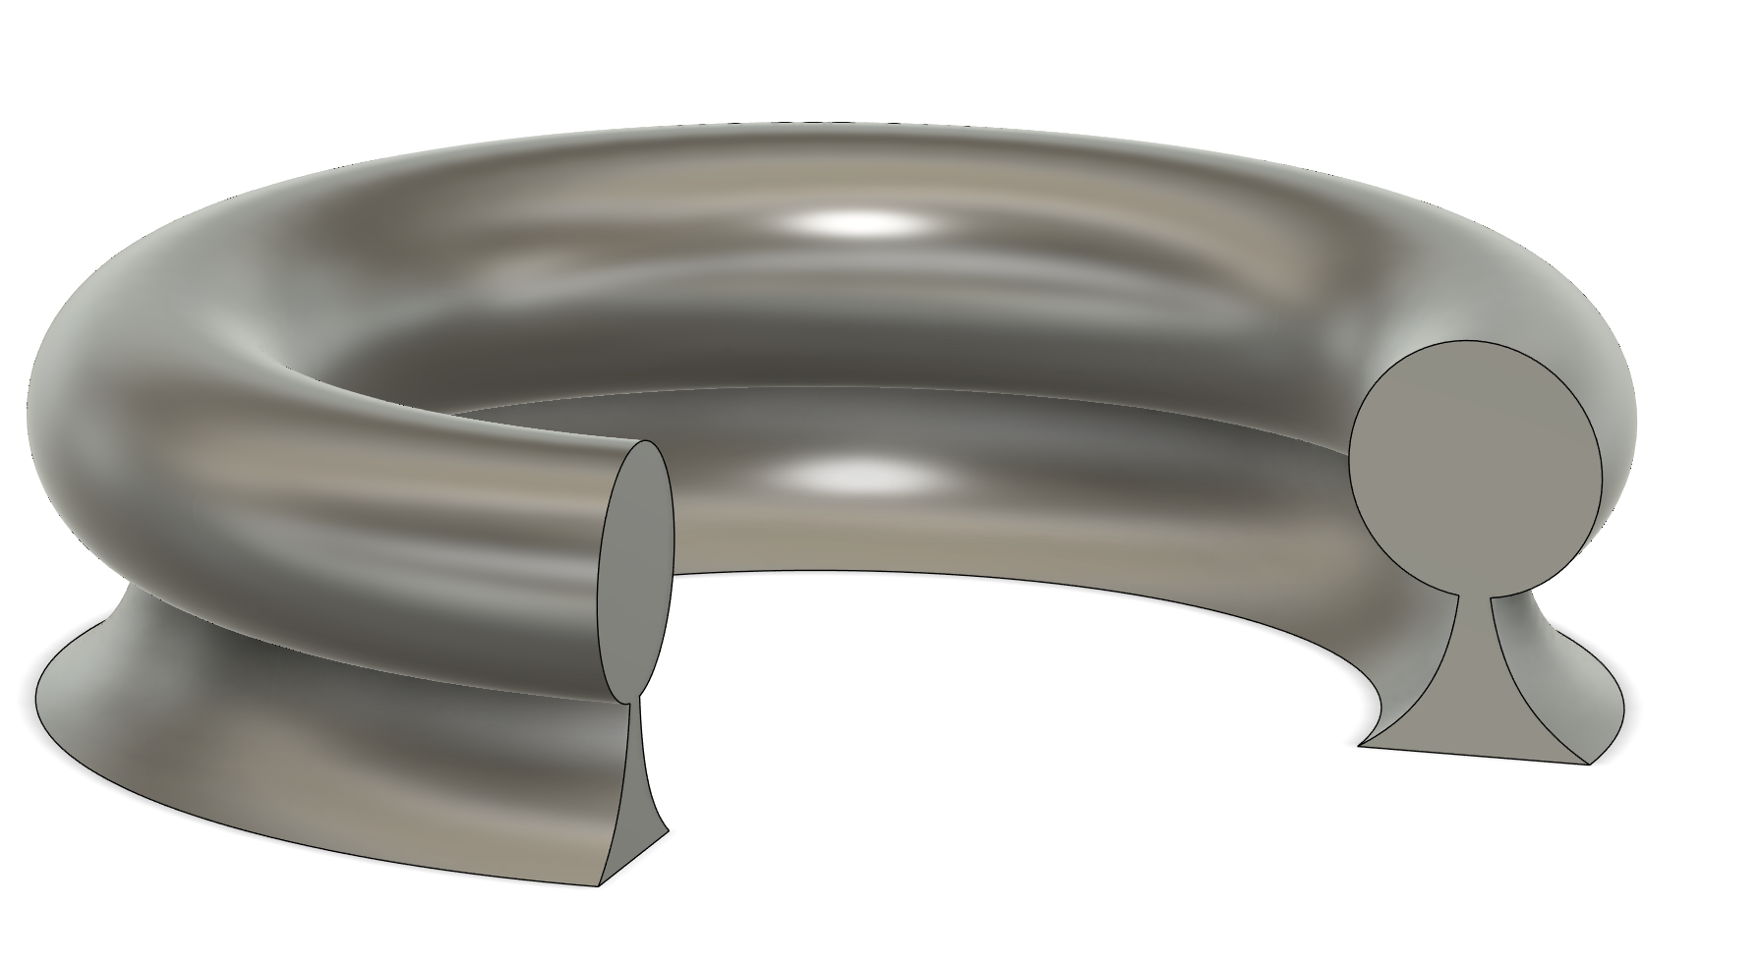
2025/4/20 THG
THG
3rd 450→150
Aeff
Large Device:
radius = 6,10, 15,20, 30
r= 3 4 5 6
Small Device:
radius = 3,6,10
r= 1.5,3
radius
r

Slide 2
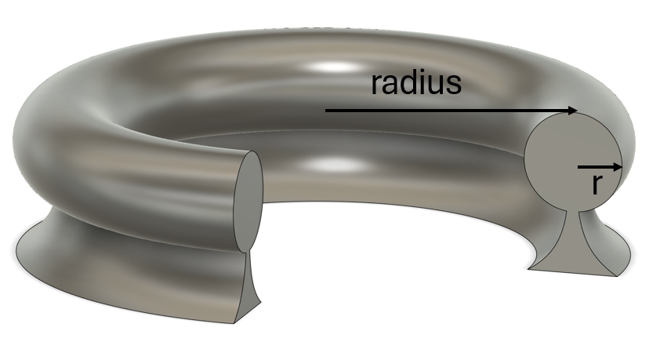
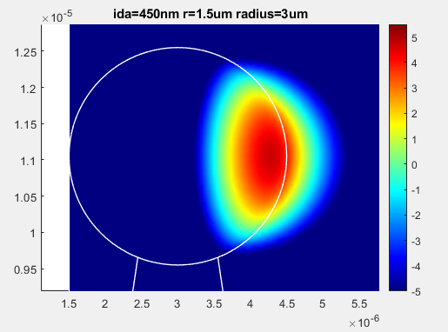
 | Aeff(um^2) | P_leak/P_tot | Q_rad(M) | Note
Large Size
ida=450nm r=3um radius=10um | 0.104277921 | 0.014691 | 8.06E+10
ida=450nm r=3um radius=15um | 0.112012335 | 0.010489 | 6.36E+11
ida=450nm r=3um radius=20um | 0.118598213 | 0.008152 | 9.34E+09
ida=450nm r=3um radius=30um | 0.129572988 | 0.005638 | 8.97E+11
ida=450nm r=3um radius=6um | 0.097639998 | 0.013852 | 8.24E+13 | TM
ida=450nm r=4um radius=10um | 0.112597492 | 0.013588 | 1.86E+12
ida=450nm r=4um radius=15um | 0.120337058 | 0.009907 | 9.21E+10
ida=450nm r=4um radius=20um | 0.126948975 | 0.007792 | 4.39E+11
ida=450nm r=4um radius=30um | 0.137974963 | 0.005458 | 2.48E+10
ida=450nm r=4um radius=6um | 0.104540469 | 0.012366 | 8.86E+13 | TM
ida=450nm r=5um radius=10um | 0.11943393 | 0.012643 | 9.08E+10
ida=450nm r=5um radius=15um | 0.127113669 | 0.009391 | 1.72E+11
ida=450nm r=5um radius=20um | 0.133707475 | 0.007467 | 1.46E+11
ida=450nm r=5um radius=30um | 0.144745766 | 0.005294 | 1.67E+11
ida=450nm r=5um radius=6um | 0.112173723 | 0.017467 | 3.80E+11
ida=450nm r=6um radius=10um | 0.126087494 | 0.011821 | 1.39E+12
ida=450nm r=6um radius=15um | 0.133747007 | 0.008928 | 4.58E+11
ida=450nm r=6um radius=20um | 0.140356929 | 0.00717 | 8.90E+11
ida=450nm r=6um radius=30um | 0.151471417 | 0.005141 | 4.47E+11
ida=450nm r=6um radius=6um | 0.118894769 | 0.015944 | 1.30E+11
Small Size
ida=450nm r=1.5um radius=10um | 0.088392198 | 0.016799 | 1.94E+10
ida=450nm r=1.5um radius=3um | 0.074741296 | 0.045627 | 27023160
ida=450nm r=1.5um radius=6um | 0.080980529 | 0.026309 | 3.82E+09
ida=450nm r=3.0um radius=10um | 0.102384638 | 0.014692 | 4.79E+09
ida=450nm r=3.0um radius=3um | 0.088982976 | 0.033261 | 3.35E+09
ida=450nm r=3.0um radius=6um | 0.09520921 | 0.021593 | 2.1E+10
By default, they are TE mode
The Yellow one is the best for THG generation
among all of the parameters explored.
As it has the least Aeff, but the most power leak out

Slide 3
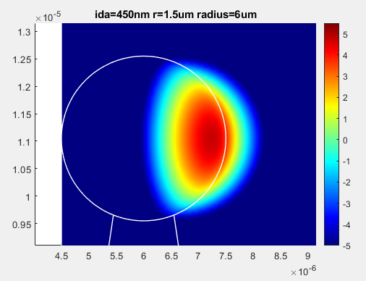
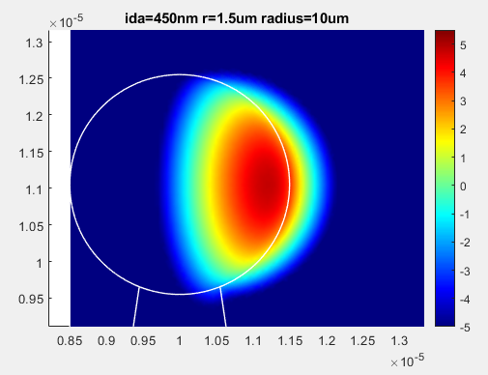
LOG SCALE
Larger radius, larger A_eff, but lower leakage energy, and the energy are more spreaded(not favorable for THG)

