Slide 1
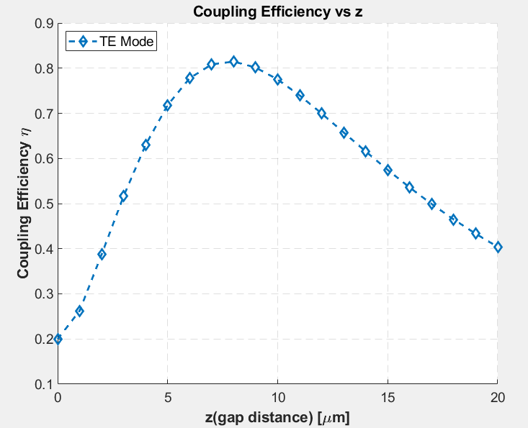



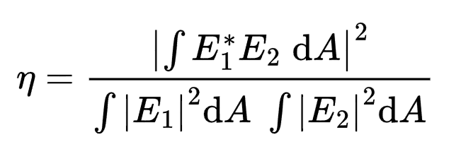
2025/1/25
Best: z=8um
Best: z=8um.
2x10um PECVD Clad.@520nm
Laser Diode is modelled as elliptical gaussian
Divergence angle: x = 22deg, y=8deg

Slide 2
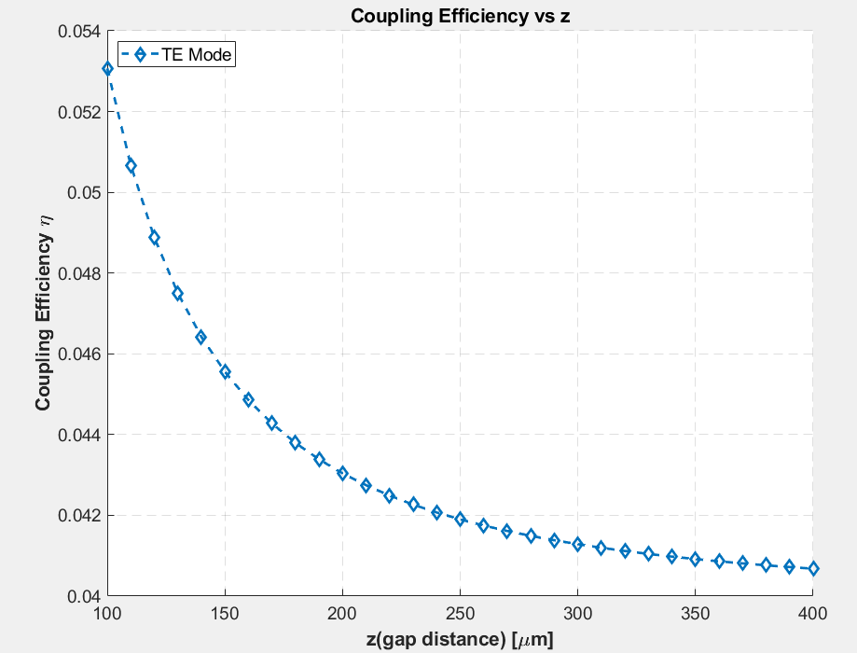
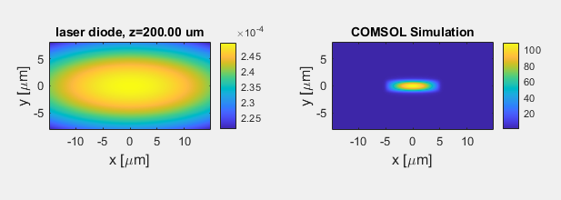
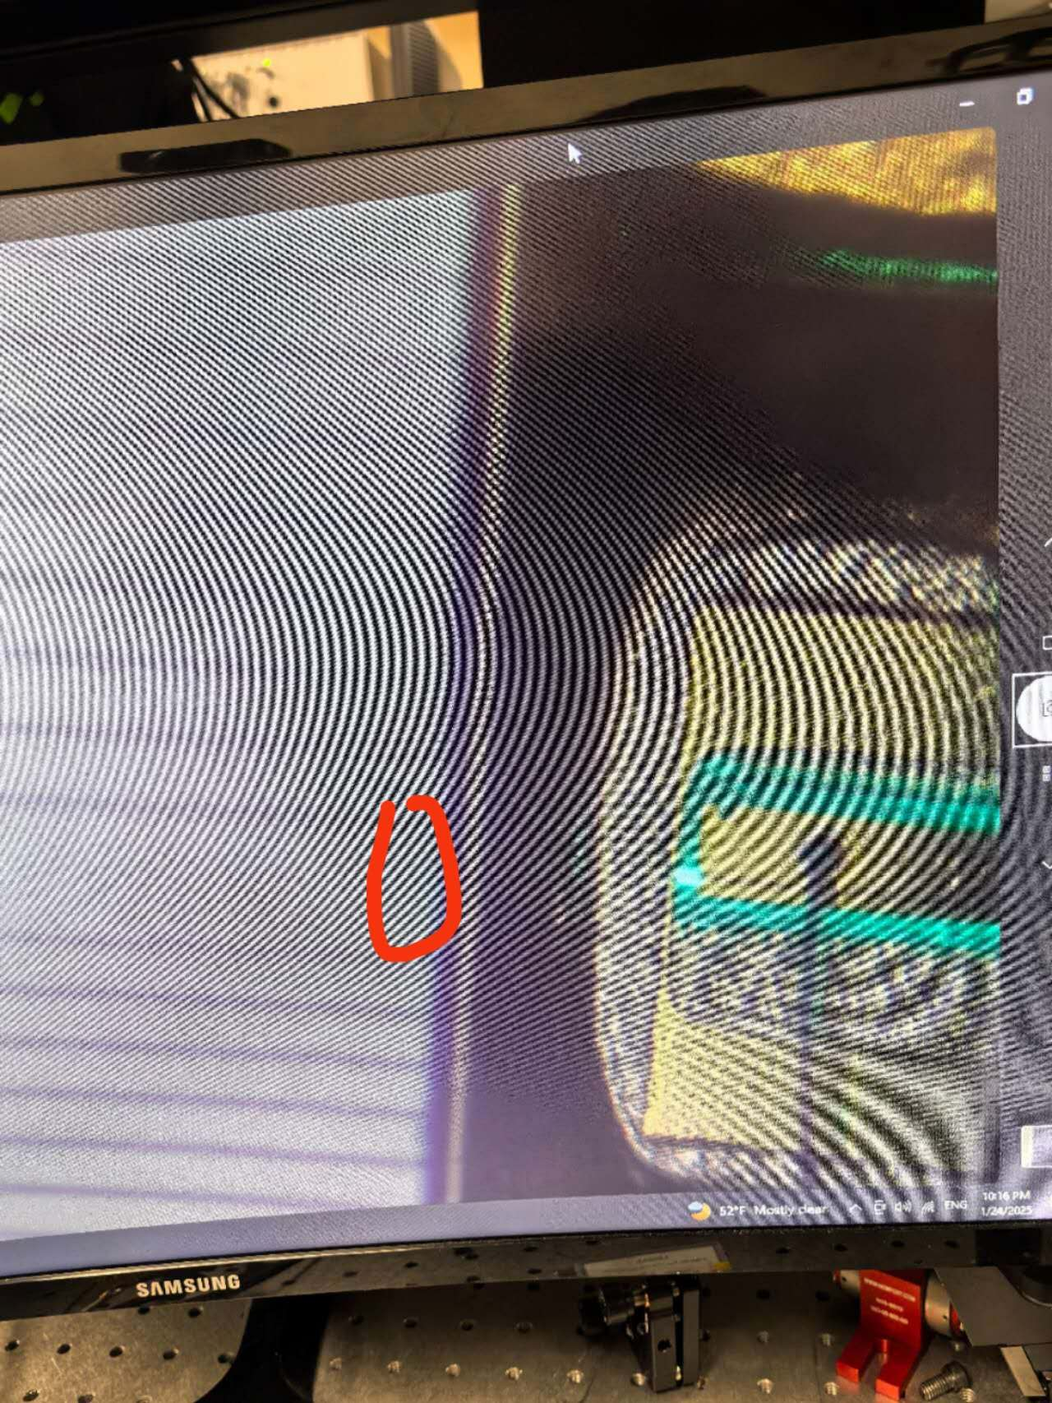
Long Z case
Roughly z= 200um

Slide 3
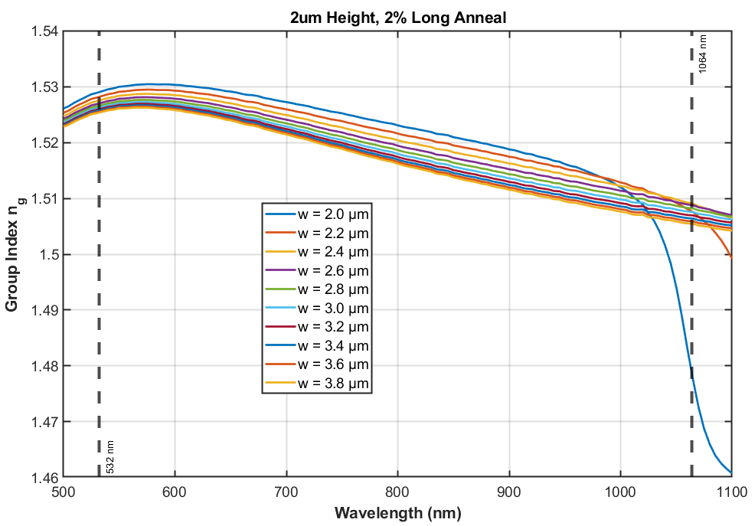

2025/2/14
Find a width that
ng(1064) = ng(532)

