Slide 1

Mario Aleksander Maciej Patryk
Fukuoka Bobiński Grzelczak Chodorowski
Illuminating the path ahead
dr inż. Krzysztof Grudzień
dr inż. Zbigniew Chaniecki
20
19
18
17
16
15
14
13
12
11
10
9
8
7
6
5
4
3
2
1
Łódz University of Technology
Project Based Learning mid-term presentation 11.04.2018
<number>
Notes:
Speaker: Mario

Slide 2



Aleksander Bobiński
inquisitive
hobby: chess
Tasks:
data crunching
archiving data
Patryk Chodorowski
analytical
hobby: chess
Tasks:
writing software for finding correlations
20
19
18
17
16
15
14
13
12
11
10
9
8
7
6
5
4
3
2
1
<number>
Notes:
Speaker: Maciek

Slide 3


Mario Fukuoka
conflict resolution
hobbies: drawing & music
Tasks:
chairman
creative force of the team
graphics design
Maciej Grzelczak
experienced in Python
hobby: beer production
Tasks:
conducting interviews
distributing online survey
20
19
18
17
16
15
14
13
12
11
10
9
8
7
6
5
4
3
2
1
<number>
Notes:
Speaker: Chodor

Slide 4
Team SWOT analysis
Strengths
Good programming skills
Excellent communication
Weaknesses
Lack of presentation skills
First time working together
Opportunities
Learning how to gather & analyse data
Threats
The expansive domain of the problem can be overwhelming
20
19
18
17
16
15
14
13
12
11
10
9
8
7
6
5
4
3
2
1
<number>
Notes:
Speaker: Maciek

Slide 5
Problem context
Is my computer lawful?
What are software licenses?
Who are they important to?
What is their purpose?
Why should we care about them?
Who do they serve?
Is our hardware legal?
20
19
18
17
16
15
14
13
12
11
10
9
8
7
6
5
4
3
2
1
<number>
Notes:
Speaker: Mario

Slide 6






Communication & data sharing
20
19
18
17
16
15
14
13
12
11
10
9
8
7
6
5
4
3
2
1
<number>
Notes:
Speaker: Chodor

Slide 7

Interviewing people
Do you read
licenses?
...no.
20
19
18
17
16
15
14
13
12
11
10
9
8
7
6
5
4
3
2
1
<number>
Notes:
Speaker: Mario

Slide 8
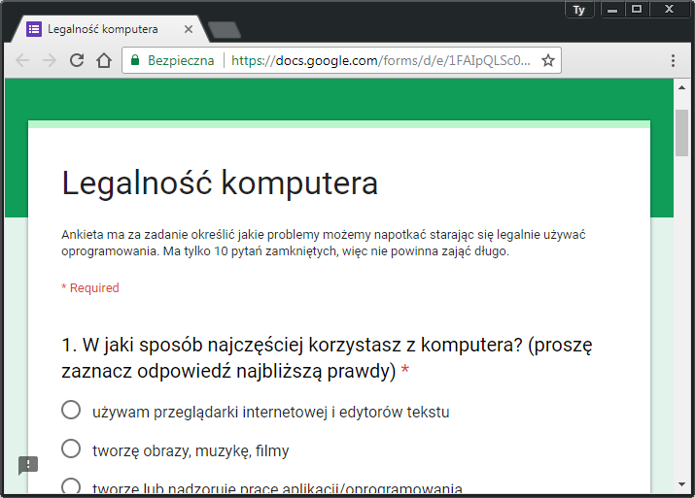

Creating an online survey
360+ responses
20
19
18
17
16
15
14
13
12
11
10
9
8
7
6
5
4
3
2
1
<number>
Notes:
Speaker: Patryk

Slide 9
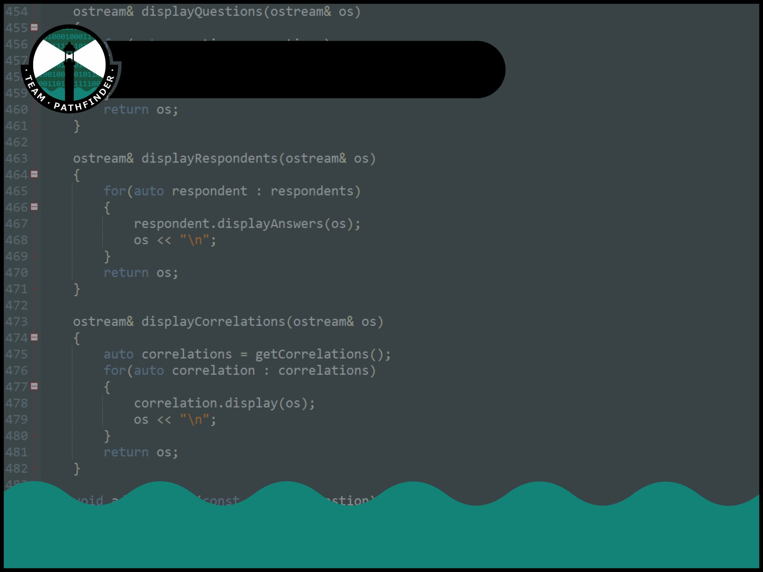

Custom data analysis tool
Calculate answers for specific group of respondents
Import answers
from
Export
results
to
20
19
18
17
16
15
14
13
12
11
10
9
8
7
6
5
4
3
2
1
<number>
Notes:
Speaker: Chodor

Slide 10
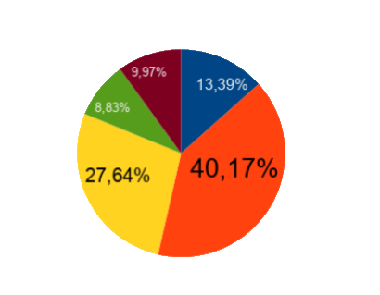
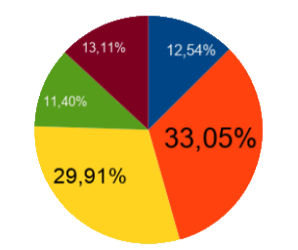
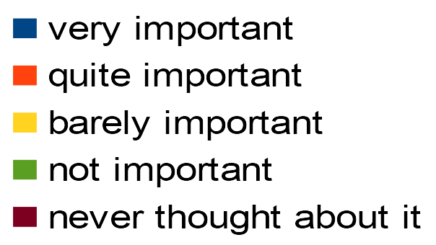
People care about legality
More than half of respondents cared about owning legal software
But less than half cared about its license
20
19
18
17
16
15
14
13
12
11
10
9
8
7
6
5
4
3
2
1
<number>
Notes:
Speaker: Olek

Slide 11

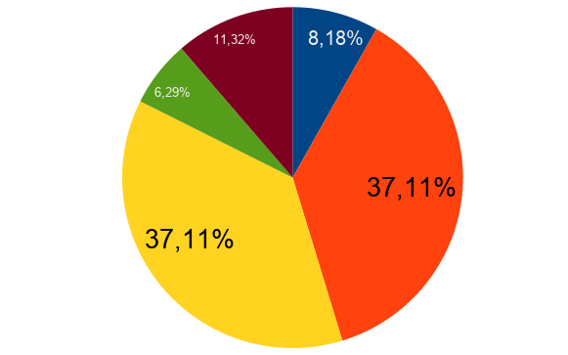

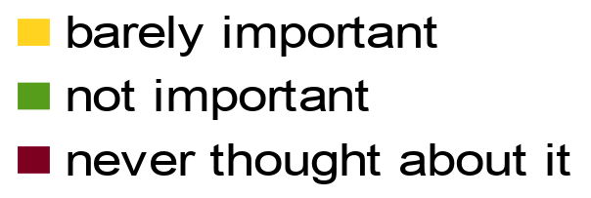
Programs of unknown origin
Over half of respondents found software of unknown origin on their computers.
Here is how important software legality is for those respondents:
20
19
18
17
16
15
14
13
12
11
10
9
8
7
6
5
4
3
2
1
<number>
Notes:
Speaker: Olek

Slide 12
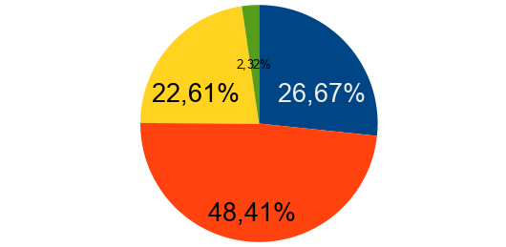
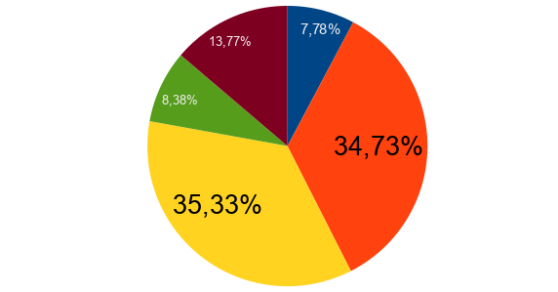
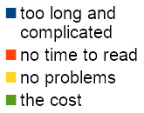
Problems with licenses
¾ of respondents had problems with licenses...
...yet almost half of those still thought that they are quite important
20
19
18
17
16
15
14
13
12
11
10
9
8
7
6
5
4
3
2
1
<number>
Notes:
Speaker: Olek

Slide 13
Problem definition
People care about software legality, but:
don’t know what software they have installed
don’t read software licenses
20
19
18
17
16
15
14
13
12
11
10
9
8
7
6
5
4
3
2
1
<number>
Notes:
Speaker: Mario

Slide 14
What we’ve done so far
7.03
First meeting with supervisors
14.03 - 21.03
Conducting interviews
28.03 - 4.04
Creating and conducting survey
Past timeline
7.03 - 14.03
Definition of potential problems
21.03 - 28.03
Analysis of interviews
4.04 - 11.04
Survey analysis, problem definition
20
19
18
17
16
15
14
13
12
11
10
9
8
7
6
5
4
3
2
1
<number>
Notes:
Speaker: Maciek

Slide 15
What we’re planning to do
1st part of April
Picking a solution
1st part of May
Implementation
June
Documentation of solution
Future timeline
2nd part of April
Research in area of solution
2nd part of May
Testing and improving of solution
20
19
18
17
16
15
14
13
12
11
10
9
8
7
6
5
4
3
2
1
<number>
Notes:
Speaker: Maciek

Slide 16
Already existing solutions
License managers for developers
different target audience
Software for users
Doesn’t fully deal with our problem (e.g. only lists programs)
20
19
18
17
16
15
14
13
12
11
10
9
8
7
6
5
4
3
2
1
<number>
Notes:
Speaker: Chodor

Slide 17
Our possible solutions
Possible solutions:
Software & license database
License parser
Software lister
20
19
18
17
16
15
14
13
12
11
10
9
8
7
6
5
4
3
2
1
<number>
Notes:
Speaker: Maciek

Slide 18




Our client & potential tools to use
Our client:
Everyday Windows user
Tools we can use:
Windows Registry
Python libraries for Windows
20
19
18
17
16
15
14
13
12
11
10
9
8
7
6
5
4
3
2
1
<number>
Notes:
Speaker: Olek

Slide 19

What we need to learn
What we need to learn:
Has ‘intelligent’ license parsing been tried? (e.g. Keras)
How to find licenses?
20
19
18
17
16
15
14
13
12
11
10
9
8
7
6
5
4
3
2
1
<number>
Notes:
Speaker: Olek

Slide 20
Thank you for your attention
20
19
18
17
16
15
14
13
12
11
10
9
8
7
6
5
4
3
2
1
20
Notes:
Mario

