Slide 1
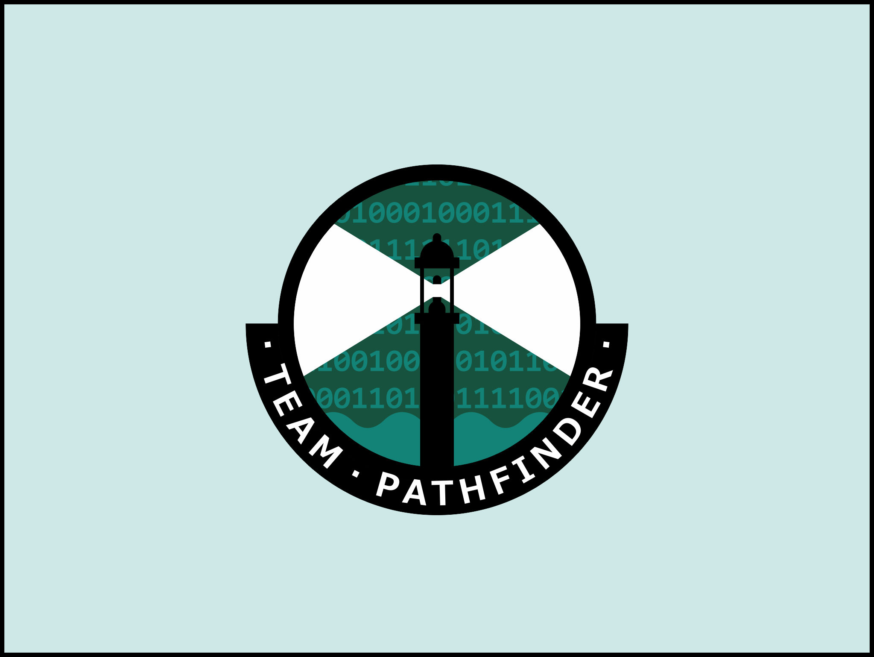


Aleksander Bobiński
Patryk Chodorowski
Maciej Grzelczak
Mario Fukuoka
Illuminating the path ahead
dr inż. Krzysztof Grudzień
dr inż. Zbigniew Chaniecki
June 29, 2018
Notes:
Olek

Slide 2

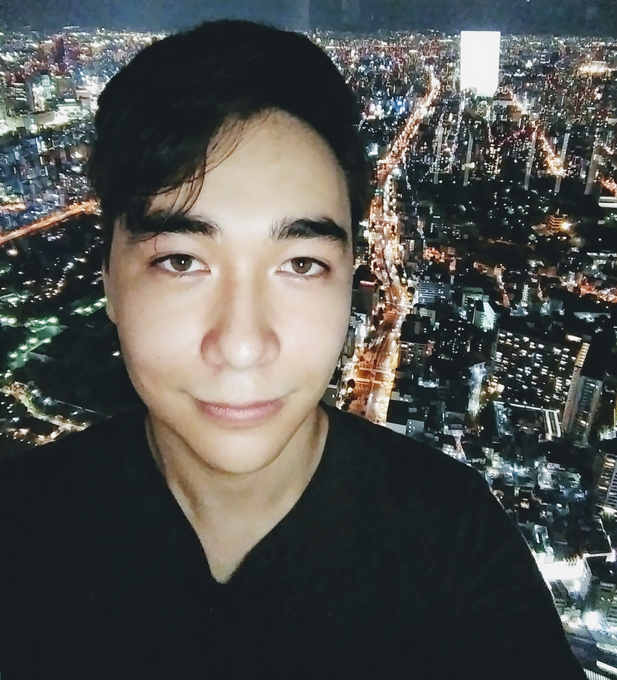
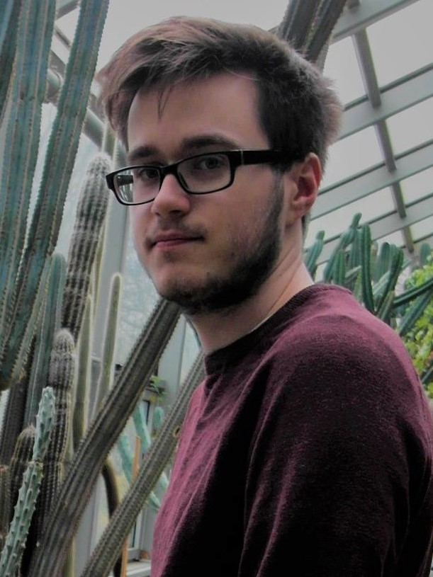
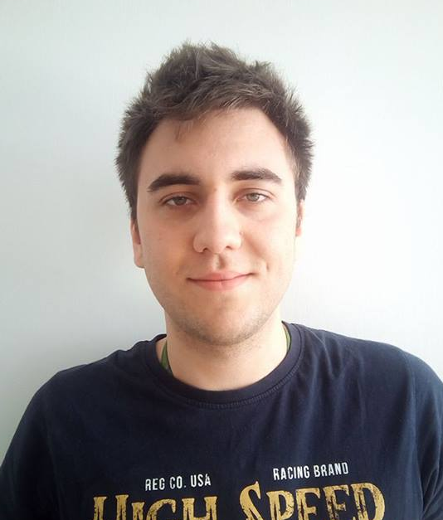
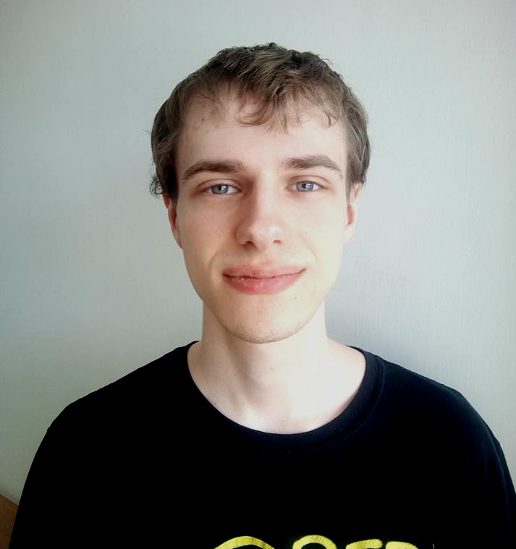
Mario
Maciek
Aleksander
Patryk
Notes:
Patryk

Slide 3





Tools used
Notes:
Patryk

Slide 4


Problem context
Notes:
Mario

Slide 5

Research & surveying
Have you ever...?
Notes:
Maciek

Slide 6
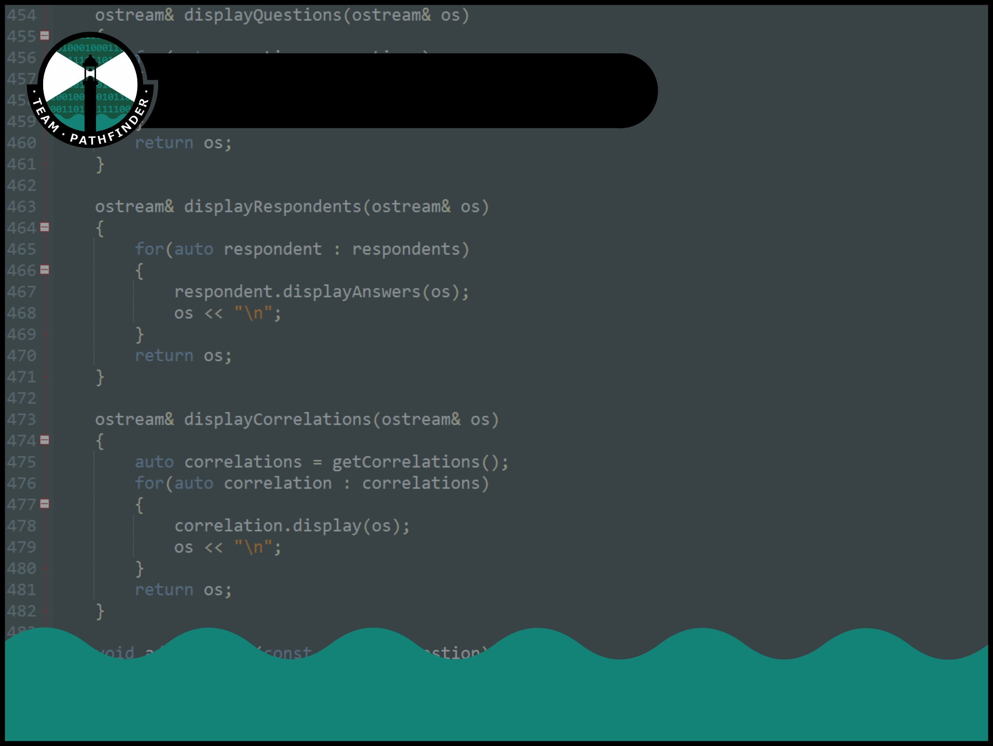


Survey analysis
Calculate answers for specific group of respondents
Import answers
from
Export
results
to
Notes:
Patryk

Slide 7
Problem definition
People care about software legality, but:
don’t know what software they have installed
don’t read software licenses
Notes:
Olek

Slide 8
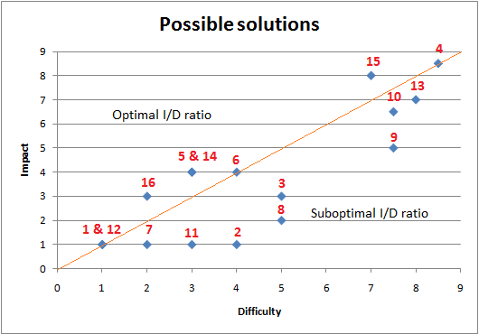
The right solution
A plot of our ideas based on impact vs. difficulty of implementation
Notes:
Maciek

Slide 9

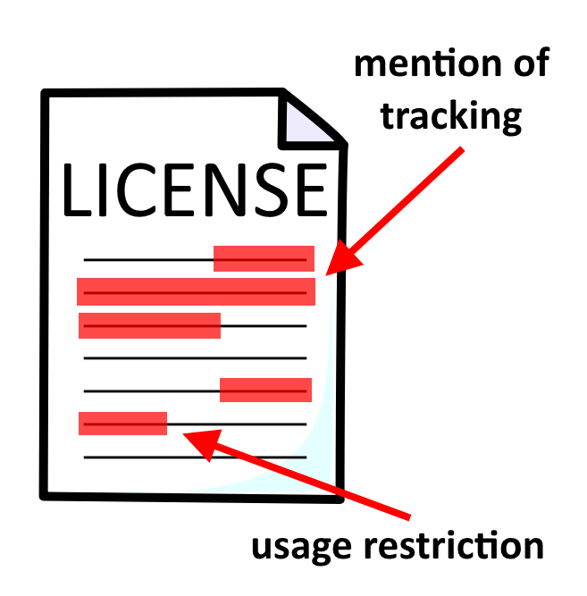


License analyzer
Notes:
Mario

Slide 10
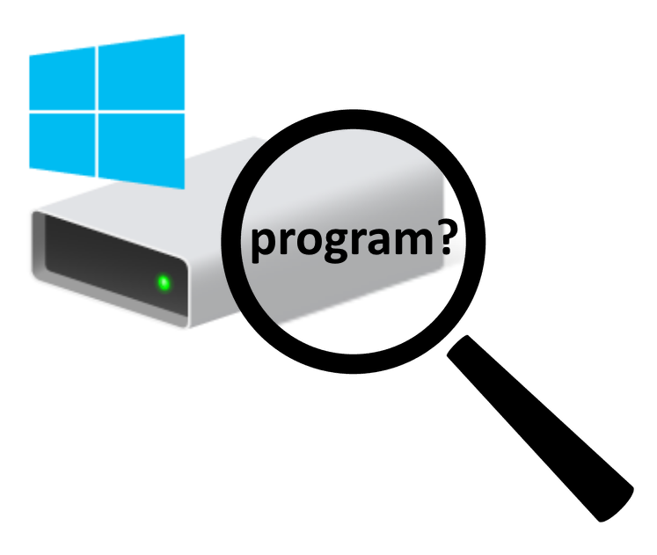
Software finder
Notes:
Maciek

Slide 11



Software & license database
The glue which holds the application together
Notes:
Olek

Slide 12

Our solution - the Pathfinder app
Notes:
Mario

Slide 13



Under the hood - software finder
Three different tried methods of scanning for software
Notes:
Patryk

Slide 14
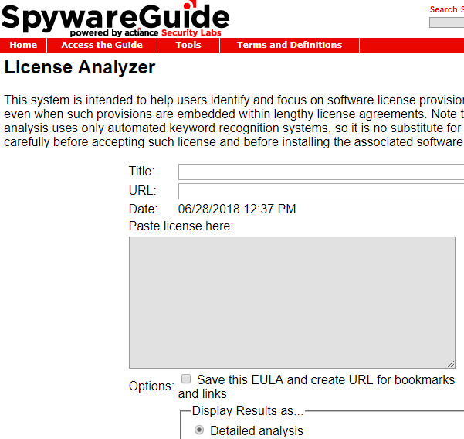
3rd party analyzer
http://www.spywareguide.com/analyze/analyzer.php
Notes:
Mario

Slide 15


GUI frameworks
The limits of our GUI using appJar, and its evolution into a Qt based GUI
Notes:
Olek

Slide 16
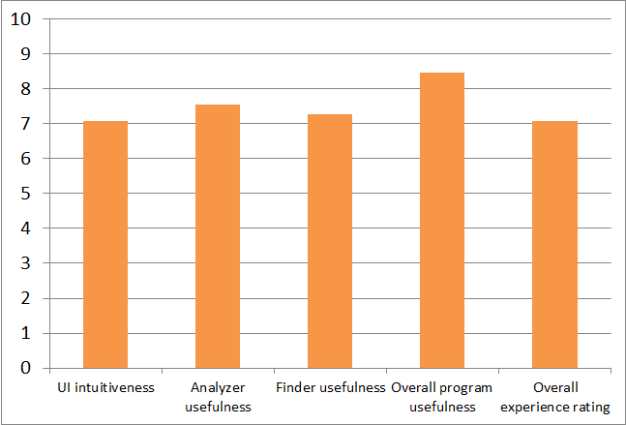
Real world tests
User feedback from 11 testers + their remarks
Notes:
Maciek

Slide 17


The future
Black box analyzer
Open source analyzer
Registry scan
Quick scan
Proposed changes
Notes:
Olek

Slide 18
Thank you for your attention
Notes:
Olek

