Slide 1


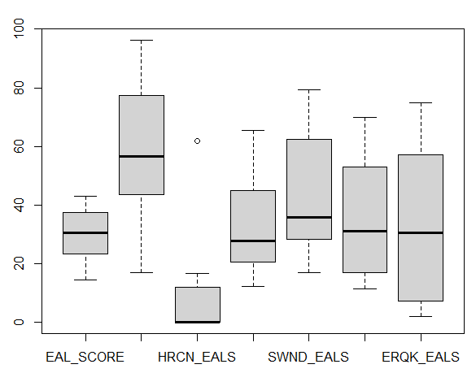
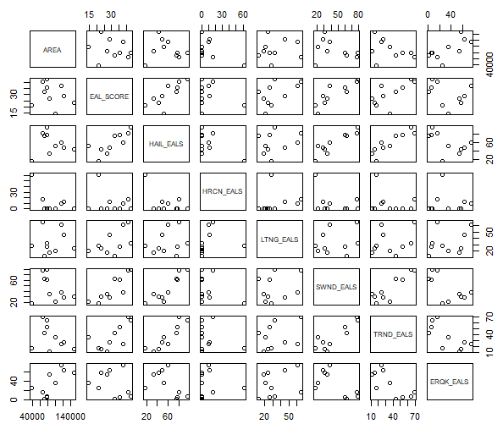
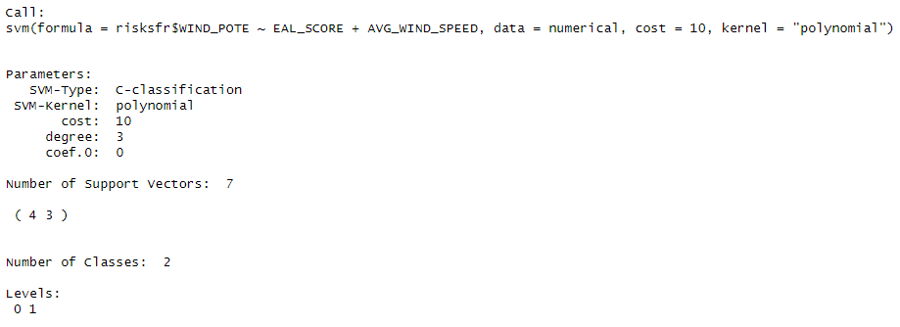

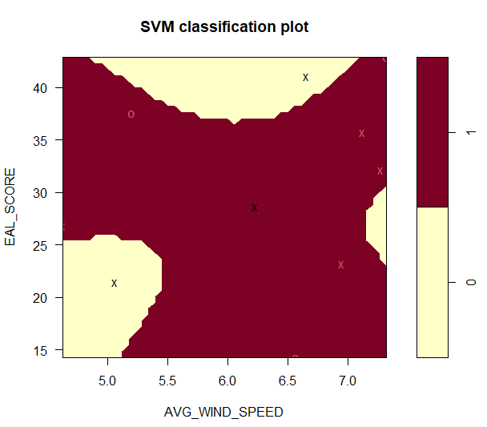
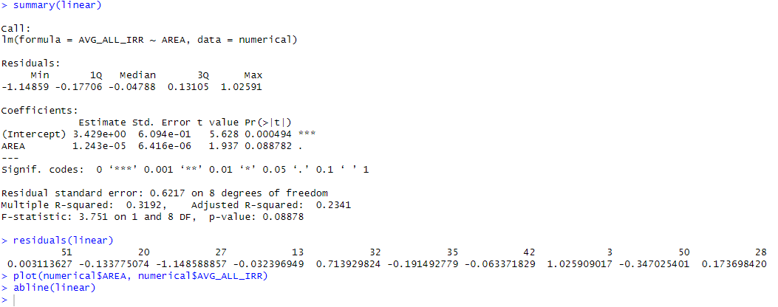
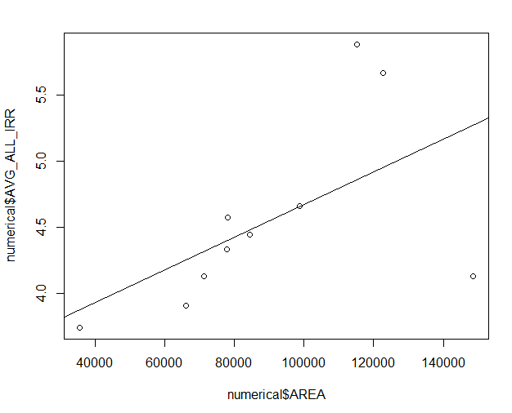
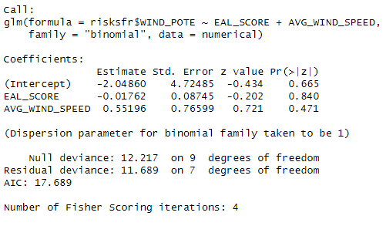
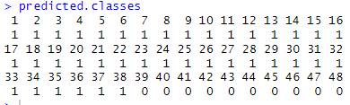
Classification of Safe States Suitable for Solar and Wind Development
Eric Zhang zhange6@rpi.edu
¹Rensselaer Polytechnic Institute, Information Technology & Web Science (ITWS), Troy, NY, United States,
Abstract
Exploratory Data Analysis and Models
As the world advances in technology, new energy sources are needed in order to keep up with the increase in energy use as the world develops. Dwindling supplies of fossil fuels also lend urgency to the push toward renewable energy. While some politicians and governments may claim otherwise, the need for renewable energy has grown more than ever as the years have gone by.
However, many factors need to be considered when making the switch to renewable energy. Among these factors is the safety of the area that the proposed plant is built in, as well as the potential output based on the natural resources that are available to be harvested. By predicting whether or not a state is a good source of wind or solar energy through relating expected annual losses and average wind speeds, officials can use this data to then propose new power plants and plan out a better energy infrastructure.
Another point of interest is solar energy. With a potential relationship between area and solar radiation, predicting the amount of solar radiation and energy available to be produced can be useful. The hypothesis is that states with low expected annual losses, low risks, and above average wind speeds are good for wind power development. In addition, a positive relationship between area and solar radiation is expected.
In order to create the desired models, analysis and preprocessing of the data was needed. The second dataset in particular, obtained from NASA Langley, consisted of several different dataframes that needed to be processed into state level data. An average for each of the measures obtained was calculated.
For the first dataset, the top ten least riskiest states in terms of expected annual loss were extracted from the dataset. The risks most likely to affect solar and wind, namely hail, lightning, strong winds, tornados, and earthquakes, were extracted along with their EALs. The average measures calculated from the second dataset were then added onto these extracted rows as a training dataset.
After the data was processed and extracted, a pair plot diagram was made to show a quick plotting of all of the features chosen.
Figure 1 – Boxplot of features sorted by hail EALs
1. Support Vector Machine:
The first model chosen was a support vector machine aiming to classify states based on wind power generation potential.
2. Logistic Regression
where the WIND_POTE is the target variable as a classification on whether or not a state has potential for wind energy and EAL_SCORE and AVG_WIND_SPEED are used as independent variables.
Figure 2 – Pairs scatter plots on all features chosen.
3. KNN Classification
using previously created dataset as training, tested on all other continental United States. Target variable set as WIND_POTE to try and classify the rest of the continental United States as having potential or no potential for wind power generation.
Motivation
Figure 6 – Results of the KNN clustering with 2 clusters and trained on 3 neighbors.
The United States has needed to transition away from fossil fuels in coal and oil for a long time, but has no motivation to do so. If there was a way to determine which states would have less risk and would gain more from investing into renewable energy, there would be more of a push into that sector. In addition, a prediction of the amount of energy available to be produced given a solar radiation measurement can be useful in determining where solar energy is most effectively produced.
Figure 3 – summary of the svm() call in R.
4. Linear Regression
finding a relationship between the variables AVG_ALL_IRR and AREA
The Data
The first dataset is obtained from the US FEMA NRI dataset, available online.
The data is collected yearly.
The state level data contains expected annual losses, while the county level data contains both risk scores and expected annual losses.
The second dataset is obtained from the NASA Langley Data Access Viewer.
Measurements for climate data is available in select regions, which is made from the map.
A rectangle containing as much of a state as possible was used in the case where the state was not rectangular.
Figure 7 –Summary of the linear regression model.
Field Name | Description
EAL_Score | A Score of the expected annual losses from risks like natural disasters.
AVG_WIND_SPEED | An average wind speed at 50 meters calculated from the NASA Langley data.
AVG_ALL_IRR | An average measure of solar irradiance given all skies.
AVG_CLR_IRR | An average measure of solar irradiance given clear skies.
Figure 4 – Plot of the support vector machine after tuning
Figure 8 – Scatter plot with best fit line.
Conclusions and Results
After conducting linear regression on area and average solar irradiance, a fairly linear relationship was found. For classification of states based on average wind speed and EAL scores, roughly half of the continental United States have good wind power potential, while the other half do not. However, the neighbor count could be adjusted to be better overall. Other features like a known variable to target with regards to wind speed potential and an average cloud cover could be useful for both determining wind power suitability and solar energy availability.
Figure 5 – Results of the logistic regression model, predictions to the right
Glossary:
R – A program to process data and perform statistical analysis
Resources:
FEMA National Risk Index Data: https://hazards.fema.gov/nri/data-resources#csvDownload
NASA Langley Data Access Map: https://power.larc.nasa.gov/data-access-viewer/
GitHub: https://github.com/Wyvail/DataAnalyticsFall2023_Term_Project_Eric_Zhang

