Slide 1
CASE 3 / KRU AND QOSTANAI HUB
Qostanai
Local Proctor
Local exam signals for human review
The problem: reviewers need context for phones,
absence and sustained off-screen attention.
Our roles: captain owns engineering and pitch.
Member 2 owns QA and demo operation. Codex assists development.
01
Notes:
0:00–0:20. We chose Case 3 from KRU and Qostanai Hub. Our prototype brings local webcam signals and exam-window events into one review timeline. The captain owns engineering and this pitch. Our second teammate owns testing and demonstration. A person reviews each alert and decides what it means.
Sources: docs/CASE_AND_RULES.md, docs/TEAM_PLAN.md. These roles reflect the user’s latest instruction. No third member, personal names or university endorsement are claimed.

Slide 2
Case requirements and coverage
Case requirement | Implemented approach | Remaining gap
Phone visible or raised | YOLOv8n + box-position rule | Photography unproven
Presence and attention | Face count + calibrated head / iris proxy | Human validation pending
Protected exam | Electron controls + optional Windows key hook | Outside-app lockdown
Functions together locally | Desktop monitor + JSON event report | Live end-to-end rehearsal
Sustained signals trigger review. Alerts do not determine misconduct.
02
Notes:
0:20–0:45. YOLO detects phones. MediaPipe supplies face counts and head and iris features. Signals must persist before entering the timeline. Electron restricts navigation and clipboard use, with an optional Windows keyboard hook. Phone photography and control of all outside applications remain partial requirements.
Sources: supplied Russian Case 3 brief, summarized in docs/CASE_AND_RULES.md; backend/vision.py; backend/rules.py; desktop/policy.cjs; backend/windows_guard.py. All implemented detectors still require participant validation.

Slide 3
Processing on the exam laptop
Webcam
frames in RAM
Python
YOLO + MediaPipe
Temporal
signal rules
Local JSON
human review
Electron exam and dashboard
Local API: 127.0.0.1
Session protection and recovery
End session / Ctrl+Shift+Q
Preview frames stay in memory. Reports store event metadata
and, during guided tests, numeric observations and notes.
Our contribution: calibrated rules, local integration and recoverable sessions.
03
Notes:
0:45–1:10. Python processes camera frames on the laptop. Pretrained YOLO and MediaPipe feed sustained-signal rules. Electron displays the exam and review timeline through a local API. Frames stay in memory. JSON stores event metadata and guided-test observations. Our contribution is this integration, calibration and recoverable workflow.
Sources: docs/ARCHITECTURE.md; backend/app.py; backend/vision.py; backend/validation.py; desktop/main.cjs. Diagram is a simplified component flow: Electron also receives preview frames from RAM and logs environment events. No cloud inference is implemented. Full offline operation still needs a human test.

Slide 4
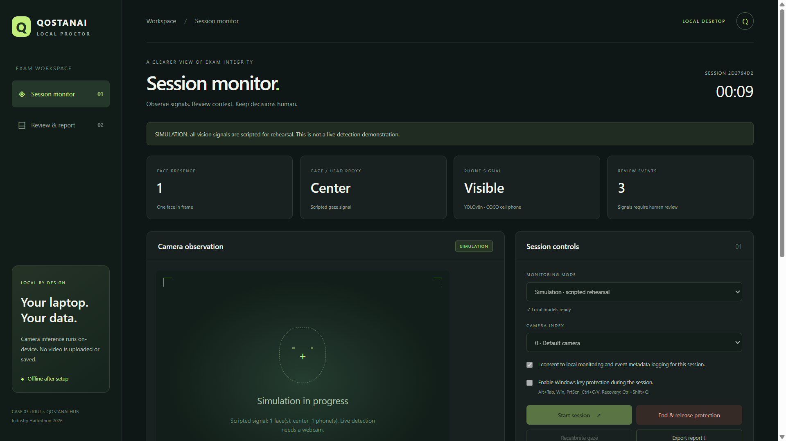
Prototype demonstration and evidence
26 Python checks
2 desktop policy checks
Passed API and Electron tests
JSON download and restart
Emergency and crash release
Camera faults with fake hardware
Human webcam trials: 0
Accuracy and live latency:
unmeasured
SIMULATION / 8 OCT 2026
04
Notes:
1:10–2:15. Use the currently verified simulation run. Start a simulation before this slide. Say: This is the actual prototype in simulation. Its vision signals are scripted, and the camera is off. Show phone-visible and phone-raised timeline entries, End or Ctrl+Shift+Q, and the downloaded ended-session JSON. Say: Our checks passed: 26 Python tests, 2 desktop policy tests, API integration and Electron recovery/export checks. Camera faults use fake hardware. We have zero recorded human webcam trials, so accuracy and live latency remain unmeasured.
Suggested 65-second sequence: 0–10 show mode and scripted phone events; 10–25 show timeline and source labels; 25–40 release protection and export; 40–50 show ended JSON; 50–65 state results and limits. This scripted sequence needs human rehearsal. If a human test fails, say what failed.
Sources: docs/RELEASE_REVIEW.md; docs/VALIDATION.md; output/qa/electron-smoke.json; scripts/check_api.py; tests/. Screenshot captured by the actual Electron smoke test on 8 October 2026 with no camera access. UI values and confidence are simulated. No physical Windows keys were pressed by these tests.

Slide 5
Proposed supervised KRU pilot
5 volunteers
2 Windows laptops
20-minute practice sessions with a teacher present
Measure
Conditions
Scenario misses and false alerts
Processing and cue-to-alert delay
Release success and reviewer time
Consent and accommodations
Human review without penalties
Agreed storage and deletion
Hypotheses: less footage transfer and faster review. No pilot has been completed.
05
Notes:
2:15–2:40. We propose five volunteers on two university Windows laptops, with a teacher supervising twenty-minute practice sessions. We would measure scenario misses, false alerts, latency and successful release, then compare reviewer effort. Reduced footage transfer and faster triage are hypotheses. This pilot needs university agreement, accommodations and a retention policy.
Source: docs/PILOT_PLAN.md. Numbers are proposed design parameters, not enrollment, deployment or performance results. Hardware baseline is the development i5-1135G7 laptop with approximately 8 GB RAM, not a validated minimum. See the pilot proposal for managed Windows edition requirements and primary Microsoft sources.

Slide 6
Limitations and next steps
Known limits
Gaze is a coarse calibrated proxy.
A raised phone cannot prove photography.
Complete OS lockdown is unfinished.
Human detection tests remain pending.
External components and AI assistance
YOLOv8n / COCO, MediaPipe, OpenCV / PyTorch, FastAPI and Electron
Codex / ChatGPT assisted development and presentation preparation.
Next: human validation, a supervised pilot and managed exam policies.
06
Notes:
2:40–3:00. Gaze remains approximate, and a raised phone cannot establish photography. Complete OS lockdown is unfinished. We disclose pretrained YOLO, MediaPipe, the software libraries and Codex/ChatGPT assistance. Our next step is human validation, followed by a supervised pilot and managed exam policies.
Sources: docs/ARCHITECTURE.md; docs/PILOT_PLAN.md; requirements-lock-windows.txt; package-lock.json; https://docs.ultralytics.com/modes/predict/ ; https://ai.google.dev/edge/mediapipe/solutions/vision/face_landmarker/python ; https://www.electronjs.org/docs/latest/api/browser-window ; https://learn.microsoft.com/en-us/windows/configuration/assigned-access/ . No custom model training, completed university pilot, certification or quantified savings are claimed. Review third-party licenses before distribution.

