Slide 1
SYMMETRY TOOL IN MATLAB

Slide 2
Symmetry in Physic

Slide 3
symmetry in python
spglib
sympy (symbolic python)
yuechangming

Slide 4


Hermitization
厄米特矩阵（Hermitian Matrix，又译作“埃尔米特矩阵”或“厄米矩阵”），
指的是自共轭矩阵。矩阵中每一个第i行第j列的元素都与第j行第i列的元素的共轭相等。
厄米矩阵主对角线上的元素都是实数的，其特征值也是实数。
不同的特征值所对应的特征向量相互正交，因此可以在这些特征向量中找出一组C的正交基。
厄米化
方阵 H 与其共轭转置的和 ($H+H^{†}$) 是埃尔米特矩阵
${\left(H+H^{†} \right)}^{†}=\left(H^{†}+H \right)$= $(H+H^{†})$

Slide 5
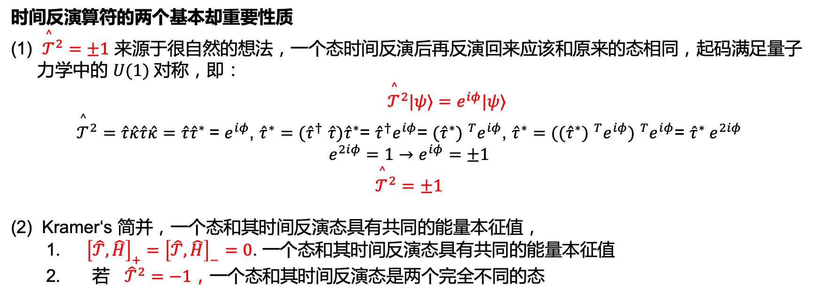
Time reversal Symmetry
时间反演算符的两个基本却重要性质
${\overset{^}{𝒯}}^{2}=±1$ 来源于很自然的想法，一个态时间反演后再反演回来应该和原来的态相同，起码满足量子力学中的 $U(1)$对称，即：
${\overset{^}{𝒯}}^{2}|ψ⟩=e^{iφ}|ψ⟩$
${\overset{^}{𝒯}}^{2}=\hat{τ}\hat{κ}\hat{τ}\hat{κ}=\hat{τ}{\hat{τ}}^{∗}$= $e^{iφ}$, ${\hat{τ}}^{∗}{=(\hat{τ}}^{†}\hat{τ}{)\hat{τ}}^{∗}$= ${{\hat{τ}}^{†}e}^{iφ}$= ${{(\hat{τ}}^{∗}) }^{T}e^{iφ}$, ${\hat{τ}}^{∗}={({{(\hat{τ}}^{∗}) }^{T}e^{iφ}) }^{T}e^{iφ}$= ${\hat{τ}}^{∗} e^{2iφ}$
$$e^{2iφ}=1→e^{iφ}=±1$$
$${\overset{^}{𝒯}}^{2}=±1$$
(2) Kramer‘s 简并，一个态和其时间反演态具有共同的能量本征值，
${\left[\hat{𝒯},\hat{H}\right]}_{+}={\left[\hat{𝒯},\hat{H}\right]}_{−}=0$. 一个态和其时间反演态具有共同的能量本征值
若 ${\hat{𝒯}}^{2}=−1，\text{一个态和其时间反演态是两个完全不同的}\text{态}$
时间反演不动点（TRIM）
$\hat{𝒯}$ $\hat{H}\left(k\right){\hat{𝒯}}^{†}=\hat{H}\left(−k\right)$
某个能量 $E(k)$ 的克莱默简并态就在$E(−k)$

Slide 6

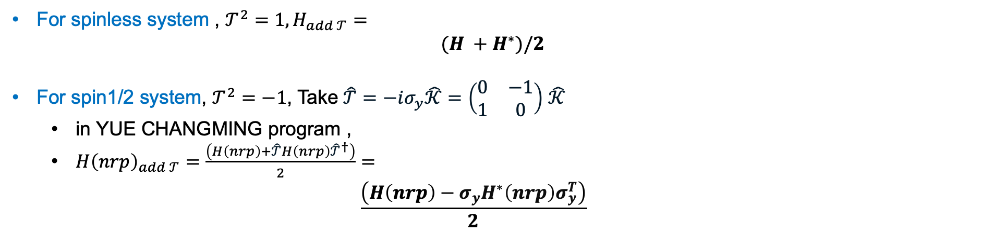
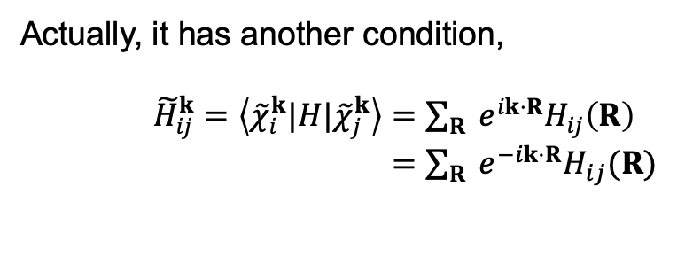
Add Time reversal Symmetry
For spinless system , $𝒯^{2}=1, H_{add 𝒯}=$
$$(H +H^{∗})/2$$
For spin1/2 system, $𝒯^{2}=−1$, Take$\hat{𝒯}=−iσ_{y}\hat{𝒦}=\left(\begin{matrix}0 & −1 \\ 1 & 0\end{matrix}\right)$ $\hat{𝒦}$
in YUE CHANGMING program ,
$H{\left(nrp\right)}_{add 𝒯}=\frac{\left(H\left(nrp\right)+\hat{𝒯}H\left(nrp\right){\hat{𝒯}}^{†}\right)}{2}=$
$$\frac{\left(H\left(nrp\right)−σ_{y}H^{∗}\left(nrp\right)σ_{y}^{T}\right)}{2}$$
$$−iσ_{y}H^{∗}\left(nrp\right){\left(−iσ_{y}\right)}^{T}$$
local symmetry?
Actually, it has another condition,
${\tilde{H}}_{ij}^{k}=\left\langle {\tilde{χ}}_{i}^{k}|H|{\tilde{χ}}_{j}^{k}\right\rangle =\sum_{R}{ }e^{ik⋅R}H_{ij}\left(R\right)$
$=\sum_{R}{ }e^{−ik⋅R}H_{ij}(R)$
particle-hole symmetry

Slide 7
Add Inversion Symmetry
For spinless system , $P^{2}=1, P exchange sites$,

Slide 8
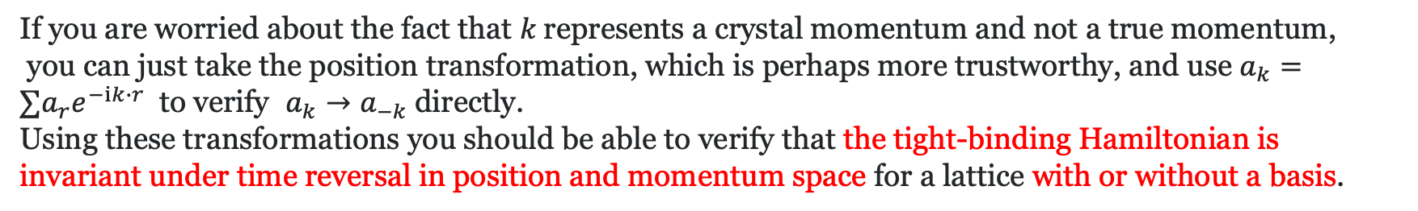
Time reversal operator in tight-binding model with second quantization form
As for the creation/annihilation operators used in second quantization the sign changes under $𝒯$ would suggest a transformation of $a_{r}→a_{r}$and $a_{k}→a_{−k}.$
If you are worried about the fact that 𝑘 represents a crystal momentum and not a true momentum,
you can just take the position transformation, which is perhaps more trustworthy, and use $a_{k}=∑a_{r}e^{−ik∙r}$to verify $a_{k}→a_{−k}$directly.
Using these transformations you should be able to verify that the tight-binding Hamiltonian is invariant under time reversal in position and momentum space for a lattice with or without a basis.

Slide 9
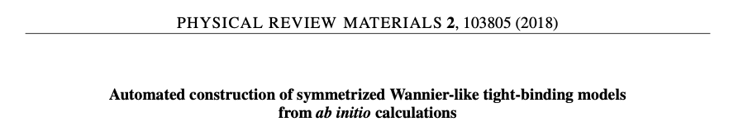
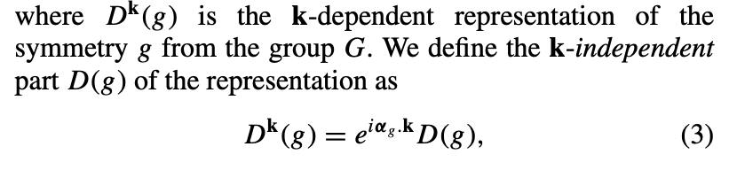
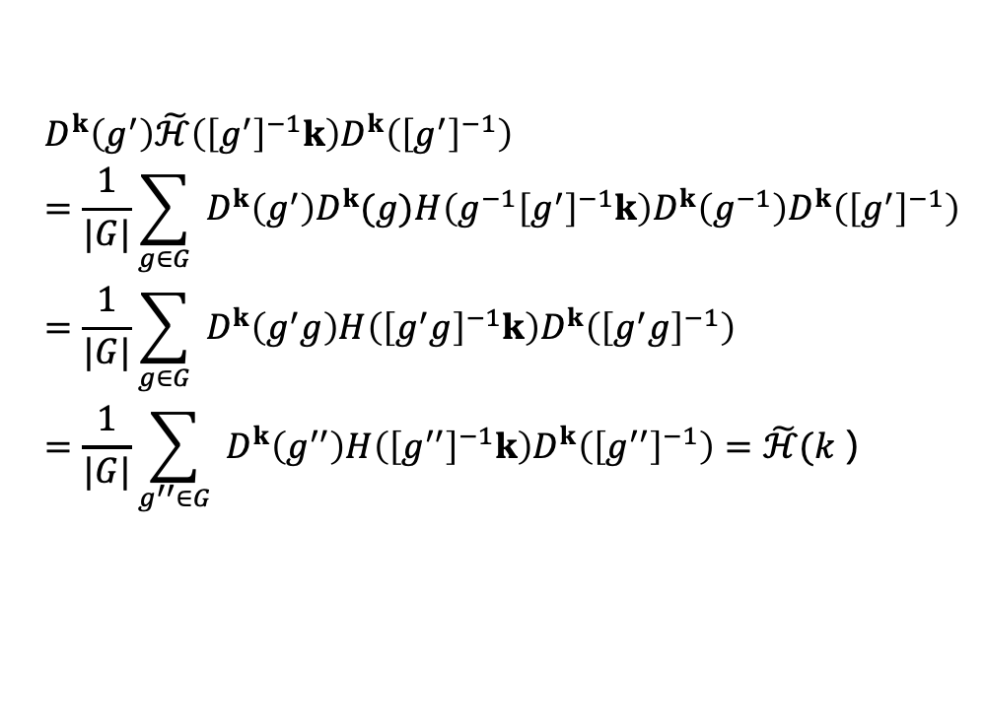
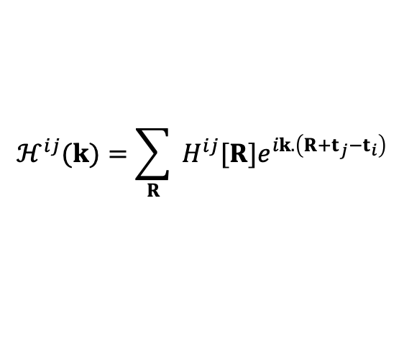
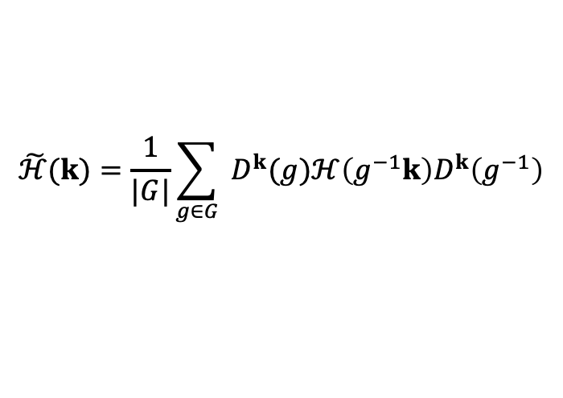

symmetrized Wannier-like tight-binding models
10.1103/PhysRevMaterials.2.103805
$$\tilde{ℋ}(k)=\frac{1}{|G|}\sum_{g∈G}{ }D^{k}(g)ℋ\left(g^{−1}k\right)D^{k}\left(g^{−1}\right)$$
$$ℋ^{ij}(k)=\sum_{R}{ }H^{ij}[R]e^{ik.\left(R+t_{j}−t_{i}\right)}$$
For a given symmetry group G, the symmetry constraint on the Hamiltonian matrix is given by
$$\begin{aligned}&D^{k}\left(g^{′}\right)\tilde{ℋ}\left({\left[g^{′}\right]}^{−1}k\right)D^{k}\left({\left[g^{′}\right]}^{−1}\right) \\ &=\frac{1}{|G|}\sum_{g∈G}{ }D^{k}\left(g^{′}\right)D^{k}(g)H\left(g^{−1}{\left[g^{′}\right]}^{−1}k\right)D^{k}\left(g^{−1}\right)D^{k}\left({\left[g^{′}\right]}^{−1}\right) \\ &=\frac{1}{|G|}\sum_{g∈G}{ }D^{k}\left(g^{′}g\right)H\left({\left[g^{′}g\right]}^{−1}k\right)D^{k}\left({\left[g^{′}g\right]}^{−1}\right) \\ &=\frac{1}{|G|}\sum_{g^{′′}∈G}{ }D^{k}\left(g^{′′}\right)H\left({\left[g^{′′}\right]}^{−1}k\right)D^{k}\left({\left[g^{′′}\right]}^{−1}\right)=\tilde{ℋ}(k）\end{aligned}$$
$$∀g∈G:ℋ(k)=D^{k}(g)ℋ\left(g^{−1}k\right)D^{k}\left(g^{−1}\right)$$

Slide 10



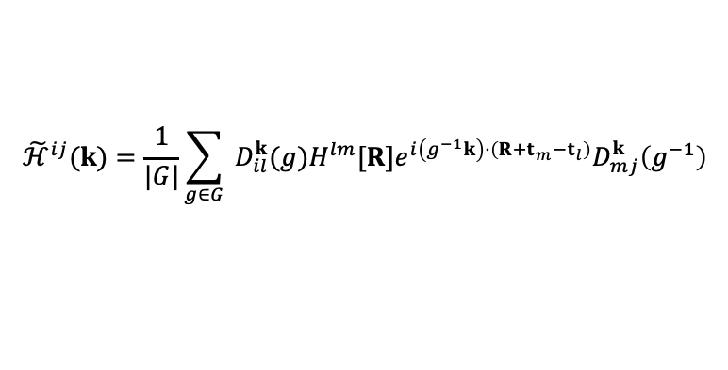

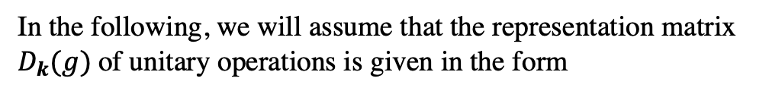
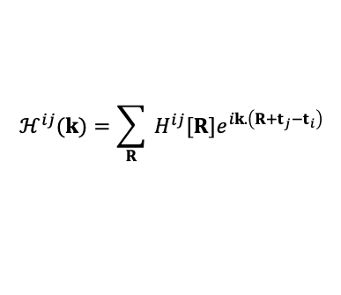
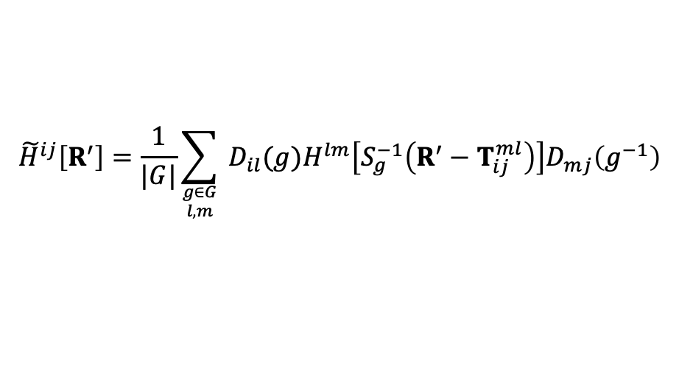


How the g on k translate into g on R
In the following, we will assume that the representation matrix $D_{k}(g)$of unitary operations is given in the form
notice that
$$D_{il}^{k}(g)≠0 \text{only} \text{if} gt_{l}−t_{i}∈ℤ^{d}$$
$$D^{k}(g)=e^{iα_{g}⋅k}D(g)=e^{iα_{g}⋅k}U_{g}$$
$$ℋ^{ij}(k)=\sum_{R}{ }H^{ij}[R]e^{ik.\left(R+t_{j}−t_{i}\right)}$$
$${\tilde{ℋ}}^{ij}(k)=\frac{1}{|G|}\sum_{g∈G}{ }D_{il}^{k}(g)H^{lm}[R]e^{i\left(g^{−1}k\right)⋅\left(R+t_{m}−t_{l}\right)}D_{mj}^{k}\left(g^{−1}\right)$$
$$D^{k}(g)=e^{iα_{g}⋅k}D(g)=e^{iα_{g}⋅k}U_{g}\hat{K}$$
where $α_{g}$ is the translation vector and $U_{g}$ is a unitary matrix.
Since g acts on r with Sg ；
A is the operation which acts upon k
$$A=±{\left(S_{g}^{T}\right)}^{−1}$$
$$T_{ij}^{ml}=S_{g}\left(t_{m}−t_{l}\right)−\left(t_{j}−t_{i}\right)∈ℤ^{d}$$
$${\tilde{H}}^{ij}\left[R^{′}\right]=\frac{1}{|G|}\sum_{{g∈G \atop l,m}}{ }D_{il}(g)H^{lm}\left[S_{g}^{−1}\left(R^{′}−T_{ij}^{ml}\right)\right]D_{mj}\left(g^{−1}\right)$$

Slide 11
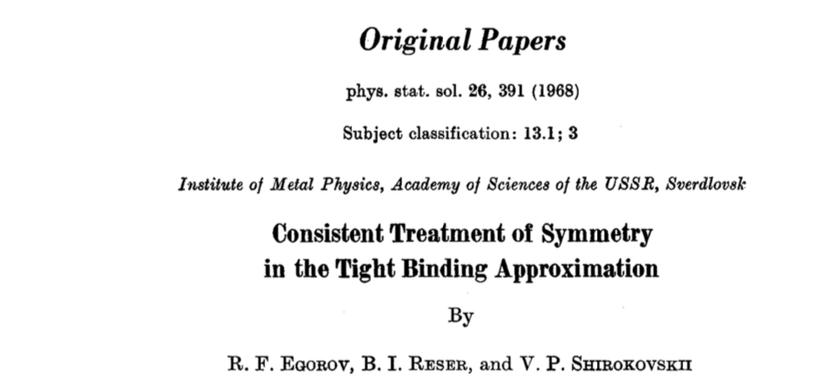



Consistent Treatment of Symmetry in the Tight Binding Approximation
Egorov, R. F., Reser, B. I. & Shirokovskii, V. P. Consistent Treatment of Symmetry in the Tight Binding Approximation. Phys. Status Solidi 26, 391–408 (1968).
The form of Hamiltonian matrix components in the tight binding approximation are deduced group-theoretically taking into account the space symmetry of the problem, time- reversal symmetry and hermiticity of the Hamiltonian.
Slater and Koster. (need SOC version)
Seitz's notation:
Any space transformation may be written in the form {$α|\text{t}$} r and is acting upon an arbitrary vector r in the following manner :
{$α|\text{t}$} r = $α$r +t .
注意顺序
$${\{α|t\}}^{−1}=\left\{α^{−1}|−α^{−1}t\right\},\{α|t\}\left\{β|t^{′}\right\}=\left\{αβ|αt^{′}+t\right\}$$
the symmetry operators commute with the Hamiltonian and always may be chosen to be unitary.
{$α|\text{t}$} H =H {$α|\text{t}$}

Slide 12

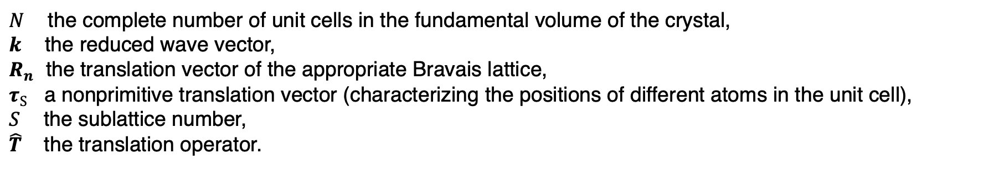
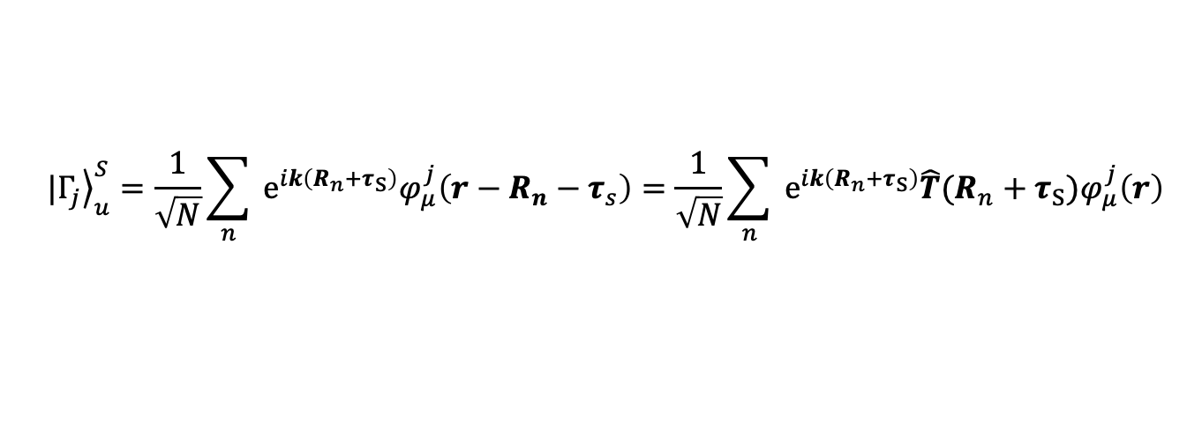
Notations
We shall label atomic functions by two indices ($j,μ$) which indicate that a given function belongs to the $μ$th row of the irreducible representation $Γ_{j}$ of the point subgroup $G_{0}$ of the space symmetry group.
$$φ\left(r\right)= φ_{μ}^{j}(r)$$
the Bloch sum may be rewritten in the form
$$|{\left.Γ_{j}\right\rangle }_{u}^{S}=\frac{1}{\sqrt{N}}\sum_{n}{ }e^{ik\left(R_{n}+τ_{S}\right)}φ_{μ}^{j}\left(r−R_{n}−τ_{s}\right)=\frac{1}{\sqrt{N}}\sum_{n}{ }e^{ik\left(R_{n}+τ_{S}\right)}{\hat{T}(R_{n}+τ_{S})φ}_{μ}^{j}\left(r\right)$$
$N$ the complete number of unit cells in the fundamental volume of the crystal,
$k$ the reduced wave vector,
$R_{n}$ the translation vector of the appropriate Bravais lattice,
$τ_{S}$ a nonprimitive translation vector (characterizing the positions of different atoms in the unit cell),
$S$ the sublattice number,
$\hat{T}$ the translation operator.
Let us form now the expression for the Hamiltonian’s matrix component between two Bloch sums:

Slide 13
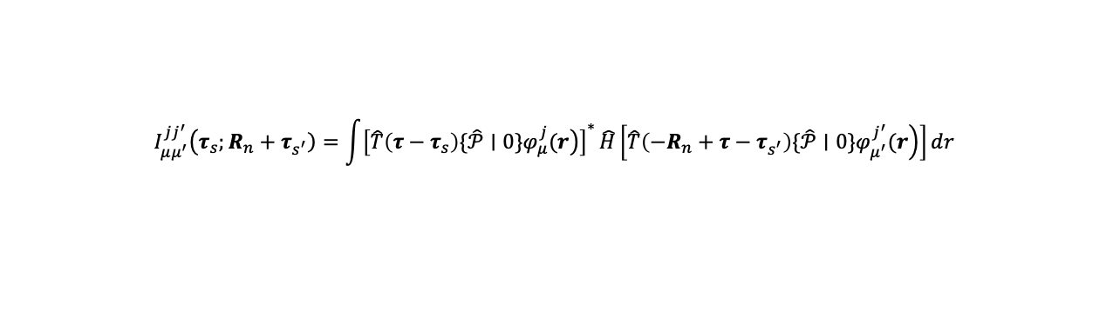
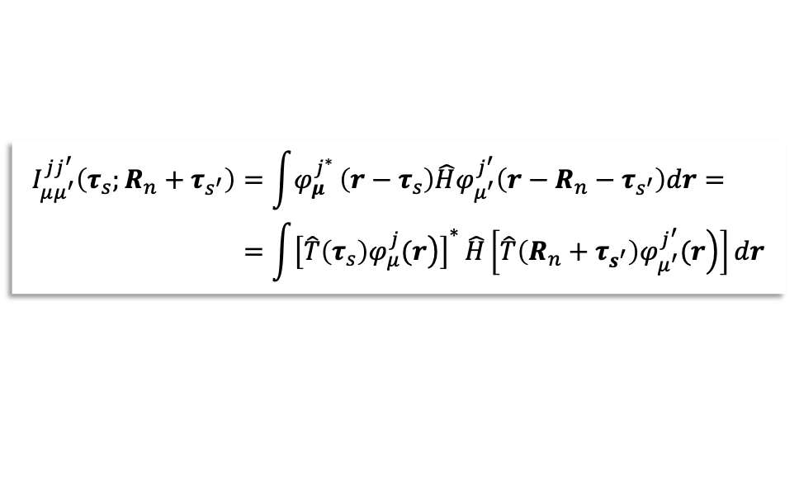

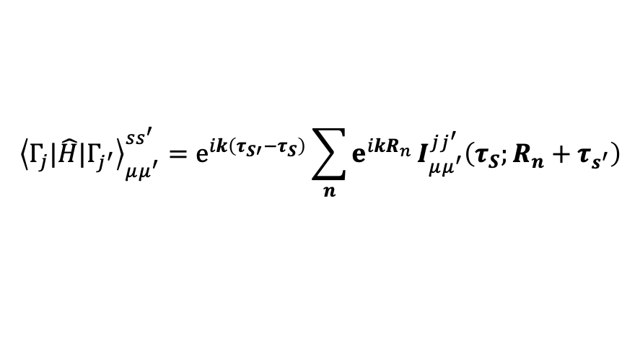


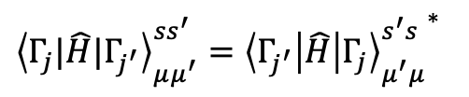
Hermiticity and Inversion
$${\left\langle Γ_{j}|\hat{H}|Γ_{j^{′}}\right\rangle }_{μμ^{′}}^{ss^{′}}=e^{ik\left(τ_{S′}−τ_{S}\right)}\sum_{n}{e^{ikR_{n}}}I_{μμ^{′}}^{jj^{′}}\left(τ_{S};R_{n}+τ_{s^{′}}\right)$$
$$\begin{aligned}I_{μμ^{′}}^{jj^{′}}\left(τ_{s};R_{n}+τ_{s^{′}}\right)&=\int{φ_{μ}^{j^{∗}}}\left(r−τ_{s}\right)\hat{H}φ_{μ^{′}}^{j^{′}}\left(r−R_{n}−τ_{s^{′}}\right)dr= \\ &=\int{{\left[\left.\hat{T}\left(τ_{s}\right)φ_{μ}^{j}(r\right)\right]}^{∗}}\hat{H}\left[\left.\hat{T}\left(R_{n}+τ_{s^{′}}\right)φ_{μ^{′}}^{j^{′}}(r\right)\right]dr\end{aligned}$$
The energy integrals are not all independent of each other. They are connected with each other by a set of relations which follow from the Hermiticity and symmetry properties of the Hamiltonian.
Hermiticity
Parity
Atomic functions always have a definite parity.
the Hamiltonian is Hermitian, we have
The operator $\{𝒫|t\}$ is an unitary one and commutes with the Hamiltonian; and we have
${\left\langle Γ_{j}|\hat{H}|Γ_{j^{′}}\right\rangle }_{μμ^{′}}^{ss^{′}}={{\left\langle Γ_{j^{′}}\left|\hat{H}\right|Γ_{j}\right\rangle }_{μ^{′}μ}^{s^{′}s}}^{∗}$
$$I_{μμ^{′}}^{jj^{′}}\left(τ_{s}\right.\left.;R_{n}+τ_{s^{′}}\right)=\int{{\left[\left.\hat{T}\left(τ−τ_{s}\right)\{\hat{𝒫}∣0\}φ_{μ}^{j}(r\right)\right]}^{∗}}\hat{H}\left[\left.\hat{T}\left(−R_{n}+τ−τ_{s^{′}}\right)\{\hat{𝒫}∣0\}φ_{μ^{′}}^{j^{′}}(r\right)\right]dr$$
$$I_{μμ^{′}}^{jj^{′}}\left(τ_{s};R_{n}+τ_{s^{′}}\right)=I_{μ^{′}μ}^{j^{′}j^{∗}}\left(τ_{s^{′}};−R_{n}+τ_{s}\right)$$
$$=ω^{j}ω^{j^{′}}I_{μμ^{′}}^{jj^{′}}\left(τ−τ_{s};−R_{n}+τ−τ_{s^{′}}\right)$$
$ω$ takes the values +1 or -1 for even and odd functions, respectively

Slide 14
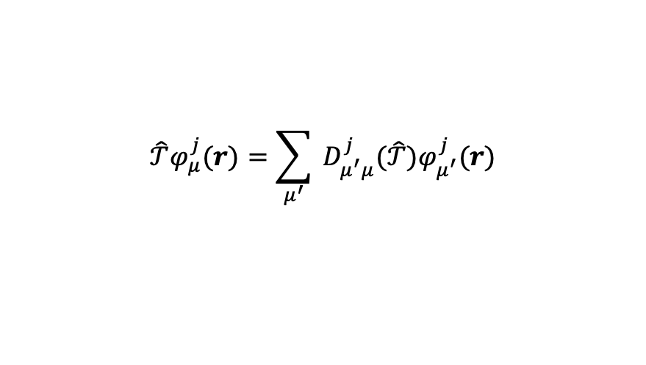
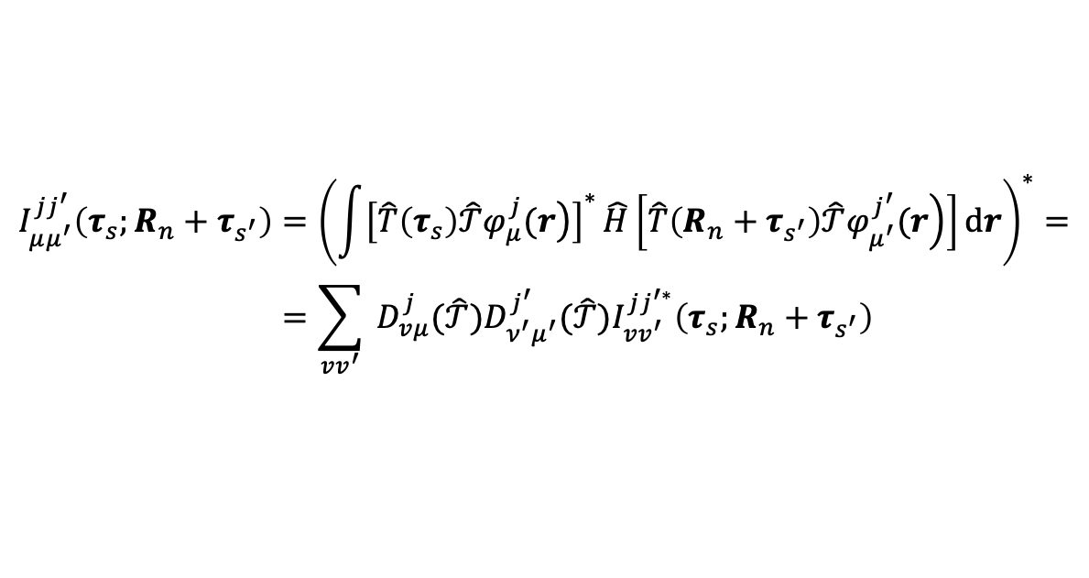
Time-reversal
Time-reversal
The most natural way to include the operator $𝒯$ in the group theoretical analysis is the use of co-representations [1]
$$\begin{aligned}I_{μμ^{′}}^{jj^{′}}\left(τ_{s};R_{n}+τ_{s^{′}}\right)&={\left(\int{{\left[\left.\hat{T}\left(τ_{s}\right)\hat{𝒯}φ_{μ}^{j}(r\right)\right]}^{∗}}\hat{H}\left[\left.\hat{T}\left(R_{n}+τ_{s^{′}}\right)\hat{𝒯}φ_{μ^{′}}^{j^{′}}(r\right)\right]dr\right)}^{∗}= \\ &=\sum_{vv^{′}}{ }D_{vμ}^{j}(\hat{𝒯})D_{ν^{′}μ^{′}}^{j^{′}}(\hat{𝒯})I_{vv^{′}}^{jj^{′∗}}\left(τ_{s};R_{n}+τ_{s^{′}}\right)\end{aligned}$$
the operator $𝒯$acts on $φ_{μ}^{j}(r)$ in the following way:
$$\hat{𝒯}φ_{μ}^{j}(r)=\sum_{μ^{′}}{ }D_{μ^{′}μ}^{j}(\hat{𝒯})φ_{μ^{′}}^{j}(r)$$
$D^{j}(\hat{𝒯})$means the matrix of the time-reversal operator in j-th co-representation.
To get concrete relations, the knowledge of the concrete form of the matrix $D^{j}(\hat{𝒯})$ is necessary.
We shall discuss only two special cases.
Spin-independent Hamiltonian and Spin-dependent Hamiltonian

Slide 15

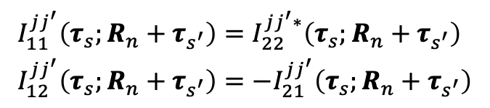
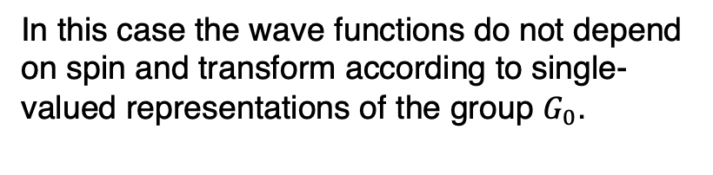
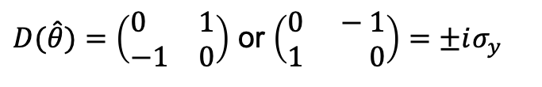

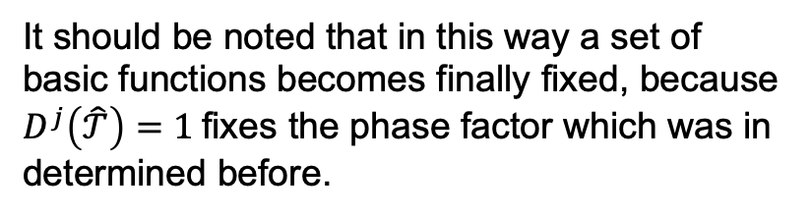
Time-reversal
Spin-independent
Spin-dependent
In this case the wave functions do not depend on spin and transform according to single-valued representations of the group $G_{0}$.
If the spin is included it is necessary to consider the functions which transform according to double-valued representations.
$$D^{j}\left(\hat{𝒯}\right)=1$$
The matrix of the time-reversal operator may be taken in the form
It should be noted that in this way a set of basic functions becomes finally fixed, because $D^{j}\left(\hat{𝒯}\right)=1$fixes the phase factor which was in determined before.
$D(\hat{θ})=\left(\begin{aligned}&0 &&1 \\ &−1 &&0\end{aligned}\right)$ or $\left(\begin{aligned}&0 &−&1 \\ &1 &&0\end{aligned}\right)=±iσ_{y}$
$$\begin{aligned}&I_{11}^{jj^{′}}\left(τ_{s};R_{n}+τ_{s^{′}}\right)=I_{22}^{jj^{′}∗}\left(τ_{s};R_{n}+τ_{s^{′}}\right) \\ &I_{12}^{jj^{′}}\left(τ_{s};R_{n}+τ_{s^{′}}\right)=−I_{21}^{jj^{′}}\left(τ_{s};R_{n}+τ_{s^{′}}\right)\end{aligned}$$
$$I_{μμ^{′}}^{jj^{′}}\left(τ_{ε};R_{n}+τ_{s^{′}}\right)=I_{μμ^{′}}^{jj^{′}∗}\left(τ_{s};R_{n}+τ_{s^{′}}\right)$$

Slide 16

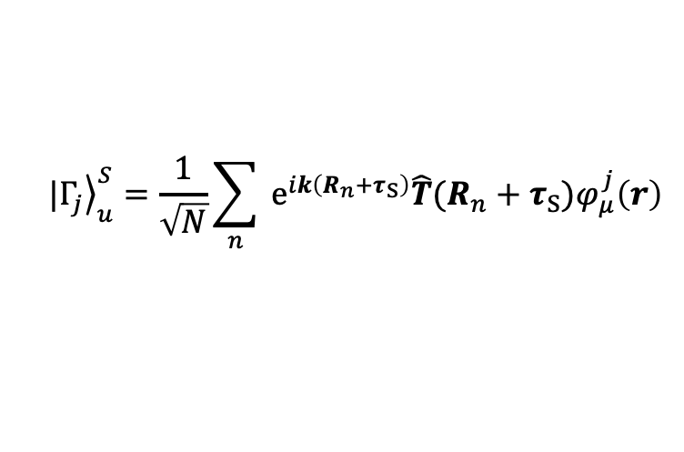

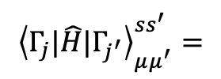
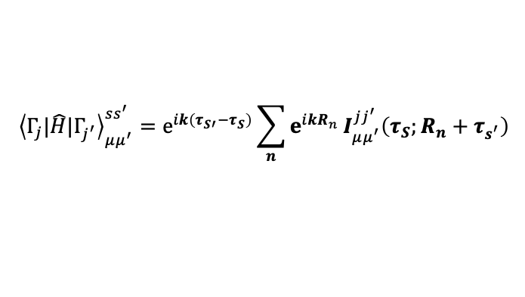

Spin-1 PT symmetry effect
Combined Hermiticity Parity Time-reversal
$$I_{μμ^{′}}^{jj^{′}}\left(τ_{s};R_{n}+τ_{s^{′}}\right)=I_{μ^{′}μ}^{j^{′}j^{∗}}\left(τ_{s^{′}};−R_{n}+τ_{s}\right)$$
$$|{\left.Γ_{j}\right\rangle }_{u}^{S}=\frac{1}{\sqrt{N}}\sum_{n}{ }e^{ik\left(R_{n}+τ_{S}\right)}{\hat{T}(R_{n}+τ_{S})φ}_{μ}^{j}\left(r\right)$$
H
P
$$I_{μμ^{′}}^{jj^{′}}\left(τ_{s}\right.\left.;R_{n}+τ_{s^{′}}\right)=ω^{j}ω^{j^{′}}I_{μμ^{′}}^{jj^{′}}\left(τ−τ_{s};−R_{n}+τ−τ_{s^{′}}\right)$$
$${\left\langle Γ_{j}|\hat{H}|Γ_{j^{′}}\right\rangle }_{μμ^{′}}^{ss^{′}}=e^{ik\left(τ_{S′}−τ_{S}\right)}\sum_{n}{e^{ikR_{n}}}I_{μμ^{′}}^{jj^{′}}\left(τ_{S};R_{n}+τ_{s^{′}}\right)$$
T
$$I_{μμ^{′}}^{jj^{′}}\left(τ_{ε};R_{n}+τ_{s^{′}}\right)=I_{μμ^{′}}^{jj^{′}∗}\left(τ_{s};R_{n}+τ_{s^{′}}\right)$$
$${\left\langle Γ_{j}|\hat{H}|Γ_{j^{′}}\right\rangle }_{μμ^{′}}^{ss^{′}}=$$

Slide 17
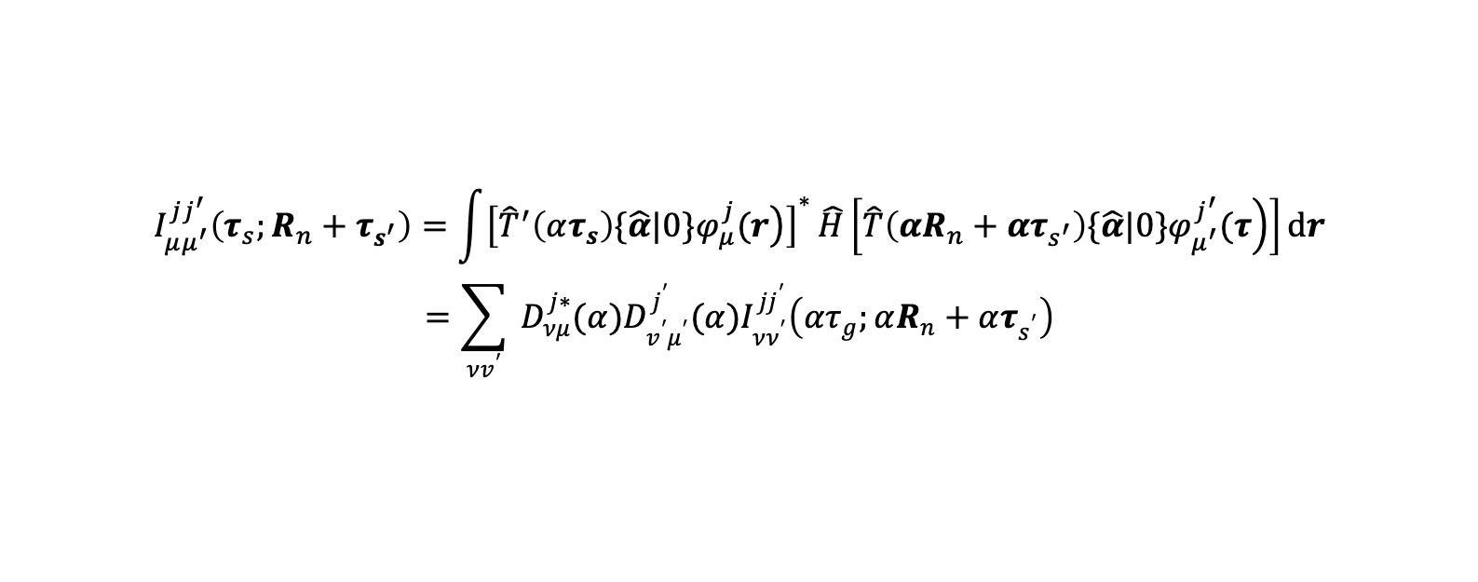

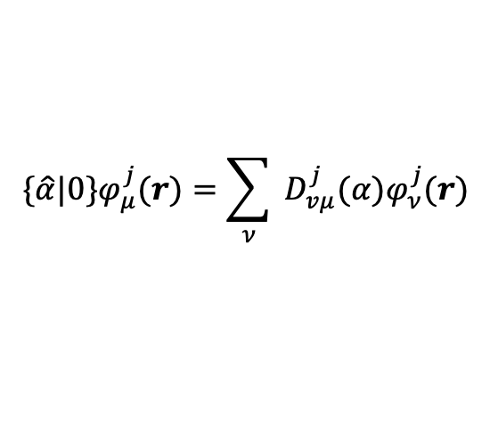
Point Symmetry
To obtain the relations between the energy integrals, it is also necessary to consider the effect of space symmetry of the system.
It is sufficient to discuss only the point symmetry, because the inversion was considered above and the translation symmetry gives only the trivial permutation of the lattice sites indices.
{$α|\text{0}$} be an operator of a point subgroup $G_{0}$
$$I_{μμ^{′}}^{jj^{′}}\left(τ_{s};R_{n}+τ_{s^{′}}\right)=\int{{\left[\left.{\hat{T}}^{′}\left(ατ_{s}\right)\{\hat{α}|0\}φ_{μ}^{j}(r\right)\right]}^{∗}}\hat{H}\left[\left.\hat{T}\left(αR_{n}+ατ_{s^{′}}\right)\{\hat{α}|0\}φ_{μ^{′}}^{j^{′}}(τ\right)\right]dr$$
$$=\sum_{νv^{′}}{ }D_{νμ}^{j∗}(α)D_{v^{′}μ^{′}}^{j^{′}}(α)I_{νν^{′}}^{jj^{′}}\left(ατ_{g};αR_{n}+ατ_{s^{′}}\right)$$
$$\{\hat{α}|0\}φ_{μ}^{j}(r)=\sum_{ν}{ }D_{vμ}^{j}(α)φ_{ν}^{j}(r)$$

Slide 18


Relations between symmetry
$$I_{μμ^{′}}^{jj^{′}}\left(τ_{s};R_{n}+τ_{s^{′}}\right)=I_{μ^{′}μ}^{j^{′}j^{∗}}\left(τ_{s^{′}};−R_{n}+τ_{s}\right)$$
$$jj^{′}$$
$$μμ^{′}$$
对应矩阵元

Slide 19
Determination of independent parameters

Slide 20
Calculation procedure - Workflow
Crystal symmetry
Determine the point subgroup of the space group of the considered crystal.
Determine
Generator
choose the set of fixed vectors QL for every coordinative sphere (see Section 2.8).
Write and Compute
Write down (29) for transformations defined in c). Solving the equations express all the energy integrals as functions of the minimum number of indepen- dent energy integrals. Use (17) and (19)for independent integrals.
Find its irreducible representations (single-or double-valued) and set them into the definite order.
For the fixed set of initial functions it is sufficient to take those representations according to which these functions transform.
Define the transformation of arbitrary vector under the operation of a from G,.
Substitute
Substitute the results from into (28) and obtain the final expres-sions for the matrix components.
Determine other matrix components with the help of formulas of Section
Compute the inner sums in (28): $\sum_{α}{ }e^{iαkQ_{p}^{l}}D_{vμ}^{j∗}(α)D_{v^{′}μ^{′}}^{j^{′}}(α)$
Compute the inner sums in (28): ∑129_𝛼▒ e^(𝑖𝛼𝒌𝑸_𝑝^𝑙 ) 𝐷_𝑣𝜇^(𝑗∗) (𝛼)𝐷_(𝑣^′ 𝜇^′)^(𝑗^′ ) (𝛼)
where u runs over the values determined by d).
c) For every QL find the transformations (Y which do not change it and form the group Gk. Then find the generators for this group.
d) For every R, +z,=+ Qk from a given coordinative sphere choose one of the transformations u which transform R, +z8into 9; (see (26)).

Slide 21
Example in Hcp ( Programing way)
Hexagonal Close-Packed (H.C.P.) Structures
Firstly, the majority of rare-earth metals for which it is reasonable to calculate the electron energy bands in the tight binding approximation have practically the h.c.p. structure.
Secondly, these structures represent a sufficiently complicated example for illustrating the idea of our method ( large number of functions, complicated elements of symmetry, necessity for taking into account the spin).

