Slide 1
HK symmetry

Slide 2

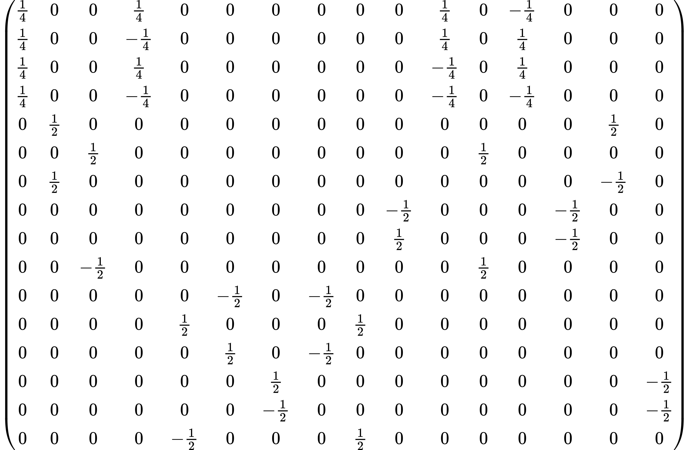





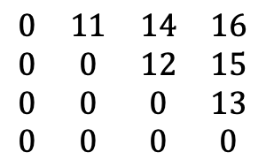
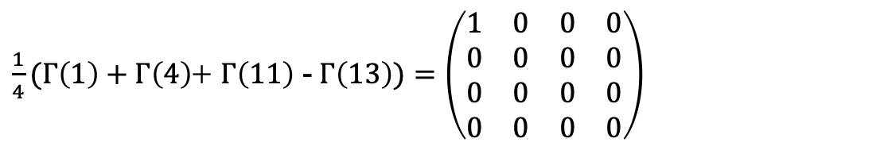
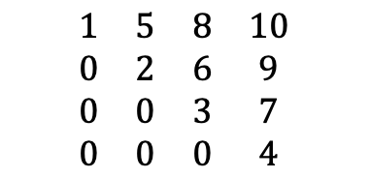


展开哈密顿量为 Gamma矩阵
$$Γ\left(1\right)$$
$\frac{1}{4}(Γ\left(1\right)+Γ\left(4\right)$+ $Γ\left(11\right)$ -$Γ\left(13\right))=\left(\begin{matrix}1 & 0 & 0 & 0 \\ 0 & 0 & 0 & 0 \\ 0 & 0 & 0 & 0 \\ 0 & 0 & 0 & 0\end{matrix}\right)$
Smat
$$Γ\left(4\right)$$
4*4 矩阵 加上共轭条件
取上三角 共16个独立量 作为基失
16个Gamma矩阵
完备基之间的线形变换
$$Γ\left(11\right)$$
real
imag
$$\begin{matrix}1 & 5 & 8 & 10 \\ 0 & 2 & 6 & 9 \\ 0 & 0 & 3 & 7 \\ 0 & 0 & 0 & 4\end{matrix}$$
$$\begin{matrix}0 & 11 & 14 & 16 \\ 0 & 0 & 12 & 15 \\ 0 & 0 & 0 & 13 \\ 0 & 0 & 0 & 0\end{matrix}$$
$$Γ\left(13\right)$$

Slide 3
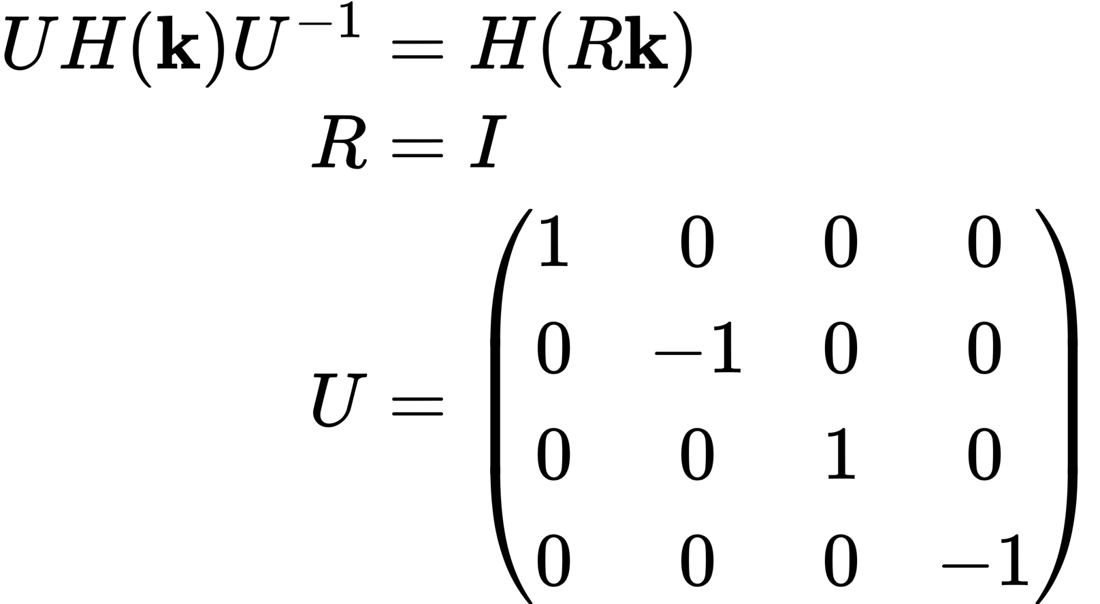
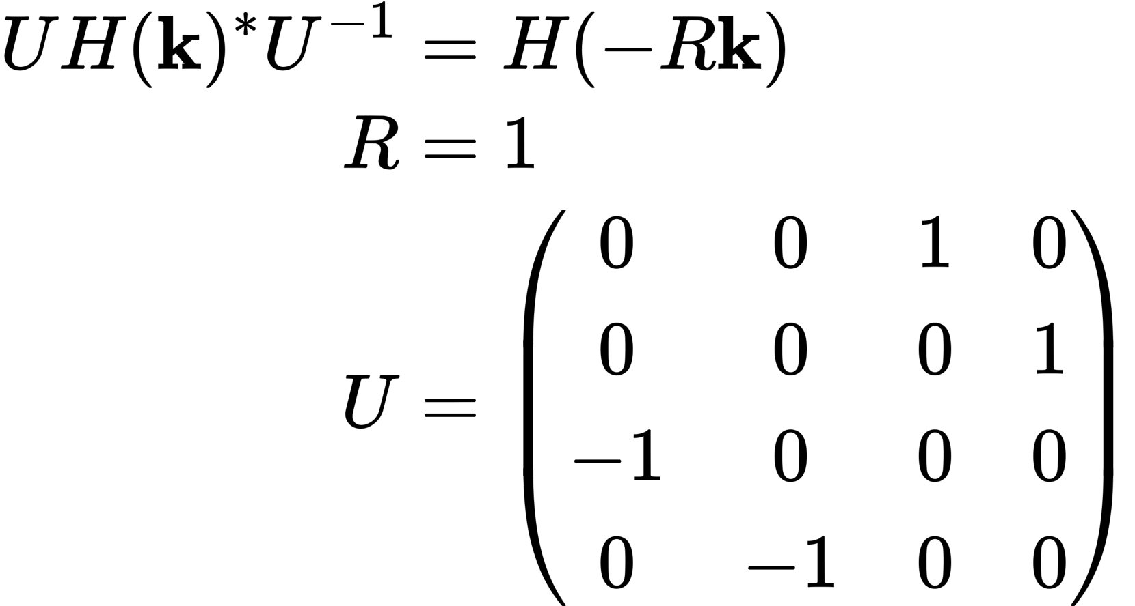
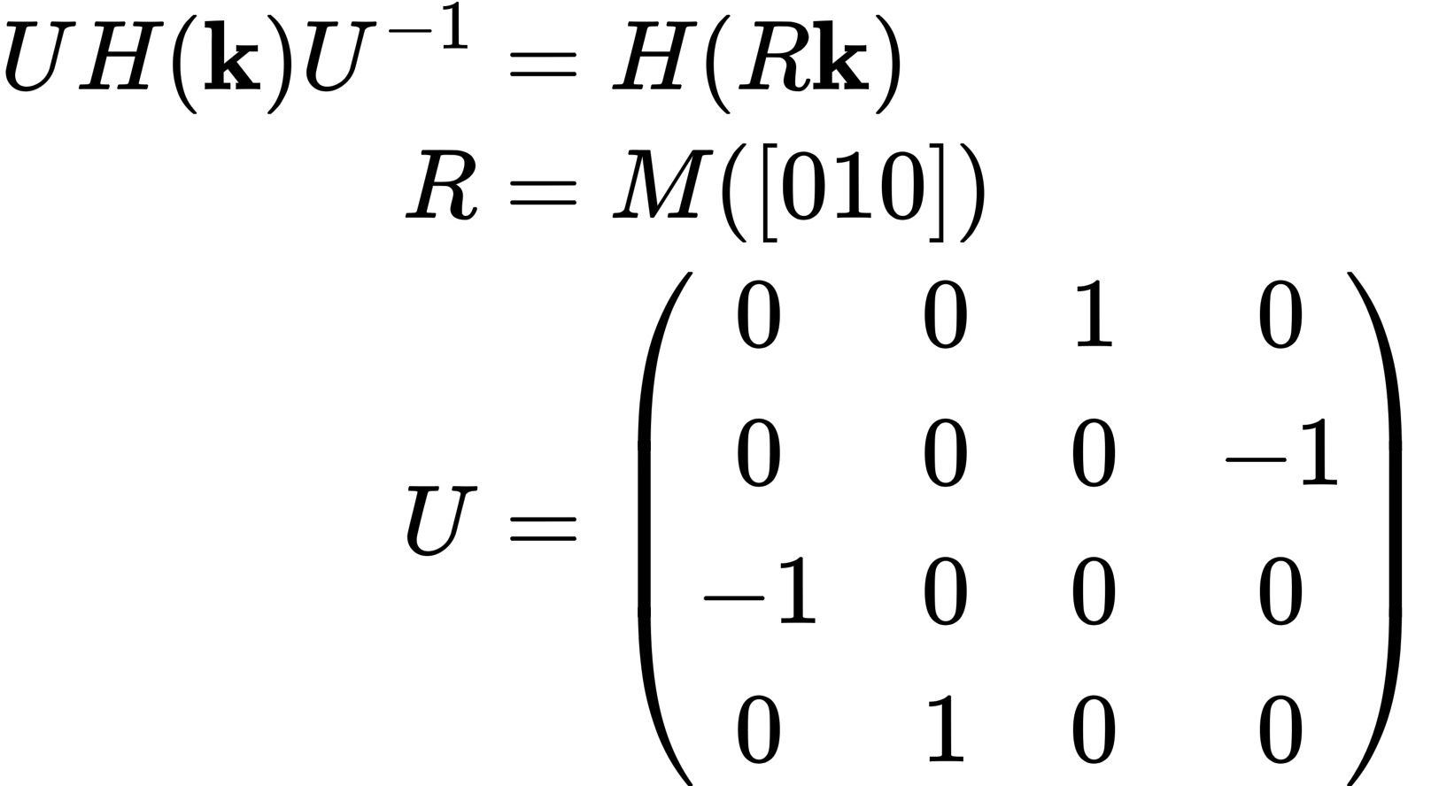
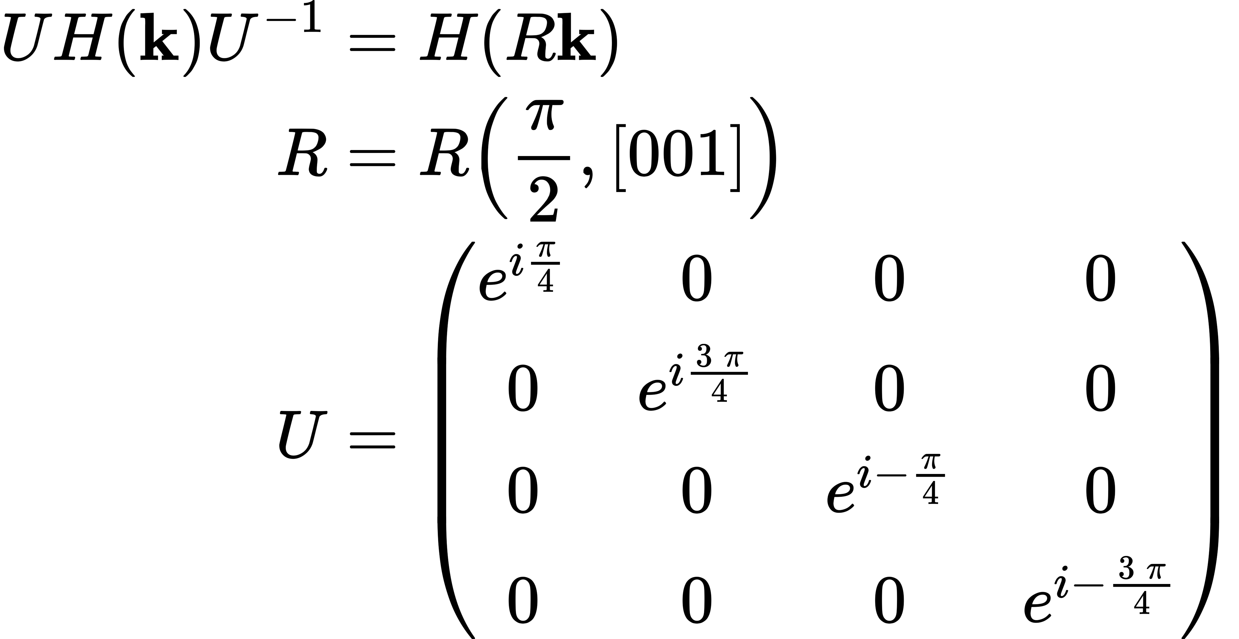
Oper
%%
Tr = Oper.time_reversal(3,double(-1i*gamma_matric(4,5)));% tau_z sigma_0
My = Oper.mirror([0,1,0],double( 1i*gamma_matric(1,2)));%
I = Oper.inversion(3,diag([1,-1,1,-1]));
C4z = Oper.rotation(1/4,[0,0,1],false, expm(1i*(pi/4)*diag([1 3 -1 -3])), 'sym',true);
P
T
My
C4

Slide 4
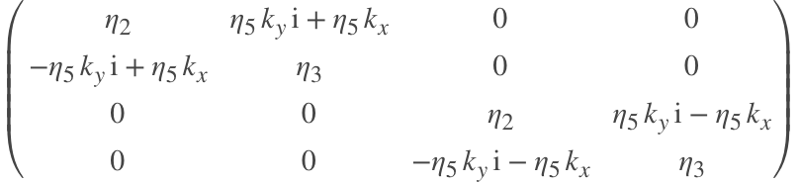
kp gen
1 order
%%
BHZ_building = HK(4,1);
BHZ_building = BHZ_building <= 'POSCAR';
BHZ_building_C4_1 = BHZ_building.applyOper(groups,'generator',true);
[BHZ_building_C4_1st,Sublist1,Unique_term1] = unique(BHZ_building_C4_1);
BHZ_building_C4_1st_sym = sym(BHZ_building_C4_1st);

Slide 5
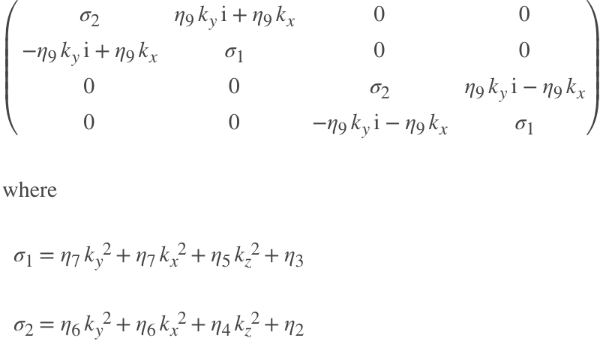
kp gen
2 order
%%
BHZ_building = HK(4,2);
BHZ_building = BHZ_building <= 'POSCAR';
BHZ_building_C4_2 = BHZ_building.applyOper(groups,'generator',true);
[BHZ_building_C4_2nd,Sublist2,Unique_term2] = unique(BHZ_building_C4_2);
BHZ_building_C4_2nd_sym = sym(BHZ_building_C4_2nd);

Slide 6
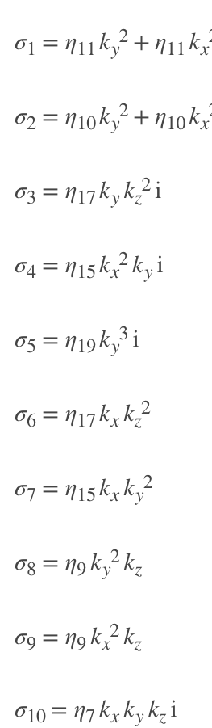
kp gen
3 order
%%
BHZ_building = HK(4,3);
BHZ_building = BHZ_building <= 'POSCAR';
BHZ_building_C4_3 = BHZ_building.applyOper(groups,'generator',true);
[BHZ_building_C4_3rd,Sublist3,Unique_term3] = unique(BHZ_building_C4_3);
BHZ_building_C4_3rd_sym = sym(BHZ_building_C4_3rd);

Slide 7
GammaDecomposition
[BHZ_building_C4_1st_Gamma,BHZ_building_C4_1st_latex_Gamma] = BHZ_building_C4_1st.GammaDecomposition();
[BHZ_building_C4_1st_pauli,BHZ_building_C4_1st_latex_pauli] = BHZ_building_C4_1st.pauliDecomposition();

Slide 8
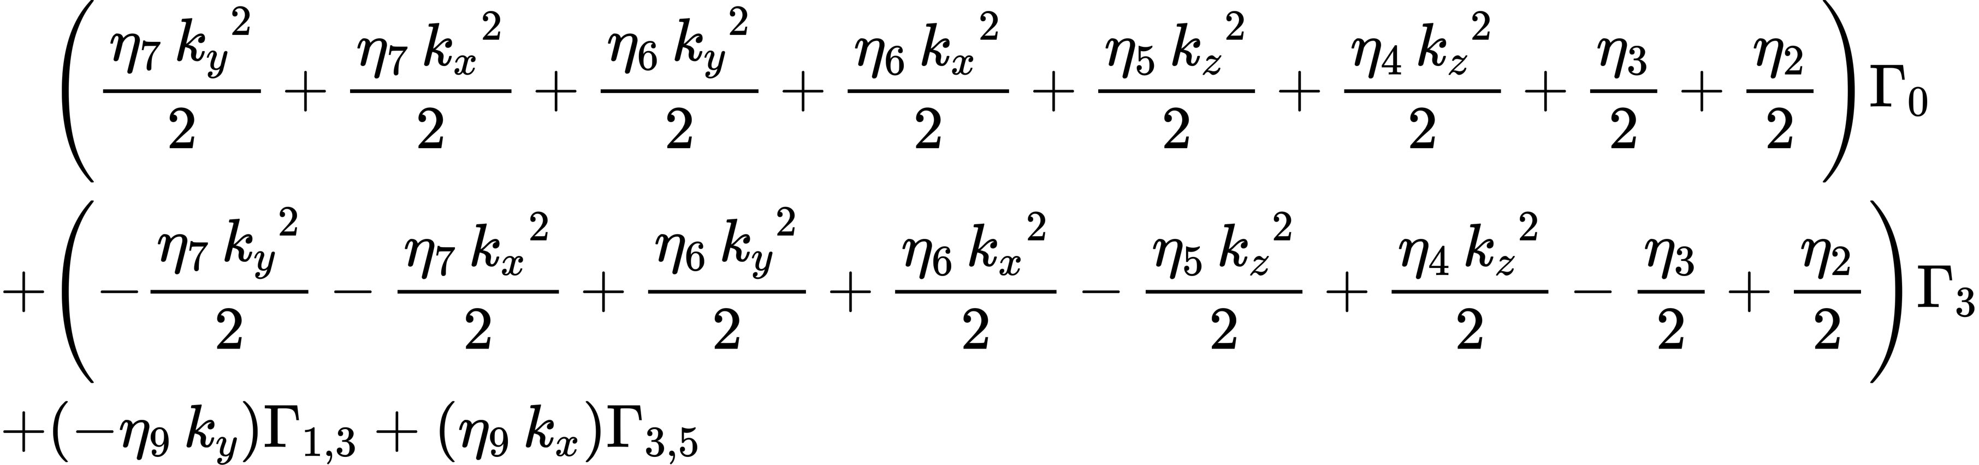
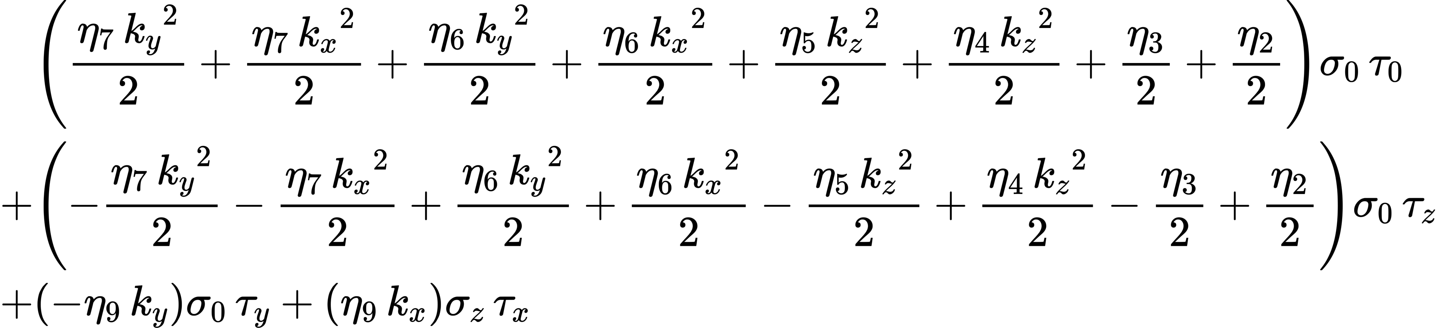
GammaDecomposition
[BHZ_building_C4_2nd_Gamma,BHZ_building_C4_2nd_latex_Gamma] = BHZ_building_C4_2nd.GammaDecomposition();
[BHZ_building_C4_2nd_pauli,BHZ_building_C4_2nd_latex_pauli] = BHZ_building_C4_2nd.pauliDecomposition();

Slide 9
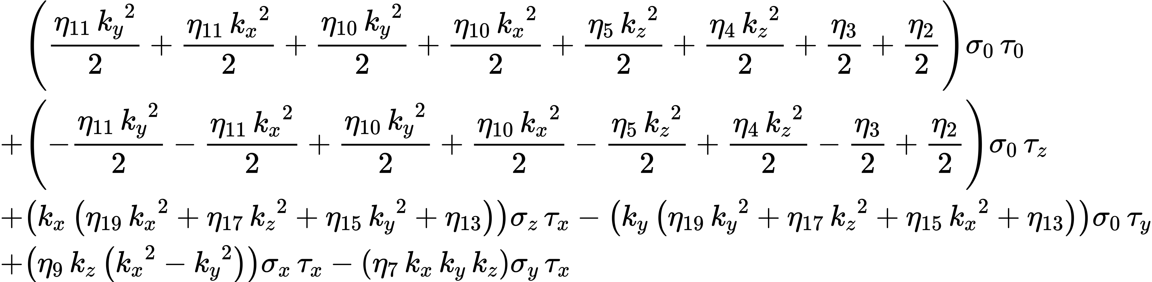
GammaDecomposition
[BHZ_building_C4_3rd_Gamma,BHZ_building_C4_3rd_latex_Gamma] = BHZ_building_C4_3rd.GammaDecomposition();
[BHZ_building_C4_3rd_pauli,BHZ_building_C4_3rd_latex_pauli] = BHZ_building_C4_3rd.pauliDecomposition();

