Slide 1
HR
matlab TB class 食用指北

Slide 2
基础构造
H_hr = HR(WAN_NUM,vectorL,NRPTS,HnumL,HcoeL)
% Graphene test
[Rm,sites,Atom_name,Atom_num]=POSCAR_readin('POSCAR','tbsk');
search_range = [1 1 0];
Accuracy = 1 ;
per_dir = [1 1 0] ;
level_cut = 1;
[Atom_store,nn_store,Rnn]=nn_SK(Rm,sites,search_range, Accuracy);
[~,H_Graphene,orb_list]=H_TB_gen_SK(level_cut,nn_store,Rm,per_dir);
>> H_hr = HR(2,[0 0 0])
>> H_Graphene
H_Graphene =
包含以下字段的 5×1 struct 数组:
seq
vector
Degen
Hcoe
Hnum
H_hr2 =
HR - 属性:
NRPTS: 5
WAN_NUM: 2
vectorL: [5×3 double]
orbL: []
elementL: []
quantumL: []
orb_symL: []
HnumL: [2×2×5 double]
HcoeL: [2×2×5 sym]
>> H_hr2 = HR.from_Hstruct(H_Graphene)
E_onsite_1 = 0;
E_onsite_2 = 0;
VppP_1 = 2.7;
% give parm
Graphene_n = Subsall(H_Graphene);
>> H_hr3 = HR.from_Hstruct(Graphene_n)
Graphene_sparse = hr2hr_sparse(Graphene_n)
>> H_hr4 = HR.from_Hsparse(Graphene_sparse )

Slide 3
基本操作 – 1 加法
>> H_hr3 = HR.from_Hstruct(Graphene_n)
>> bandplot(EIGENCAR,[-8,8])
>> H_hr_test = H_hr3;
>> H_hr_test = [1 , 0; 0 1 ]+ H_hr_test ;
>> EIGENCAR = EIGENCAR_gen(H_hr3,'tc');
全局 + 【1 0 ；
0 1】
>> H_hr_test = [-1 , 0; 0 -1 ] + H_hr_test
全局 + 【1 0 ；
0 1】
back!
>> H_hr_test = H_hr_test + [-1 , 0; 0 -1 ]
矩阵在后面对homecell 作加减法；

Slide 4
基本操作 – 2
>> H_hr_test = H_hr3;
>> H_hr_test = [1 , 0; 0 1 ]+ H_hr_test ;
>> H_hr_test = -H_hr_test;
>> H_hr_test = H_hr_test - H_onsite;
Homecell 相减
整体反号
构造 onsite 项 做出来个haldane
定义 H_onsite TB对象
>> H_haldane_term = HR(2,[0 0 0]) ;
>> H_onsite = HR(2,[0,0,0],1,[1 0;0 -1])
>> V_NNN = [1 0 0; 0 1 0;-1 -1 0 ];
>> H_hr_test = H_hr_test + H_onsite;
>> H_haldane_term.set_hop(kron(sigma_z,-0.06i),…
1,1,V_NNN,'set')
Homecell 相加
>> H_haldane_term = H_haldane_term.autohermi('num')
相加
这种方法可以全局平移费米面
等价于后面加一个mat
>> H_hr_test = H_hr_test + H_haldane_term;

Slide 5
基本操作 – 3
>> H_hr_test = H_hr_test .* [1 1/2;1/3 1] ;
>> H_hr_test = H_hr_test * (1/3);
每个NRPT .* [1 1/2;1/3 1]
>> H_hr_test = H_hr_test .* [1 2;3 1] ;
不要使用 除法 ，对矩阵来说 除法是求逆 暂时还没用到这个操作
乘回来
>> H_hr_test = H_hr_test * 3 ;
乘回来了
>> H_hr_test2 = H_hr_test2 .^2
支持 两个TB对象的 矩阵乘法 和元素乘法 目前还不清楚用途
矩阵在前面 对homecell 作 乘 法；

Slide 6
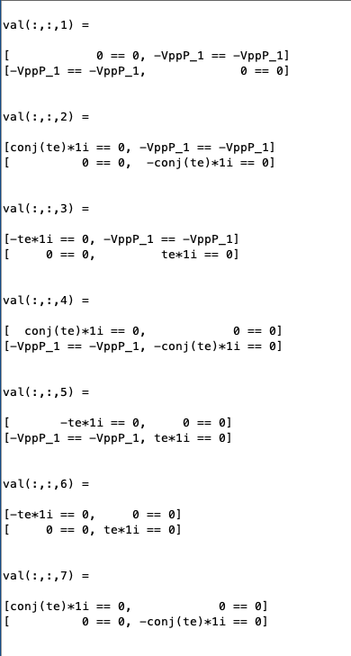
基本操作 – 4
判断两个TB是否相等
>> H_hr_test2 = H_hr_test;
>> H_hr_test2 = H_hr_test2 .^2
>> H_hr_test2 == H_hr_test
ans =
logical
1
>> H_hr_test2 == H_hr_test
ans =
logical
0
>> H_hr_test2 ~= H_hr_test
ans =
logical
0
>> H_hr_test2 = H_hr2 + H_haldane_term;
>> H_hr_test = H_hr_test2 - H_haldane_term;
>> [logical_num,logical_mat ]= H_hr_test2 ==H_hr_test;

Slide 7
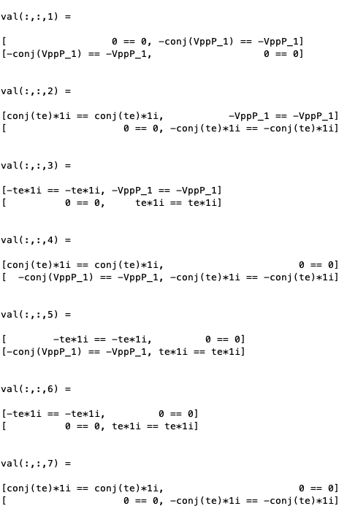
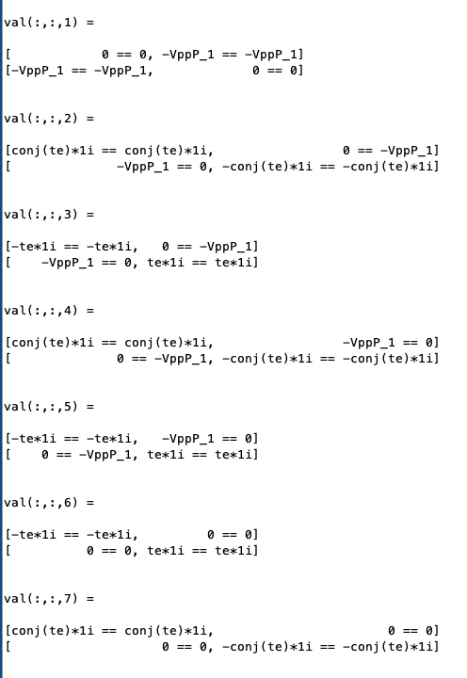
基本操作 – 5
>> H_Haldane = H_hr2 + H_haldane_term;
>> H_Haldane_dagger = H_Haldane’
>> [~,check_diff] = (H_Haldane_dagger == H_Haldane)
厄米共轭
>> H_Haldane_T = H_Haldane.'
转置
>> [~,check_diff] = (H_Haldane_T == H_Haldane)
厄米性要求
\pi 键为实数
转置就是单纯的转置

Slide 8
函数重载
H_Haldane_conj = conj(H_Haldane);
H_Haldane_kron = kron([1,0;0,-1], H_Haldane)

Slide 9
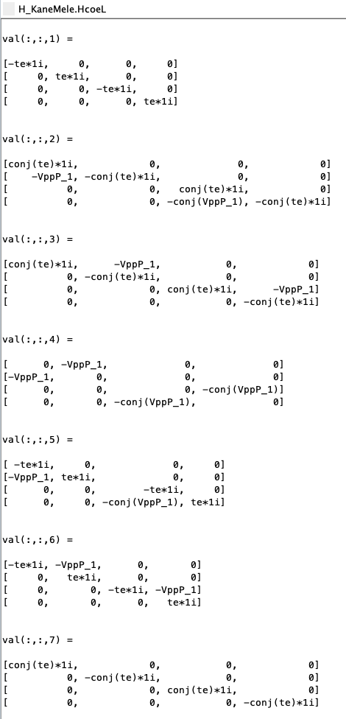
基本操作-6
>> H_KaneMele = [H_Haldane,H_Haldane_conj];
>> H_KaneMele = [H_Haldane;H_Haldane_conj];
>> H_KaneMele_n = H_KaneMele.Subsall()
>> EIGENCAR = EIGENCAR_gen(H_KaneMele_n,'tc’);
>> bandplot( EIGENCAR,[-3,3]);
直和

Slide 10
HR.nn_sk_smart & HR.H_TB_gen_SK
tic;H_test_Hr_nngen = H_test_Hr_addposcar.nn_sk_smart(); toc
32s
256 s
tic;H_test_Hr_nngen = H_test_Hr_addposcar.nn_sk_smart([1 1 0]); toc
search_range
46 s
tic;H_test_Hr_nngen = H_test_Hr_addposcar.nn_sk_smart([1 1 0],3,5); toc
Accuracy
Rlength_cut
tic;H_test_Hr_tbsk_gen = H_test_Hr_nngen.H_TB_gen_SK(20);toc
6 s
Level_cut

Slide 11
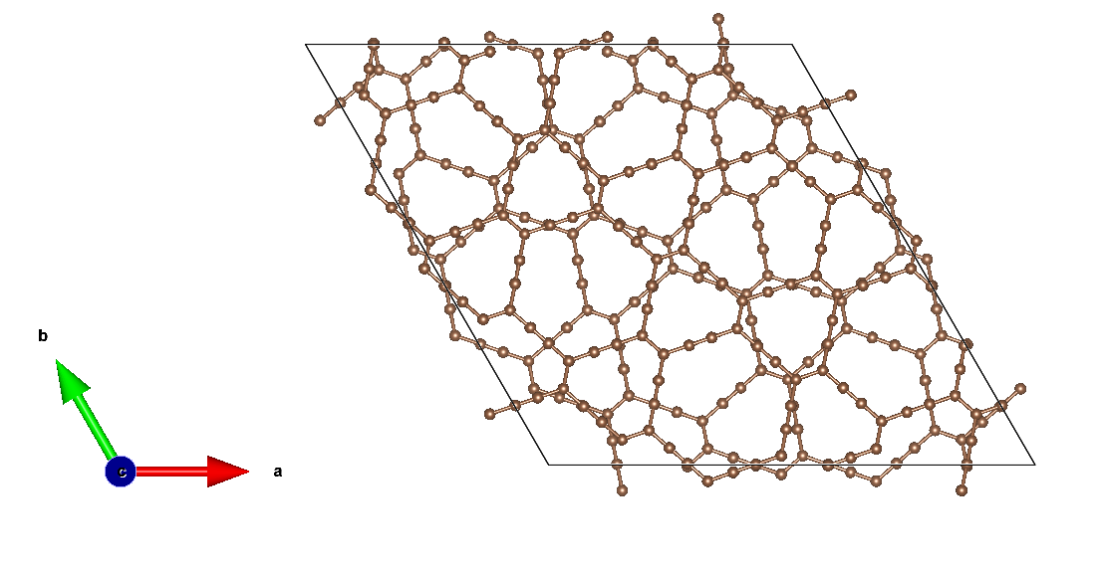
example: $β −GDY bilayer$
H_test_Hr_beta_GDY = HR(252);
H_test_Hr_beta_GDY_addposcar = H_test_Hr_beta_GDY<'POSCAR’
H_test_Hr_beta_GDY_nngen = H_test_Hr_beta_GDY_addposcar.nn_sk_smart([1 1 0],3,5);
H_test_Hr_beta_GDY_tbsk_gen = H_test_Hr_beta_GDY_nngen.H_TB_gen_SK(50);
set parm
%% subs
H_test_Hr_beta_GDY_tbsk_n = H_test_Hr_beta_GDY_tbsk_gen.Subsall();
%% band
Efermi = 0.2;
EIGENCAR = EIGENCAR_gen(H_test_Hr_beta_GDY_tbsk_n,'tc')-Efermi;
%% plot
bandplot(EIGENCAR,[-0.5,0.5],'tbGPY','b');
%% Gen hr
H_test_Hr_beta_GDY_tbsk_n.Gen_hr('wannier90_hr.dat_06t1'); % generate hr.dat
~ 10min old: > 6h

