Slide 1
TCMP PROJECT
The tour of Topological Condensed Matter Physic
Xu-Tao Zeng
parkman@buaa.edu.cn
15-Aug-2021

Slide 2
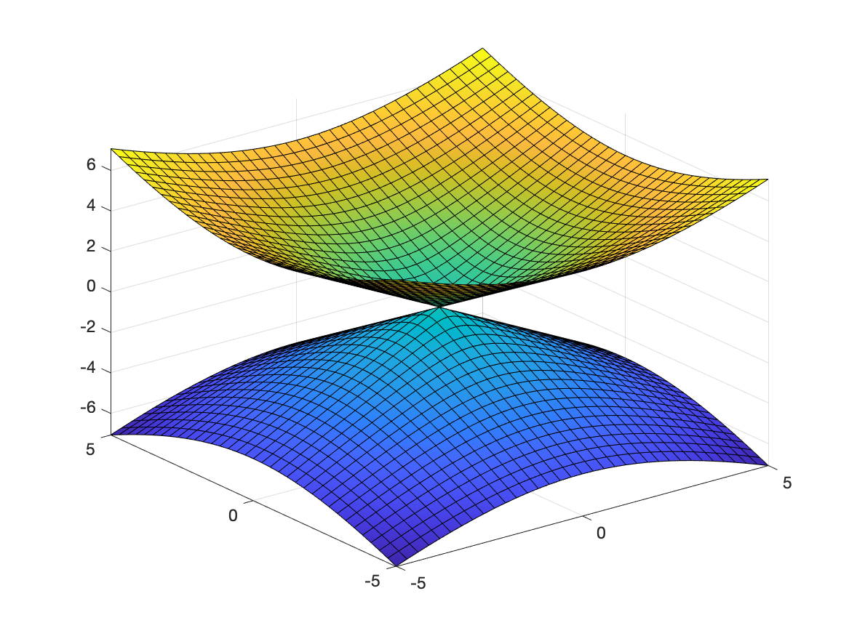
Dirac Cone

Slide 3
What You Can Do with Dirac Cone
Reveal the physic of a model
Inculding:
Fermi Velocity
Band Inversion
Analyze the mass term.

Slide 4
Parameters
Value | Description
auto | The default auto algorithm chooses a bin width to cover the data range and reveal the shape of the distribution.
scott | Is optimal if the data is close to being jointly normally distributed. This rule is appropriate for most other distributions, as well.

