Slide 1
Modeling the US Population
A Risky Business
Xu-Tao Zeng
parkman@buaa.edu.cn
15-Aug-2021

Slide 2
Population Modeling Approach
Fit polynomial to U.S. Census data
Use polynomials to extrapolate population growth
Based on "Computer Methods for Mathematical Computations", by Forsythe, Malcolm and Moler, published by Prentice-Hall in 1977
Varying polynomial degree shows riskiness of approach

Slide 3
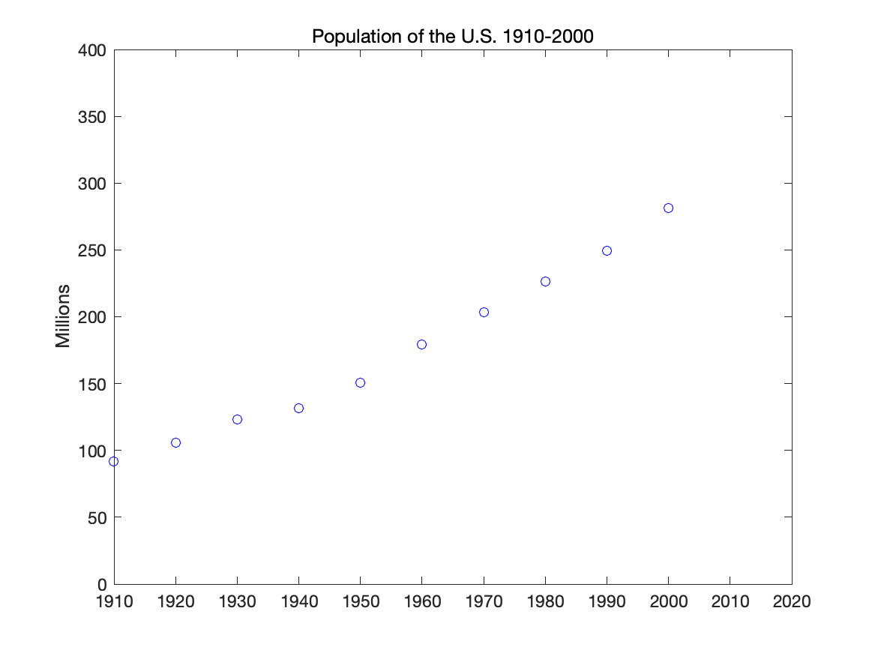
US Census data from 1900 to 2000

Slide 4
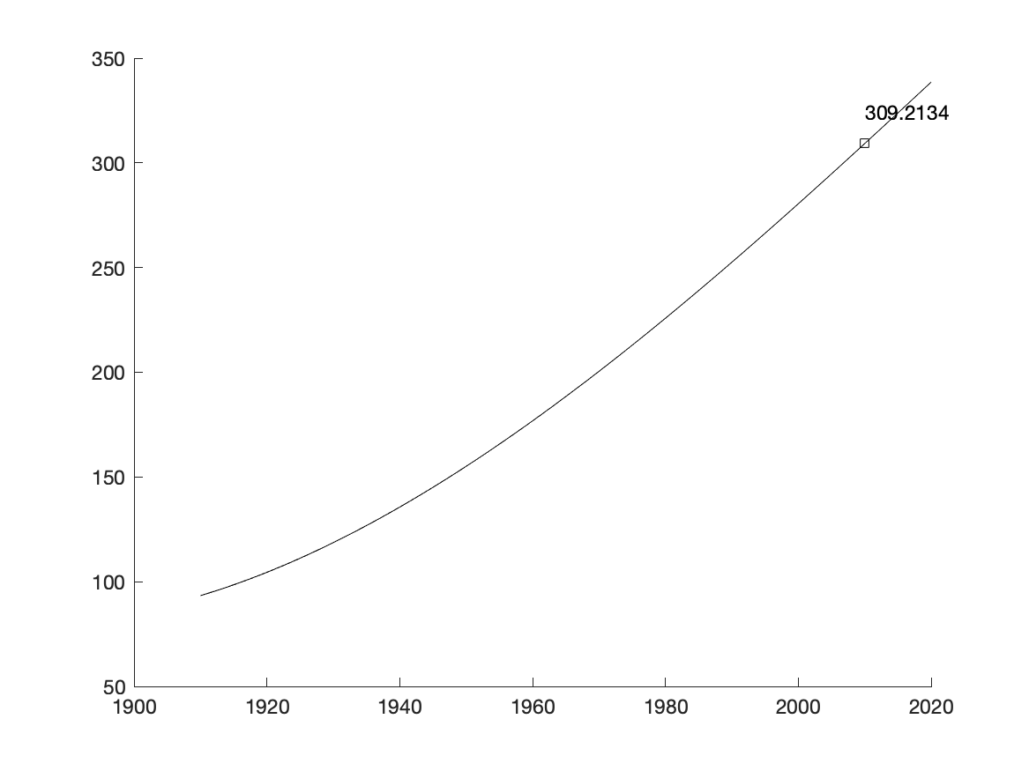
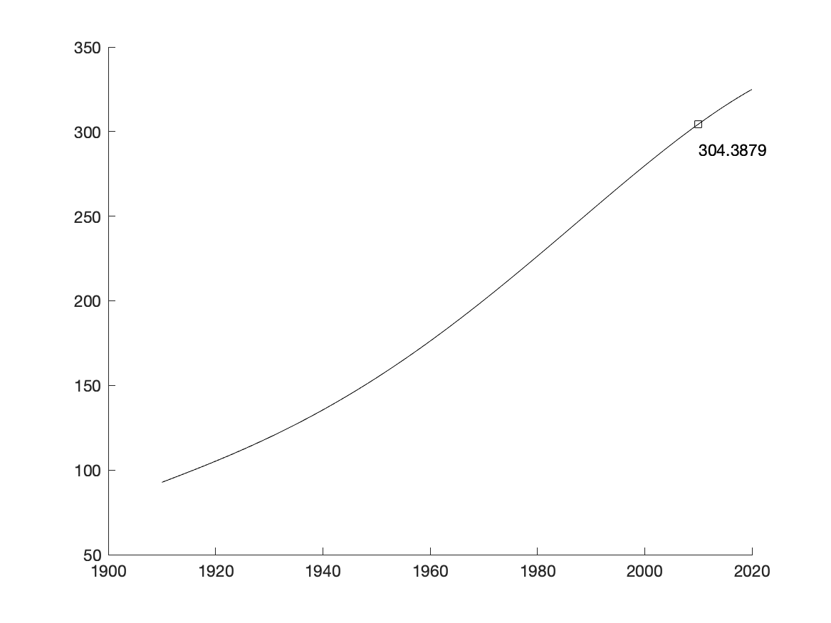
Polynomial Degree Changes Extrapolation
Cubic extrapolation
Quartic extrapolation

Slide 5
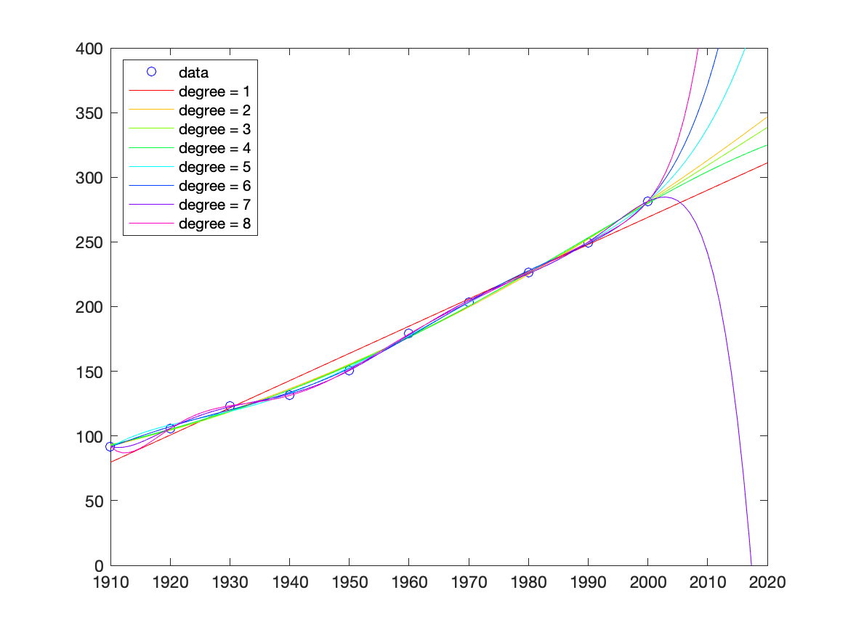
As the degree increases, the extrapolation becomes even more erratic

