Slide 1
Seminar Software Engineering
TPL Detection on Android Apps: Related Work Research
28.05.2026
Tim Jordi
Supervised by:
Prof. Dr. Timo Kehrer
Thomas Sutter
Software Engineering Group
Institute of Computer Science
University of Bern

Slide 2
Outline
Background
Introduction
TPL Detection
Benchmarking
Results
Conclusion
Outlook

Slide 3


Background
Bachelors Thesis: Building a Ground-Truth Dataset of Android Hybrid Applications and Their Third-Party Libraries
1: https://avatars.githubusercontent.com/u/14101776?s=280&v=4, 25.05.26; 2: https://de.wikipedia.org/wiki/React_Native, 25.05.26
Notes:
Building Pipeline
Hybrid Frameworks (Flutter, Apache Cordova, React Native,…)
Goal: Ground Truth Dataset

Slide 4
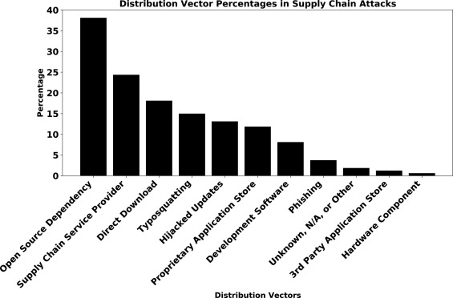
Introduction
Gokkaya et al.: Software supply chain: A taxonomy of attacks, mitigations and risk assessment strategies, 2026
Notes:
Libraries become more important
Interest in knowing libraries
Open-source vs. proprietary apps
Up to 60% of an Apps code are libraries

Slide 5
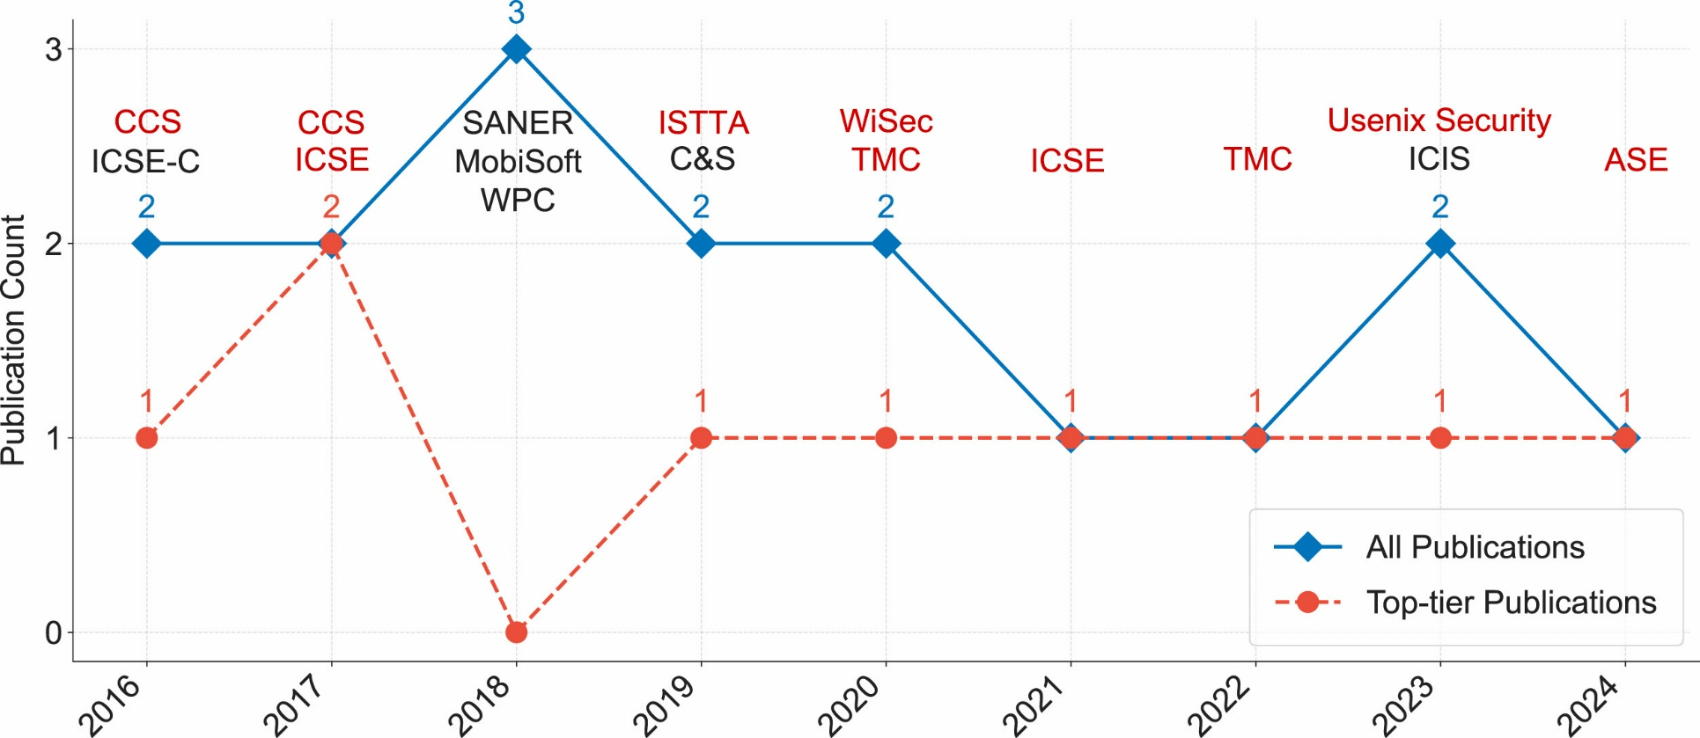
TPL Detection
Zhan et al.: The hidden complexities of Android TPL detection: An empirical analysis of techniques, challenges, and effectiveness, 2025
Notes:
Recent research topic
3 Categories: learning-based, similarity-based and clustering-based
Many different approaches
Same goal

Slide 6
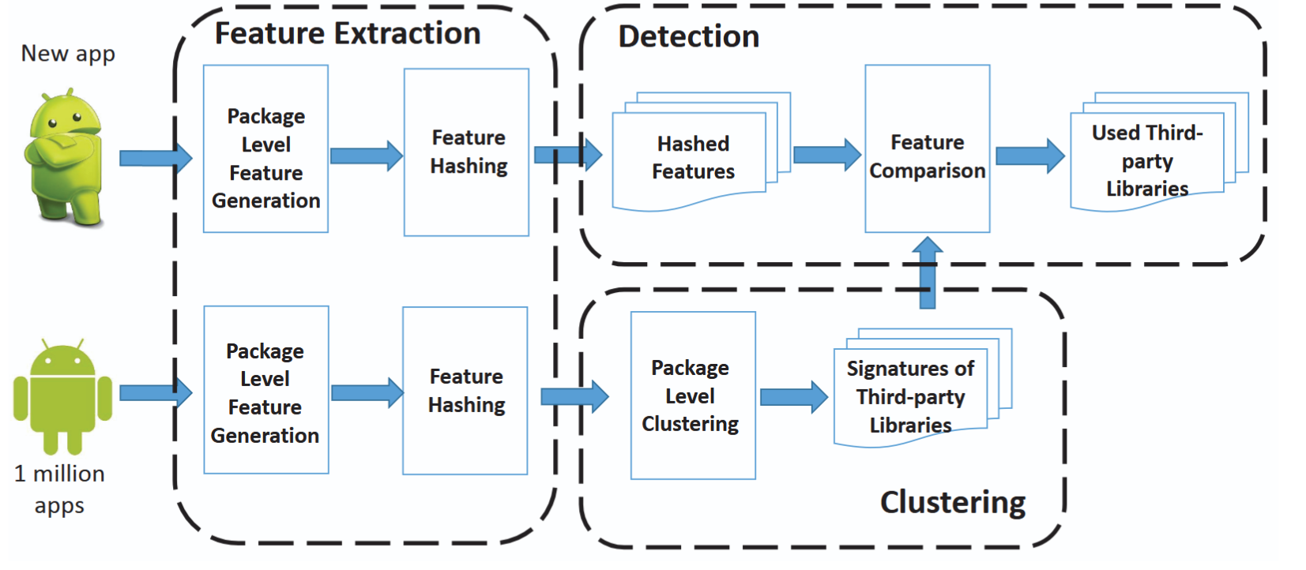
Clustering-based Detection
Ziang et al.: LibRadar: Fast and Accurate Detection of Third-party Libraries in Android Apps, 2016
Notes:
Extract Features (relationships, hierarchy, signatures)
Hash
Cluster on apps
Label Clusters
Compare Fingerprints
No Database needed
Faster after clustering, less accurate
LibRadar, LibD

Slide 7
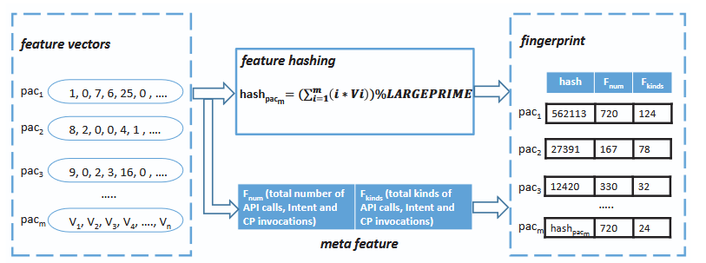
Clustering-based Detection
Ziang et al.: LibRadar: Fast and Accurate Detection of Third-party Libraries in Android Apps, 2016
Notes:
Similarity based hashing

Slide 8
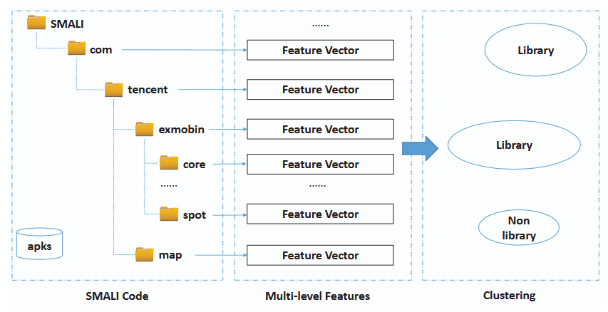
Clustering-based Detection
Ziang et al.: LibRadar: Fast and Accurate Detection of Third-party Libraries in Android Apps, 2016

Slide 9
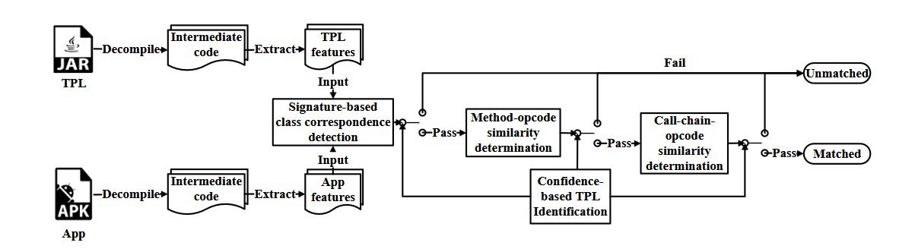
Similarity-based Detection
Wu et al: LibScan: Towards More Precise Third-Party Library Identification for Android Applications, 2023
Notes:
Build profile from Library
Build profile from App
Compare with probability
Profile consist of class hierarchy, fuzzy hashes of bytecode, Control Flow Graphs, Class dependency signatures…
Prone to obfuscation
More accurate, but usually slower
LibScout, ORLIS, LibPecker

Slide 10
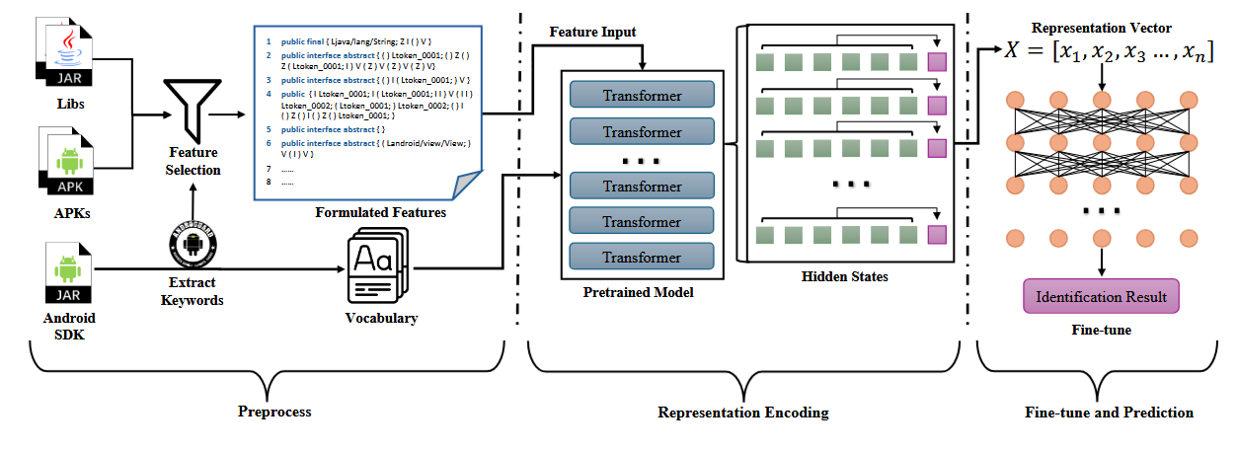
Learning-based Detection
Pan et al: Pay Your Attention on Lib! Android Third-Party Library Detection via Feature Language Model, 2025
Notes:
Language Model
Pretrained on unlabelled data
Hard to find data set
LibAttention

Slide 11
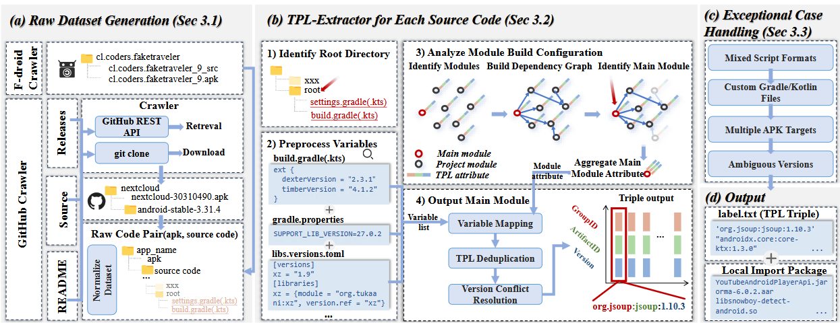
Benchmarking
Gu et al. : Revisiting Third-Party Library Detection: A Ground Truth Dataset and Its Implications Across Security Tasks, 2025
Notes:
Sources: Github, Fdroid
Only one independent benchmark (2025)
Find APKs on GitHub & F-Droid
Extract TPLs
Test selected tools
Hybrid Frameworks excluded

Slide 12
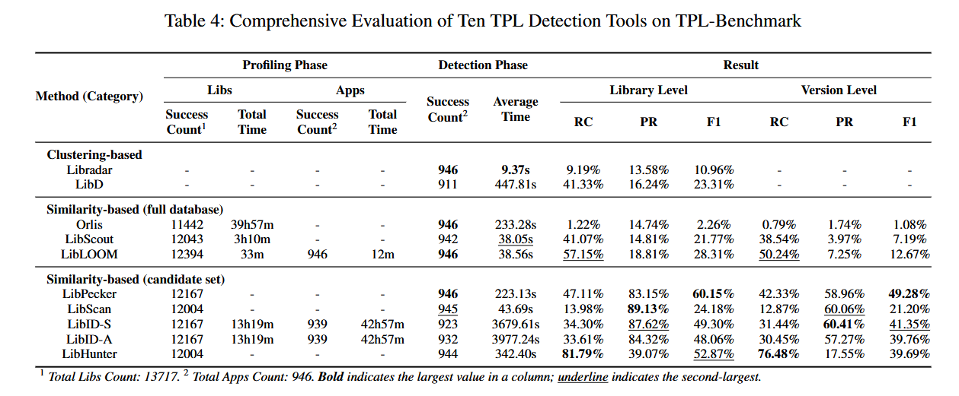
Results

Slide 13
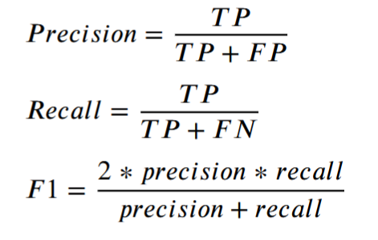
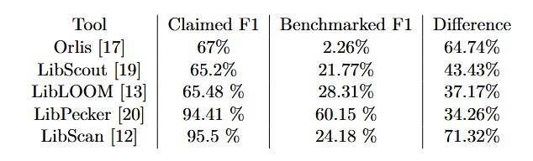
Comparison
Notes:
=> People overrate their tools in papers
TP: correctly identified
FP: incorrectly identified as present when they are not
FN: incorrectly identified as absent when they are present

Slide 14
Conclusion
Standardized testing data set required
Version level accuracy scores low
Existing Data sets not representative
Notes:
Featuring:
Obfuscated apps
Native apps
Hybrid apps

Slide 15
Outlook
Data set offers obfuscated and non obfuscated hybrid apps
Guaranteed accuracy by self-compiling
Used for:
  Benchmarking
  Training models

Slide 16

Questions

Slide 17
Sources
Slide 3:
  1: https://avatars.githubusercontent.com/u/14101776?s=280&v=4, 25.05.26;
  2: https://de.wikipedia.org/wiki/React_Native, 25.05.26
Slide 4:
  B. Gokkaya, L. Aniello, and B. Halak, “Software supply chain: A taxonomy of attacks, mitigations and risk assessment strategies,” Journal of Information Security and Applications, vol. 97, p. 104324, 2026. [Online]. Available: https://www.sciencedirect.com/science/article/pii/S2214212625003606,
  H. Wang, Y. Guo, Z. Ma, and X. Chen, “Wukong: a scalable and accurate two-phase approach to android app clone detection,” in Proceedings of the 2015 International Symposium on Software Testing and Analysis, ser. ISSTA 2015. New York, NY, USA: Association for Computing Machinery, 2015, p. 71–82. [Online]. Available: https://doi.org/10.1145/2771783.2771795

Slide 18
Sources
Slide 5: L. Zhan, J. Ming, J. Fu, G. Peng, L. Sha, and L. Lan, “The hidden complexities of android tpl detection: An empirical analysis of techniques, challenges, and effectiveness,” Computers Security, vol. 159, p. 104672, 2025. [Online]. Available: https://www.sciencedirect.com/science/article/pii/S016740482500361X
Slide 6-8: Z. Ma, H. Wang, Y. Guo, and X. Chen, “Libradar: Fast and accurate detection of third-party libraries in android apps,” in 2016 IEEE/ACM 38th International Conference on Software Engineering Companion (ICSE-C), 2016, pp. 653–656.
Slide 9: Y. Wu, C. Sun, D. Zeng, G. Tan, S. Ma, and P. Wang, “LibScan: Towards more precise Third-Party library identification for android applications,” in 32nd USENIX Security Symposium (USENIX Security 23). Anaheim, CA: USENIX Association, Aug. 2023, pp. 3385–3402. [Online]. Available: https://www.usenix.org/conference/usenixsecurity23/presentation/wu-yafei
Slide 10: D. Pan, Y. Xu, R. Feng, D. Yu, J. Chen, Y. Fang, and Y. Zhang, “Pay your attention on lib! android third-party library detection via feature language model,” in 2025 IEEE International Conference on Software Analysis, Evolution and Reengineering (SANER), 2025, pp. 217–228.

Slide 19
Sources
Slide 11-13: J. Gu, H. Lu, G. Nan, Y. Lin, K. Wang, Y. Guo, Y. Cao, and Y. Liu, “Revisiting third-party library detection: A ground truth dataset and its implications across security tasks,” pp. 1–3, 7–9, 2025. [Online]. Available: https://arxiv.org/abs/2509.04091

