Slide 1
Bachelors Thesis
Building a Ground-Truth Dataset of Android Hybrid Applications and Their Third-Party Libraries
07.07.2026
Tim Jordi
Supervised by:
Prof. Dr. Timo Kehrer
Thomas Sutter
Software Engineering Group
Institute of Computer Science
University of Bern

Slide 2
Outline
Introduction
TPL Detection
Benchmarking
Results
Conclusion

Slide 3
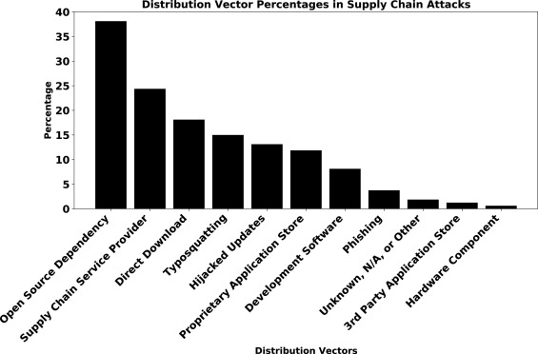
Introduction
Gokkaya et al.: Software supply chain: A taxonomy of attacks, mitigations and risk assessment strategies, 2026
Notes:
Libraries become more important
Interest in knowing libraries
Open-source vs. proprietary apps
Up to 60% of an Apps code are libraries

Slide 4
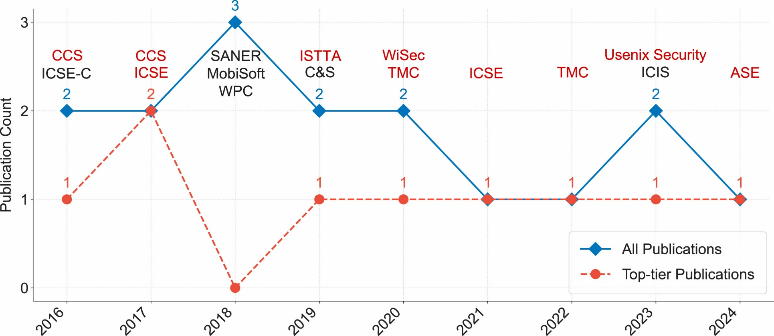
TPL Detection
Zhan et al.: The hidden complexities of Android TPL detection: An empirical analysis of techniques, challenges, and effectiveness, 2025
Notes:
Subjective to the authors
3 Categories: learning-based, similarity-based and clustering-based
Many different approaches
Same goal

Slide 5
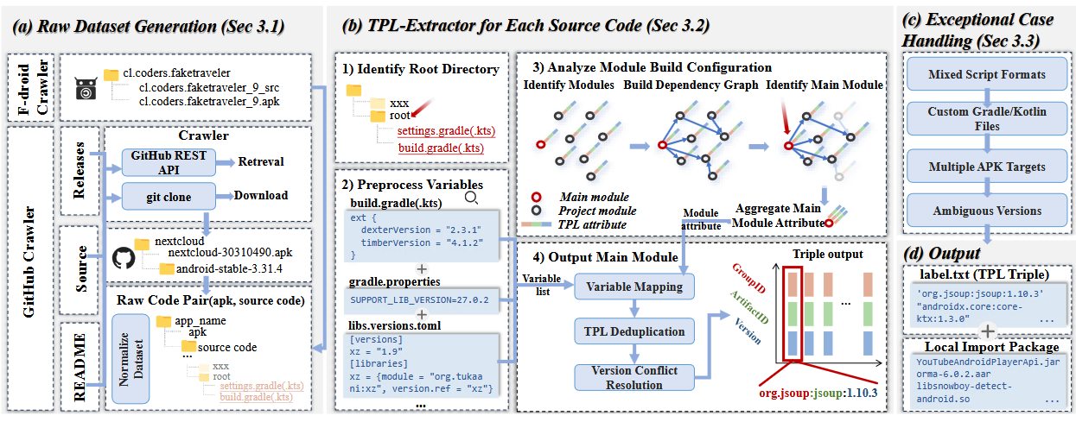
Benchmarking
Gu et al. : Revisiting Third-Party Library Detection: A Ground Truth Dataset and Its Implications Across Security Tasks, 2025
Notes:
Sources: Github, Fdroid
Only one independent benchmark (2025)
Find APKs on GitHub & F-Droid
Extract TPLs
Test selected tools
Hybrid Frameworks excluded

Slide 6
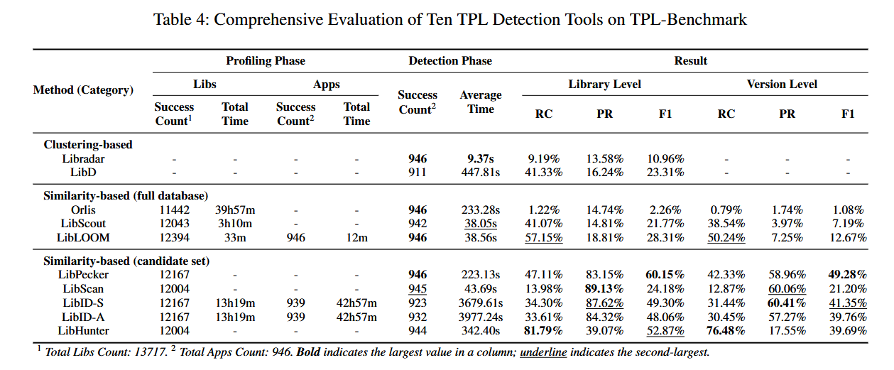
Results
Notes:
10 tools

Slide 7
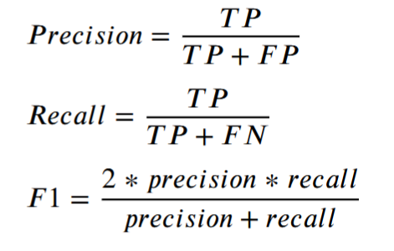
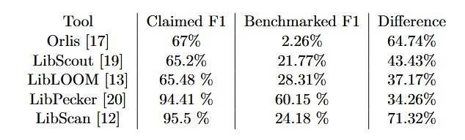
Comparison
Notes:
=> People overrate their tools in papers
TP: correctly identified
FP: incorrectly identified as present when they are not
FN: incorrectly identified as absent when they are present

Slide 8
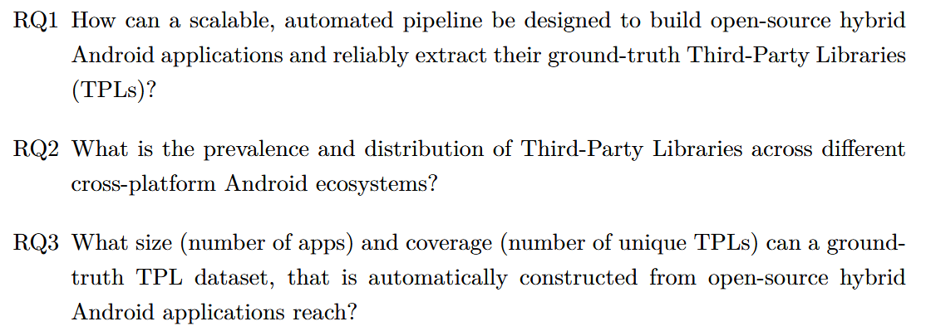
Research Questions

Slide 9
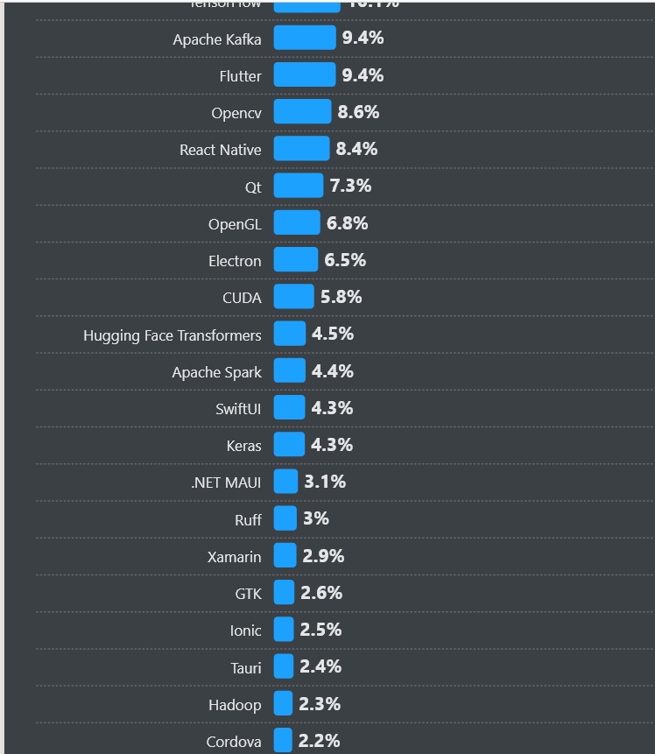
Frameworks
Notes:
Excerpt from the 2024 stackoverflow developers survey
Is in line with other source

Slide 10
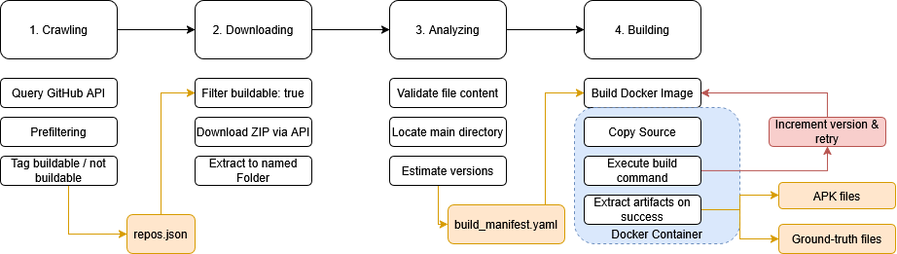
Pipeline Design
Notes:
incrementation strategy
Main directory location
Estimate versions
Build command also runs code gen

Slide 11
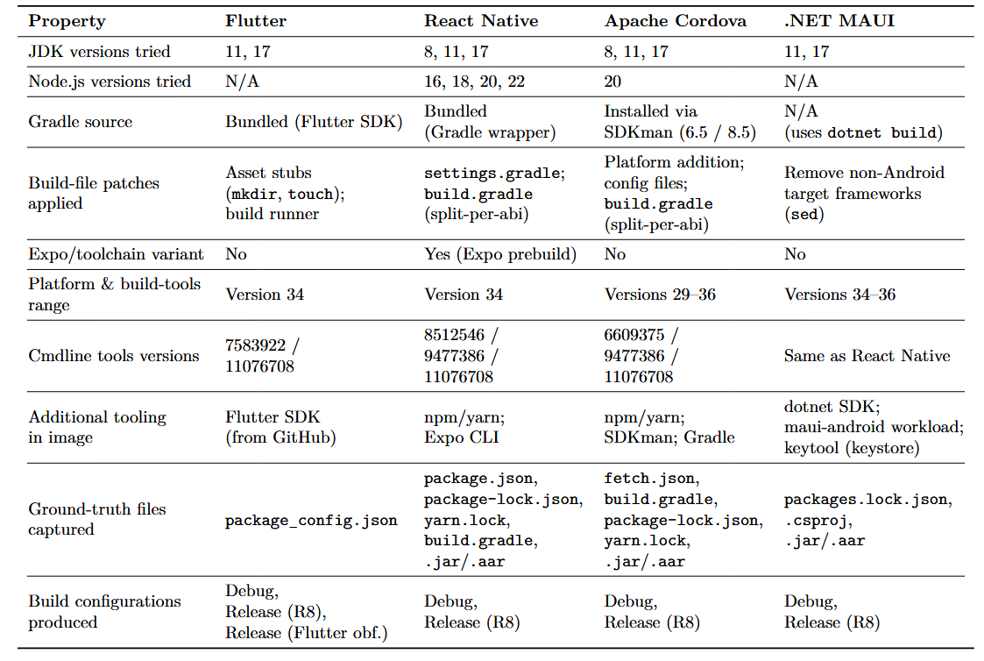
Implementation
Notes:
Gradle source
Ground truth files captured
Build configurations

Slide 12
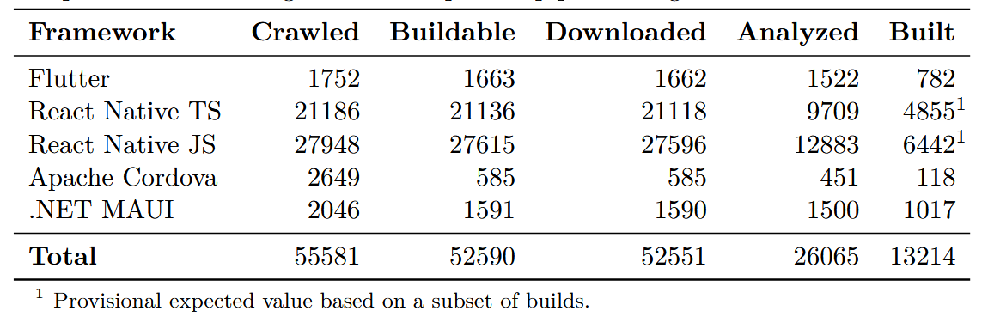
Results
Notes:
Disclaimer: React Native numbers are not final (Maven Central)

Slide 13
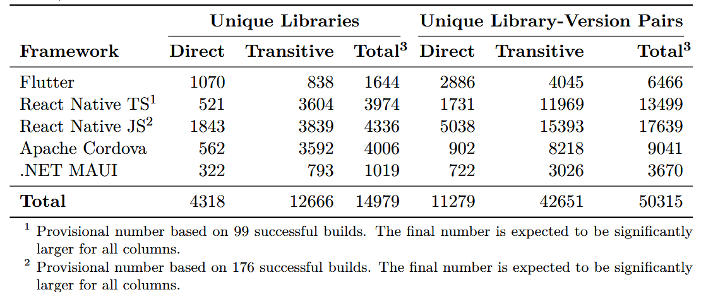
Results

Slide 14
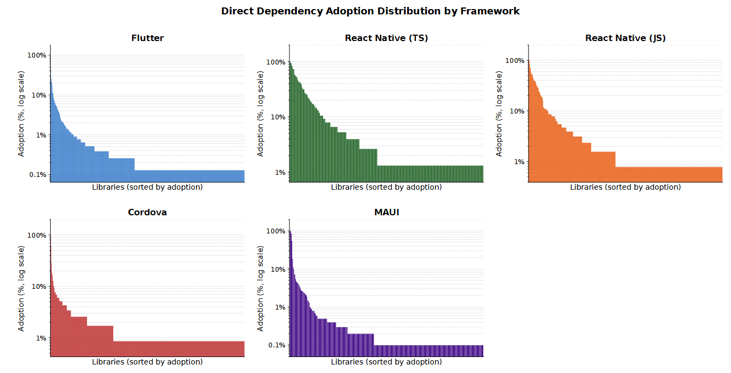
Results

Slide 15
Conclusion
    First Android hybrid application dataset
    Direct obfuscation observation
    Evaluation of existing tools
    Improving performance on hybrid apps

Slide 16

Questions

Slide 17
Sources
Slide 3:
  1: https://avatars.githubusercontent.com/u/14101776?s=280&v=4, 25.05.26;
  2: https://de.wikipedia.org/wiki/React_Native, 25.05.26
Slide 4:
  B. Gokkaya, L. Aniello, and B. Halak, “Software supply chain: A taxonomy of attacks, mitigations and risk assessment strategies,” Journal of Information Security and Applications, vol. 97, p. 104324, 2026. [Online]. Available: https://www.sciencedirect.com/science/article/pii/S2214212625003606,
  H. Wang, Y. Guo, Z. Ma, and X. Chen, “Wukong: a scalable and accurate two-phase approach to android app clone detection,” in Proceedings of the 2015 International Symposium on Software Testing and Analysis, ser. ISSTA 2015. New York, NY, USA: Association for Computing Machinery, 2015, p. 71–82. [Online]. Available: https://doi.org/10.1145/2771783.2771795

Slide 18
Sources
Slide 5: L. Zhan, J. Ming, J. Fu, G. Peng, L. Sha, and L. Lan, “The hidden complexities of android tpl detection: An empirical analysis of techniques, challenges, and effectiveness,” Computers Security, vol. 159, p. 104672, 2025. [Online]. Available: https://www.sciencedirect.com/science/article/pii/S016740482500361X
Slide 6: Z. Ma, H. Wang, Y. Guo, and X. Chen, “Libradar: Fast and accurate detection of third-party libraries in android apps,” in 2016 IEEE/ACM 38th International Conference on Software Engineering Companion (ICSE-C), 2016, pp. 653–656.
Slide 7: Y. Wu, C. Sun, D. Zeng, G. Tan, S. Ma, and P. Wang, “LibScan: Towards more precise Third-Party library identification for android applications,” in 32nd USENIX Security Symposium (USENIX Security 23). Anaheim, CA: USENIX Association, Aug. 2023, pp. 3385–3402. [Online]. Available: https://www.usenix.org/conference/usenixsecurity23/presentation/wu-yafei
Slide 8: D. Pan, Y. Xu, R. Feng, D. Yu, J. Chen, Y. Fang, and Y. Zhang, “Pay your attention on lib! android third-party library detection via feature language model,” in 2025 IEEE International Conference on Software Analysis, Evolution and Reengineering (SANER), 2025, pp. 217–228.

Slide 19
Sources
Slide 9-11: J. Gu, H. Lu, G. Nan, Y. Lin, K. Wang, Y. Guo, Y. Cao, and Y. Liu, “Revisiting third-party library detection: A ground truth dataset and its implications across security tasks,” pp. 1–3, 7–9, 2025. [Online]. Available: https://arxiv.org/abs/2509.04091

