Slide 1

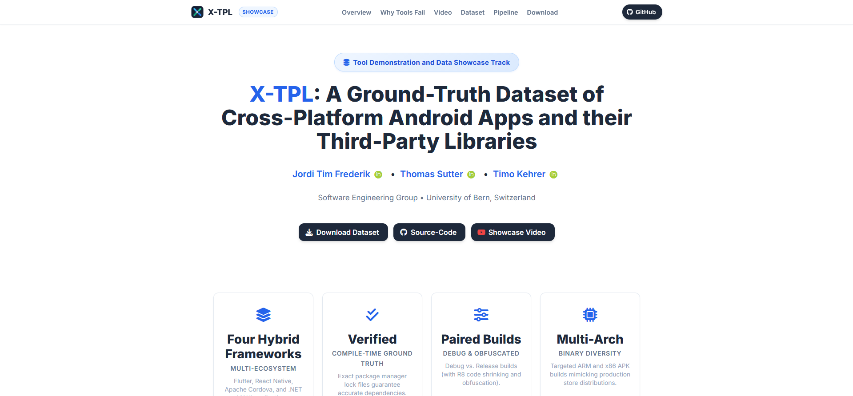
Notes:
I’m Tim Jordi and in this Video, I’m presenting you X-TPL, a ground-truth dataset of cross-platform android apps and their third-party libraries.

Slide 2
Notes:
Imagine the following Scenario: You want to download an app, let’s say pinterest.
You go to the google play store, you click download and the app is automatically installed on your phone. However, you might want to know, what you in fact just downloaded, and whether its free from malware viruses and other malicious code.
Normally, there are tools for this.

Slide 3
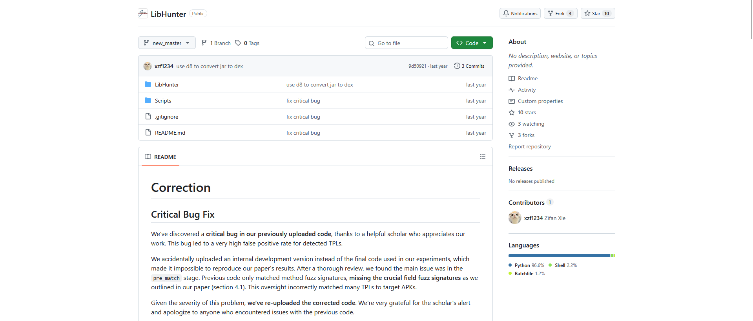
Notes:
Tools such as LibHunter allow detecting TPLs directly from .apk files. However, up to this day, tools offering TPL detection are not very accurate, and what weighs more, do not actively support non-native apps.
In our case, pinterest consists mostly of react native code. React Native is a javascript framework, that allows cross-compilation for windows, macOS, iOS, android and more. All existing TPL detection tools are only developed for apps using native java or Kotlin.
This does, therefore, not accurately reflect the market share of hybrid frameworks such as flutter, react native, apache cordova and .NET MAUI.

Slide 4
{show archive}
Notes:
To address this gap, we propose X-TPL. It’s a dataset consisting of over 6000 apps across flutter, react native, apache cordova and .NET MAUI. APKs are split per architecture and

Slide 5
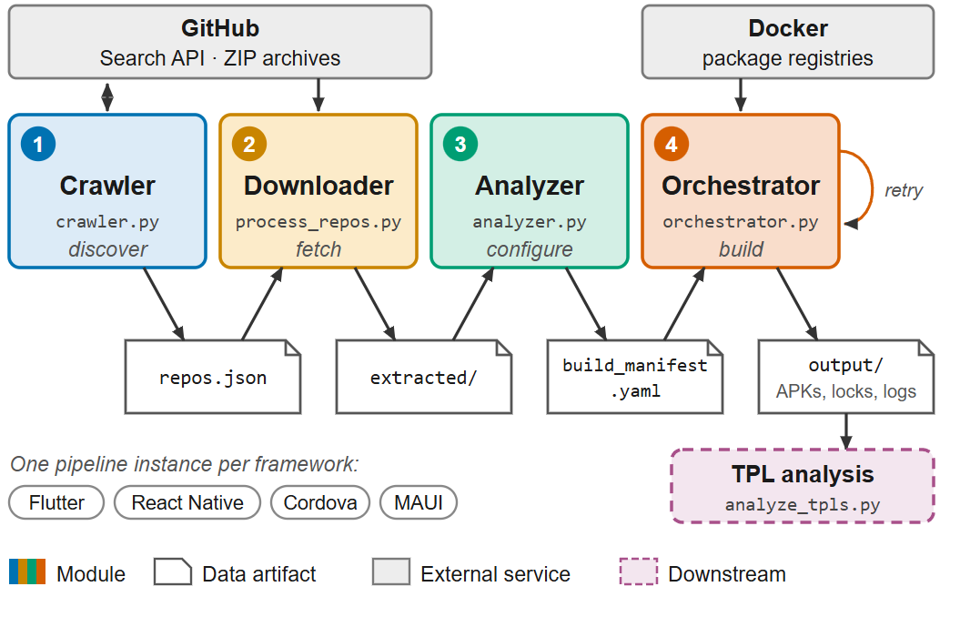
Notes:
The dataset has been compiled directly from source code, which was crawled directly from open-source GitHub repositories. The source code is first analyzed and then built using a custom build orchestrator.
Since we are building these apps directly from source code, and we extract the TPL specification files directly after the build process, we can ensure the resolved packages are all accurately depicted in the ground truth data.

Slide 6
Website: https://x-tpl.github.io
Dataset: https://vault.cloudlab.zhaw.ch/vault-data/x-tpl

