Slide 1






Structure-Preserving Motion Estimation for Learned Video Compression
Han Gao, Jinzhong Cui, Mao Ye, Shuai Li, Yu Zhao, Xiatian Zhu

Slide 2



Problem
Method
Illustration
Characteristic
Damage both the spatial structure of motion inferred and the corresponding residual;
Break the consistent nature across frames since the estimated motion is no longer consistent with the movement in the original video due to the distortion.
$$X_{t}$$
Previous & conventional
Motion Estimation
$${\hat{X}}_{t−1}$$
$$X_{t}$$
Spatial structure is preserved when estimating motion;
Non-correspondence at motion compensation stage.
Motion Estimation
Ideal but not corresponding
$$X_{t−1}$$
$${\hat{X}}_{t−1}$$
Spatial structure is preserved when estimating motion;
Without any non-correspondence at motion compensation stage.
Proposed
$$X_{t}$$
Motion Estimation
$$X_{t−1}$$

Slide 3
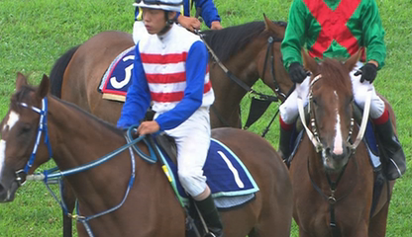
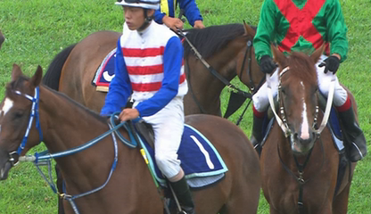
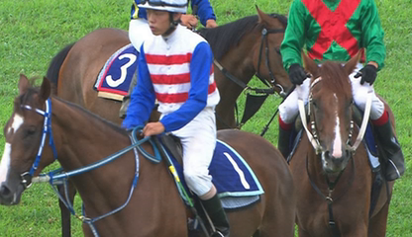
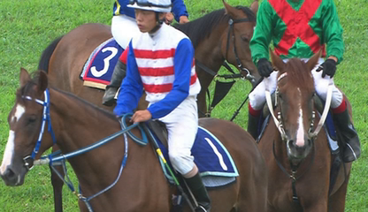












Overview of Proposed SPME
$$X_{t−1}$$
Feature Extraction
$$F_{t−1}$$
SPM-Net
Motion Compression
$$△_{aux}$$
Concat
3×3 Conv
3×3 Conv
128
ReLU
64
$$F_{t}$$
$$θ_{t}$$
$${\hat{θ}}_{t}$$
Fusion Module
Concat
128
64
$$M_{t}$$
3×3 Conv
ReLU
$$X_{t}$$
3×3 Conv
$$△_{main}$$
MCPE-Net
Entropy Coding
$${\hat{F}}_{t−1}$$
$${\overline{F}}_{t}$$
$${\hat{X}}_{t−1}$$
—-
Decoded Frame Buffer
$$Y_{t}$$
Recon-Net
$${\hat{X}}_{t}$$
$${\hat{F}}_{t}$$
$${\hat{R}}_{t}$$
$$R_{t}$$
Residual Compression

Slide 4
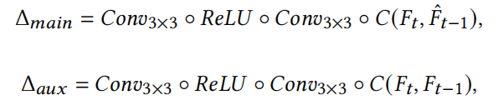











Architecture of Sub-networks
64
kernels
Linear
kernels
3×3 Conv
3×3 Conv
Linear
3×3 Conv
64
$$△_{aux}$$
3×3 Conv
64
64
64
(2×3×3×G)
$${\tilde{F}}_{t}^{s}$$
3×3 Conv
64
$$△_{s}$$
$$O_{t}$$
3×3 Conv
64
3×3 Conv
3×3 Conv
3×3 Conv
Deformable Convolution
64
64
+
64
64
+
$${\hat{θ}}_{t}$$
+
3×3 Conv
+
$$△_{main}$$
3×3 Conv
$${\tilde{F}}_{t}$$
64
64
X
X
$${\tilde{F}}_{t}^{c}$$
$$△_{c}$$
64
64
64
$$θ_{t}$$
3×3 Conv
64
$${\overline{F}}_{t}$$
3×3 Conv
3×3 Conv
Sigmoid
3×3 Conv
$$△_{aux}$$
Sigmoid
V
128
3×3 Conv
3×3 Conv
$${\hat{F}}_{t−1}$$
ReLU
,

Slide 5
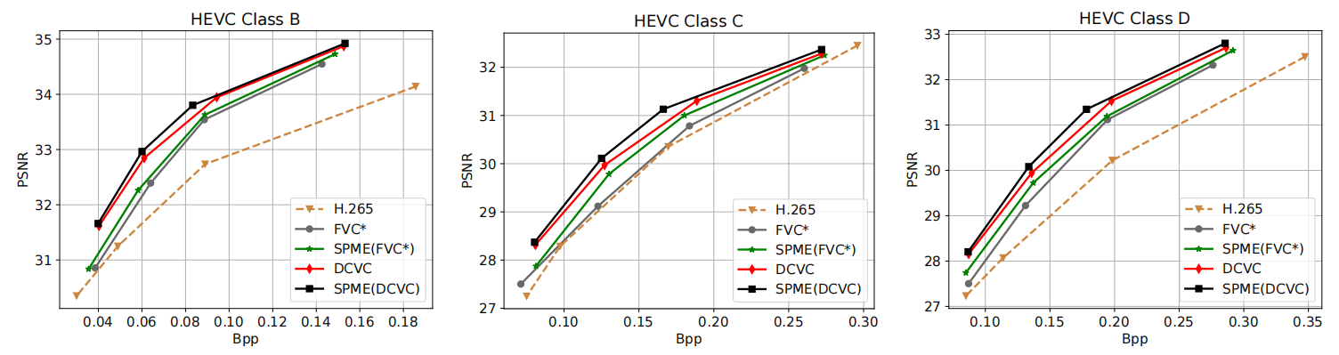
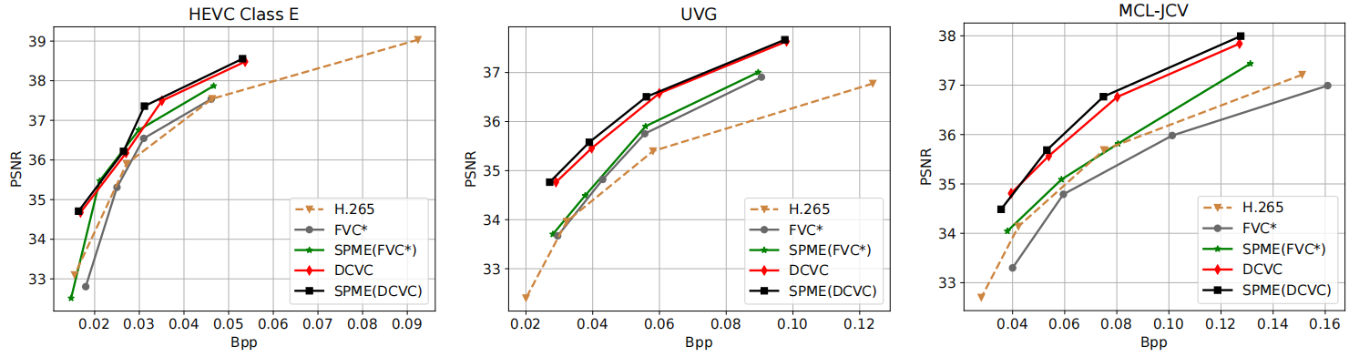
Experimental Results
R-D curves on HEVC Class B/C/D/E, UVG and MCL-JCV dataset in terms of PSNR.

Slide 6
Experimental Results
 | FVC* | SPME (FVC*) | DCVC | SPME (DCVC)
HEVC Class B | -21.45 | -26.78 | -35.59 | -39.53
HEVC Class C | -2.14 | -9.06 | -14.88 | -18.93
HEVC Class D | -16.55 | -21.60 | -26.26 | -29.98
HEVC Class E | 8.31 | -11.08 | -17.69 | -21.04
MCL-JCV | 16.12 | -3.16 | -28.78 | -31.70
UVG | -12.82 | -16.81 | -37.74 | -41.30
BDBR(%) results on HEVC Class B/C/D/E, MCL-JCV and UVG dataset in terms of PSNR.

Slide 7
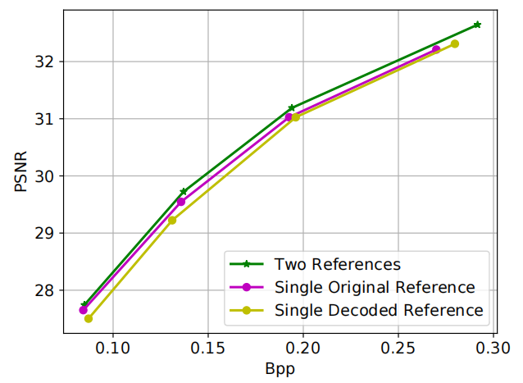
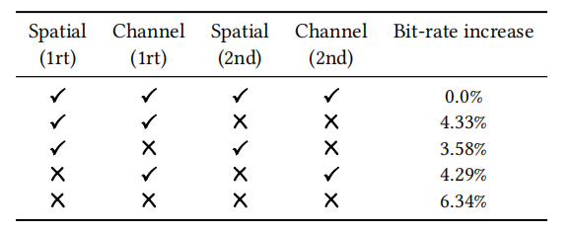
Ablation Studies
Effect of different branches in the attention mechanism.
1rt: motion fusion module;
2nd: prediction enhancement module.
Effect of different reference frames.

Slide 8
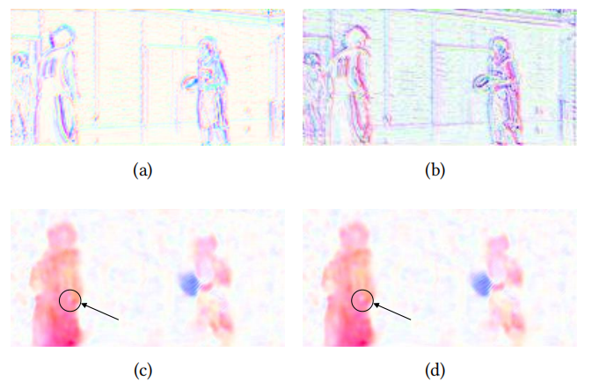
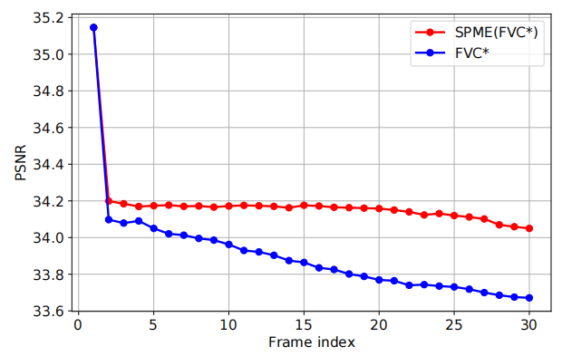
Analysis
The change of PSNR with time inside a GoP.
Visualization of different motion fields. (a) FVC*; (b) SPME (FVC*);
(c) DCVC; (d) SPME (DCVC).

Slide 9

Take Home Messages
Identify a generic limitation of motion estimation in learned video compression;
Propose a plug-and-play method to use the original previous frame as auxiliary data for motion estimation.
Code and Appendix are available at: https://github.com/gaohan-12/SPME

