Slide 1



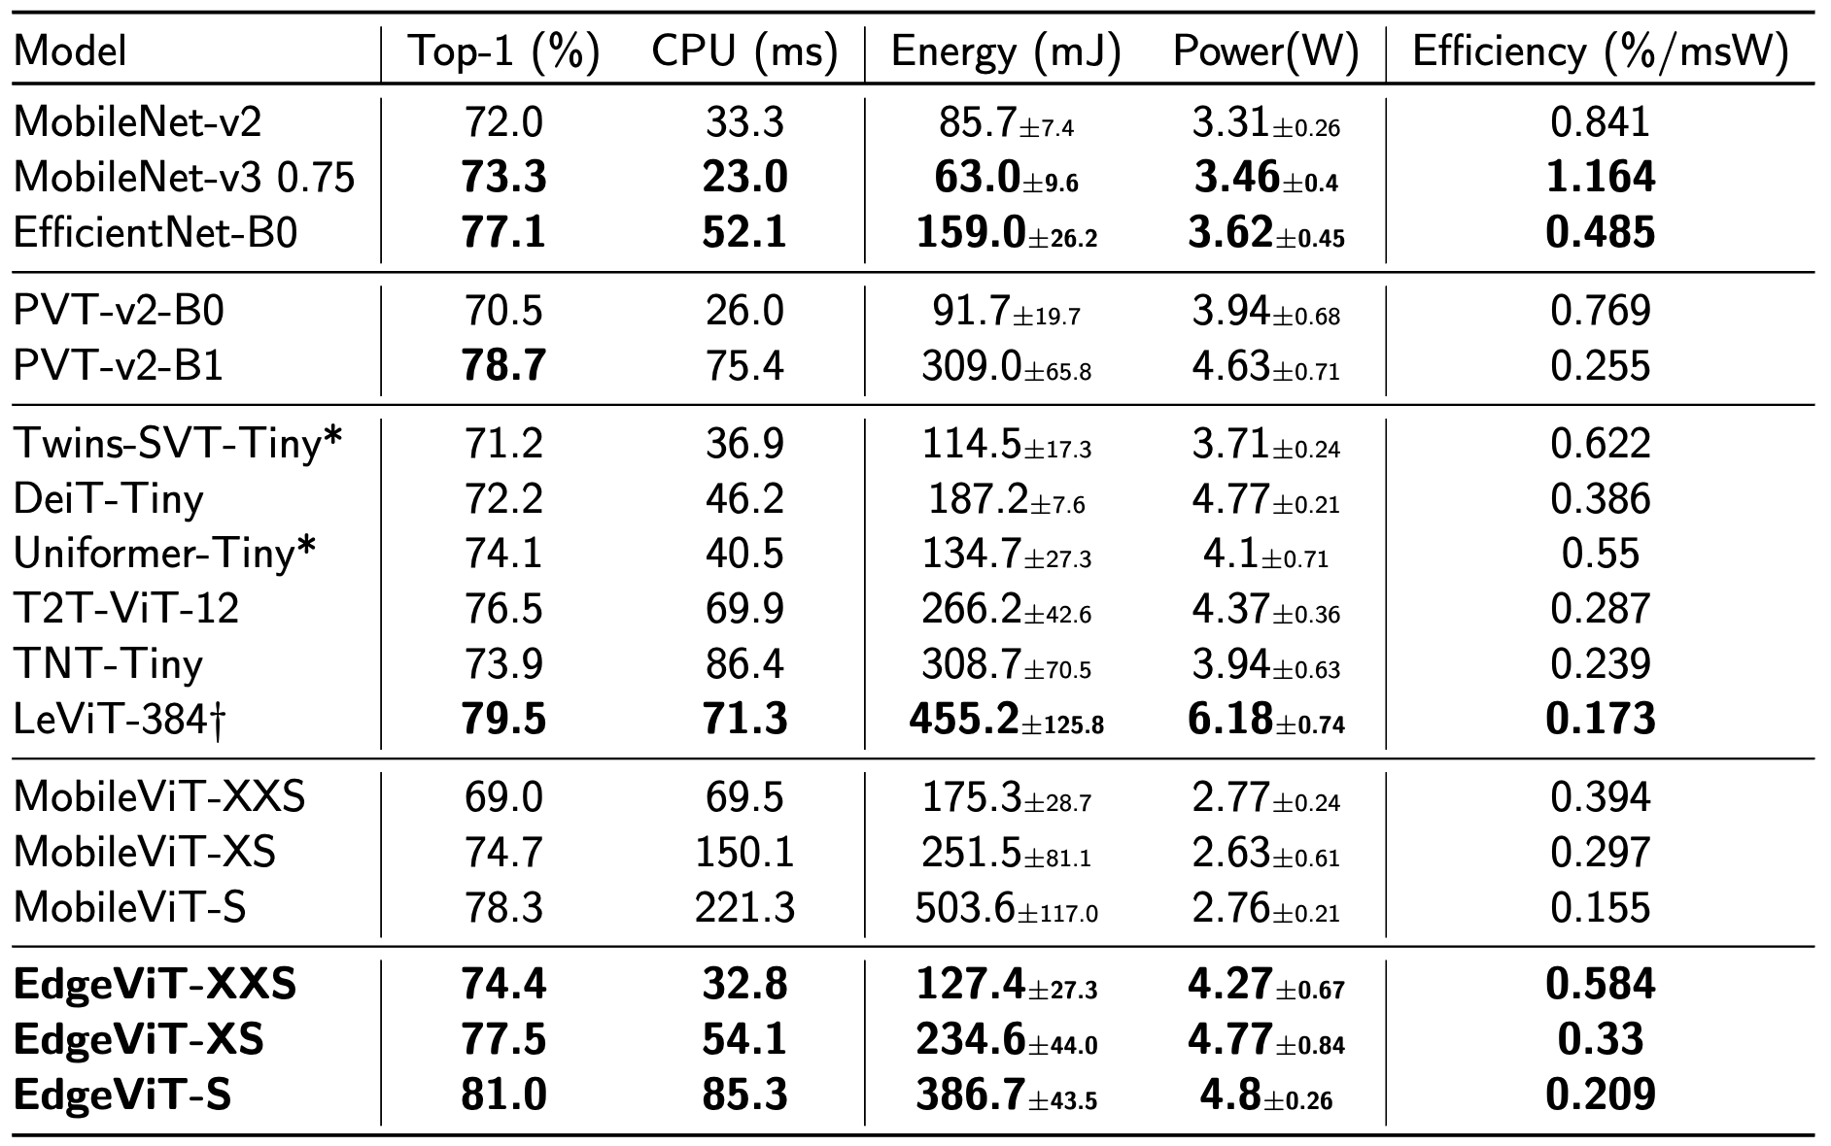

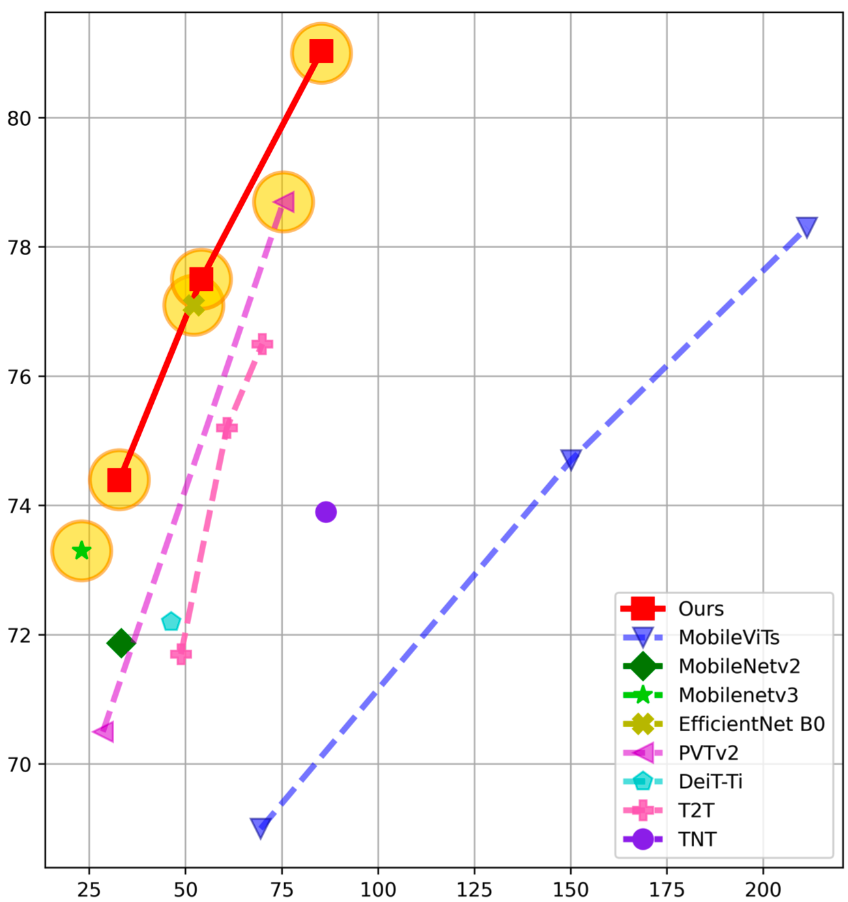
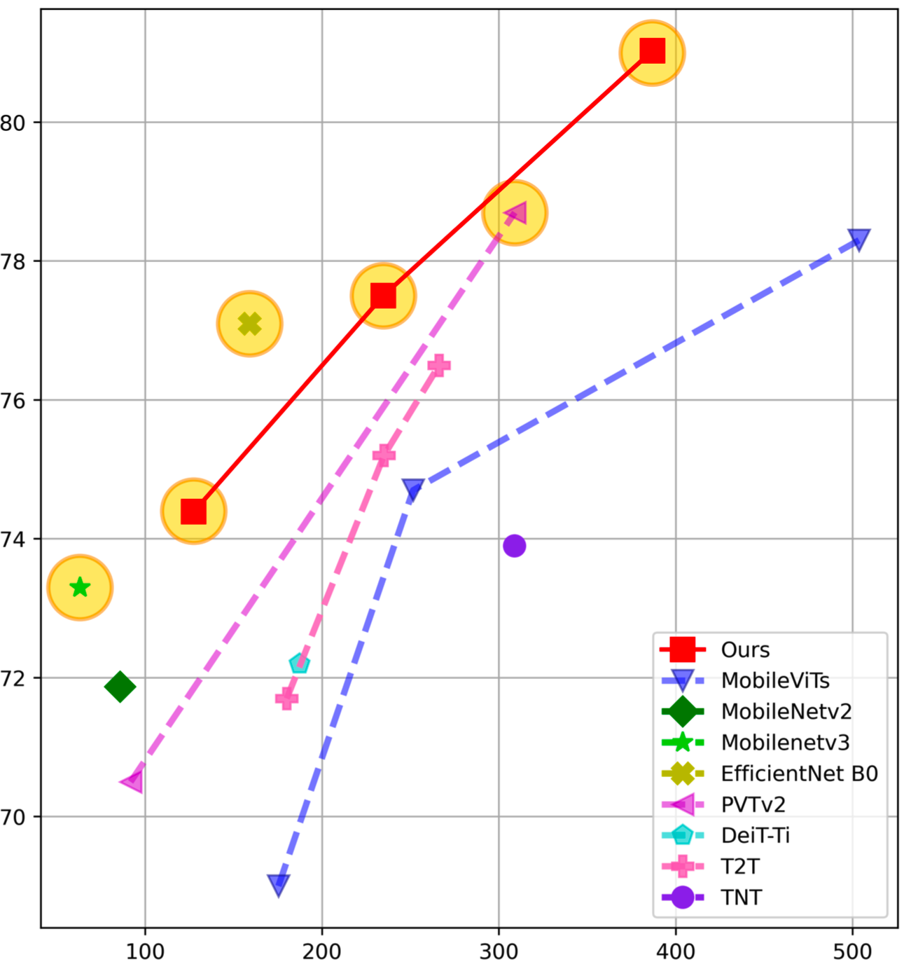
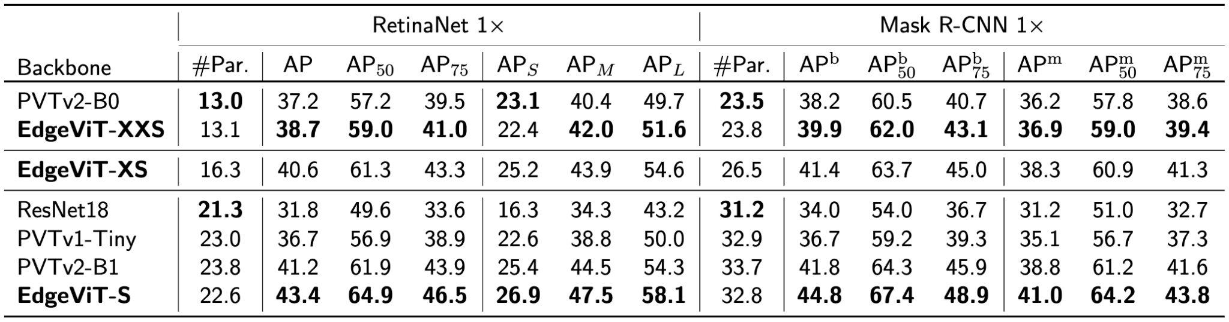
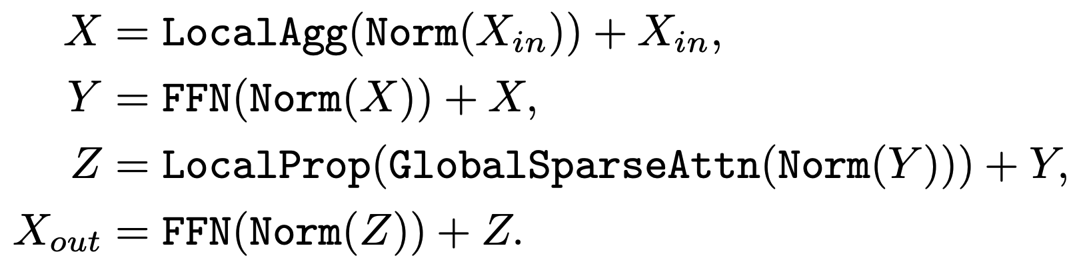
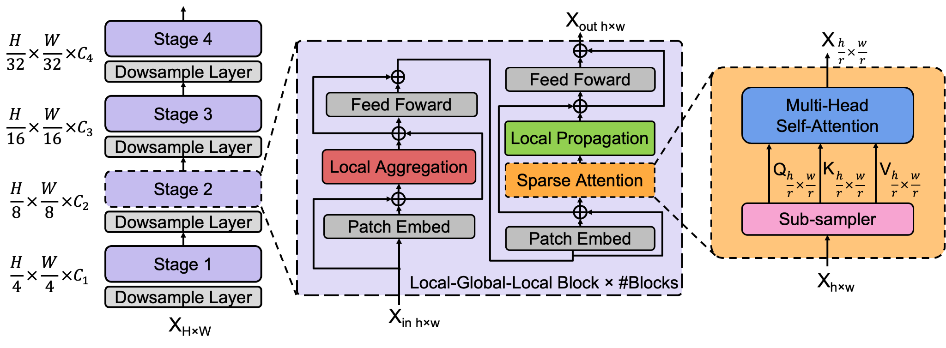
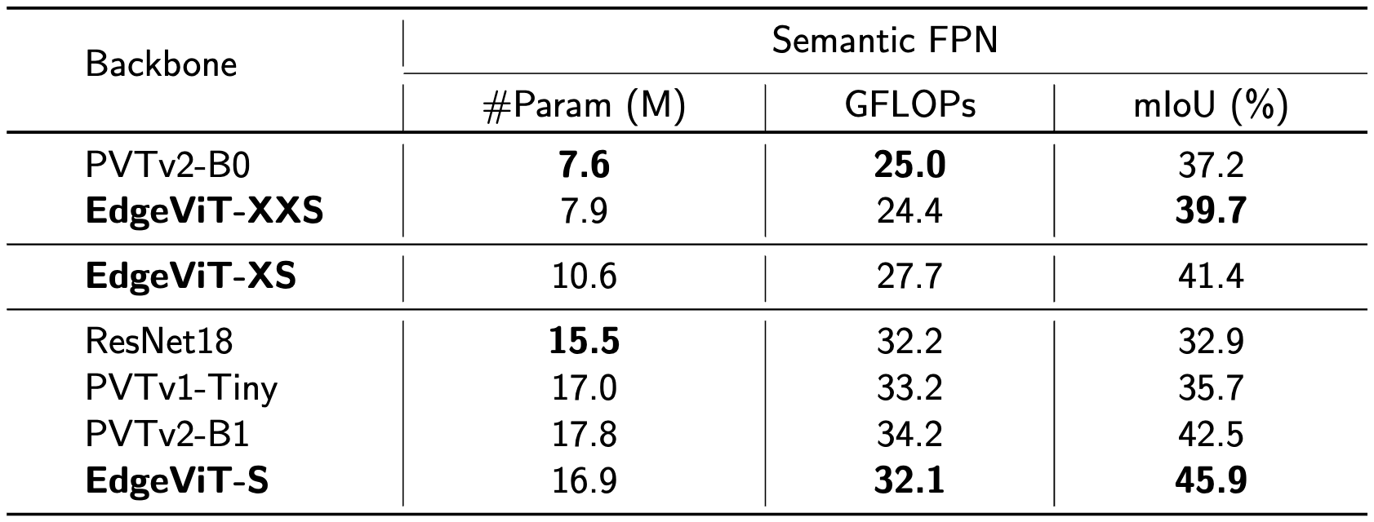
EdgeViTs: Competing Light-weight CNNs on Mobile Devices with Vision Transformers
Junting Pan, Adrian Bulat, Fuwen Tan, Xiatian Zhu, Lukasz Dudziak, Hongsheng Li,
Georgios Tzimiropoulos and Brais Martinez
Source code: https://github.com/saic-fi/edgevit
1. Contributions
2. EdgeViTs
3. Results
We investigate the design of light-weight ViTs from the practical on-device deployment and execution perspective.
We present EdgeViTs, based on an optimal decomposition of self-attention using standard primitive operations.
We consider latency and energy consumption of different models rather than the number of FLOPs or parameters.
EdgeViTs are based on a factorization of the standard self-attention by introducing a light-weight and easy-to-implement local-global-local (LGL) bottleneck with three operations:
Local information aggregation from neighbor tokens with depth-wise convolutions;
Forming a sparse set of evenly distributed delegate tokens for long-range information exchange by self-attention;
Diffusing updated information from delegates to the non-delegate tokens in local neighborhoods via transposed convolutions.
On-device evaluation on ImageNet-1K
We define an energy-aware efficiency metric as the average gain in top-1 accuracy from each 1W run for 1ms (equivalent to consuming 1mJ of energy)
(a) Local Aggregation (b) Global Sparse Attention (c) Local Propagation
COCO Object Detection
Accuracy/Latency and Accuracy/Energy trade off on ImageNet-1K. Note that, all three variants of our EdgeViTs are pareto-optimal, are highlighted with amber cercle.
Testing device: Samsung Galaxy S21 (latency), Snapdragon 888 Hardware Development Kit (energy).
COCO Instance Segmentation

