Slide 1

Class Discriminative Adversarial Learning
for Unsupervised Domain Adaptation
Lihua Zhou¹ Mao Ye¹ Xiatian Zhu² Shuaifeng Li¹ Yiguang Liu³
¹University of Electronic Science and Technology of China
²University of Surrey
³Sichuan University
Notes:
Hello, everyone, I am very excited here to introduce our work. “Class Discriminative Adversarial Learning for Unsupervised Domain Adaptation”.

Slide 2


Unsupervised Domain Adaptation
PROBLEM
Domain shift
Performance
decay
Train set
Test set
Source domain
Target domain
Transfer knowledge from source domain to target domain
by mitigating domain shift
Notes:
Let’s start with our problem, Unsupervised domain adaptation.
In real world application, there exists domain shift between train set and test set, which results performance decay.
Unsupervised domain adaptation aims to transfer knowledge from source domain to target domain by mitigating domain shift.

Slide 3



PROBLEM
Unsupervised Domain Adaptation
Source data
with labels
How to fine-tune
Target data
without labels
Adapted model
Train a adapted model that works well in target domain
Notes:
Suppose we have labeled source data and unlabeled target data, our goal is to train a model that works well in unlabeled target domain.

Slide 4
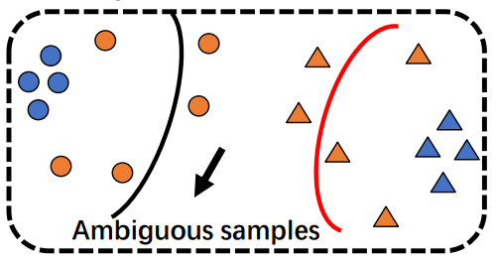
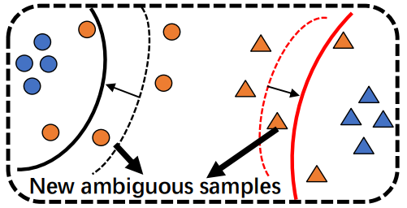
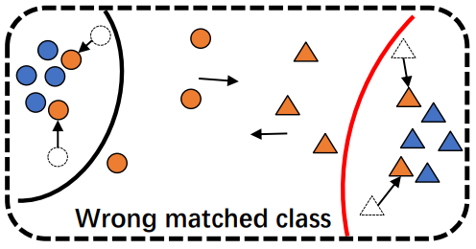

Bi-Classisier Adversarial Learning
While traditional bi-classifier adversarial learning methods ignore the optimization of ambiguous target samples which have inconsistent predictions by two classifiers and misclassified by least on classifiers. And these samples could be dominated by misclassified classifier and matched to the wrong class. In addition, in the second step, these methods tend to yield more ambiguous samples due to maximize the prediction discrepancy.
Using labeled source samples to train feature extractor and two classifiers
Fixing feature extractor and training two classifiers by maximizing the prediction discrepancy of target samples
Fixing two classifiers and training feature extractor by minimizing the prediction discrepancy of target samples.
Notes:
Our approach is on the basis of bi-classifier adversarial learning, which can be divided into three steps.
The first step is using labeled source samples to perform the supervised training of the feature extractor and two classifiers.
In the second step, the feature extractor is fixed and two classifiers is trained by maximizing the prediction discrepancy of target samples to find out the target samples out of source distribution.
In the third step, two classifiers are fixed and the feature extractor is trained by minimizing the prediction discrepancy of target samples to align the distribution between two domains.
While these methods ignore the ambiguous target samples which may detected by misclassified classifier and align to the wrong class. In addition, these methods tend to yield more ambiguous target samples due to maximize the prediction discrepancy.

Slide 5
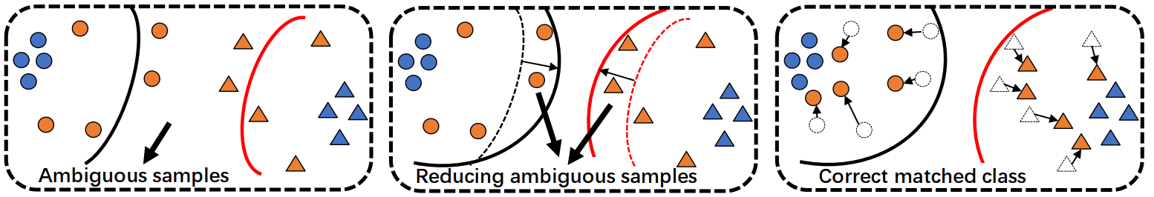
CDAL
Using labeled source samples to train feature extractor and two classifiers
Compared with traditional bi-classifier adversarial learning methods, CDAL can more effectively improve the discrimination ability of both adapted classifiers whilst reasoning away ambiguous target samples during training by Expertise-aware Classifier Interference. And the representation regularization can enhance the learning of feature extractor with conditional distribution alignment.
Fixing feature extractor and training two classifiers by proposed Expertise-aware Classifier Interference
Fixing two classifiers and training feature extractor by minimizing the prediction discrepancy of target samples and the representation regularization
Notes:
Therefore, how to handle the ambiguous target samples is a key to this kind of method. To that end, we propose a novel Class Discriminative Adversarial Learning (CDAL) method.
By proposed ECI strategy, the second step of CDAL can make two classifiers improve their discriminative power, resulting in less ambiguous samples. And in third step, a representation regularization is designed for enhancing the learning of feature extractor with conditional distribution alignment to further suppress ambiguous target samples.

Slide 6
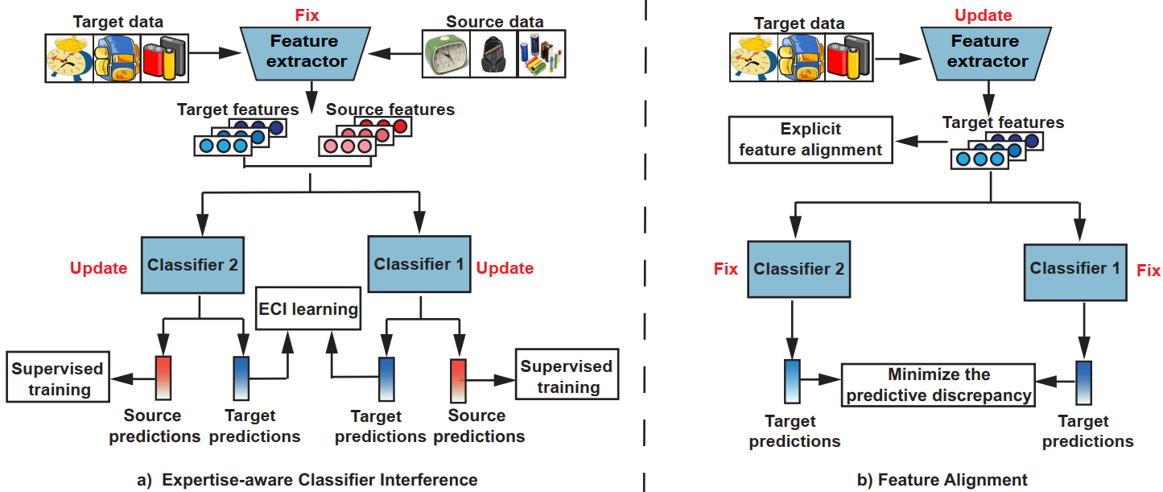
DETAIL
Our method can be divided into three steps, the first step is supervised training based on labeled source domain, the second step is Expertise-aware Classifier Interference, and the third step is Feature Alignment.
Notes:
Our method CDAL improves the second and third steps of the traditional bi classifier adversarial learning methods. In the second step, we propose the ECI strategy, and in the third step, we add representation regularization to better perform feature alignment.

Slide 7

DETAIL
Before the each epoch, our method first randomly select m source samples into memory for each category, then the initial cluster centers are calculated based on memory and K-means algorithm is performed to pseudo-label target samples.
During the training, our method can also be divided into three steps as traditional bi-classifier adversarial learning methods.
In the first step, it is same as traditional bi-classifier adversarial learning methods :
Notes:
Before the each epoch, we need pseudo-label all target samples. Specifically, our method first randomly select m source samples into memory for each category, then the initial cluster centers are calculated based on memory and K-means algorithm is performed to pseudo-label target samples.
Then during the training, our method also can be divided into three steps. And the first step is same as traditional bi-classifier adversarial learning methods, which uses labeled source samples to train the feature extractor and two classifiers.

Slide 8




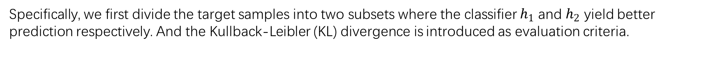
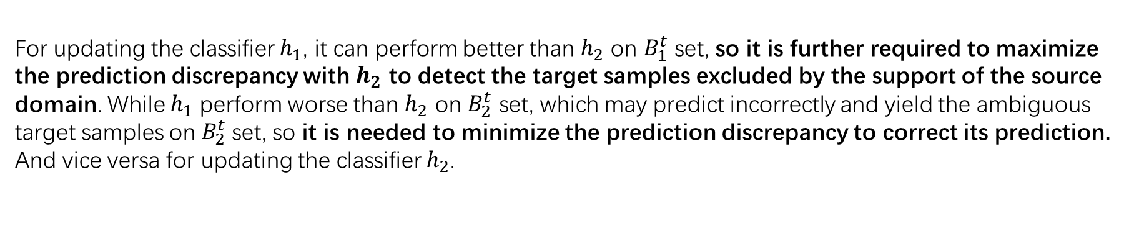
DETAIL
In the second step, the Expertise-aware classifier interference (ECI) is proposed by us. Traditional bi-classifier adversarial learning methods yield new ambiguous target samples in this step, while our method can be effective to solve this problem.
Specifically, we first divide the target samples into two subsets where the classifier $h_{1}$ and $h_{2}$ yield better prediction respectively. And the Kullback-Leibler (KL) divergence is introduced as evaluation criteria.
For updating the classifier $h_{1}$, it can perform better than $h_{2}$ on $B_{1}^{t}$ set, so it is further required to maximize the prediction discrepancy with $h_{2}$ to detect the target samples excluded by the support of the source domain. While $h_{1}$ perform worse than $h_{2}$ on $B_{2}^{t}$ set, which may predict incorrectly and yield the ambiguous target samples on $B_{2}^{t}$set, so it is needed to minimize the prediction discrepancy to correct its prediction. And vice versa for updating the classifier $h_{2}$.
Notes:
Traditional bi-classifier adversarial learning methods yield new ambiguous target samples in the second step, while our method can be effective to solve this problem by proposed ECI strategy.
Specifically, we first divided target samples into two subsets, where the classifier $h_{}$ one and $h_{}$ two yield better prediction respectively. The KL divergence is used as evaluation criteria.
For updating the classifier, on the one hand, we need to maximize the prediction discrepancy so that this classifier is dominant to help the subsequent feature alignment, and on the other hand, we need to reduce the prediction discrepancy to obtain consistent predictions and reduce ambiguous samples. Specifically, for updating the classifier$h_{}$ one, it can perform better than${ h}_{}$ two on $B_{}^{t}$ one set, so it is further required to maximize the prediction discrepancy with ${ h}_{}$ two to detect the target samples excluded by the support of the source domain. While $h_{}$ one perform worse than $h_{}$ two on $B_{}^{t}$ two set, which may predict incorrectly and yield the ambiguous target samples on $B_{}^{t} two$set, so it is needed to minimize the prediction discrepancy to correct its prediction. And vice versa for updating the classifier $h_{} two$.

Slide 9
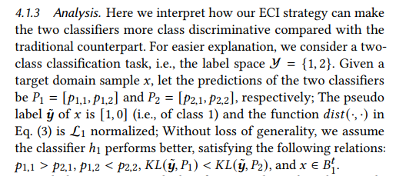

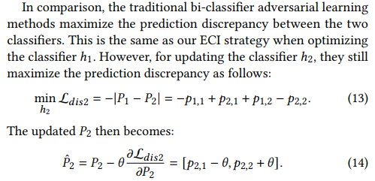
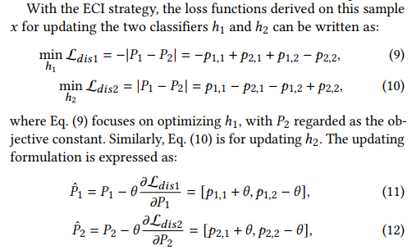
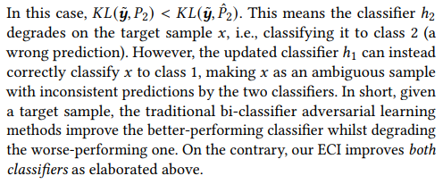
DETAIL
Notes:
Compared with traditional bi-classifier adversarial learning method, our ECI can make two classifiers more discriminative. For easier explanation, we consider a two class classification task. Given a target domain sample 𝑥, let the predictions of the two classifiers be 𝑃 one and 𝑃 two respectively; The pseudo label of 𝑥 is [1, 0] and the function 𝑑𝑖𝑠𝑡(·, ·) is L one norm; We assume the classifier ℎ1 performs better, satisfying the following relations: 𝑝1,1 is greater than 𝑝2,1, 𝑝1,2 is smaller than 𝑝2,2, the 𝐾𝐿 divergence of P one is smaller than the 𝐾𝐿 divergence of P two and 𝑥 is belongs to 𝐵𝑡 one.
With the ECI strategy, the loss functions derived on this sample 𝑥 for updating the two classifiers ℎ1 and ℎ2 can be written as Equation 9 and Equation 10 respectively.
And the updated predictions of P1 and P2 are shown in Equation 11 and Equation 12 respectively. Due to theta is the learning rate which is greater than 0. So the updated prediction has a smaller KL divergence, which means two classifier are both more class discriminative.
The traditional bi-classifier adversarial learning method is same as while updating the classifier h1. However, for updating classifier h2, these methods still maximize the prediction discrepancy as Eq.13, the updated prediction p2 is shown in Eq.14.
In this case, the updated prediction will have greater KL divergence. This means the classifier ℎ2 degrades on the sample 𝑥, that is, classifying it to class 2 (a wrong prediction), which makes samples x be a ambiguous samples.

Slide 10


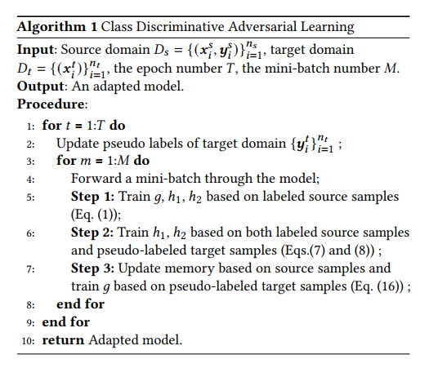
DETAIL
In the third step, in addition to the traditional minimization of prediction discrepancy to update the feature extractor, we further propose a representation regularization to require that the target features be explicitly close to the source features in memory.
Our method can be summarized in Algorithm 1.
Notes:
In the third step, in addition to the traditional minimization of prediction discrepancy to update the feature extractor, we further propose a representation regularization to require that the target features be explicitly close to the source features in memory.
Our method can be summarized in Algorithm 1.

Slide 11
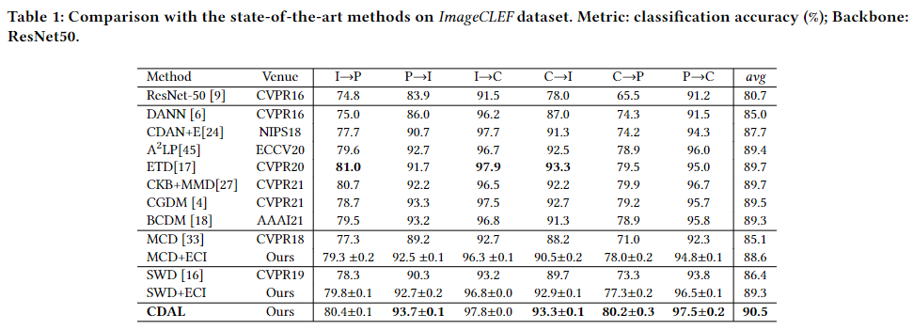
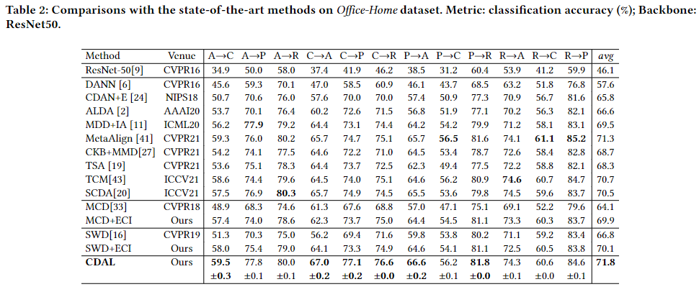
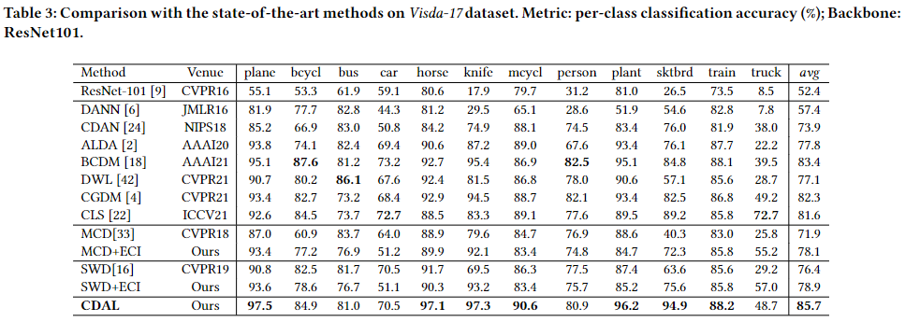
EXPERIMENT
Our method yields new state-of-the-art results
Notes:
In the experiment, we first compared our method with other recent popular method, and our method yields new state-of-the-art results.

Slide 12
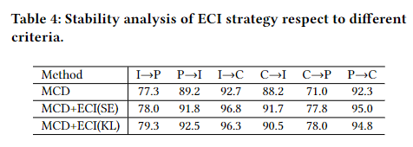
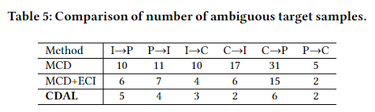
EXPERIMENT
We perform ECI strategies using different evaluation criteria, such as entropy and KL divergence. The experimental results all show that the ECI strategy can better improve the model performance.
We count the number of ambiguous samples for the trained models using different strategies. The result shows that both the ECI strategy and representation regularization are effective.
Notes:
Then we perform ECI strategy with other different evaluation criteria, such as entropy, and it also can improve the performance.
We also count the ambiguous target samples when the model training is complete. The result shows that both the ECI strategy and representation regularization are effective.

Slide 13
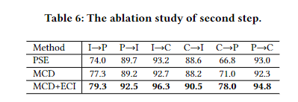
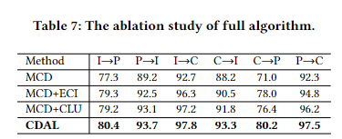
EXPERIMENT
We modify the second step of the original MCD by using the pseudo label and the ECI strategy, respectively. From the results, the ECI strategy yields the best performance.
We conduct an ablation study to analyze the role of each part of our method. From the results, both the ECI strategy and representation regularization can improve the performance on the basis of MCD.
Notes:
We modify the second step of the original MCD by using the pseudo label and the ECI strategy, respectively. From the results, the ECI strategy yields the best performance.
We conduct an ablation study to analyze the role of each part of our method. From the results, both the ECI strategy and representation regularization can improve the performance on the basis of MCD.

Slide 14
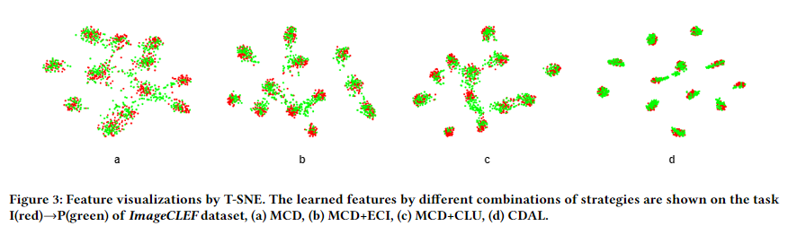
EXPERIMENT
We visualize the features to give an intuitive understanding of our method. It presents consistent observations :(a) MCD, (b) MCD+ECI, (c) MCD+CLU, (d) CDAL. From the experimental results we also find that these features are increasingly concentrated, which is consistent with our ablation analysis.
Notes:
We visualize the features to give an intuitive understanding of our method. From the results we also find that these features are increasingly concentrated, which is consistent with our ablation analysis.

Slide 15
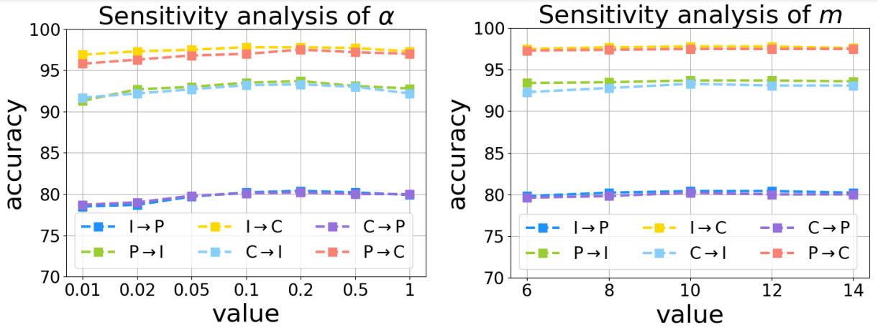
EXPERIMENT
We analyze the sensitivity of parameter α and m to verify the robustness of our method. α is a balance hyperparameter and m is size of our memory during the training. From the results, the performance rarely fluctuates when these hyperparameters change.
Notes:
We analyze the sensitivity of parameter α and m to verify the robustness of our method. α is a balance hyperparameter and m is size of our memory during the training. From the results, the performance rarely floats when these hyperparameters change.

Slide 16
Thanks for your listening
Notes:
That's all for our report, thank you very much for listening.

