Slide 1







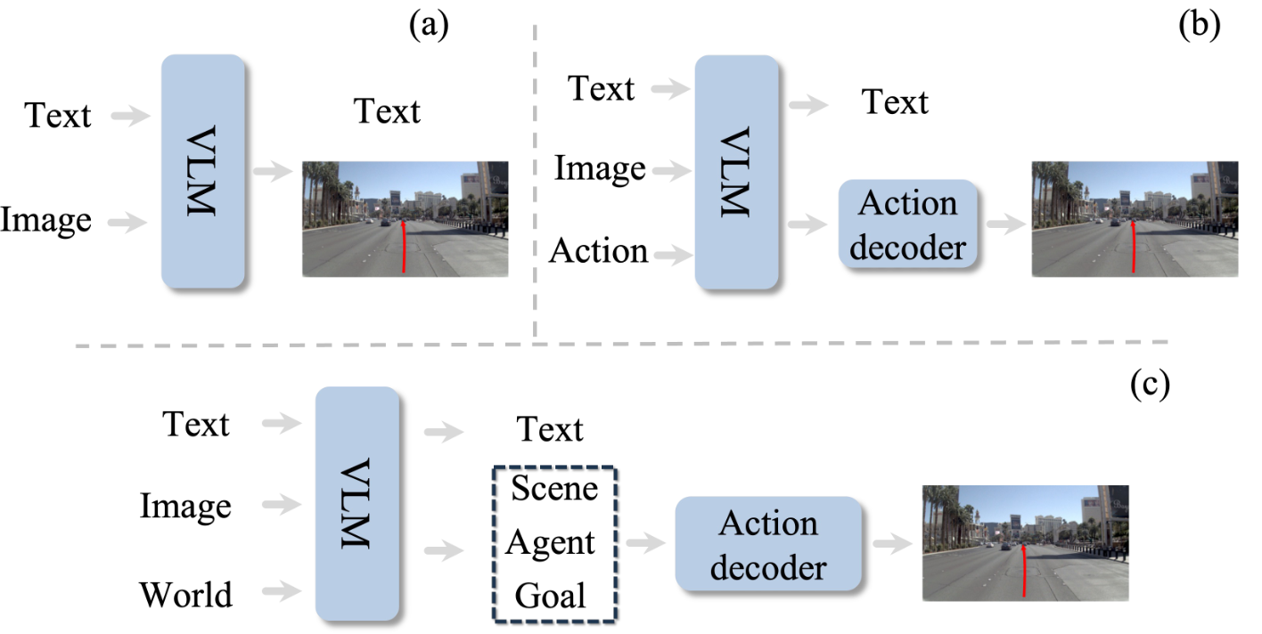
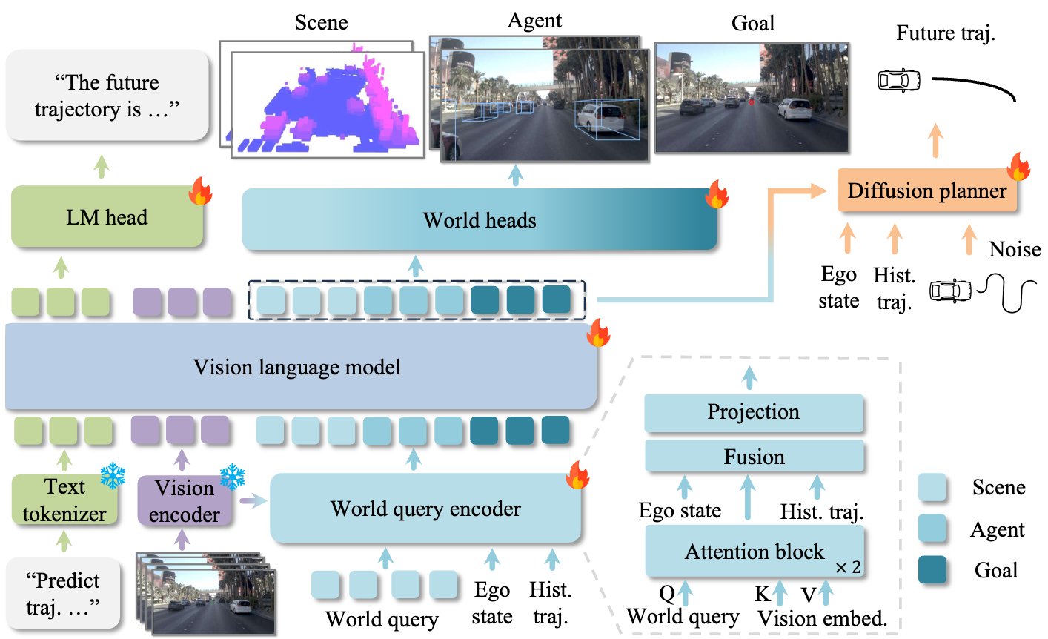
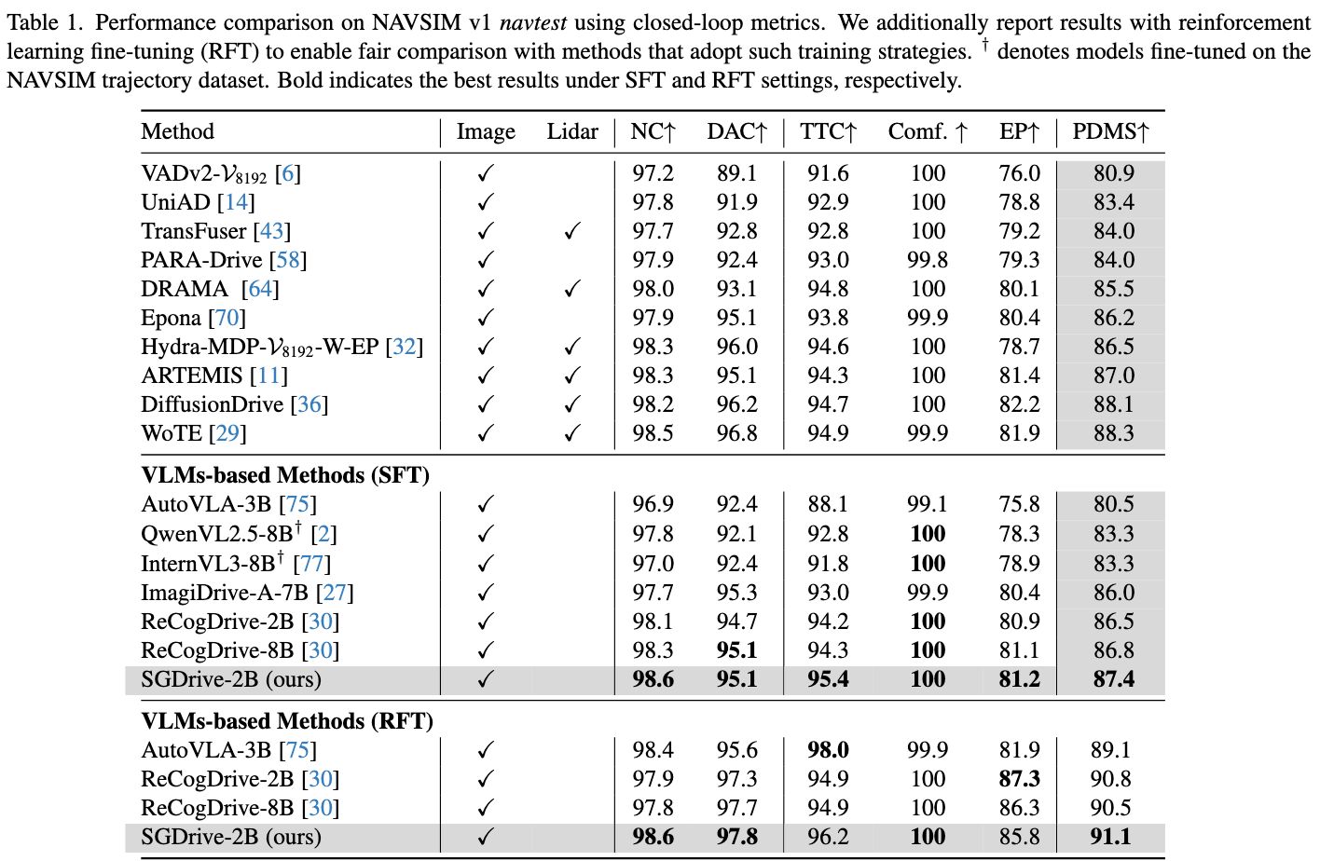
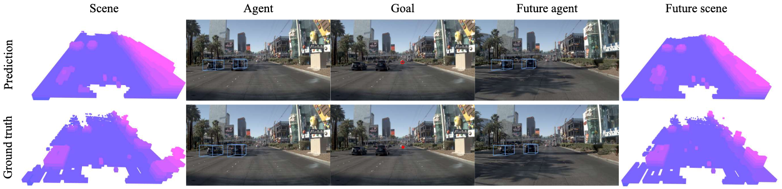
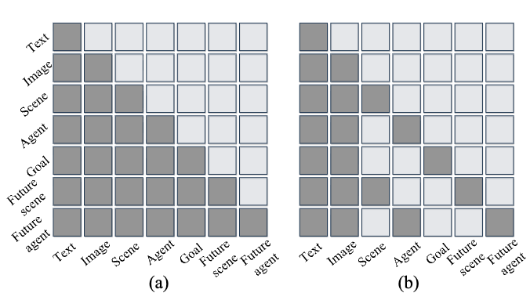
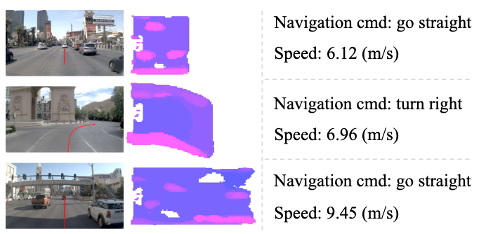
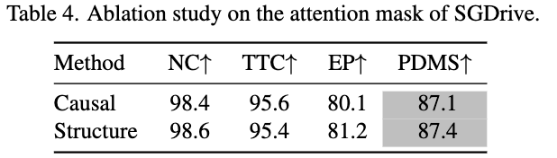
SGDrive: Scene-to-Goal Hierarchical World Cognition for Autonomous Driving
Jingyu Li^{1,2∗} Junjie Wu^{3∗} Dongnan Hu^{4,2} Xiangkai Huang³ Bin Sun³ Zhihui Hao³ Xianpeng Lang³ Xiatian Zhu⁵ Li Zhang^{1,2}
¹ Fudan University ² Shanghai Innovation Institute ³ Li Auto Inc. ⁴ Tongji University ⁵ University of Surrey
https://github.com/LogosRoboticsGroup/SGDrive
Poster
Motivation
SGDrive overview
Experiments
Previous methods suffer from several key
limitations:
Lack of spatial perception
Difficulty in discerning critical information
Lack of future world state forecast
Key points and contributions
Our SGDrive acquires comprehensive driving-
relevant world knowledge from three aspects:
Scene geometric layout
Perceiving driving-relevant agents
Inferring driving goal
Contributions:
We propose a novel Vision-Language-Action model with world representation for autonomous driving.
We unlock the world cognition capability of VLA models.
SGDrive achieves state-of-the-art
performance on the NAVSIM benchmark
The SGDrive pipeline introduces hierarchical 〈world〉 queries (scene, agent, and goal) for world modeling and trajectory generation.
We introduce a block-wise structured
attention mask to address multi-task representational contamination
Conclusion/Concat us:
We introduce SGDrive, a novel framework that explicitly structures a VLM’s representation learning around a driving-specific knowledge hierarchy, enabling safer and more reliable autonomous driving.
Email: jingyuli0911@gmail.com

